Slide 1
TURNING CUSTOMERS
INTO SUBSCRIBERS
Tien Tzuo

Slide 2
WE NOW LIVE IN A
SUBSCRIPTION ECONOMY
dshiftha ppens
Notes:
[Pass 1 note — covers the stakes run, slides 2-9] The altitude of the pain. The stakes are drawn at 30,000 feet here — "the way people buy has changed," "52% of the Fortune 500 gone." That's right for a category keynote and it makes the room think big. What it never does is drop to one operator's actual Tuesday — the billing team that can't launch a new pricing plan without engineering, the finance lead who can't close the books because usage revenue won't reconcile. A skeptical buyer feels a market shift intellectually but feels their own pain viscerally, and this deck only gives the first. Is there one concrete, named operator problem you could land somewhere before slide 20, so the shift stops being about "every industry" and starts being about them?

Slide 3

CTS
A SHIFT FROM PRO
TO RELATIONSHIPS
P oducts
P odu ct + be vices
Custo me Ce nt ic
7000
R elatio nshiD Cent ic
1990s

Slide 4

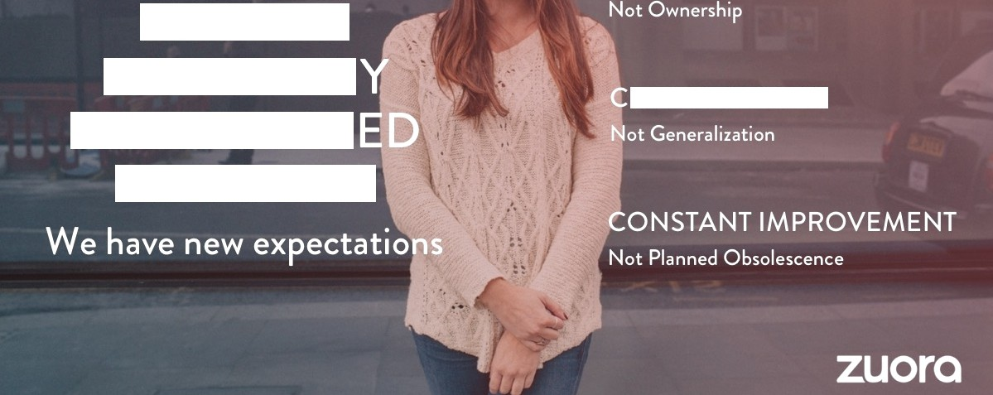
PEOPLE BU
THE WAY
U TOM ZAT ON
HAS CHANG
FOR GOOD

Slide 5

A GLOBAL
80 o 420B
O
OŁ Deo Dle in France are
OÊ German companies
^8! ⁰8 ^^8^{S}C^t tt^{O}8^
moving away from traditiona I ownership
Have dealt witH I be issue
of subscription
in the U S in 20 5; up
from $21S B in 20 0 0.
con su mptio n models
business models.

Slide 6

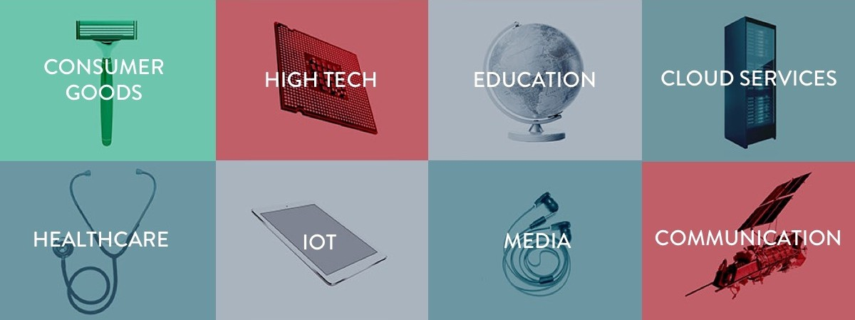
EVERY INDUSTRY SHIFTING
Leaders are creating new experiences through a new kind of business model

Slide 7




PAN HAVE
TH EST COM
NVE TE
EMS LVES AWAY
FROM PRODUCTS

Slide 8
FORTUNE 500 COMPANIES
HAVE DISAPPEARED
Ave age
i fe expectancy 15 years

Slide 9
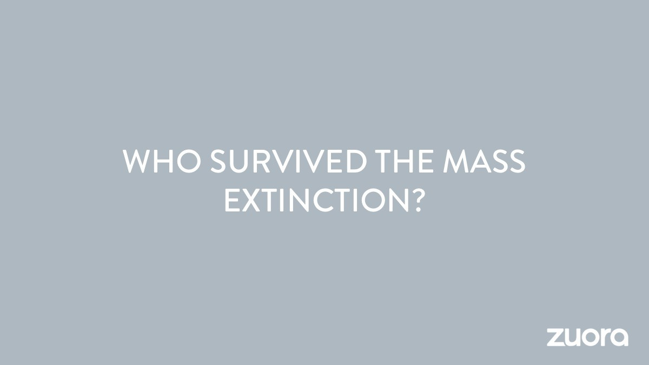

Slide 10
GENERAL ELECTRIC
From light bulbs to digital services
"The dfgltoÍ company. /Îì 0 t s Olso On İndus t rİOl comeOne’
Notes:
[Pass 1 note — covers the promised-land run, slides 10-15] Six straight slides make one point: incumbents transformed and disruptors won by going relationship-first (GE, Unilever/Dollar Shave Club, IBM, then Amazon/Google/Apple/Facebook/Salesforce, then Uber/Spotify/Box/Airbnb). Live, the accumulation is deliberate and it builds pressure. But it's also the one stretch that repeats rather than advances, so it's your timing shock-absorber: if a slot runs short, this is the section that can lose two slides without the argument losing a link. Which two of these six are carrying the point, and which are there for rhythm?

Slide 11
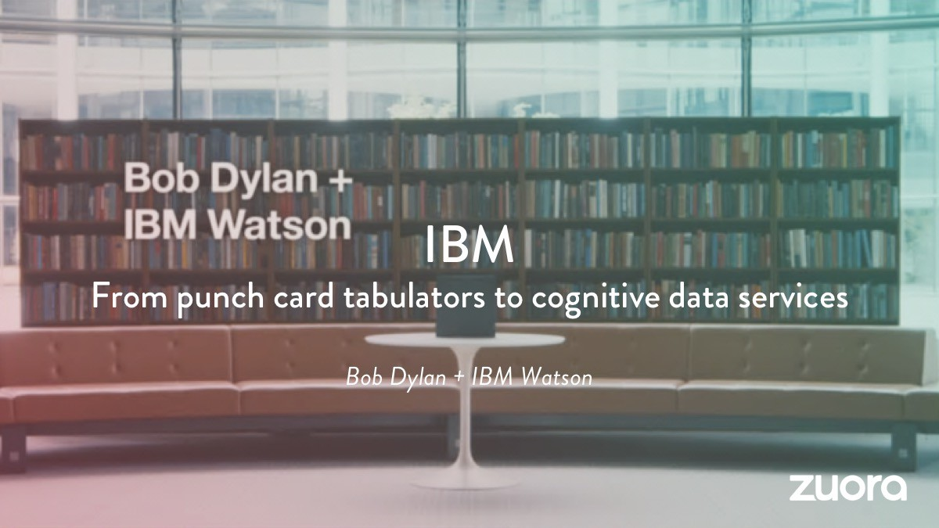

Slide 12
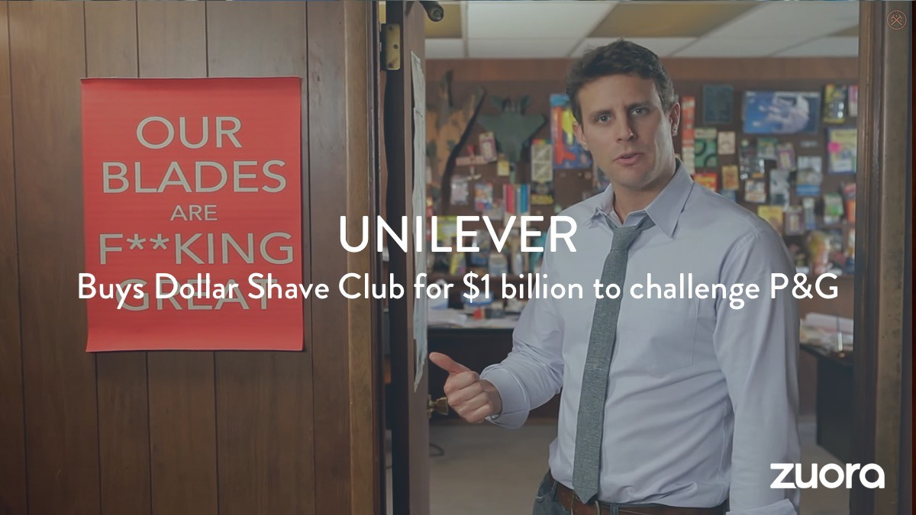

Slide 13


Slide 14
The new disruptors

Slide 15










TH COMMO
R

Slide 16



















THEY
BS
Ongo\ ng
M ernor abİe
On- demand
Ful fillmen t
R aI- tim

Slide 17








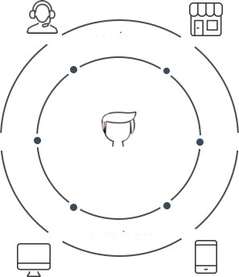












IT'S
EW WAY
THI I
product
service
VS.
channels
subscriber
experience
customer
channels

Slide 18
Unit Sales
Value pricing
Branding
Selling products
Unit margins H it products
Experience
Solving needs
Customer lifetime value Deep relationships

Slide 19
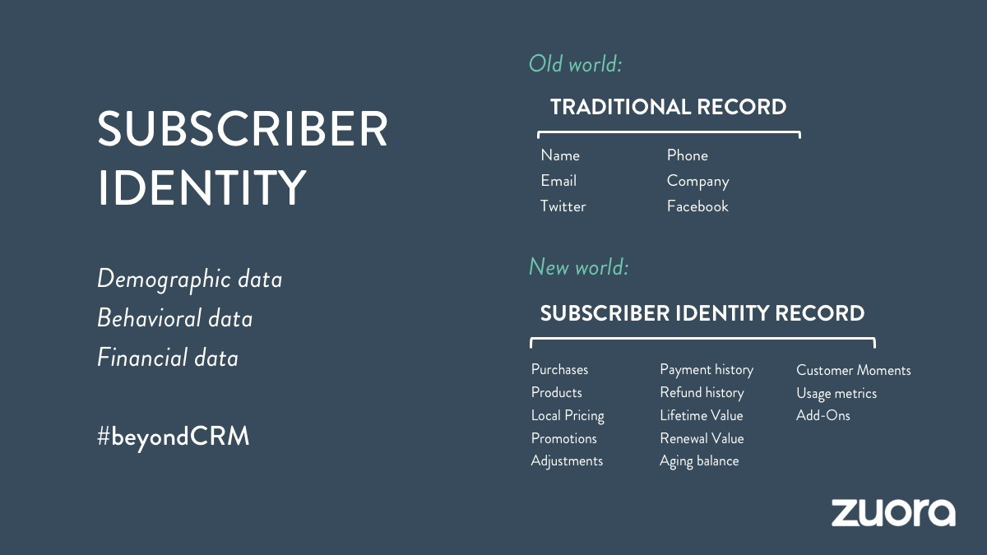

Slide 20
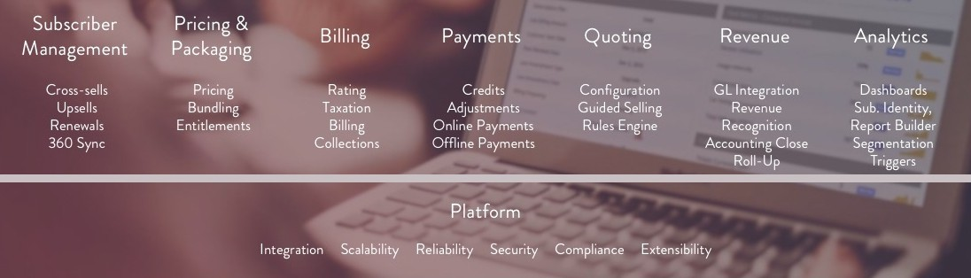
THAT S WHY WE BUILT ZUORA
Notes:
[Pass 1 note] "A unified solution for the Subscription Economy." Nineteen slides establish one idea at a time, in huge type on full-bleed imagery — and then the product reveal drops a seven-column grid (Subscriber Management, Pricing & Packaging, Billing, Payments, Quoting, Revenue, Analytics) with three-to-five sub-items each, plus a Platform bar of six more. It's ~40 feature words at the exact moment the room has finally been made to want the product. The deck spent the whole runway teaching the audience to feel one thing per slide, then breaks its own visual language on the slide that matters most, and the eye has nowhere to land. Live you can talk them through it — but if the job of this slide is "here is the one thing Zuora does for the world you just described," what is that one thing, and does the grid say it or bury it?

Slide 21
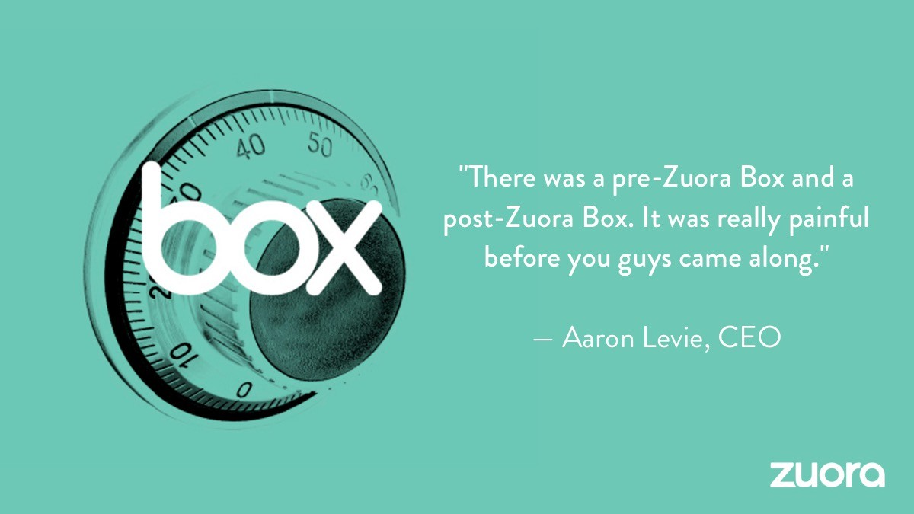

Slide 22
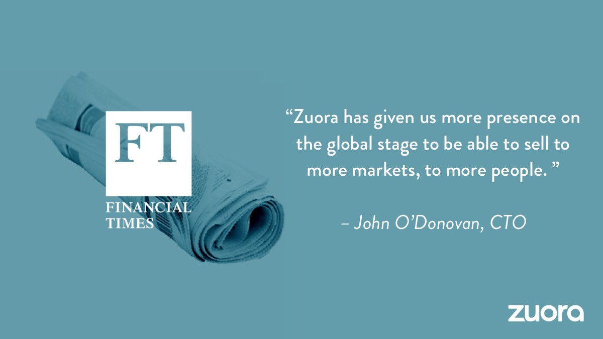

Slide 23
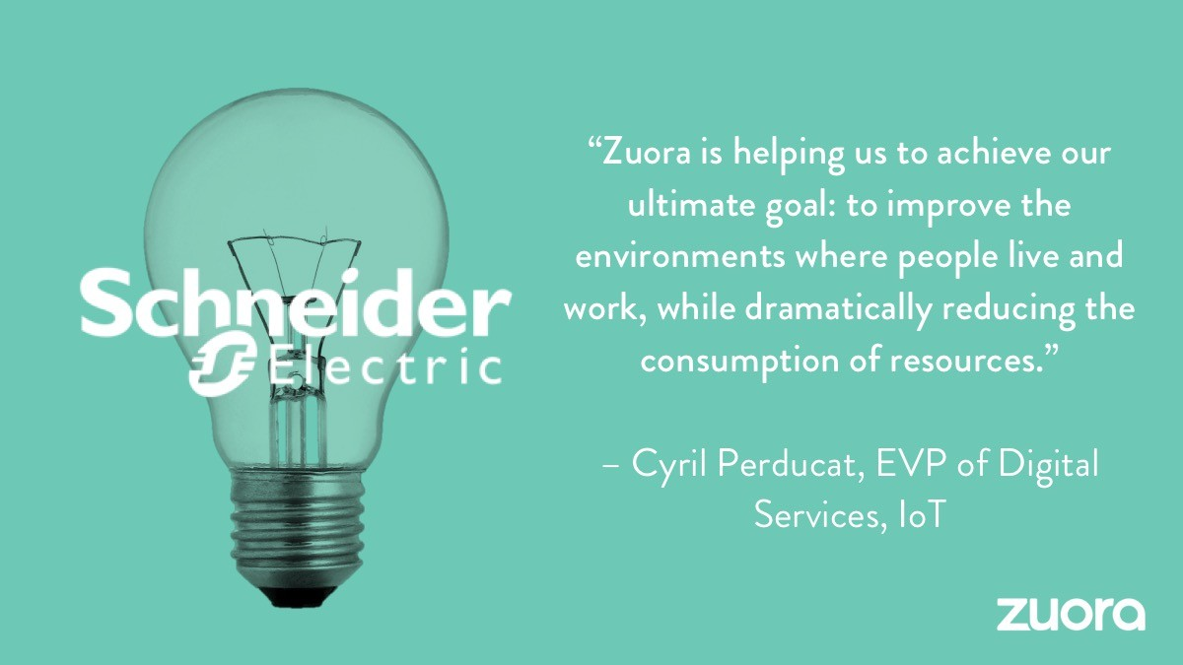

Slide 24

THE END

