Slide 1
START
Amount
Fake/Real
Object Detection
Pre-processing
Feature Extraction
Evaluation
Is real?
NO
YES
YES
NO
END

Slide 2
START
Amount
Fake/Real
Object Detection
Pre-processing
Feature Extraction
Feature Selection
Evaluation
Evaluation
NO
YES
YES
NO
END

Slide 3
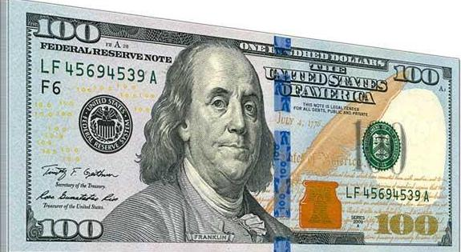
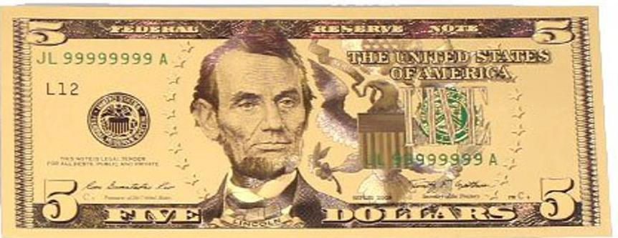

Slide 4
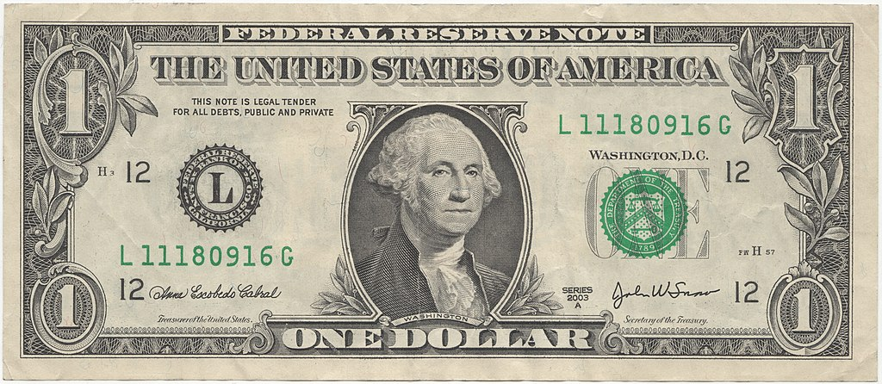
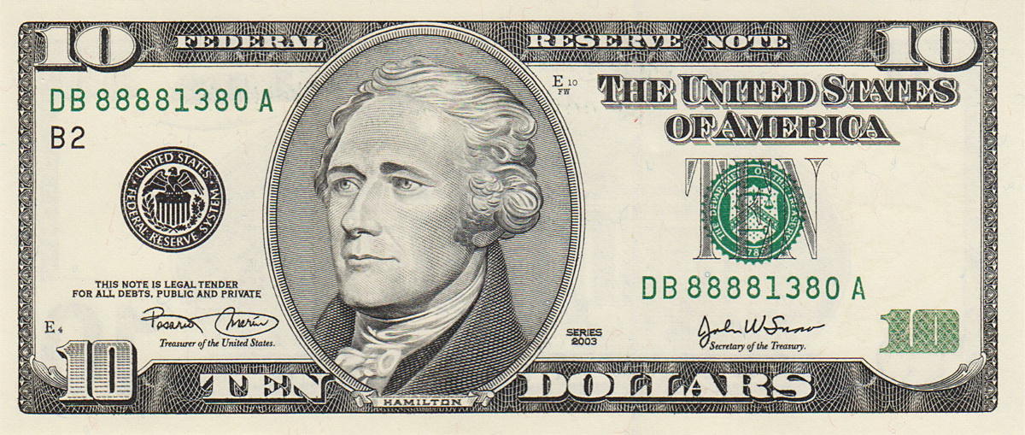
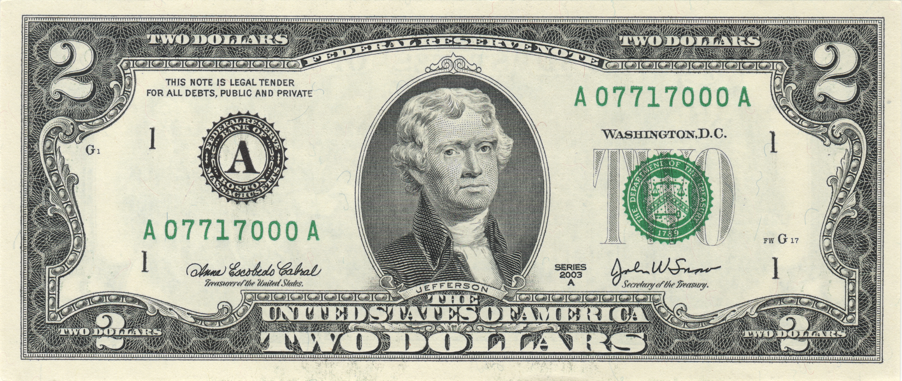
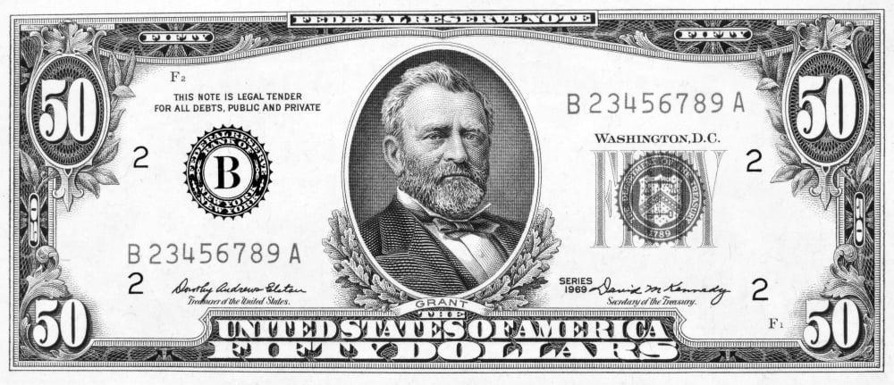
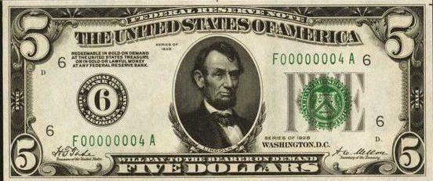
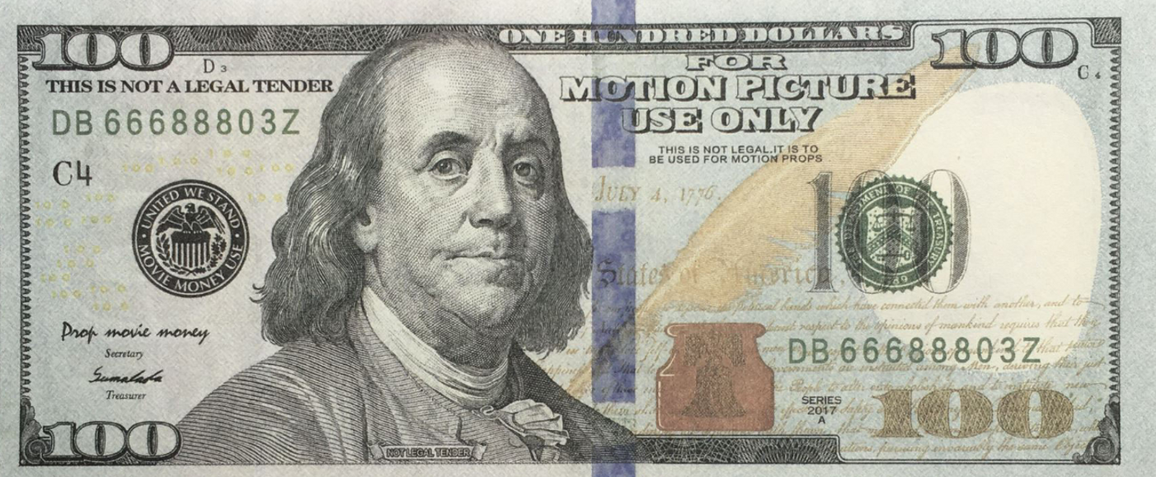
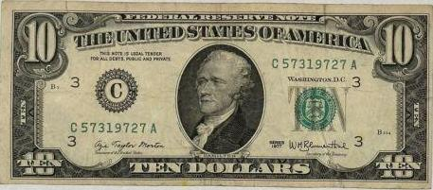
Predefined dataset
Algorithm
Input image

