Slide 1

G2M Case Study
Virtual Internship
25-10-2021

Slide 2
1. BACKGROUND
Business Problem
XYZ is a private firm in US. Due to remarkable growth in the Cab Industry in last few years and multiple key players in the market, it is planning for an investment in Cab industry.
Go-to-Market(G2M) strategy
A go-to-market strategy (GTM strategy) is an action plan that specifies how a company will reach target customers and achieve competitive advantage. Go-to-market strategies tend to focus on the short-term, but effective ones will also consider how any immediate success can be sustained over a longer period.
Objective
Provide actionable insights to help XYZ firm in identifying the right company for making investment.

Slide 3
2. HYPOTHESIS
How does the profit change over time?
How does the percentage of profitable trips change by the city?
How does average profit change by holidays?
How does the demand of the cab industry change over time?
How the demand varies according to age?
Loyalty of customers
Fluctuations of payment methods

Slide 4
3. DATA ANALYSIS SUMMARY
This data analysis has been mainly divided into three parts:
Data Understanding and Preparation
Exploratory data analysis
Profit Analysis
Demand Analysis
Client Analysis
Recommendation for investment

Slide 5

DATA ANALYSIS SUMMARY CONT..
Datasets
Cab_Data.csv
City.csv
Customer_ID.csv
Transaction_ID.csv
Us-holiday-dates.csv
master_df.csv
No of Features: 15
Total Data Points: 359392
Timeframe: from 31/01/2016 to 31/12/2018
Figure 2.1

Slide 6
4. ASSUMPTIONS
According to the graphs, there are outliers in the Price Charged feature. But since we do not have enough information on the components that made the Price Charged, it is not appropriate to treat it as an outlier.
There are outliers in the Price_Charged feature. But since we do not have enough information on the components that made the Price_Charged, it is not appropriate to treat it as an outlier.
When calculating the Profit per ride, all other factors were considered as constants and only Price_Charged and Cost_of_Trip features were used to calculate the profit.
Users feature of city dataset is treated as all the cab users in the city. (including Yellow and Pink cab)

Slide 7
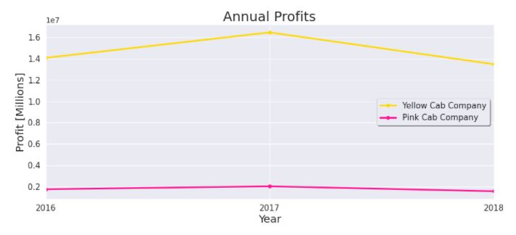
Profit Analysis
5. PROFIT ANALYSIS
Annual Profits
Figure 4.1

Slide 8
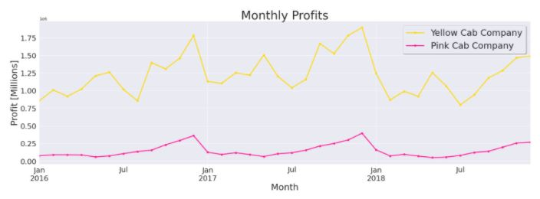
Profit Analysis
PROFIT ANALYSIS CONT..
Monthly Profits
Yellow Cab Company's earnings are more stable with fluctuations of 23.08% while Pink Cab Company's earnings vary with fluctuations of 61.22%.
Figure 4.2

Slide 9
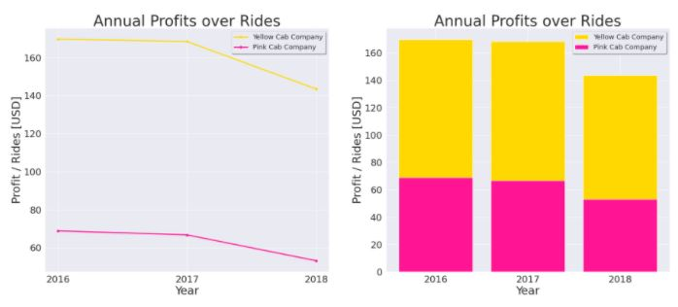
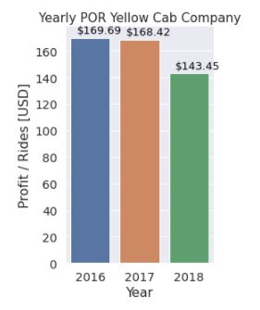
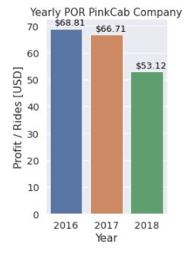
PROFIT ANALYSIS CONT..
Average profits over Rides (Annual)
Figure 4.4
Figure 4.3
Profit per ride decreases over time in both companies.

Slide 10
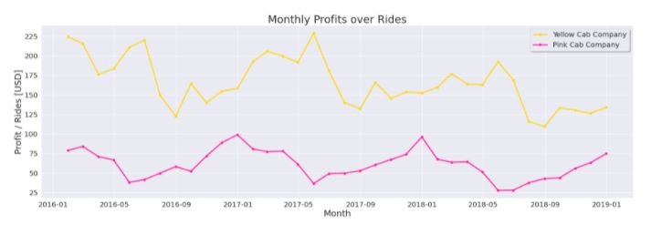
PROFIT ANALYSIS CONT..
Average profits over Rides (Monthly)
Figure 4.5

Slide 11
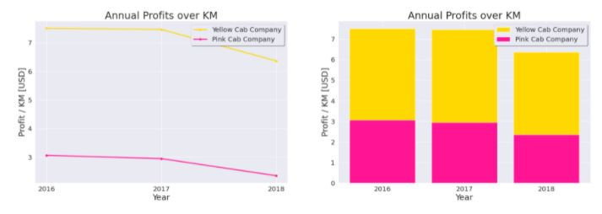
PROFIT ANALYSIS CONT..
Average profits over Km (Annual)
Figure 4.6
Profit per Km decreases over time in both companies.

Slide 12
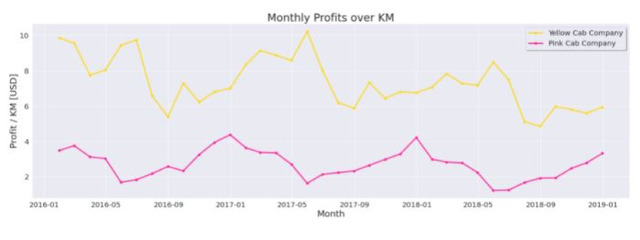
PROFIT ANALYSIS CONT..
Average profits over Km (Monthly)
Figure 4.7
Profit per Km in Yellow cab company is higher than Pink cab company for each and every month.

Slide 13
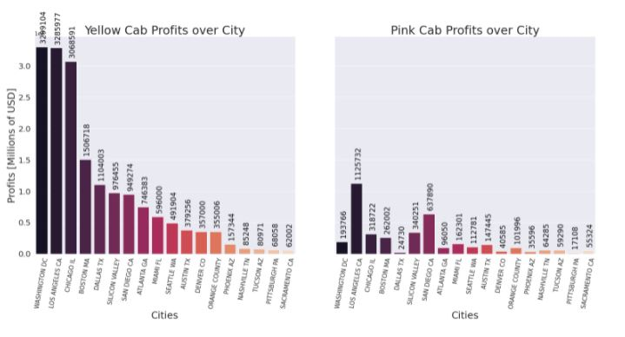
PROFIT ANALYSIS CONT..
Profit - City wise
In this analysis New York city has been removed from both cab companies to get a better sight of the profits over the other cities.
And we can conclude that Yellow Cab has greater market share in every City.
Figure 4.8

Slide 14
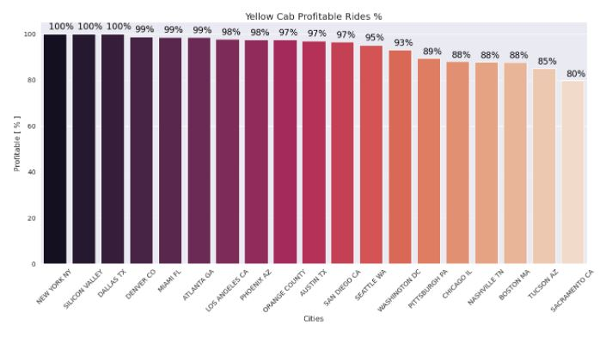
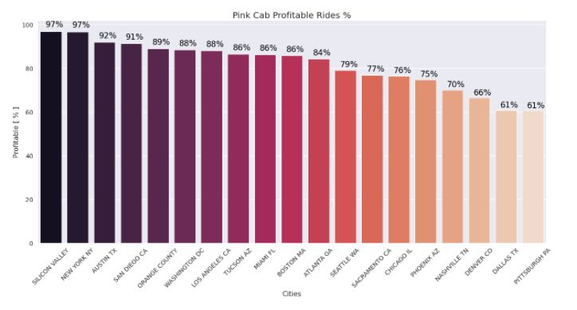
PROFIT ANALYSIS CONT..
Profit - City wise (Percentage)
Figure 4.9
Now, we can answer the second hypothesis. For that, let's assume that if the profitability percentage of rides per city is higher than 80%, it will perform well. Then we can say that: profitability percentage of rides change by cities and Yellow Cab has a high performance according to the analysis by maintaining a high level of profitable rides in every City.

Slide 15
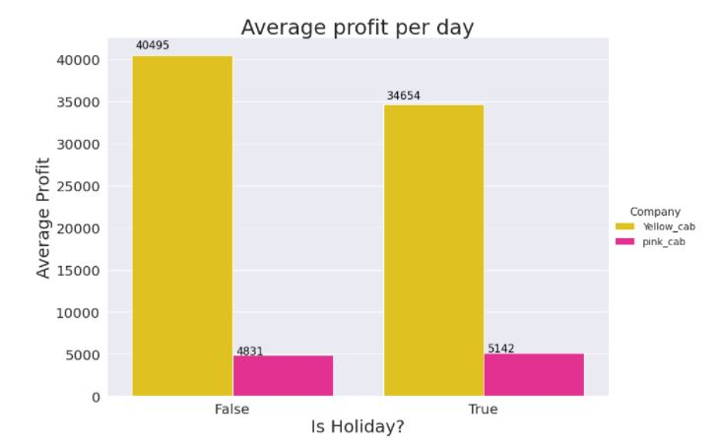
PROFIT ANALYSIS CONT..
Profit per day
In Yellow cabs, the average profit per holiday is less than the average profit per normal day.
But when considering the average profit per day in pink cab company, they have gained a bit of higher profit on a holiday than a normal day.
Figure 4.10

Slide 16
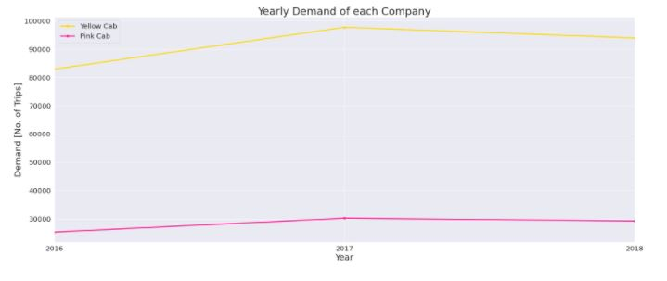
6. DEMAND ANALYSIS
Annual Demand
Figure 5.1
Yearly demand of Yellow cab company is maintained nearly 4 times greater than the demand of Pink cab company.

Slide 17
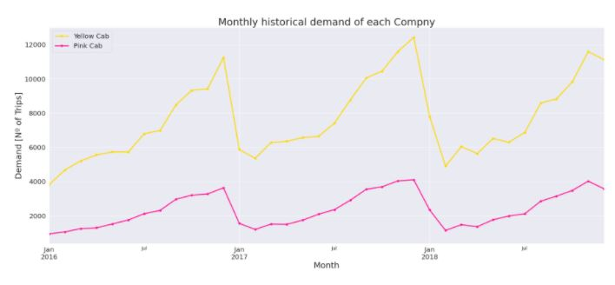
DEMAND ANALYSIS CONT..
Monthly Demand
Figure 5.2
There is a seasonality of demand changing throughout every year. The highest demand is in December.

Slide 18
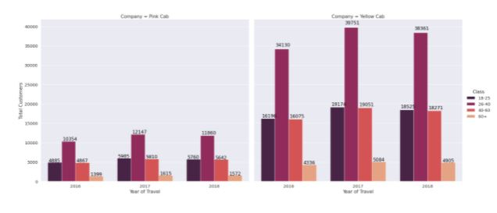
DEMAND ANALYSIS CONT..
Demand Age wise
Figure 5.3
Each year both companies have more customers in the age class of 20-40 years.

Slide 19
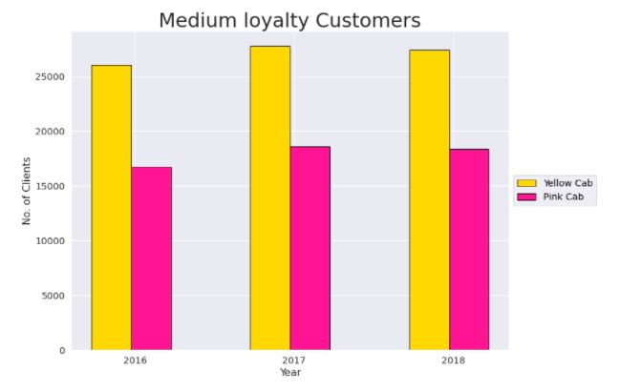
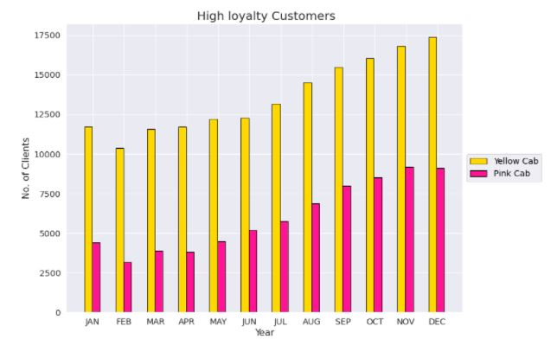
7. CLIENT ANALYSIS
Loyalty of customers
To analyze the Loyalty rates, Let's define 2 classes:
1. Medium loyalty Customers - Customers who took more than 10 rides yearly. 2. High loyalty Customers - Customers who took more than 10 rides monthly
Figure 5.4
Figure 5.5

Slide 20
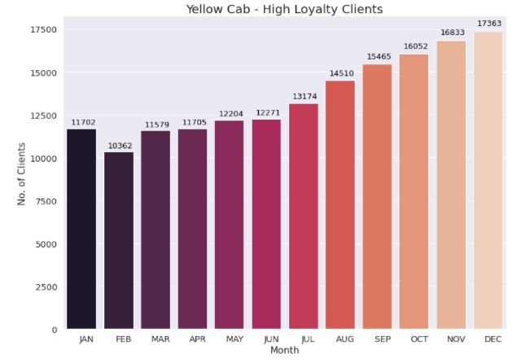
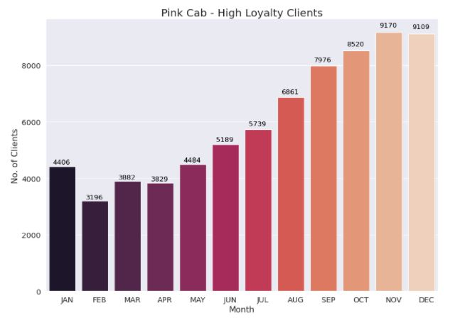
CLIENT ANALYSIS CONT..
Loyalty of customers (High loyalty Clients)
Figure 5.6
Figure 5.7
Yellow Cab Company is doing better in both classes of Loyalty Rates.

Slide 21
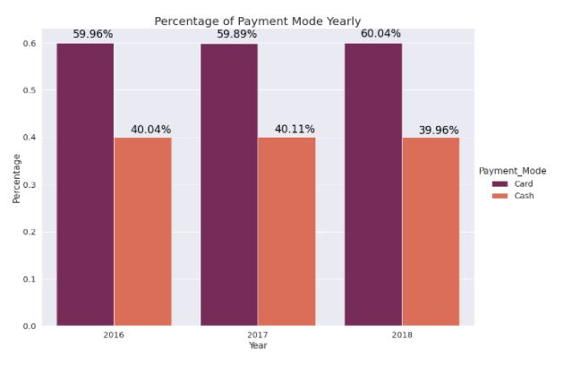
CLIENT ANALYSIS CONT..
Variation of payment mode with time
Minimal deviations in the payment method are observed over time.
Figure 5.8

Slide 22
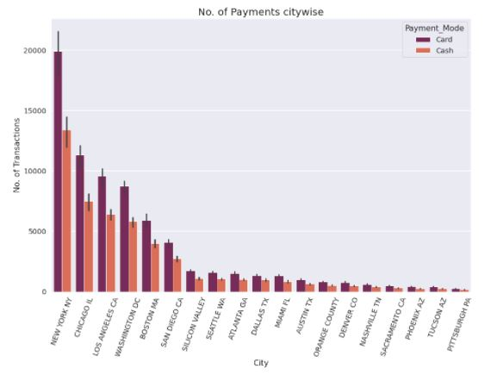
CLIENT ANALYSIS CONT..
Payment mode (City wise)
Minimal deviations of the payment method are observed in each city.
Figure 5.9

Slide 23
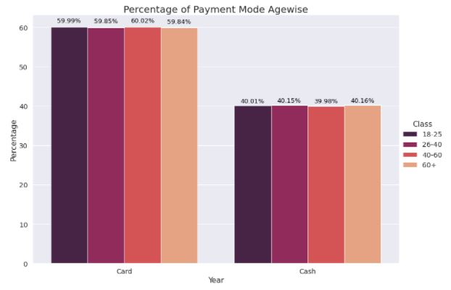
CLIENT ANALYSIS CONT..
Payment mode (Age wise)
Minimal deviations of the payment method are observed with respect to the age of the clients.
Figure 5.10

Slide 24
8. RECOMMENDATION
1. How does the profit change over time?
According to the analysis, Yellow Cab Company's earnings are more stable than Pink Cab Company's earnings.
Profit per ride of Yellow cab company is higher than Pink cab company over three years.
Profit per Km decreases over time in both companies.
Profit per Km in Yellow cab company is higher than Pink cab company for each and every month.
2. How does the percentage of profitable trips change by the city?
Profitability percentage of rides change by cities.
Yellow Cab has greater market share in every City.
3. How does average profit change by holidays?
In Yellow cabs, the average profit per holiday is less than the average profit per normal day.
Pink cab company have gained a bit of higher profit on holidays than normal days.

Slide 25
RECOMMENDATION CONT..
4. How does the demand of the cab industry change over time?
Yearly demand of Yellow cab company is about 4 times greater than yearly demand of Pink cab company.
There is a seasonality of demand changing throughout the year in both cab companies.
5. How the demand varies according to age? Each year both companies have more customers in the age class of 20-40 years.
6.Loyalty of customers
Yellow Cab Company is doing better in both classes of Loyalty Rates.
7. Fluctuations of payment methods
Minimal deviations in the payment method are observed over time.
Minimal deviations of the payment method are observed in each city.
Minimal deviations of the payment method are observed with respect to the age of the clients.
According to the overall analysis Yellow cab company is better than the Pink cab company for investing.
According to the overall analysis, Yellow cab company is better than the Pink cab company for investing.

Slide 26
Thank You!

