Slide 1
Capstone Project
Project Task Manager

Slide 2
Project Task Manager
Title: Development Overview
Prepared by: Nima Tshering
Date: 12-07-2025
Version: 1.1

Slide 3
Business Objectives
Facilitate Communication and Collaboration → Centralized updates, better team alignment
Ensure Accountability and Ownership → Clear roles, deadlines, and responsibilities
Reduce Project Failures and Cost Overruns → Early risk detection, improved project delivery

Slide 4
Target Market : Small Businesses
This lightweight project management tool to be tailored for small businesses — helping teams stay organized, hit deadlines, and collaborate, without enterprise-level costs.
Small businesses with 5–50 people
Limited software budgets
Rely on spreadsheets, emails, or other free tools

Slide 5
Project Scope
Responsive web application for task planning and collaboration
Accessible across desktop, tablet, and mobile devices
Key features:
User management
Project creation
Task creation and assignment
Status updates and deadlines

Slide 6
Technology Stack
Full-Stack Framework (Next.js 15+)
Handles both Frontend and Backend
ORM (Drizzle)
Type-safe, schema-first ORM for SQL databases
Database (MySQL)
Styling (Tailwind CSS)
ShadCN
GitHub - Version Control & Collaboration

Slide 7
Development Process
Requirements Gathering – Defined scope and business needs (SRS)
System Design – Architecture, database schema (drizzle), UI mock-ups (Figma)
Development – Feature development in small cycles
Testing & QA
Unit Testing

Slide 8
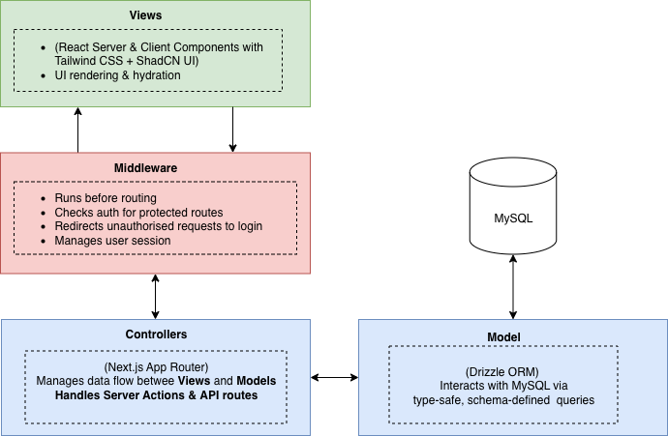
Application Architecture (MVC)

Slide 9
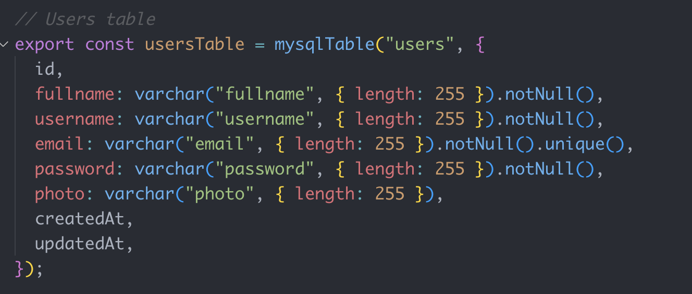
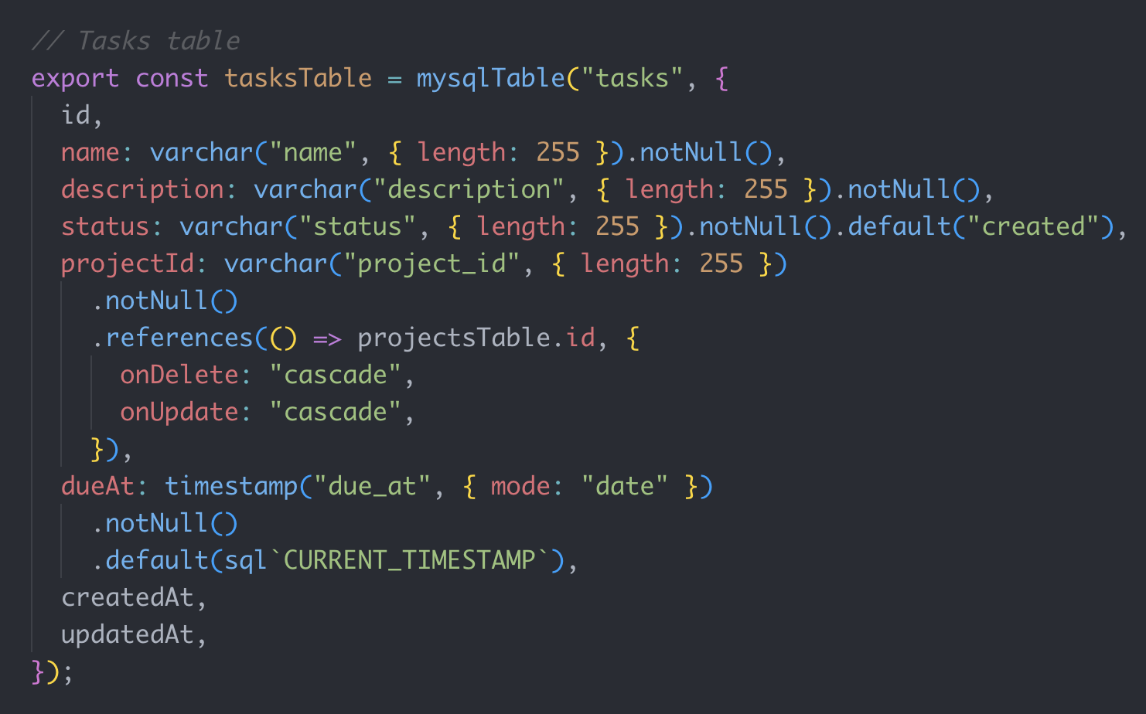
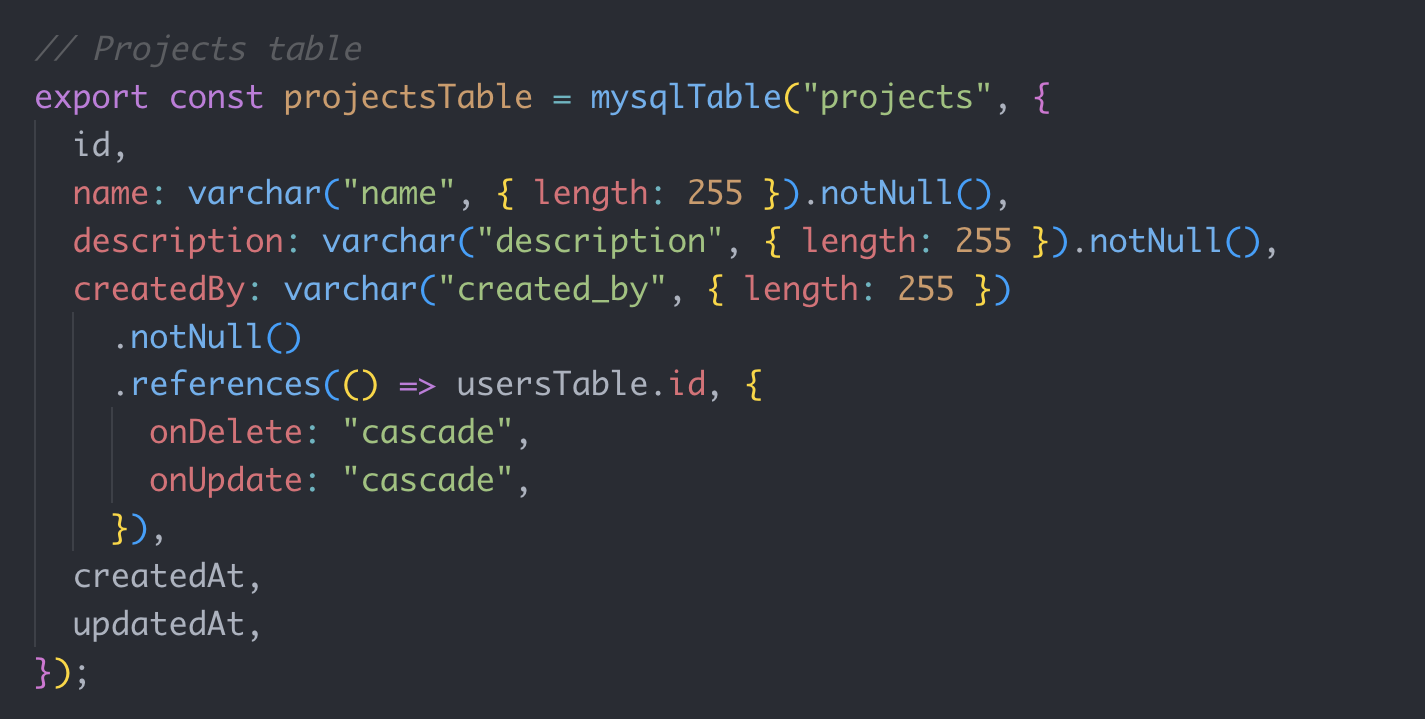
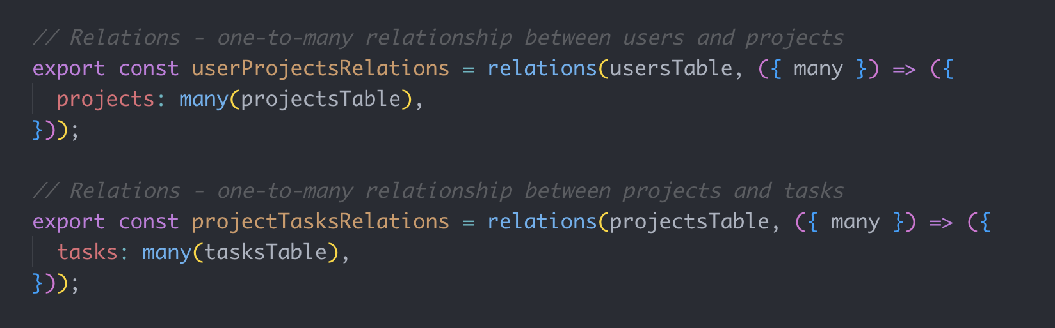
Database Schema – Drizzle ORM
Users Table
Tasks
Projects
Relationships

Slide 10
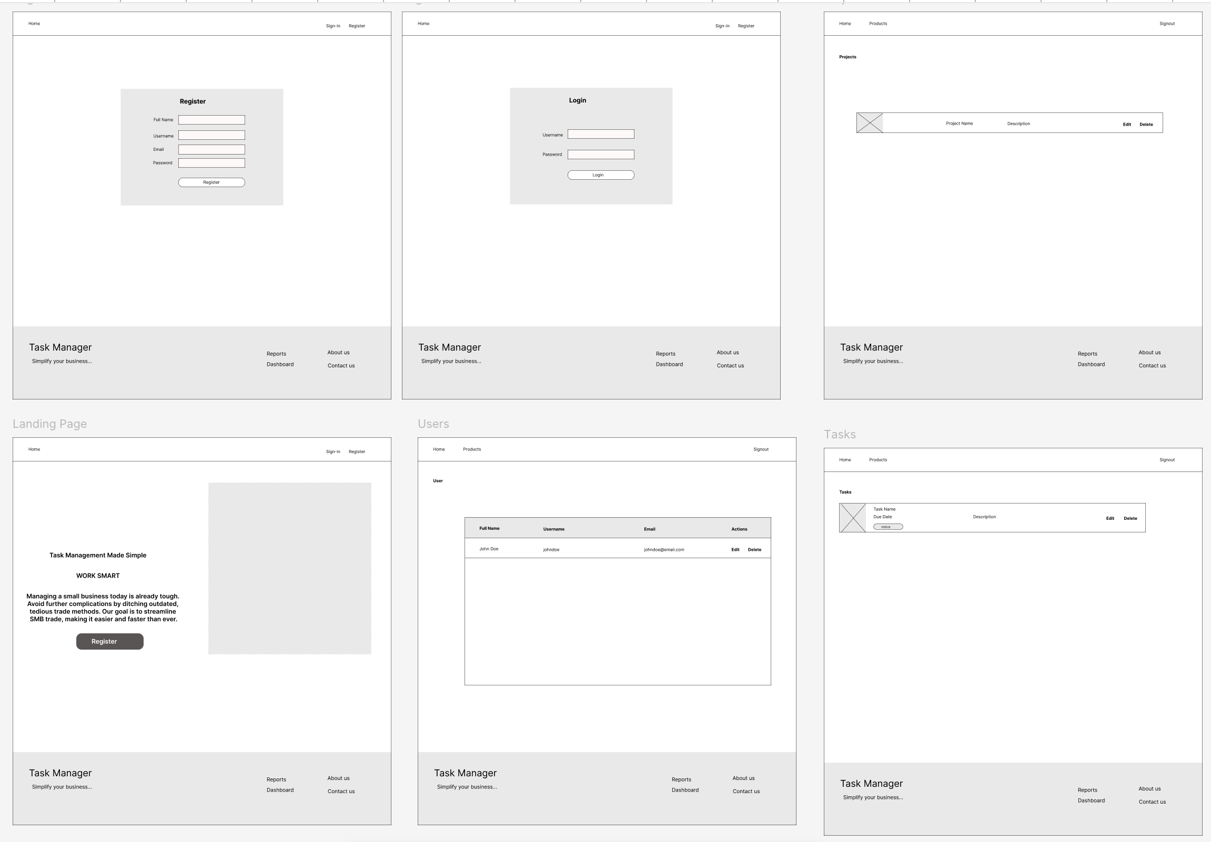
Figma Designs (Desktop)

Slide 11
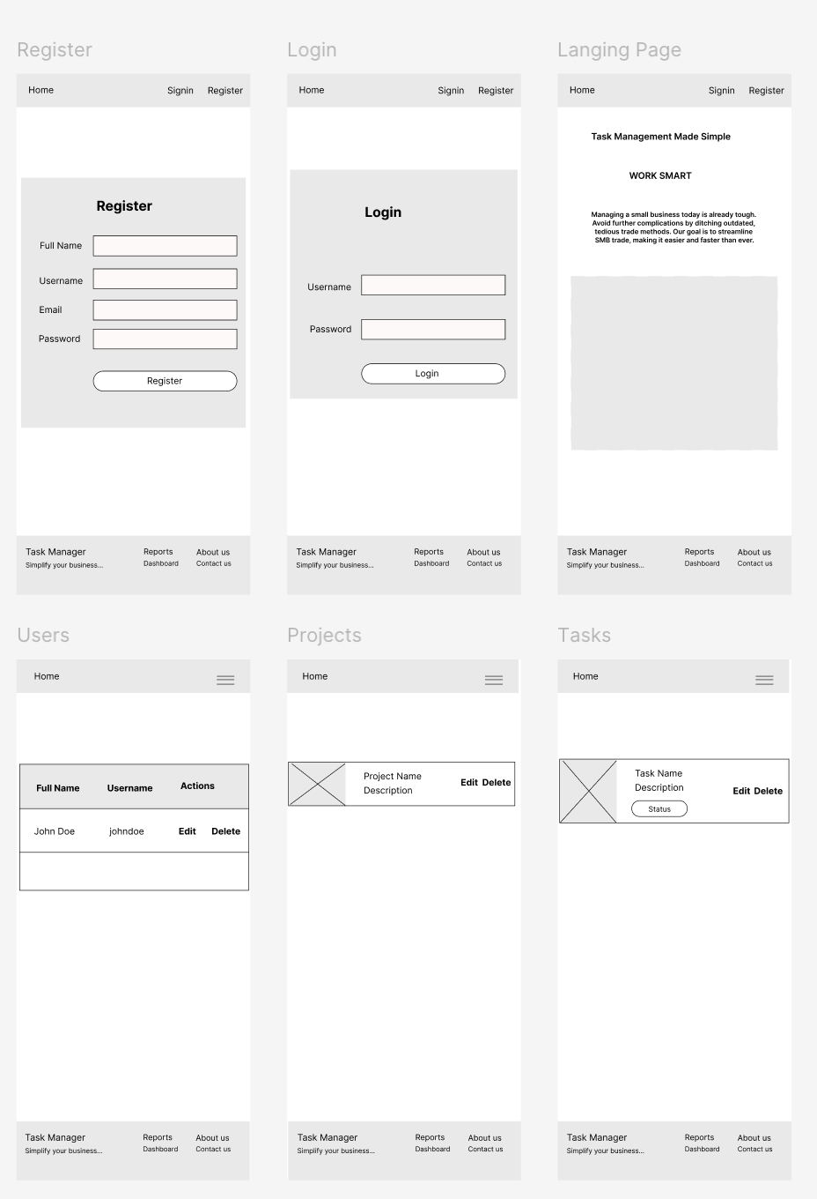
Figma Designs (Mobile Devices)

Slide 12
Project Timeline
Date Range | Activities
7–12 July | Requirement finalization, environment setup, user/team/authentication dev
13–17 July | Core functionality: project/task management, dashboard, notifications
18–20 July | Testing, bug fixing, UI refinements
21 July | Review and rehearsal
22 July | Presentation and feedback session

Slide 13
Effort Allocation
Responsibility Area | Effort (%) | Description
Requirement Analysis | 15% | Finalizing requirements and planning
Design | 15% | UI/UX design, frontend/backend development
Development& Testing | 50% | Manual testing, bug fixes, quality assurance
Presentation Prep | 20% | Demos and documentation

Slide 14
Future Work
Advanced Reporting & Analytics
Third-Party Integrations(Stripe Payment )
Document Management
Custom Workflows
Role-Based Access Control (RBAC) - (Clerk – Authentication)
Mobile App for iOS and Android

Slide 15
System Demo

Slide 16
References
Next.js 15+
Official Docs: https://nextjs.org/docs
App Router Overview: https://nextjs.org/docs/app/building-your-application/routing
Middleware in Next.js
Middleware Guide: https://nextjs.org/docs/app/building-your-application/routing/middleware
JOSE Library (JWT Authentication)
Official Docs: https://jose.dev/
GitHub Repository: https://github.com/panva/jose
Drizzle ORM
Official Docs: https://orm.drizzle.team
GitHub: https://github.com/drizzle-team/drizzle-orm
MySQL
Official Site: https://www.mysql.com/
Developer Docs: https://dev.mysql.com/doc/
Tailwind CSS
Official Docs: https://tailwindcss.com/docs
ShadCN UI
Component Library: https://ui.shadcn.com
Based on Radix UI: https://www.radix-ui.com/
MVC Architecture
MDN Glossary: https://developer.mozilla.org/en-US/docs/Glossary/MVC
ChatGPT (OpenAI)
Assisted in code suggestions,
Helped with clarifying MVC pattern for NextJS, and
Learn more: https://openai.com/chatgpt

Slide 17
Questions ?

