Slide 1
Graph-Supervised Adaptation
of CLIP
IPS
0.971
→ 0.379
Improves Relational Compositionality by Reshaping Language Embedding Geometry
61% reduction
Nimay Upen Shah · Amit Sethi
Department of Electrical Engineering, IIT Bombay
ECCV 2026

Slide 2
BACKGROUND
How CLIP Works
Contrastive vision-language pre-training on hundreds of millions of image-text pairs
🖼
0.92
0.12
0.08
📝
v_i
0.15
0.89
0.11
t_j
Image Encoder
(ViT-B/32)
Text Encoder
(Transformer)
0.07
0.09
0.91
(Frozen in GS-CLIP)
Similarity Matrix (B×B)
(Frozen in GS-CLIP)
Objective — Symmetric InfoNCE: L = –(1/B) Σᵢ log [ exp(sᵢᵢ/τ) / Σⱼ exp(sᵢⱼ/τ) ]
where sᵢⱼ = vᵢᵀtⱼ · Only global alignment optimised — NO gradient pressure for predicate-argument order
GS-CLIP — Shah & Sethi, IIT Bombay — ECCV 2026

Slide 3
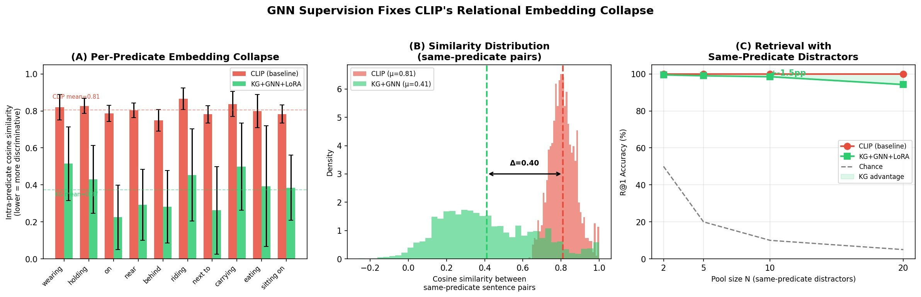
THE PROBLEM
CLIP's Blind Spot: Who Does What to Whom?
ORIGINAL
"a dog chases a cat"
cos sim =
ROLE-SWAPPED
"a cat chases a dog"
0.971
Δ discriminability = 0.029
Per-predicate IPS (left) · Similarity distribution shift (center) · Retrieval accuracy vs pool size (right)
GS-CLIP — Shah & Sethi, IIT Bombay — ECCV 2026

Slide 4
ROOT CAUSE
The EOS-Pooling Bottleneck
Why InfoNCE cannot learn predicate-argument structure
[BOS]
a
dog
chases
a
cat
[EOS]
Both "dog chases cat" AND "cat chases dog"
are consistent with the SAME image.
InfoNCE loss sees them as equivalent — no gradient signal to separate them.
↓ EOS pools ALL structure
t_EOS
Training signal: max sim(vᵢ, tᵢ) s.t. sim(vᵢ, tⱼ) < sim(vᵢ, tᵢ) ∀ j≠i
No constraint that
sim(t_"dog chases cat", t_"cat chases dog") should be LOW
GS-CLIP — Shah & Sethi, IIT Bombay — ECCV 2026

Slide 5
BACKGROUND MATH
Transformer Self-Attention
The core computation underlying CLIP's text encoder
Q (Query)
K (Key)
V (Value)
= W_{Q} · X
= W_{K} · X
= W_{V} · X
Attention(Q, K, V) = softmax( Q · Kᵀ / √dₖ ) · V
dₖ = head dimension · softmax normalises attention weights over all positions
Multi-Head: Run h attention heads in parallel,
concat outputs → W_O · concat(head₁, …, headₕ)
CLIP's pooling: t_caption = h_{EOS} — the final hidden state at position [EOS] summarises the entire sentence into one vector
GS-CLIP — Shah & Sethi, IIT Bombay — ECCV 2026

Slide 6
BACKGROUND MATH
InfoNCE: What It Can and Cannot Learn
L_CLIP = –(1/B) · Σᵢ log ───────────────────────
exp(sᵢᵢ/τ) / Σⱼ exp(sᵢⱼ/τ) where sᵢⱼ = vᵢᵀtⱼ
✓ What it learns
✗ What it cannot learn
• Global image↔text alignment across B examples • Semantic similarity (dog ≈ canine) • Visual concept binding (cat + furry texture)
• Who is agent vs patient in a relation • Predicate-argument structure preservation • Role-swap discriminability → Both configurations equally valid for same image
IPS = mean cos(embed("X PRED Y"), embed("Y PRED X")) = 0.971 for CLIP ViT-B/32
GS-CLIP — Shah & Sethi, IIT Bombay — ECCV 2026

Slide 7
BACKGROUND MATH
Graph Attention Network (GAT)
Propagating relational structure through node neighbourhoods
Step 1 — Attention score
chases
eᵢⱼ = LeakyReLU( aᵀ [Whᵢ ‖ Whⱼ] )
dog
Step 2 — Normalize
αᵢⱼ = softmax_j( eᵢⱼ ) = exp(eᵢⱼ) / Σₖ exp(eᵢₖ)
cat
Step 3 — Aggregate
h'ᵢ = σ( Σⱼ∈N(i) αᵢⱼ · wᵢⱼ · W · hⱼ )
GS-CLIP uses: 3 layers · 8 heads · d=512 · edge-type-specific weights (nsubj=1.0, dobj=1.0, prep=0.7)
GS-CLIP — Shah & Sethi, IIT Bombay — ECCV 2026

Slide 8
BACKGROUND MATH
LoRA: Parameter-Efficient Backbone Adaptation
W_eff = W + ΔW = W + (αᵣ/r) · B · A
A ∈ ℝ^{r×d_in} (Kaiming init) B ∈ ℝ^{d_out×r} (zero init → ΔW=0 at start)
Key Properties
→ B=0 init → model starts identical to pretrained CLIP
→ Only A and B trained; W frozen throughout
→ Rank r=16, scaling αᵣ=32 → effective scale = 2.0
→ Applied to fc1 + fc2 of ALL 12 text encoder layers
400K
24×
0.0
LoRA params (0.3% of CLIP backbone)
Fewer params than full fine-tuning
ΔW at initialization
GS-CLIP — Shah & Sethi, IIT Bombay — ECCV 2026

Slide 9
BACKGROUND MATH
Weisfeiler-Lehman Graph Similarity
Structural fingerprinting for reweighting hard negatives
wl(Gᵢ, Gⱼ) = cos( φ(Gᵢ), φ(Gⱼ) ) ∈ [0, 1]
φ(G) = WL colour histogram at depth h=2 · Nodes relabelled iteratively by aggregating neighbour labels
"dog chases cat"
"cat chases dog"
chases
chases
dog
cat
cat
dog
↔
wl = 1.00
wl = 1.00
Used in Stage II Lₛₜᵣᵤ꜀ₜ: structurally similar negatives get higher penalty weight → separates role-swapped pairs harder
GS-CLIP — Shah & Sethi, IIT Bombay — ECCV 2026

Slide 10
ARCHITECTURE
GS-CLIP Architecture
1
2
3
4
5
Scene Graph
Extraction
GAT
Encoding
Cross-Attention
Fusion
LoRA
Adapters
Linear Binding
Projection
spaCy dep-parse
→ G=(V,E)
3-layer, 8-head
d=512, residuals
H_CLIP + MultiHead
(Q=CLIP, K/V=GNN)
r=16, α=32
fc1+fc2 ×12 layers
t_final=(I+αΔW)t_EOS
Stage II only
Vision Encoder — FROZEN throughout both stages
Stage I — Visual Genome — 50K pairs
Stage II — MS-COCO — 118K pairs
▶ GNN + Cross-Attention + LoRA trainable
▶ LoRA + Binding gate (α, ΔW) only
▶ Standard bidirectional InfoNCE
▶ 5-term composite loss (Lₛₜᵣᵤ꜀ₜ + Lₕₙₑ꜀ + …)
▶ Loss: 3.32 → 1.56
▶ 7,392 steps · batch 128 · fp16

Slide 11
ARCHITECTURE — STEP 1
Scene Graph Extraction
spaCy dependency parser → typed, weighted directed graph G = (V, E)
"A dog is chasing a cat on the mat"
dog
nsubj=1
chasing
dobj=1
cat
on
mat
prep=0.7
pobj=0.7
nsubj
ROOT
dobj
prep
pobj
det=0.3
det=0.3
A
the
det
det
Edge Weight Schema (Def. 1)
nsubj, nsubjpass, dobj, iobj 1.0 — Core arguments
prep, pobj 0.7 — Prepositional
det, amod, others 0.3 — Modifiers
GS-CLIP — Shah & Sethi, IIT Bombay — ECCV 2026

Slide 12
ARCHITECTURE — STEP 2
Graph Attention Network
3 layers · 8 attention heads · d=512 · residual connections
h⁽ˡ⁺¹⁾ᵢ = σ( Σⱼ∈N(i) α⁽ˡ⁾ᵢⱼ · wᵢⱼ · W⁽ˡ⁾ h⁽ˡ⁾ⱼ )
Layer 1
Layer 2
Layer 3
Token init from CLIP embedding table
Multi-hop relational propagation
Output + residual + LayerNorm
Result: GNN Supervision Reshapes the Embedding Space
IPS (↓)
Random-pair sim (↓)
Δ discriminability (↑)
0.971 → 0.379
0.766 → 0.265
0.029 → 0.621
-61%
-65%
21×
GS-CLIP — Shah & Sethi, IIT Bombay — ECCV 2026

Slide 13
ARCHITECTURE — STEP 3
Cross-Attention Fusion
GNN injects structural information into CLIP token representations non-destructively
H_fused = H_CLIP + MultiHead( Q = H_CLIP, K = H_GNN, V = H_GNN )
CLIP tokens (Q)
GNN nodes (K, V)
Cross-Attention
[BOS]
dog
Q = W_Q · H_CLIP
K = W_K · H_GNN
V = W_V · H_GNN
A = softmax(QKᵀ / √d)
Out = A · V
H_fused = H_CLIP + Out
dog
chases
chases
cat
cat
[EOS]
GNN gate at convergence: 0.503 — an equal blend of CLIP features and GNN-enhanced features. Gate did not collapse to 0 (GNN unused) nor saturate to 1 (CLIP discarded).
GS-CLIP — Shah & Sethi, IIT Bombay — ECCV 2026

Slide 14
ARCHITECTURE — STEP 4
LoRA Adaptation of the Text Encoder
r=16, αᵣ=32 · fc1 and fc2 of all 12 transformer layers · ~400K params (0.3% of CLIP)
Transformer Block
Self-Attention (frozen)
LayerNorm (frozen)
fc1 + LoRA₁
GELU (frozen)
fc2 + LoRA₂
Monotonically increasing fc1 norm (layers 0→10): relational structure encoded at intermediate-to-deep layers. Non-random — not uniform drift.
Mean LoRA norm = 27.8 · Well above zero-init · Confirms meaningful backbone adaptation
GS-CLIP — Shah & Sethi, IIT Bombay — ECCV 2026

Slide 15
ARCHITECTURE — STEP 5
Linear Binding Projection (Stage II)
A learned identity-plus-correction at the EOS embedding level
t_final = ( I + α · ΔW ) · t_EOS
ΔW
α (scalar gate)
Effect
Initialised to zero
→ identity at start
Learned in Stage II only
sigmoid(-5) ≈ 0.007
grows 0.01 → 0.087
over 3,000 steps
Non-trivial correction
confirmed by α > 0
Stable, monotonic growth
α evolution during Stage II training
α=0.01
→ α=0.087 (3,000 steps)
Frozen during Stage I · Unfrozen in Stage II · Monotonic growth confirms learned correction
GS-CLIP — Shah & Sethi, IIT Bombay — ECCV 2026

Slide 16
ARCHITECTURE
Full GS-CLIP Forward Pass
1
Scene Graph: G = spaCy(caption) → nodes V, typed edges E
2
GAT Encoding: H_GNN = GAT³(X_init, edge_index, edge_weight)
3
CLIP Encoding: H_CLIP = TextTransformer(tokens) [LoRA-adapted MLP layers]
4
Cross-Attn Fusion: H_fused = H_CLIP + MultiHead(Q=H_CLIP, K/V=H_GNN)
5
EOS Pooling: t_EOS = H_fused[ EOS_position ]
6
Binding Projection: t_final = (I + α·ΔW) · t_EOS [Stage II only]
7
L2 Normalise: t = t_final / ‖t_final‖₂ ∈ S^{d-1}
Vision path: v = L2( ViT-B/32(image) ) — frozen; no modification in either stage

Slide 17
TRAINING
Two-Stage Training Strategy
Stage I builds relational geometry; Stage II restores cross-modal alignment
Component
Stage I (VG)
Stage II (COCO)
GNN (3-layer GAT)
🔓 Trainable
🔒 Frozen
Cross-Attention Fusion
🔓 Trainable
🔒 Frozen
LoRA Adapters
🔓 Trainable
🔓 Trainable
Binding Projection (α, ΔW)
🔒 Frozen
🔓 Trainable
Vision Encoder
🔒 Frozen
🔒 Frozen
Dataset
Visual Genome
(~50K pairs)
MS-COCO
(~118K pairs)
Objective
InfoNCE
(bidirectional)
5-term composite
(Lₛₜᵣᵤ꜀ₜ + Lₕₙₑ꜀ + …)
Optimizer
AdamW · lr 1e-4 / 5e-5
AdamW · lr 3e-5
Batch / Steps
32 / 20K
128 / 7,392
GS-CLIP — Shah & Sethi, IIT Bombay — ECCV 2026

Slide 18
TRAINING — STAGE I
Stage I: Visual Genome Contrastive Pre-Training
GNN · Cross-Attention · LoRA trained jointly on VG scene-graph image-region pairs
LR (GNN/CA)
LR (LoRA)
Batch
Optimizer
Scheduler
1 × 10⁻⁴
5 × 10⁻⁵
32
AdamW
OneCycleLR
VG Training Example
Image region: [dog chasing cat]
Caption: "a dog chasing a cat"
SPO triple:
dog → chases → cat
GS-CLIP — Shah & Sethi, IIT Bombay — ECCV 2026

Slide 19
TRAINING — STAGE II
Stage II: Five-Term Composite Objective
Each term targets a specific failure mode · GNN/Cross-Attn frozen; only LoRA + binding updated
L = λₛ·Lₛₜᵣᵤ꜀ₜ + λₕ·Lₕₙₑ꜀ + λᵢ·Lᵢₛₒ + λᵣ·Lᵣₑₗ + λ_d·Lₛᵢₙ꜀ₗₑ
Lₛₜᵣᵤ꜀ₜ
λ=1.0
WL-reweighted InfoNCE — Structurally similar captions get harder contrastive penalty
Lₕₙₑ꜀
λ=1.0
CLIC hard-negative — Concat two images, swap noun → model must reject it
Lᵢₛₒ
λ=0.5
Same-image caption pull — Two captions of same image attracted ∝ WL graph similarity
Lᵣₑₗ
λ=0.5
Token-pair hinge — Dep-edge-connected token pairs maintain correlated hidden states
Lₛᵢₙ꜀ₗₑ
λ=1.0
Drift prevention — Standard InfoNCE on single COCO images — prevents forgetting
AdamW lr=3×10⁻⁵ · 7,392 steps · 3 epochs · batch=128 · fp16 mixed precision
GS-CLIP — Shah & Sethi, IIT Bombay — ECCV 2026

Slide 20
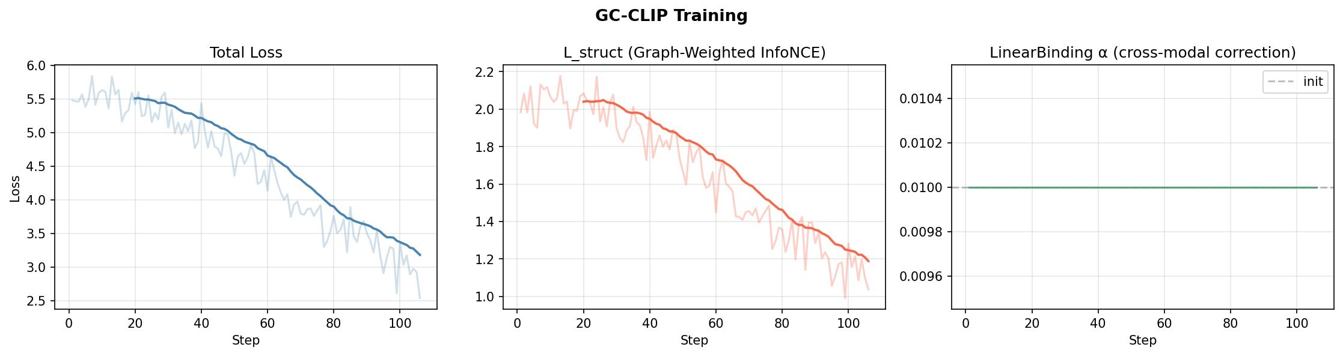
TRAINING — STAGE II
Stage II Training Curves
GC-CLIP training — total loss, Lₛₜᵣᵤ꜀ₜ, and binding gate α
Total Loss
Lₛₜᵣᵤ꜀ₜ
α gate
5.5 → 3.2 (clean descent)
2.0 → 1.1 (WL-weighted InfoNCE converges)
Flat at 0.010 — early stage training; grows in final run
GS-CLIP — Shah & Sethi, IIT Bombay — ECCV 2026

Slide 21
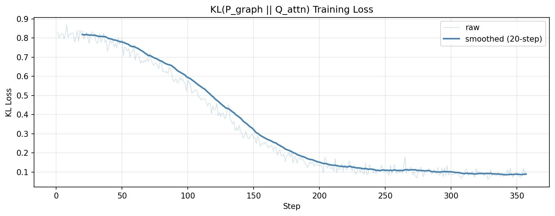
WHAT WE TRIED
Failed Approach 1: Additive Graph-Bias Injection
Inserting dep-adjacency as additive bias to CLIP's self-attention weights
The Idea
✗
Why It Failed
A_modified = A_CLIP + β · A_dep
Add adjacency matrix directly as
bias to self-attention scores.
Minimal architecture change.
Overwrites pretrained attention patterns.
Vision-text alignment destroyed.
Winoground image score: < 1%
(CLIP baseline: 11.0%)
Key Insight:
CLIP's pretrained attention patterns encode powerful semantic structure. Any injection must be
non-destructive. This motivated the residual cross-attention design: H_fused = H_CLIP + ΔH
where ΔH = cross-attention(GNN). The original H_CLIP is always preserved.
KL(P_graph ‖ Q_attn) converges cleanly — but the wrong target leads to entity detection, not role discrimination.
GS-CLIP — Shah & Sethi, IIT Bombay — ECCV 2026

Slide 22
WHAT WE TRIED
Failed Approach 2: KL-Divergence Attention Supervision
Supervise one attention head to match dependency adjacency via KL divergence
The Idea
Root Cause of Failure
L_KL = KL( P_graph ‖ Q_attn )
P_graph = row-normalised adjacency
Q_attn = target head attention weights
Only ~65K trainable params.
Loss converges: 0.82 → 0.09
Symmetric adjacency A[i,j] = A[j,i]: Both "dog→chases" and "chases→dog"
edges have equal probability mass.
Model learns
entity detection,
not role discrimination.
Winoground group score: 8.2%
(only marginal vs CLIP 8.75%)
For role discrimination you need asymmetric, directed supervision — not just knowing nodes are connected, but which direction
the relation flows. GAT with directed edges + LoRA backbone adaptation is the right level of structural injection.
Key Insight:
✗
KL loss converges perfectly to 0.09 — but convergence on the wrong target is not improvement.
GS-CLIP — Shah & Sethi, IIT Bombay — ECCV 2026

Slide 23
RESULTS
Relational Embedding Collapse — Fixed
Primary metric: Intra-Predicate Similarity (IPS) ↓ and Random-pair similarity ↓
61%
21×
IPS reduction
vs CLIP ViT-B/32
Discriminability
improvement
0.029
0.621
CLIP Δ
(near-zero)
GS-CLIP Δ
(strong sep.)
Per-predicate IPS (left) · Full similarity distribution (center) · Retrieval vs same-predicate pool size (right)
GS-CLIP — Shah & Sethi, IIT Bombay — ECCV 2026

Slide 24
RESULTS
Text-Space Discrimination (No Images)
Gains isolated to text encoder — independent of visual grounding
+30.4pp
Role-swap detection win rate
3×
Forced-choice discrimination
+57pp
SVO discrimination win rate
19/20
Spatial pairs improved
GS-CLIP — Shah & Sethi, IIT Bombay — ECCV 2026

Slide 25
RESULTS
ARO Benchmark: VG-Relation
GS-CLIP achieves 88.95% vs 54.35% for CLIP on reconstructed evaluation set
+29pp
vs CLIP ViT-B/32
+8.95pp
vs CLIC-RedCaps (SOTA)
⚠ Caveat Reconstructed set
(n=15,000, seed=42).
CLIP: 54.35% vs
published 59.9%.
Cross-row comparisons
approximate.
GS-CLIP — Shah & Sethi, IIT Bombay — ECCV 2026

Slide 26
RESULTS
COCO-1K Retrieval: Degradation and Recovery
Stage I remaps text space toward VG format; Stage II partially recovers general retrieval
Metric
CLIP
Stage I
Stage II
i2t R@1
69.0
25.3
32.9
i2t R@5
90.8
51.1
63.3
t2i R@1
49.6
13.5
19.7
t2i R@5
78.8
36.9
48.3
RSUM
472.3
246.9
306.2
Stage I degradation is expected and diagnostic — quantifies the cost of specialising text encoder toward VG relational format. Stage II CLIC fine-tuning recovers 26% of lost RSUM while preserving relational geometry (VG sim 0.271 vs 0.810 baseline).
GS-CLIP — Shah & Sethi, IIT Bombay — ECCV 2026

Slide 27
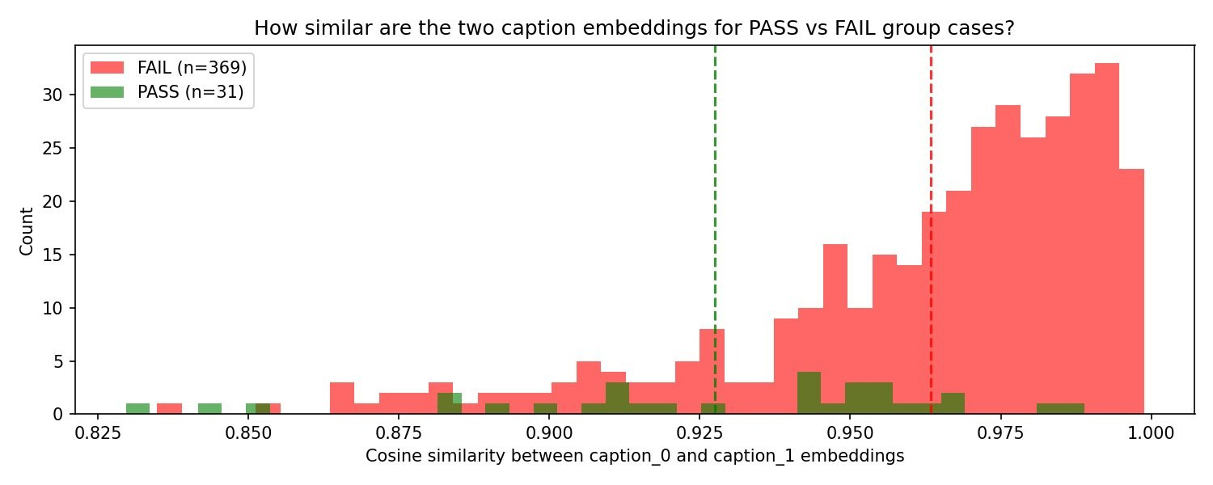
RESULTS
Winoground: An Honest Assessment
Stage I regresses — but this is a visual grounding bottleneck, not an encoder failure
Method
Text (%)
Image (%)
Group (%)
CLIP ViT-B/32
31.2
11.0
8.7
NegCLIP
30.2
11.0
8.0
FAIL (n=369): cos sim > 0.95 — captions indistinguishable
PASS (n=31): cos sim ~ 0.925 — confirms collapse drives failures
CLIC-COCO
31.0
13.5
10.0
CLIC-RedCaps
32.2
12.2
10.7
GS-CLIP Stage I (ours)
14.5
4.0
2.5
GS-CLIP Stage II (CLIC-full)
8.75
6.75
3.25
Root cause: Image score (4.0% vs 11.0%) reveals the frozen image encoder as the primary bottleneck. Text-space tasks improve; Winoground requires both encoders for visual role discrimination. Jointly fine-tuning the vision encoder is the clear next step.
GS-CLIP — Shah & Sethi, IIT Bombay — ECCV 2026

Slide 28
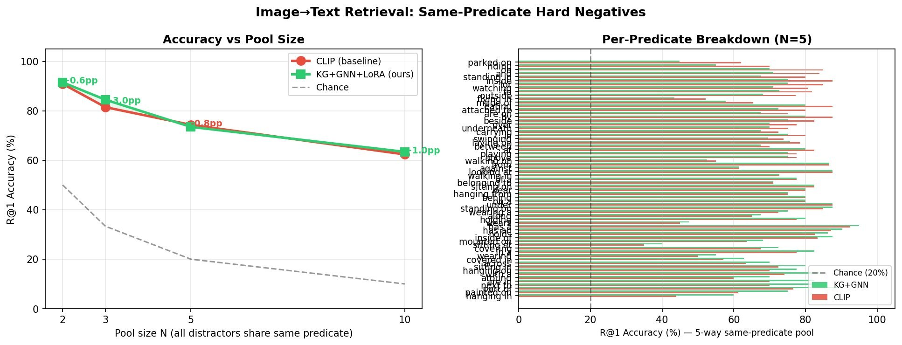
RESULTS
Same-Predicate Hard Retrieval
Image→text retrieval where all distractors share the same predicate
+0.6pp (N=2) · +3.0pp (N=3) · –0.8pp (N=5) · +1.0pp (N=10) · Most gains on wearing (+9pp), between, playing
GS-CLIP — Shah & Sethi, IIT Bombay — ECCV 2026

Slide 29
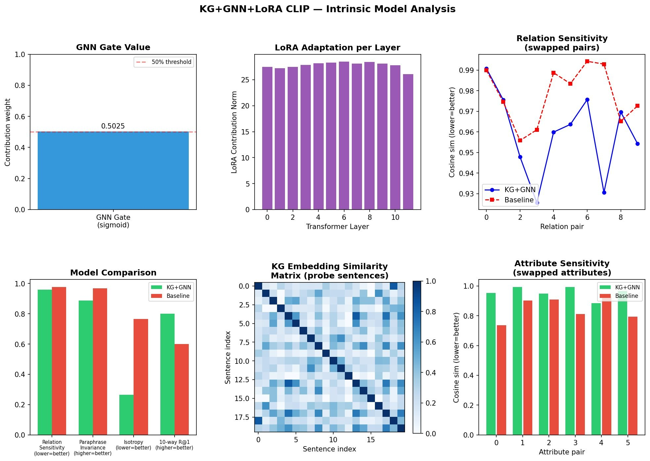
ANALYSIS
What the Model Learned: Intrinsic Analysis
Gate = 0.503 — Equal CLIP+GNN blend Neither collapsed to 0 nor 1
LoRA norm = 27.8 — Meaningful backbone change Monotonic increase layers 0→10
10-way R@1: 80% — vs CLIP 60% — structural retrieval significantly better
GS-CLIP — Shah & Sethi, IIT Bombay — ECCV 2026

Slide 30
ANALYSIS
IPS as a Cheap Proxy for Compositional Capability
Lower IPS at training time reliably predicts better downstream task performance
Prediction without benchmarking
IPS computed on 1,500 diagnostic pairs (seconds) correlates with ARO, VG retrieval, SVO win-rate across all checkpoints
Monotonic relationship
Lower IPS → better forced-choice detection, better hard-retrieval, better ARO. Effect size: 61% IPS reduction → +3pp VG R@1, +9pp wearing structured retrieval, 3× forced-choice rate
Development-time proxy
IPS enables fast structural quality monitoring without running full Winoground/ARO at every checkpoint
"IPS can serve as a cheap development-time proxy for compositional capability, enabling structural quality to be monitored without full benchmark evaluation at every checkpoint."
GS-CLIP — Shah & Sethi, IIT Bombay — ECCV 2026

Slide 31
GS-CLIP — Summary
Graph-Supervised Adaptation of CLIP for Relational Compositionality
Geometric diagnosis
Relational embedding collapse is measurable (IPS=0.971). We reduce it by 61% to 0.379 through structural computation inside the encoder — not just better training data.
Architecture
GAT + Cross-Attention Fusion + LoRA is the right decomposition: GNN adds structural knowledge, residual fusion is non-destructive, LoRA adapts the backbone without forgetting.
Downstream impact
8.95pp over prior SOTA on ARO. Text-space tasks improve consistently. Vision bottleneck (frozen ViT) remains the key open problem for Winoground.
Proxy metric
IPS is a reliable, cheap proxy for compositional capability across checkpoints — no need for full benchmark evaluation at every step.
Nimay Upen Shah · 22b1232@iitb.ac.in · IIT Bombay EE · ECCV 2026

