Slide 1
DIGIT MEMORY / v2 / RETRIEVAL AS A BASELINE
Digit Memory
A study in retrieval as classification.
98.4%
HELD-OUT ACCURACY
1-NN on a stratified 75/25 split of the sklearn digits dataset.
Nimit Jain / github.com/nimb-ou/ML_projects

Slide 2
§ 01 · THE QUESTION
The fastest model is the one you don't need.
Most ML projects start with what model to use. This one started with a different question: what if you just stored the data, organized it well, and looked things up?

Slide 3
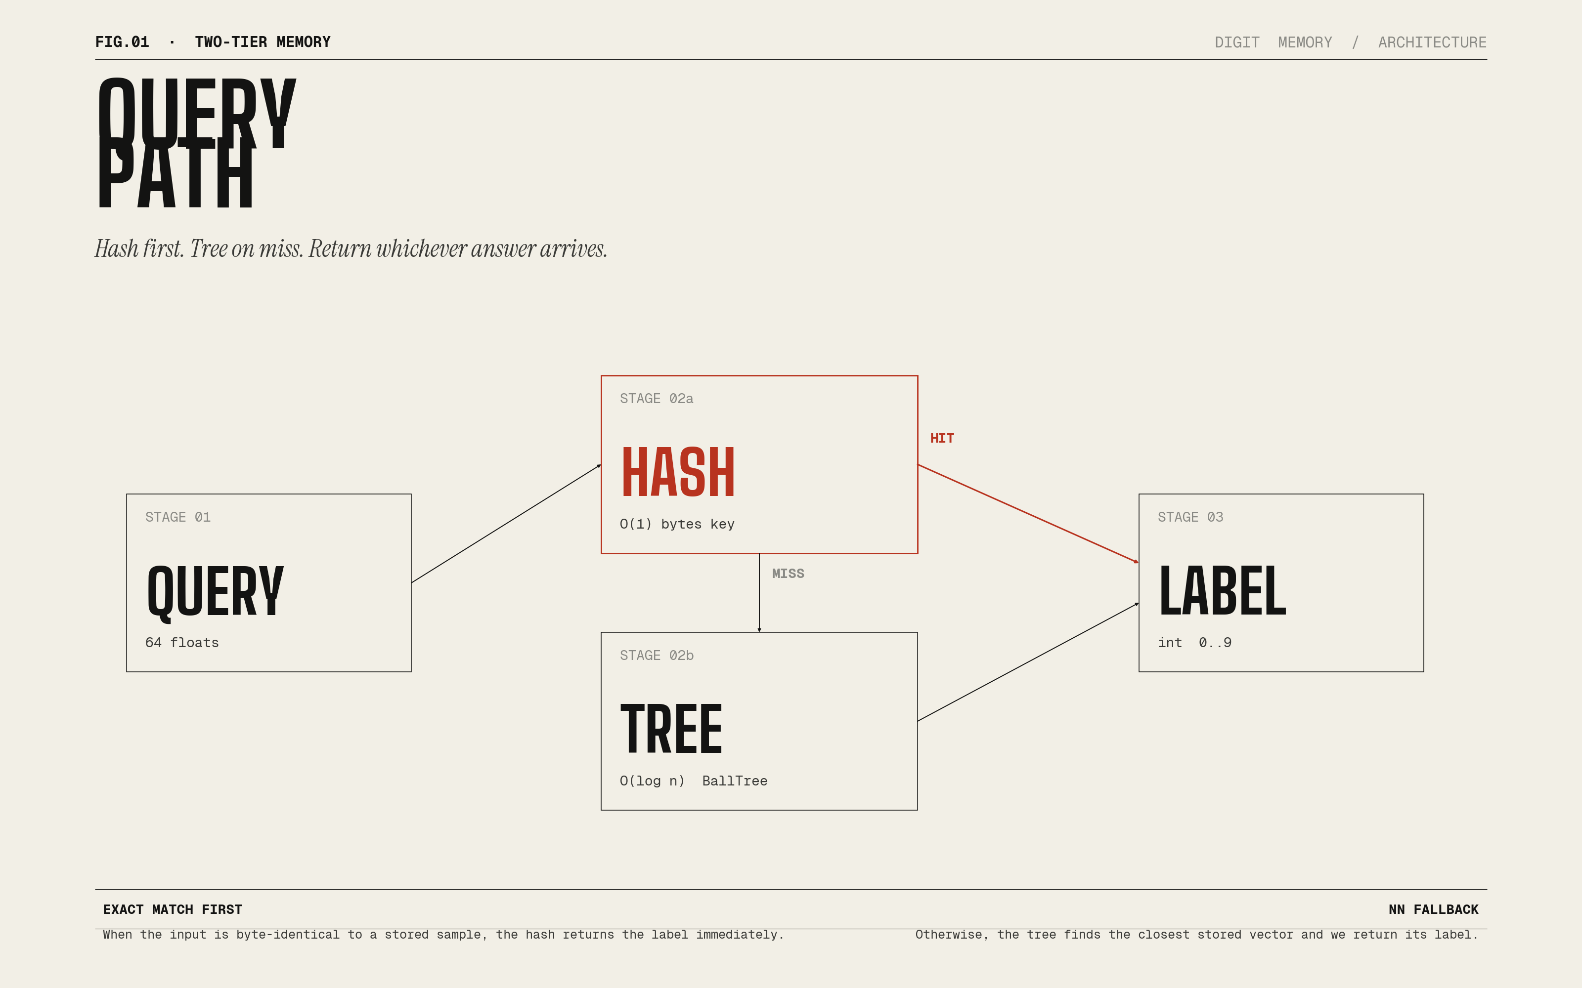
§ 02 · ARCHITECTURE
Two-tier lookup
Hash first. Tree on miss. Return whichever answer arrives.

Slide 4
§ 03 · NUMBERS
HELD-OUT ACCURACY
EXACT LOOKUP
NEAREST NEIGHBOR
98.4%
3 us
50 us
stratified 75/25 split
Python dict, O(1)
BallTree, k=1
No training. No gradients. No epochs.

Slide 5
§ 04 · IMPLEMENTATIONS
Three ways
Writing the same system three times is the closest I have found to actually understanding it.
01
PYTHON
digits_memory.py
Production-style. SQLite persistence. sklearn KDTree.
02
JUPYTER
digits_study_guide.ipynb
43 cells. Pandas DataFrames. Three NN backends benchmarked.
03
C
digits_memory.c
Zero dependencies. FNV-1a open-addressed hash. Brute-force NN.

Slide 6
§ 05 · ROBUSTNESS
How robust?
Accuracy on the held-out test set with injected Gaussian noise.
sigma = 0
sigma = 5
sigma = 10
98.4%
93.8%
67.1%
Smooth degradation. No cliff. No catastrophic forgetting.

Slide 7
§ 06 · TAKEAWAYS
What I learned
01
Retrieval is an underused baseline.
On small-to-medium data, just remembering the answer often works.
02
Match the structure to the query distribution.
Exact lookups -> hash. Approximate -> tree. Production wants both.
03
Always benchmark before you assume.
At 1797 x 64, vectorized brute force beat KDTree and BallTree.
04
Writing it three times compounds understanding.
Python lets you build it. C makes you understand it.

Slide 8
§ 07 · END
Try it. Then try beating it.
github.com/nimb-ou/ML_projects
MIT · Code, blog, notebooks, slides — all in the repo.
Nimit Jain · 2026

