Slide 1

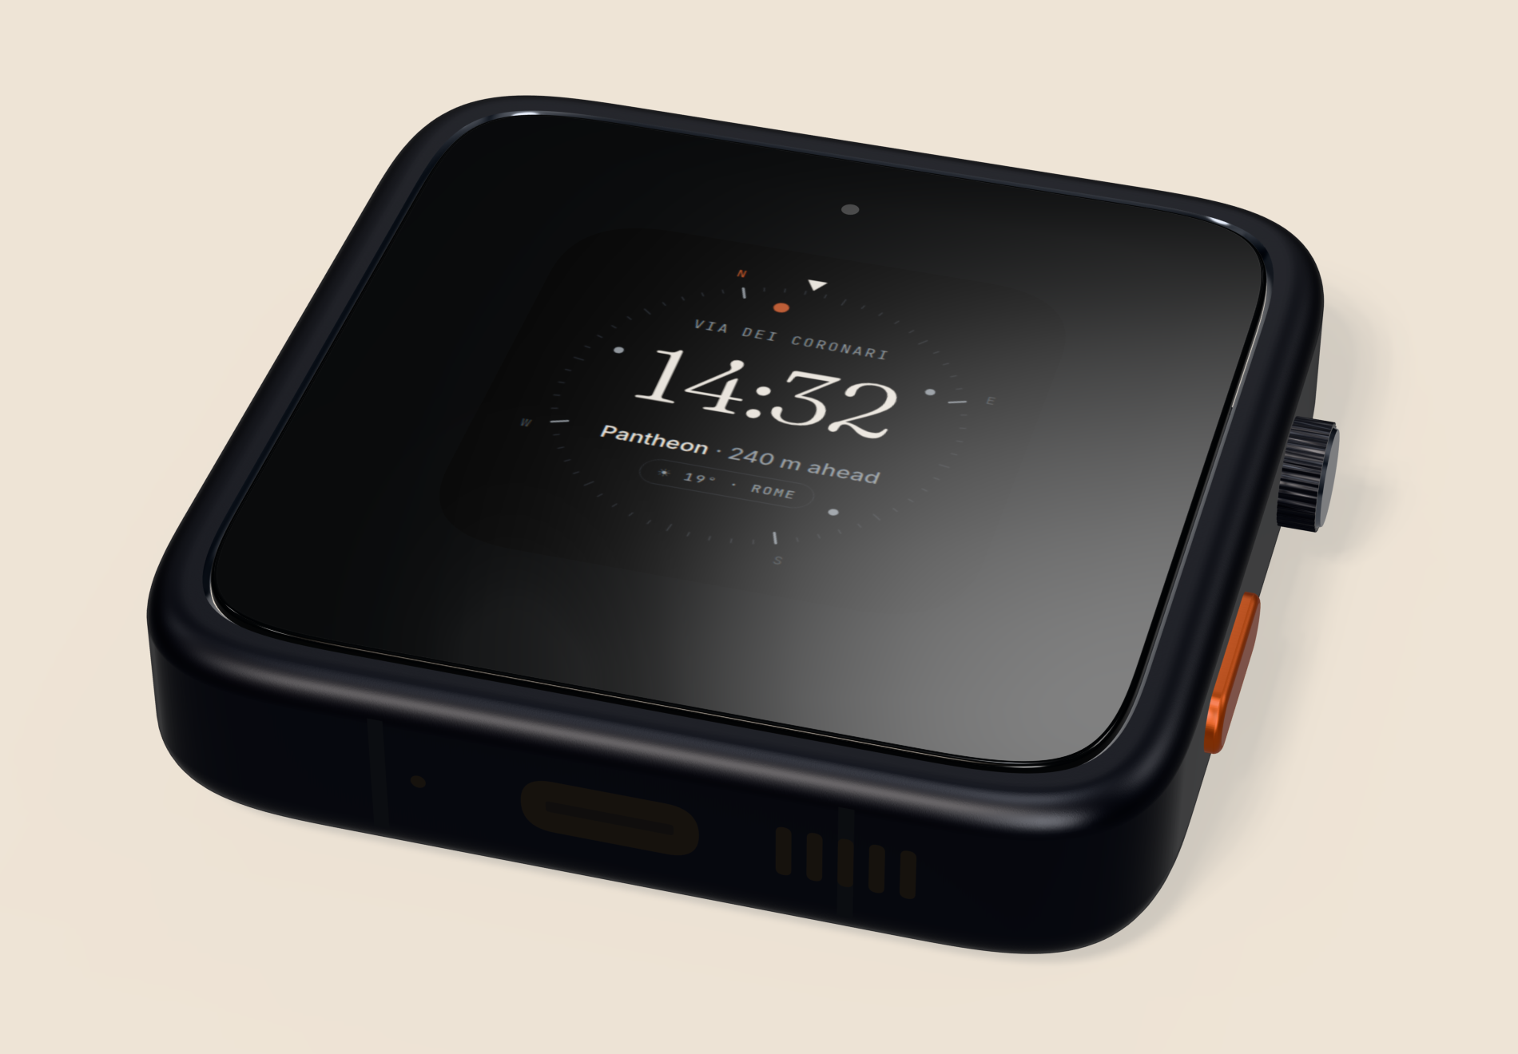
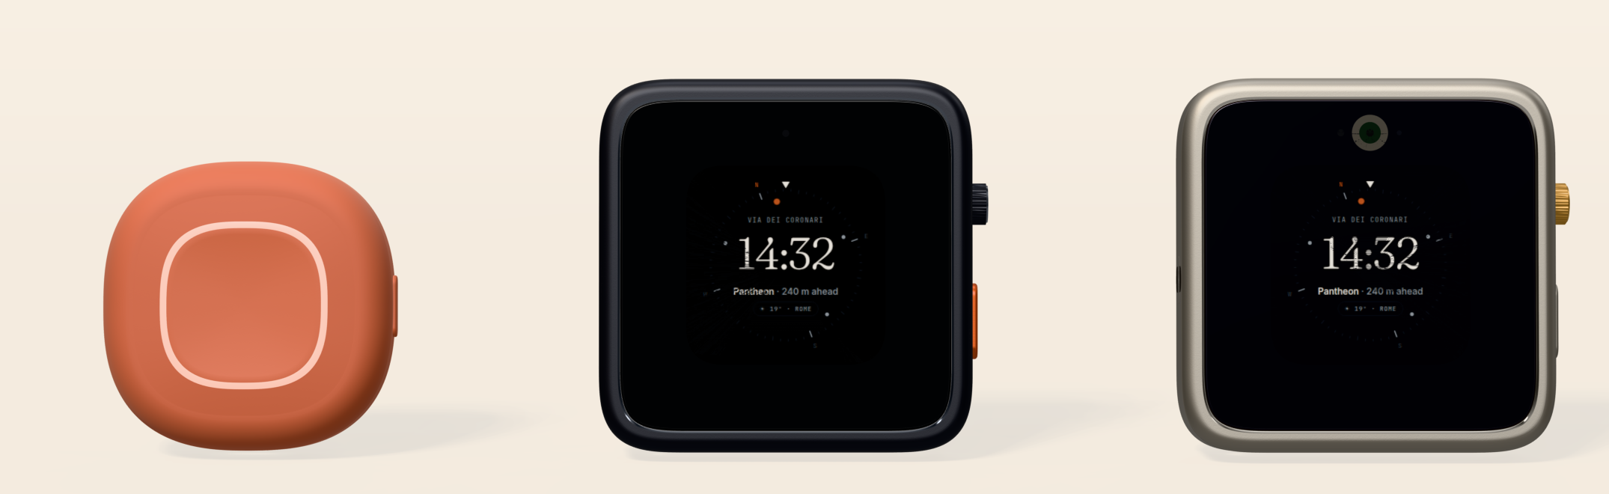

Every street has a story.
A pocket-sized AI travel companion that tells you the true, sourced stories of the city around you, through your own earphones. Online or offline. Phone stays in your pocket.
Pre-seed · $1.75M SAFE · $12M post-money cap
Pebble $149 · Square $299 · Atlas $599
Industrial-design renders (design/industrial). Not production units.
Nimit Jain, Founder & CEO · LORE Labs, Inc. (Delaware C-corp, planned) · Nov 2026
LORE Labs · Pre-seed 2026 · Confidential
01

Slide 2

THE PROBLEM
In a new city, your phone is your guide, your map, your wallet
and your only lifeline. It is bad at all four at once.
Eyes on the screen
Battery dead by 4 pm
Phone out = target
Data is still a hassle
Travellers read Wikipedia in front of monuments and still miss what is there. Generic "top 10" lists and audio guides tied to single sites.
Maps, camera, tickets and payments all drain one battery. When it dies you lose navigation, payments and the ability to call for help.
Greater Rome: 33,455 pickpocketing incidents in 2024 (+68% vs 2019). Holding a phone out marks you as a lost tourist.
>70% of frequent travellers in one survey had experienced roaming bill shock (avg. >€200). eSIMs help, but need setup per trip.
Who feels it most: solo travellers aged 22-45 making 2+ international trips a year. 35-48% of travellers now plan or take solo trips; solo share of Hostelworld bookings is 63%.
Sources: research/trends.md, research/personas.md, research/README.md (quotezone.co.uk pickpocketing aggregation, telecompaper.com roaming survey, Skyscanner/Global Rescue/IMG). Secondary aggregations; indicative.
LORE Labs · Pre-seed 2026 · Confidential
02

Slide 3
THE SOLUTION
Walk with a brilliant local friend who knows the history.
01
02
03
04
You walk
LORE knows where you face
It tells you what's there
You go deeper, or not
Phone in pocket. LORE clipped on or in hand. Your own earphones (LE Audio / A2DP).
Map Vision fuses L1+L5 GNSS, 9-axis IMU, steps and building outlines.
"The building on your right...look up." 20-40 s stories from checked, sourced facts.
Press: talk. Double-press: what's around me. Long-press: SOS. Quiet while you cross or talk.
“See the Pantheon behind you? Turn around and look up. The building you see was rebuilt under the emperor Hadrian around 113 to 125 AD. Yet the inscription on the front credits Marcus Agrippa...”
Actual output of the Rome prototype (simulated walk, offline template path). Facts rome-pantheon-1..4, source: en.wikipedia.org/wiki/Pantheon,_Rome
Source: software/simulations/output/rome-walk-transcript.md (SIMULATED sensors). Principle D4: the AI tells the story; it cannot invent history.
LORE Labs · Pre-seed 2026 · Confidential
03

Slide 4
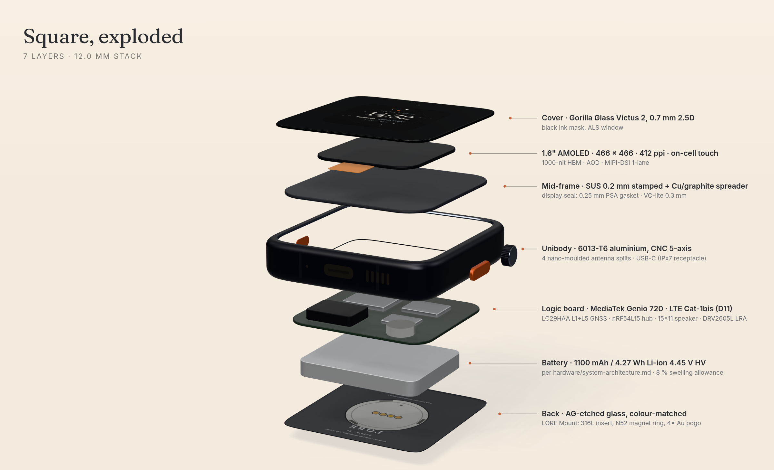
WHY A DEVICE, NOT JUST AN APP
Phones are bad at three things travellers need. A device fixes them.
Works when the phone doesn't
Built-in global eSIM (Square/Atlas, LTE Cat-1bis, 150+ countries). Phone stolen or flat: you still have stories, maps and SOS.
2+ day battery, separate from the phone
Simulated travel day: Pebble 2.1, Square 2.1, Atlas 2.4 days (new cell, optimised firmware). Phone battery stays for photos and payments.
Offline City Packs
Maps, routing, stories and on-device AI (3B on Square) with no signal. Rome pack: 86 POIs, 215 sourced fact cards today.
Eyes up, phone hidden
Honest test (Gate G0): if the phone app alone delivers ≥80% of the value, we ship the app first and keep the device as a premium model (decision D1).
Physical controls: press to talk, double-press 'what's around me', long-press SOS. Walk-me-home check-ins.
Sources: COMPANY.md 'why buy'; hardware/simulations/results.md (SIMULATED battery); software/README.md; company/decisions-log.md D1, D11.
LORE Labs · Pre-seed 2026 · Confidential
04

Slide 5
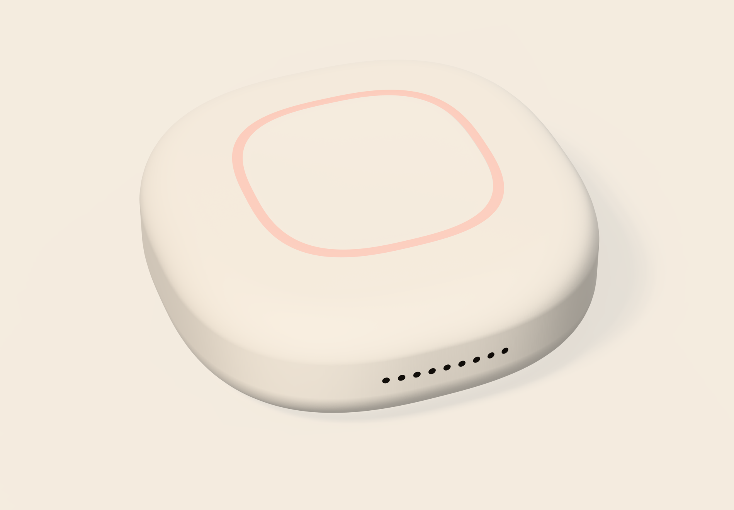
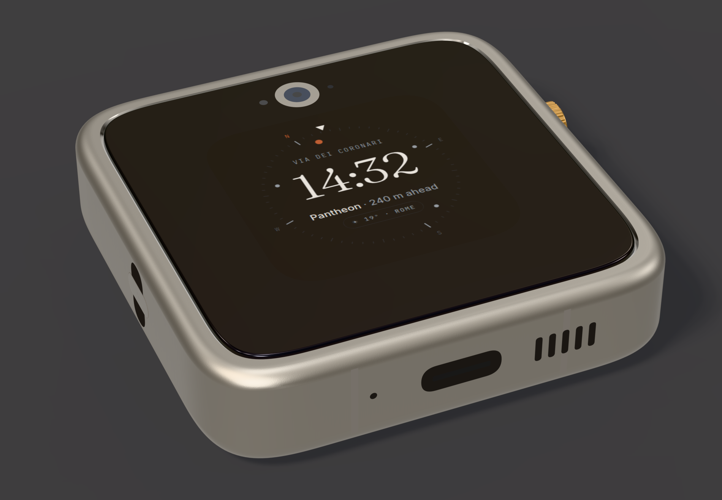
THE PRODUCT FAMILY
Good / better / best, one software platform.
LORE Pebble
$149
LORE Square
$299
LORE Atlas
$599
Clip-on, 42×42×14 mm, LED ring. 'Lite' design (D10): AI via phone over BLE; offline pre-generated stories. 1.5-day target.
54×54×12 mm aluminium, 1.6" AMOLED, crown. LTE Cat-1bis + global eSIM (D11), on-device 3B model. 2-day target.
Titanium + sapphire, 13.5 mm (D12), Glance camera, satellite SOS (NTN). On-device 3-4B + vision. '2+ days'.
LORE Pass: Explorer $9.99/mo or $79/yr · Trip Pass $29 / 14 days / 5 GB · $49 / 30 days / 10 GB · free tier (3 cities). Every device includes 3 months of Explorer. LORE Kit accessories incl. LORE Buds $129.
Renders: design/industrial/renders (concept renders, not production units). Specs: COMPANY.md, hardware/README.md, decisions D8, D10-D12.
LORE Labs · Pre-seed 2026 · Confidential
05

Slide 6
HOW MAP VISION WORKS
LORE 'sees' without a camera: sensor fusion + map geometry.
Multi-band GNSS (L1+L5)
Heading fusion
Kalman filter: heading + compass bias; rejects magnetic disturbance.
Story engine
Interest, distance, visibility, novelty, cooldowns, quiet moments (crossing / talking).
Fact guard
Narration may use ONLY the selected fact cards; else a deterministic template.
left · right · ahead · behind · look up
9-axis IMU + compass
Simulated accuracy (hardware/simulations): left/right 99.9% with EKF + map-matching + L1/L5; EKF alone 98.9%; L1+L5 adds 3-7 points over L1-only.
Prototype walk (software sim): direction 100% vs ground truth; fused heading error mean 4.3°, p95 12.7°.
Gate G1 bar on real walks: ≥90%. D3 kill line: <85%.
Step & walking direction
Building footprints, street sides, entrances
Places + live data
Why no camera on the first models (D3): avoids privacy problems, cost and battery drain. Only Atlas adds an opt-in 'Glance' camera. Patent provisionals planned before any public demo: P1 Map Vision, P2 quiet-moment (legal-ops/ip-strategy.md).
Caveat: all accuracy figures are SIMULATED. Real-walk validation in Rome starts with the EVT beta (Q1 2027).
Sources: hardware/README.md, hardware/simulations/results.md, software/packages/core (heading-fusion.ts, story-engine.ts, narration.ts).
LORE Labs · Pre-seed 2026 · Confidential
06

Slide 7
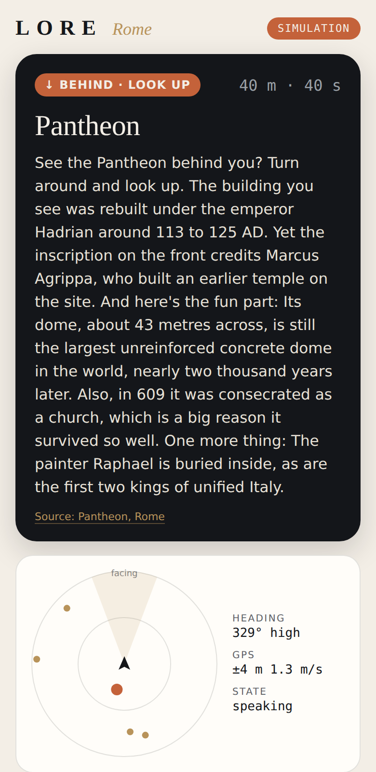
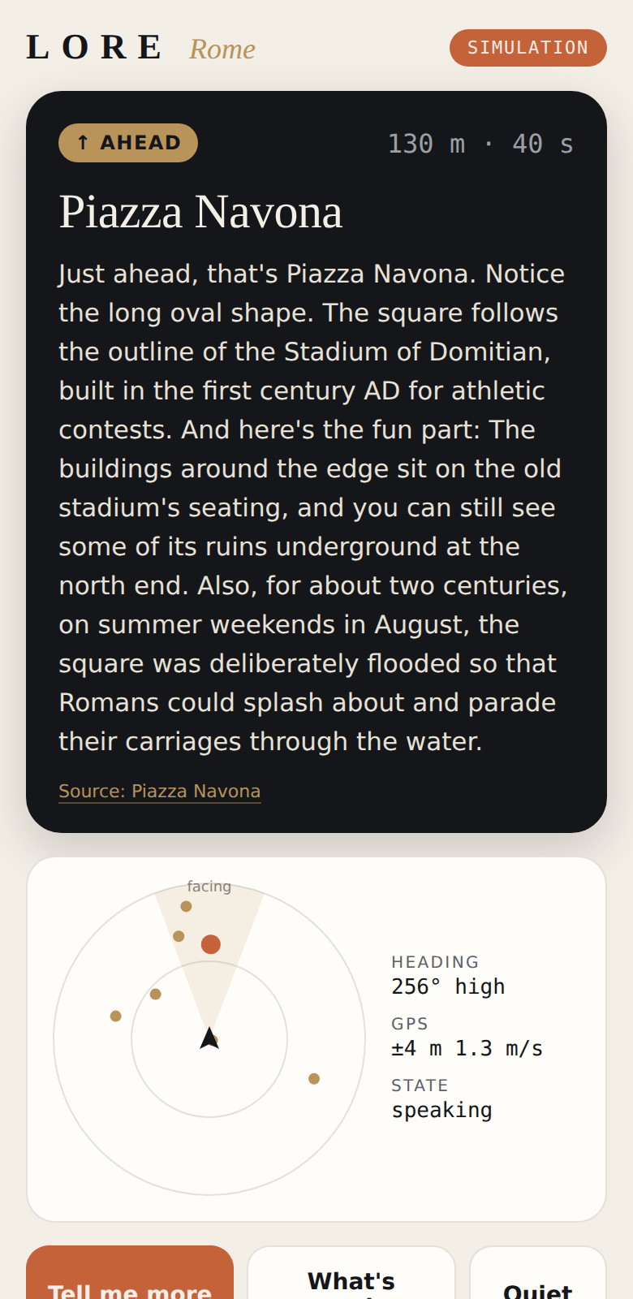
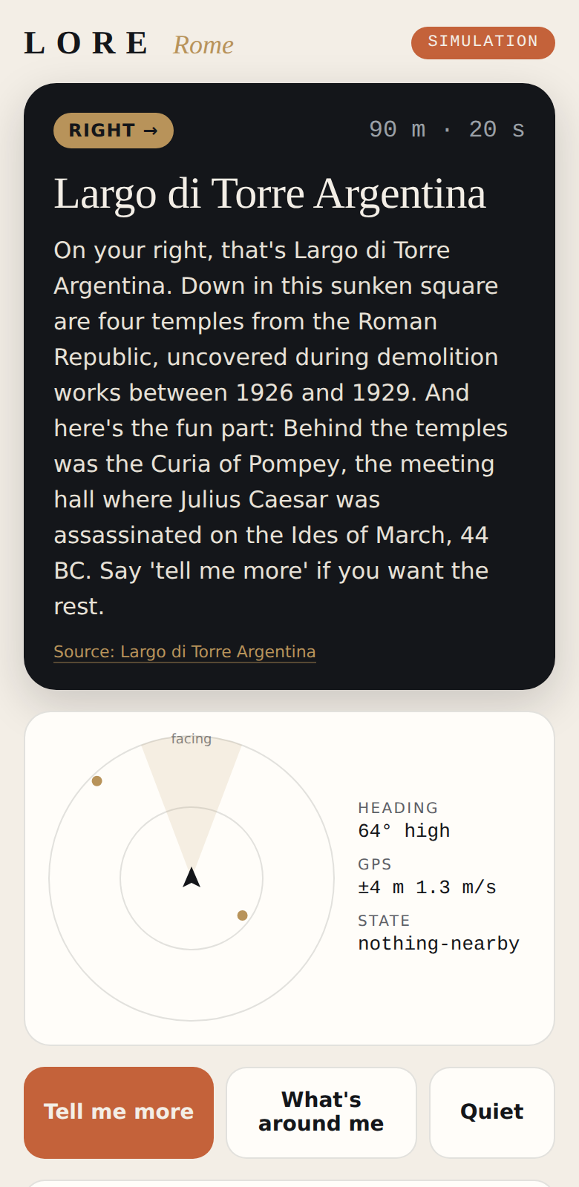
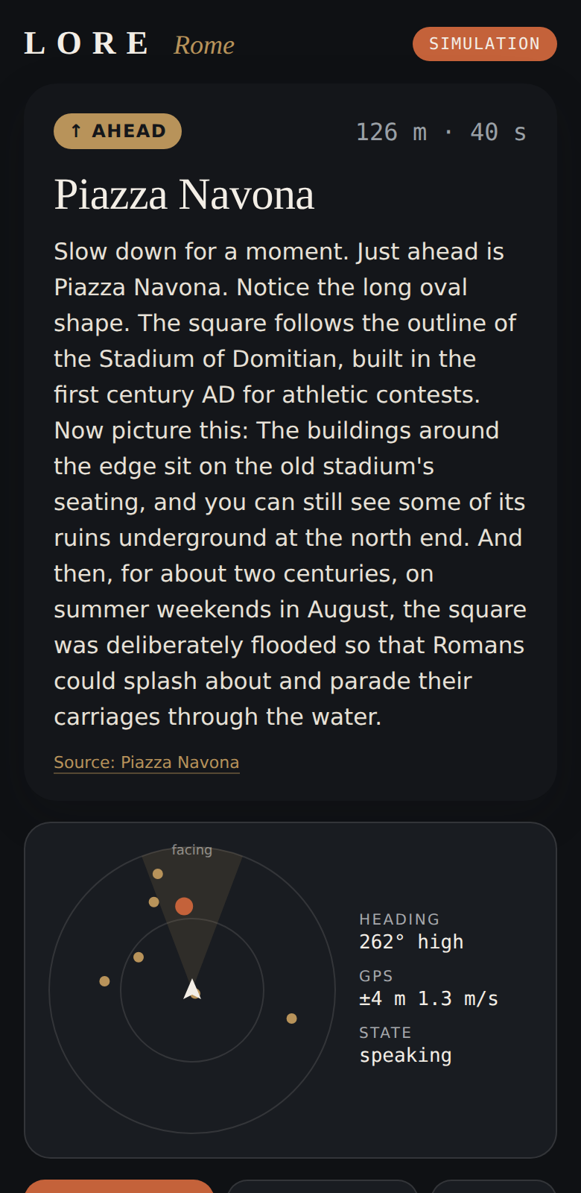
DEMO: THE WORKING ROME PROTOTYPE
The real story engine, walking Pantheon to Trevi (1.93 km).
Walk-simulation metrics (SIMULATED)
Metric
Value
Narrations
17 (8.8 / km)
Facts spoken / repeats
39 / 0.0%
Quiet-moment compliance
100% (0 violations)
Direction accuracy vs truth
100%
Fused heading error
4.3° mean · 12.7° p95
Share of time speaking
26%
Rome City Pack
86 POIs · 215 fact cards
Simulation mode, phone viewport: Pantheon · Piazza Navona · 'What's around me' at Largo Argentina · dark 'storyteller' persona.
Tests passing
61 vitest + 16 pytest
What is not proven yet: no real-user walks, no EVT hardware. Seed facts are curated with Wikipedia citations but still need an online verify pass and editorial review before customers hear them. Gate G0 (Nov 2026-Jan 2027): 20 Rome walk tests + 200 remote sim users.
Sources: software/README.md, software/apps/prototype/screenshots/, software/simulations/output/rome-walk-transcript.md.
LORE Labs · Pre-seed 2026 · Confidential
07

Slide 8
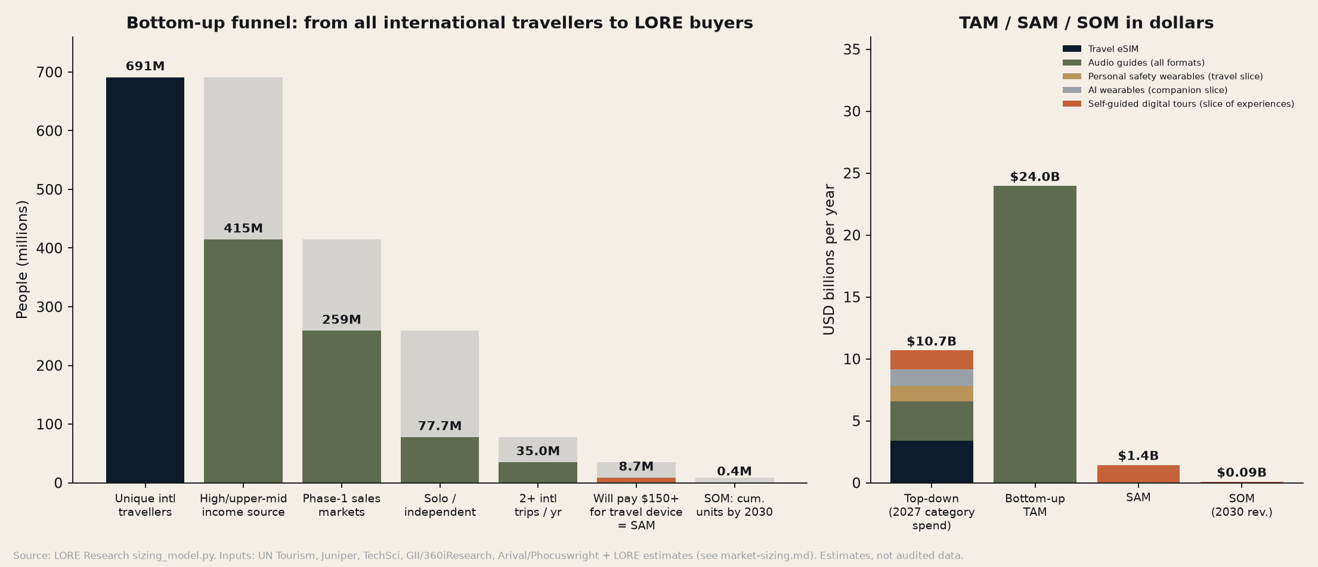
MARKET
A $10.7B/yr job market today; we size the beachhead bottom-up.
$10.7B
TAM (top-down, 2027): eSIM, audio guides, travel safety, AI-companion, self-guided tours
$24.0B
TAM (bottom-up): 145M frequent international travellers × $165 ARPU
$1.44B
SAM: 8.7M solo/independent travellers, 2+ trips/yr, US/CA/UK/EU/AU-NZ, will pay $150+
$93M
Tailwinds: 1.52B international arrivals in 2025 (+4%); top-100 city arrivals +8%; travel eSIM $1.8B (2025, +85%) → $8.7B (2030); solo-travel spend ~$482B (2024) → ~$1.07T (2030).
SOM 2030 base: 250k units in 2030, 415k cumulative (4.7% of SAM). Bear $46M / Bull $148M
Source: research/market-sizing.md (all figures cited with URLs there), research/charts/market-size-waterfall.png. SOM is a Research estimate [EST].
LORE Labs · Pre-seed 2026 · Confidential
08

Slide 9
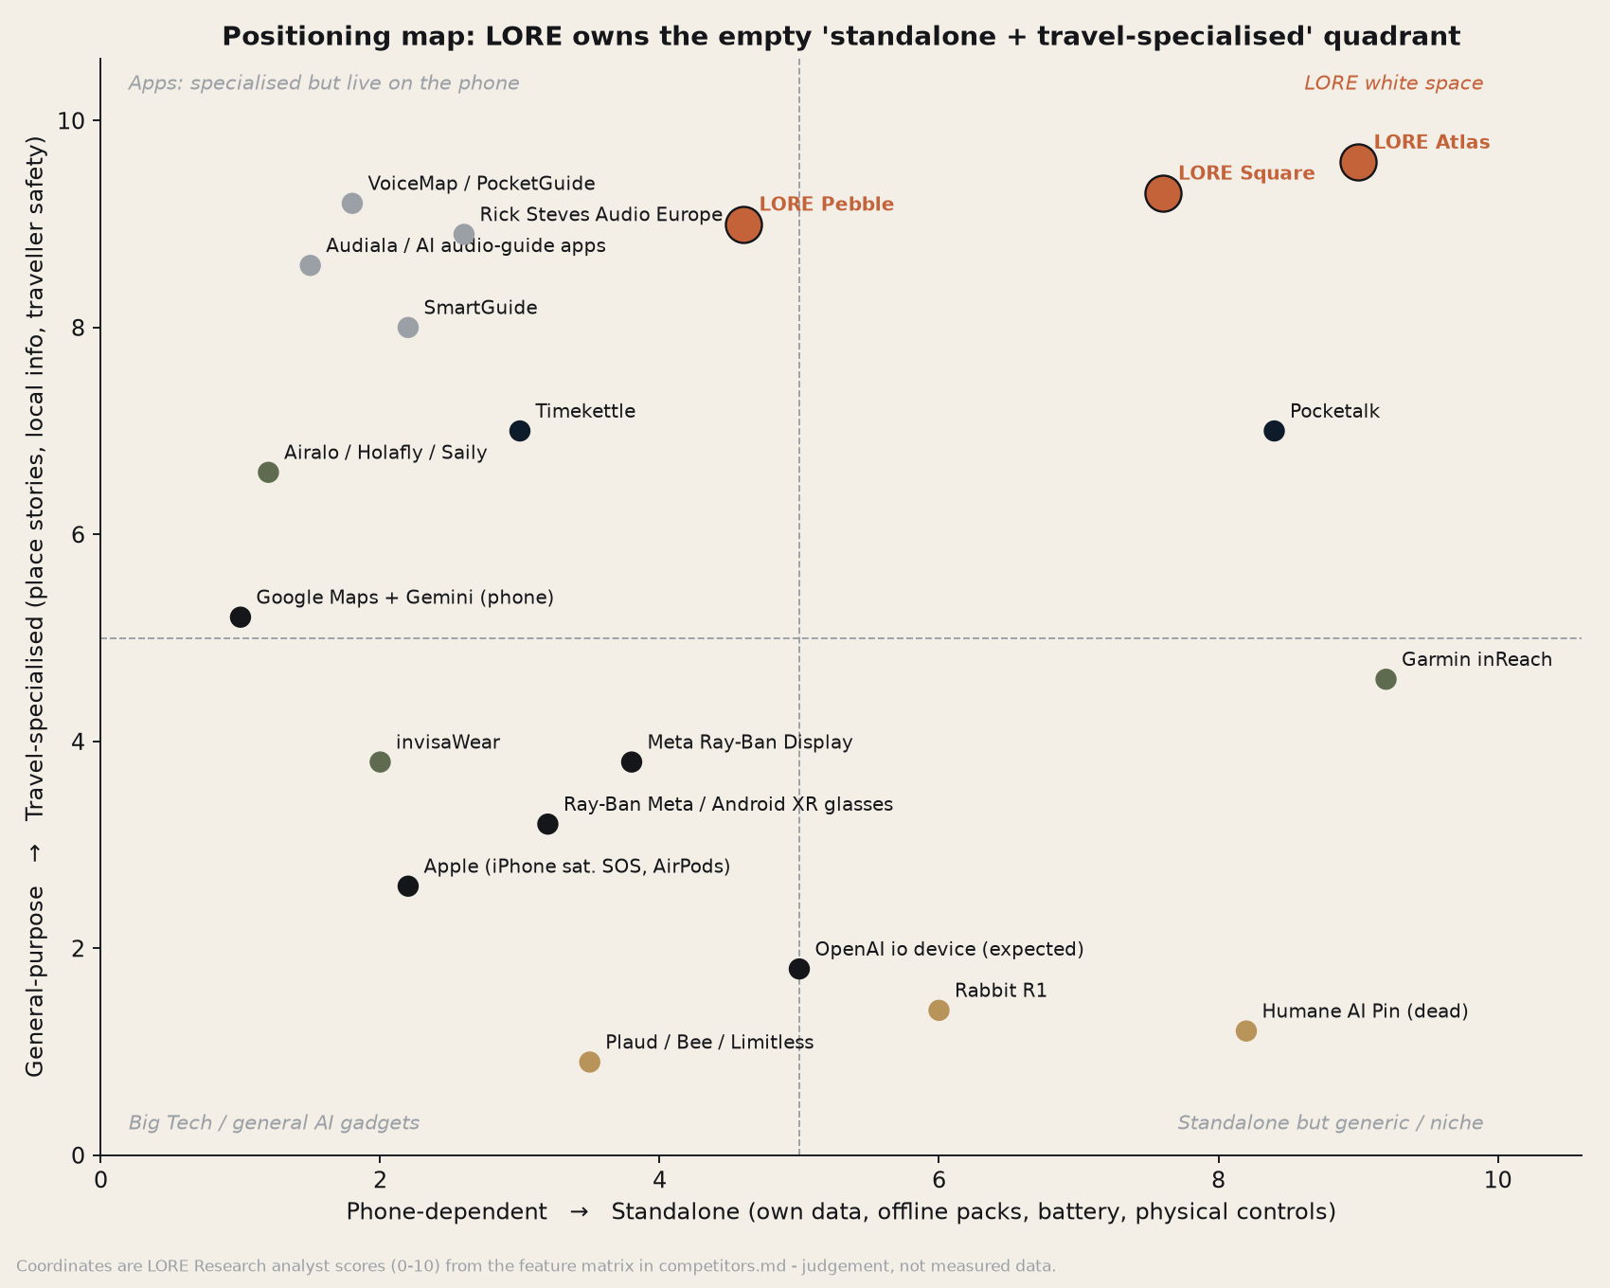
COMPETITION AND POSITIONING
Nothing else is standalone, travel-first and verified.
Threat
What it is
Our answer
Google/Samsung Gemini glasses + Maps
Fall 2026; camera + assistant
Travel brain; works with any audio
Meta Ray-Ban / Display
~7M glasses sold 2025
No camera needed; $149 entry
Phone + AI-guide app + eSIM
Audiala $4.99/mo + Airalo
Battery, theft, eyes-up, SOS
OpenAI io device
H2 2026-27 (narrative)
Narrow job; verified facts
Lessons we design against: Humane (~10k units; assets sold to HP for $116M) and Rabbit (~130k sold, ~5% daily use) shipped general assistants with no daily job. Plaud (>1M devices, ~$250M run-rate) shows one narrow job + clip-on + subscription works.
Moat we are building: sourced City Packs and the fact-checking process; Map Vision IP; brand.
Source: research/competitors.md (30-product matrix, URLs inside), research/charts/positioning-map.png.
LORE Labs · Pre-seed 2026 · Confidential
09

Slide 10
BUSINESS MODEL AND PRICING
Hardware gets us in; LORE Pass and bookings compound.
Pebble
Square
Atlas
Hardware
US price
$149
$299
$599
DTC first; retail after returns <5%, led by Pebble + Atlas (D15)
Kickstarter super early bird
$99
$199
$399
LORE Pass
$9.99/mo · $79/yr · Trip Pass $29 / $49; 3 months free with every device
EU / UK
€159 / £149
€329 / £299
€649 / £599
Price anchor
Plaud NotePin S $179
Pocketalk Plus $299.95
inReach Mini 3+ $499 / Watch Ultra $799
LORE Kit
Clip, lanyard, dock, case, LORE Buds $129, city bundles
Why these prices: Research's comparable-price ladder (research/pricing-research.md). Atlas raised $549 → $599 (D8), to be A/B tested; revert if the survey shows >20% loss of purchase intent.
Retention by design (the Rabbit lesson): annual Explorer at $79, a free tier that stays useful, home-city 'Weekend Walks', and retention KPIs reported to investors.
Bookings
Affiliate fees: hotels, tours, restaurants
B2B fleet
Rental for hostels and tour operators (pilots Q4 2027+)
Sources: COMPANY.md, research/pricing-research.md, company/decisions-log.md D6, D8, D15.
LORE Labs · Pre-seed 2026 · Confidential
10

Slide 11
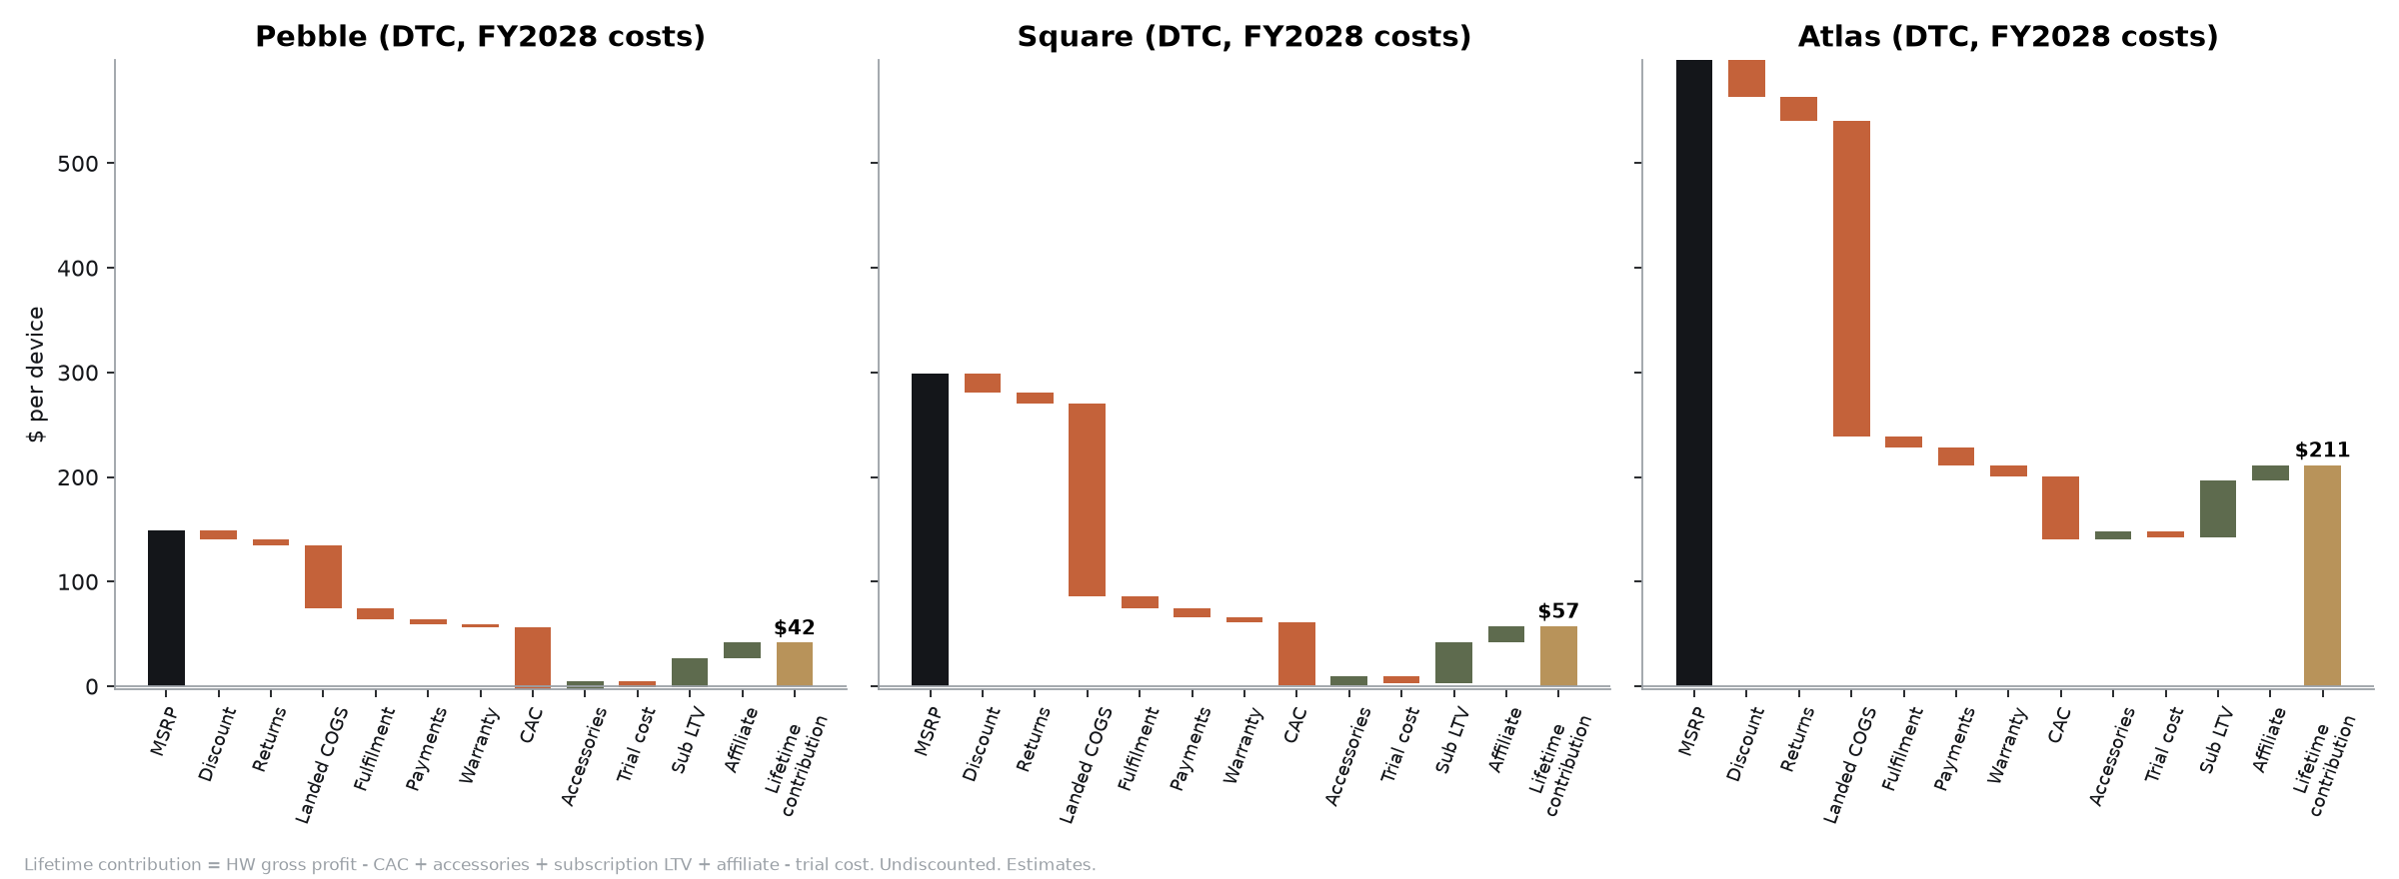
UNIT ECONOMICS
We found the margin problem early and changed the product.
Landed COGS @10k units
Before (full spec)
Decision
After
Pebble $149
$157 incl. NRE → −5% GM
D10: 'Lite' (AI via phone)
~$90 → 39% GM
Square $299
$299 incl. NRE → 0% GM
D11: LTE Cat-1bis, cost-down
Target ≤$240 by unit 10k; $329 fallback
Atlas $599
$413 incl. NRE → 25% at $549
D8 price $599; D12 13.5 mm
Margin engine
Any SKU, China FATP
Square $343 landed (tariffs)
D13: Vietnam / Malaysia
0% duty assumed
DTC hardware GM (H2-2028 cost): Pebble 42% · Square 23% · Atlas 37%. At launch, before the D11 cost-down, Square is only 7%.
Lifetime contribution per device: $42 / $57 / $211 incl. LORE Pass, accessories and affiliate, after $60 paid CAC.
LORE Pass GM ≈69% (2028) → ≈75% (2031); cloud + data ≈ $2.02 per paid user-month.
Biggest swing: if the Square cost-down fails, FY31 EBITDA is −$8.3M not +$0.8M. DVT gate Sep-2027: >$205 ex-NRE → price $329. Square is DTC-only until landed ≤$200 (D15).
Sources: hardware/README.md + hardware/bom/BOM.md (estimates, 2026 DRAM prices), finance/unit-economics.md, company/decisions-log.md D10-D13.
LORE Labs · Pre-seed 2026 · Confidential
11

Slide 12
GO-TO-MARKET AND KICKSTARTER
Stories sell; safety justifies; Kickstarter proves demand.
Nov 26-Jan 27
Feb-Apr 27
Pre-launch
25 May-24 Jun 27
Q4 27
2028
Waitlist
Rome beta
List + VIPs
Kickstarter
DTC
Retail / airport
5k sign-ups
50 EVT units
20k emails, 2k $1 VIPs
$250k goal
First 5k units
after returns <5%
$1.04M
≈$50
$554k
$70
Kickstarter base case: 4,600 backers × $225 avg pledge (plan, not a result)
Cost per backer on $230k marketing (Gate G2 needs <$60)
Conservative case: misses $1M; escalation playbook ready
DTC blended CAC ceiling after launch
Channels: TikTok/IG organic ('Secrets of Rome') → paid lead gen ($2.75 CPL target) → creators (≤$45 CPB) → PR (15+ tier-1/2 articles) → email (8% list conversion).
Messaging: Look up · True stories · Go anywhere, safely. Lead with experience, justify with safety.
Honesty: no partners, customers or pre-orders exist yet; all named companies are targets.
Sources: gtm/README.md, gtm/gtm-strategy.md, gtm/kickstarter/, finance/kickstarter-economics.md.
LORE Labs · Pre-seed 2026 · Confidential
12

Slide 13
ROADMAP, MILESTONES AND GATES
Each stage removes the biggest risk before we spend on the next.
Stage 0 · Nov 26-Jan 27
Stage 1 · Feb-May 27
Stage 2 · Jun-Aug 27
Stage 3 · Sep 27-Apr 28
Prove the magic
Prove the device
Prove demand
Ship
Phone PWA + Rome pack (300+ places hand-checked); 20 Rome walks; n≥500 survey
50 EVT units; ODM selected (VN/MY); SoC locked; pre-seed closes; first hires
Kickstarter (25 May-24 Jun); 20k list; DVT; certification starts
$6M seed; PVT → first 5k units; FCC/CE/UKCA/carriers; 1 → 8 cities; B2B pilots
G0: ≥40% 'very disappointed'; ≥60% finish a 30-min walk; ≥25% would pay $149+
G1: battery ≥1.5 days measured; left/right ≥90% on walks; beta use ≥3 days/week
G2: ≥$1M pledged; ≥3,000 backers; CPB <$60
G3: returns <5%; attach >55%; churn <6%/mo; NPS >50
What we will not do: no glasses; no camera before Atlas; ≤1 new city/month until City Pack quality is measured; no retail before DTC returns <5%. 2028: retail + 20 cities.
Source: company/operating-plan.md, COMPANY.md timeline, gtm/README.md.
LORE Labs · Pre-seed 2026 · Confidential
13

Slide 14
TEAM AND HIRING
Founder-led today; the pre-seed buys the founding team.
#
First hires (pre-seed)
When
Nimit Jain, Founder & CEO
1
Founding Embedded / Firmware Lead
Nov 2026
Product, fundraising and story quality. Today every department (research, brand, design, hardware, software, finance, GTM, legal/ops, IR) is run as an AI-agent team with founder sign-off on every output; this deck is built from their files.
2
Founding ML / Story-Engine Engineer
Nov 2026
3
Mobile + Backend Engineer
Dec 2026
4
Hardware / Electrical Lead (contract first)
Jan 2027
5
Sensor-Fusion / Map Vision Engineer
Jan 2027
Contract-first, to de-risk
6
Content Editor-in-Chief (City Packs)
Jan 2027
Industrial-design studio, EE/RF consultancy, ODM programme manager, fractional CFO and GC, patent/TM attorneys. Pre-seed team 6-8 people in 2027; ~20 at seed (2028).
7
Growth & Community Lead (Kickstarter)
Feb 2027
8
Supply Chain & Quality Manager
Mar 2027
We are not claiming hires, advisors or investors that do not exist. Roles, salary bands (US/EU/IN) and equity bands: legal-ops/hr-hiring.md. 12% option pool planned.
Sources: company/org-chart.md, legal-ops/hr-hiring.md, legal-ops/README.md.
LORE Labs · Pre-seed 2026 · Confidential
14

Slide 15
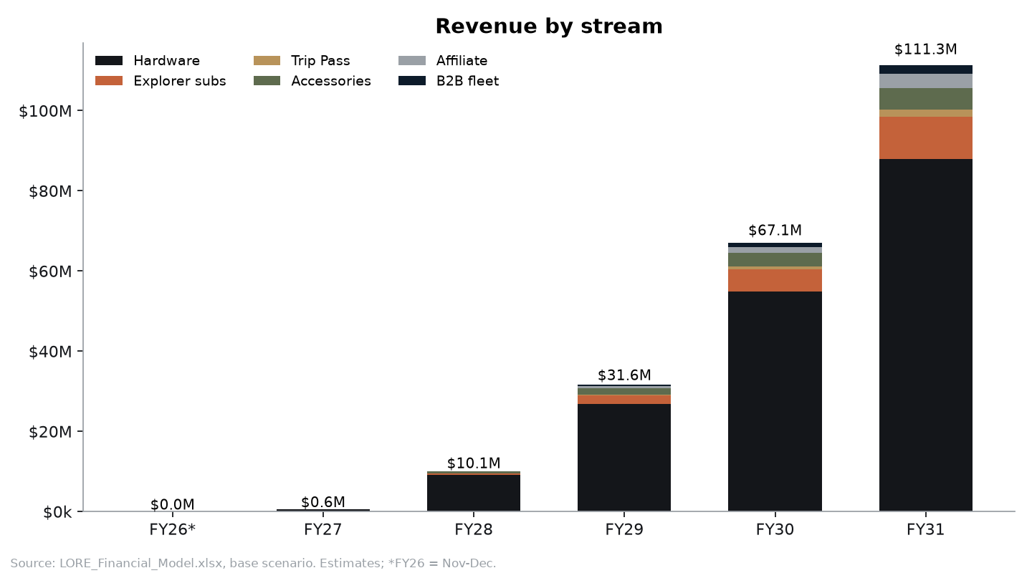
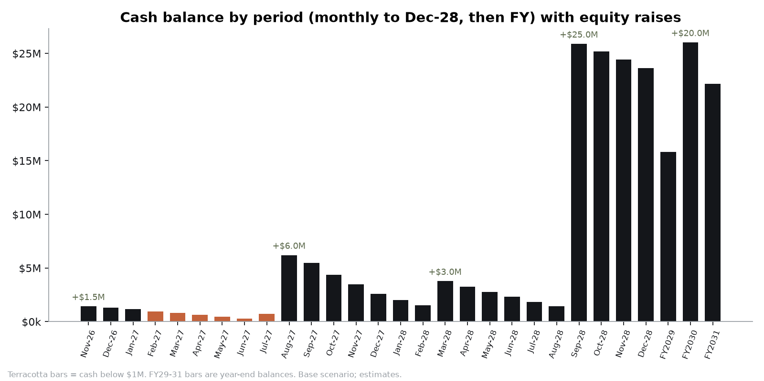
FINANCIALS
Base case: $111M revenue and EBITDA-positive in FY2031.
Base case
FY27
FY28
FY29
FY30
FY31
Units
3.4k
40k
120k
250k
400k
Revenue
$596k
$10.1M
$31.6M
$67.1M
$111.3M
Gross margin
11%
27%
33%
38%
41%
EBITDA
-$4.2M
-$4.3M
-$7.2M
-$5.4M
$836k
Subscription ARR
$0
$798k
$3.3M
$7.6M
$13.6M
Scenarios FY31 revenue: Bear $56.2M · Base $111.3M · Bull $166.1M.
Funding need: $55.5M total equity to break-even (D16): pre-seed → $6M seed → $3M seed-2 → $25M A → $20M B. Bear case needs ≈$72M. At $1.5M the pre-seed bottomed at $278k in Jun-27, so the round is now $1.75M (D14).
Research cross-check: SOM 2030 base $93M (bear $46M / bull $148M).
Source: finance/LORE_Financial_Model.xlsx via finance/model_summary.json; finance/charts. All projections are estimates.
LORE Labs · Pre-seed 2026 · Confidential
15

Slide 16
THE ASK
$1.75M pre-seed SAFE
$12M post-money cap
Use of funds
Founding engineering team
$500k · 29%
R&D salaries + burden ($464k), dev tools & ML compute ($36k)
Kickstarter, brand & community
$322k · 18%
Gets us to: Gate G0 (product love), 50 EVT units and Gate G1, a $1M+ Kickstarter (Gate G2), and the $6M seed.
Investor owns: ≈14.6% at the $12M post-money cap. $1.5M + $250k top-up (D14).
Runway: Nov 2026 to the Kickstarter payout (Jun/Jul 2027) and the $6M seed (Aug 2027). The $250k top-up (D14) lifts the Jun-27 cash low from ~$278k to ~$0.5M.
Campaign marketing $230k, growth lead, brand/PR
Hardware: ID, ODM NRE, 50 EVT
$210k · 12%
ID/ME/CMF agency $95k, ODM NRE $80k, EVT build $35k
G&A, legal, IP, insurance
$168k · 10%
Founder salary, formation, trademarks, provisionals, SaaS
City Pack content (Rome, London)
$40k · 2%
Editorial fact-checking and storytellers
Cash buffer through Kickstarter
$510k · 29%
Low point ~$528k in Jun-27 with the D14 top-up (was $278k)
Let's walk Rome together.
Nimit Jain
Founder & CEO, LORE Labs, Inc.
nimitjain.248@gmail.com · India
Live prototype demo on request. Data room index: investor/data-room-index.md
LORE Labs · Pre-seed 2026 · Confidential
16

