Slide 1
Presentation
Dot Net Framework
Prepared By-
Tejas Prakash Nimbalkar.

Slide 2
Introduction of .Net
It is a product of Microsoft to develop platform independent and object oriented software.there are three type of application are develop are as follow
Web Application, Desktop Application and Mobile Application.
There are 30 plus language are inbult in .Net Framework to develop
an application.
Eg-C#.net,f#.net,vb.net, cobol.net, pascal.net etc.
Most Probably C# is main language use to develop an applicaton.

Slide 3
Dot Net Framework
It is the software which masks the functionality of OS and executes .Net language’s compiled CIL codes under its control by providing the feature like
Portability
Security.
Automatic memory management

Slide 4
CLR-Common Language Runtime
It can convert IL code(Intermediate Language) into Machine Code.
In this CLR all applications are run under thre supervison of CLR.
A process known as just-in-time compilation converts compiled code into machine instructions which the computer's CPU then executes.
It can provide some benefit are as follows
Portability
Security
Automatic memory management

Slide 5
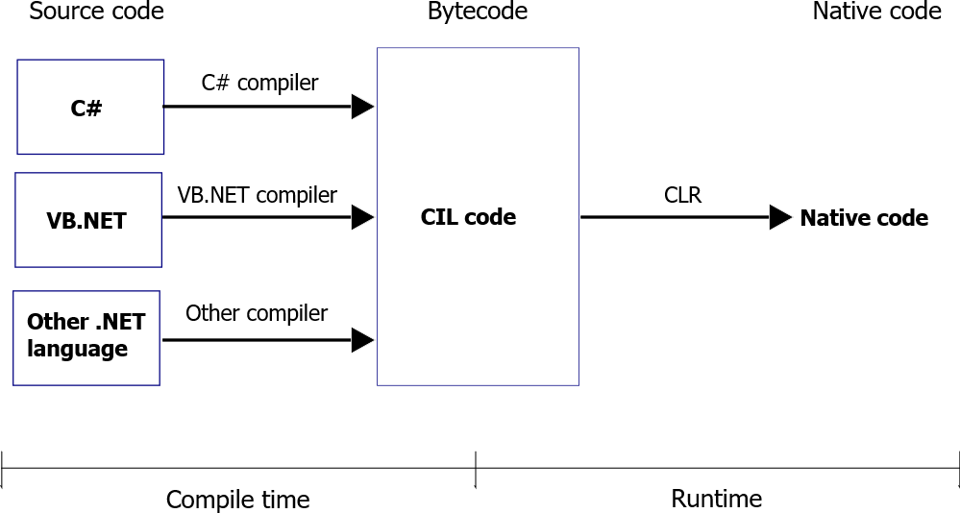

Slide 6
BCL(Base Class Library)
A library is a set of re-usable functionality.
Each and every programming language has built in library like header files in C, C++ and packages in java.
Same as the above .net languages are also provided with built in library known as BCL.
Class library is the collection of reusable types that are closely integrated with CLR.

Slide 7
Class Loader
Class loader is responsible for loading required libraries.
That are consume under the application from base class library in the runtime for the execution of the application.
The loading of the class would be handled by the class loader.

Slide 8
Automatic Memory Management
memory management is the process of allocation and de-allocation of memory that is require for execution of program.
services that the Common Language Runtime provides during Managed Execution.
All refrance type are allocated on the managed heap.
Automatic memory management can eliminate common problems, such as forgetting to free an object and causing a memory leak, or attempting to access memory for an object that has already been freed.

Slide 9
JIT(Just In Time) Compiler
JIT (Jus t in time) compiler is responsible for the conversion of CIL code into Machine Code.
If a code executing on a target machine calls a non-native method, the JIT compiler converts the IL of that method into native code.
various types of JIT compilation
1. Pre - JIT.
2.Econo - JIT.
3.Normal - JIT.
Pre – JIT -
Pre-JIT compilation, complete source code is converted into native code in a single cycle.

Slide 10
Econo – JIT –
Econo-JIT compilation, the compiler compiles only those methods that are called at run time.
Normal – JIT –
Normal-JIT compilation, the compiler compiles only those methods that are called at run time.

Slide 11
Thank You

