Slide 1
core parts of a model checker
Front-end
Specification
Search
Storage
symtab
stack
hash
hash
lex/yacc
search
store
lex/yacc
search
store
GUI
search
store
exact
compressed
dfa
tree
hash-compact
bitstate
error reporting
tool-kit:
301 lines
195 lines
133 lines
67 lines
spin:
7,346 lines
15,151 lines
25,218 lines

Slide 2
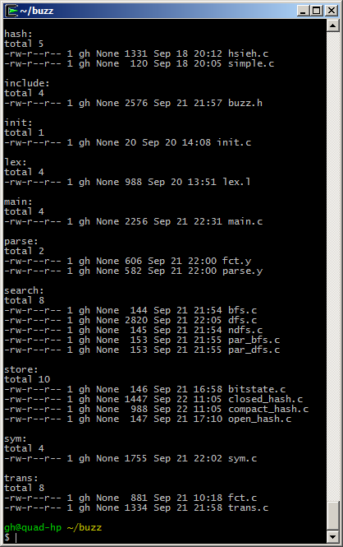
building
blocks
hashing
interface defs
lexical
analysis
parsing
search
storage
step
semantics

Slide 3
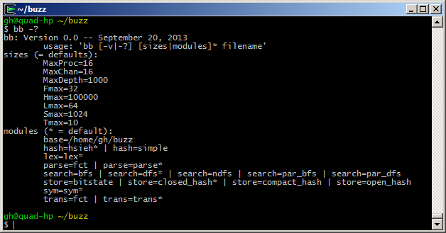
a builder interface (update: “bb” is now just “buzz”)

Slide 4
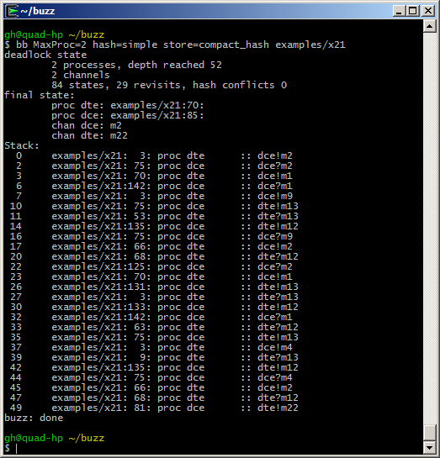
build your own

Slide 5
the default parse.y (no data)
%{
#include "buzz.h"
%}
%start system
%token PROC NAME NUMBER NEXT
%%
system : model { prep_ast(ast); }
;
model : proc { ast = $1; }
| proc model { ast = $1; $1->nxt = $2; }
;
proc : PROC NAME { procname = $2->nm; }
'{' seq '}' { $$->nm = $2->nm; $$->attr = $5; }
;
seq : /* none */ { $$ = 0; }
| stmnt ';' seq { $1->nxt = $3; }
;
stmnt : NAME '!' NAME { $$ = $2; $$->dst = $1; $$->msg = $3; }
| NAME '?' NAME { $$ = $2; $$->dst = $1; $$->msg = $3; }
| NAME ':' stmnt { $$ = $3; add_label($1->nm, $3); }
| NEXT NAME { $$->attr = $2; }
;
%%
two predefined message passing primitives

Slide 6
transition semantics
int
transition(AST *a, int notblocked)
{ int dst = 0, msg = -1, rv = 0;
Assert(a);
switch (a->tok) {
case '!': // dst [!?] msg
Assert(a->attr && a->attr->attr);
dst = a->attr->val;
msg = a->attr->attr->val;
Assert(dst >= 0 && dst < SV && msg > 0);
if (B_state.sv[dst] == 0)
{ B_state.sv[dst] = msg;
rv = 1;
}
break;
case '?’: ...
case ‘@’: ...

Slide 7
alternating bit protocol
examples/c_abp
process sender
{
s0: s2r!m0; r2s?a0;
s2r!m1; r2s?a1;
next s0;
}
process receiver
{
s0: s2r?m0; r2s!a0;
s2r?m1; r2s!a1;
next s0;
}
s0
!m0
?a1
?a0
!m1
s0
?m0
!a1
!a0
?m1

Slide 8
dining philosophers
process p0
{
s0: f0?tok; f1?tok; next s1;
s0: f1?tok; f0?tok; next s1;
s1: f0!tok; f1!tok; next s0;
s1: f1!tok; f0!tok; next s0;
}
process p1
{
s0: f0?tok; f1?tok; next s1;
s0: f1?tok; f0?tok; next s1;
s1: f0!tok; f1!tok; next s0;
s1: f1!tok; f0!tok; next s0;
}
process init
{
f0!tok;
f1!tok;
}
(non-determinism)
s0
f0?
f1?
f0!
f1!
f1!
f0!
f1?
s1
f0?
examples/c_philo

Slide 9
2nd parser
parse.y (45 lines)
%{
#include "buzz.h"
%}
%start system
%token PROC NAME NUMBER NEXT
%%
system : model { prep_ast(ast); }
;
model : proc { ast = $1; }
| proc model { ast = $1; $1->nxt = $2; }
;
proc : PROC NAME { procname = $2->nm; }
'{' seq '}' { $$->nm = $2->nm; $$->attr = $5; }
;
seq : /* none */ { $$ = 0; }
| stmnt ';' seq { $1->nxt = $3; }
;
stmnt : NAME '(' ')’ { $$->val = find_fct($1)+1; }
| ELSE | TIMEOUT | TRUE | FALSE
| NAME ‘@’ NAME { $$ = $2; $$->attr = $1; $1->attr = $2; }
| NAME ':' stmnt { $$ = $3; add_label($1->nm, $3); }
| NEXT NAME { $$->attr = $2; }
;
%%
replaces
predefined primitives
with user-defined
C functions:

Slide 10
transition semantics
int
transition(AST *a, int notblocked)
{ int rv = 0;
assert(a);
switch (a->tok) {
case ELSE:
rv = (notblocked == 0);
break;
case '@':
assert(a->attr && a->attr->attr);
rv = proc_at_label(a);
break;
case TIMEOUT:
case TRUE:
rv = 1;
break;
case FALSE:
rv = 0;
break;
default:
if (a->val > 0) // function call
{ rv = functions[a->val-1].fct();
}
break;
}
if (B_verbose)
{ fprintf(stderr, "\t%s:%3d: proc %s exec %s (...",
a->fnm, a->ln, B_procname, a->nm, a->tok, rv);
}
return rv;
}

Slide 11
alternating bit with C functions
// constants s2r, r2s, Msg, Ack
process sender
{
s0: snd_m0(); rcv_a0();
snd_m1(); rcv_a1();
next s0;
}
process receiver
{
s0: rcv_m0(); snd_a0();
rcv_m1(); snd_a1();
next s0;
}
%%

Slide 12
%%
int
snd(int dst, int tp, int seqno)
{
if (B_state.sv[dst])
{ return 0;
}
B_state.sv[dst] = 2*tp + seqno;
return 1;
}
int
rcv(int src, int tp, int seqno)
{
if (B_state.sv[src] != 2*tp + seqno)
{ return 0;
}
B_state.sv[src] = 0;
return 1;
}
int snd_m0(void) { return snd(s2r,Msg,0); }
int rcv_a0(void) { return rcv(r2s,Ack,0); }
...
functions must return 0
if they block, without
side-effects.
they must execute and
return non-zero otherwise.
they can access all the
data structures exposed in
the generic interface (e.g.,
the state vector)
but, functions cannot have
arguments (could be done
by extending the parser)
try: buzz –d examples/p_fct

