Slide 1
core parts of a model checker
Front-end
Specification
Search
Storage
symtab
stack
hash
hash
lex/yacc
search
store
lex/yacc
search
store
GUI
search
store
exact
compressed
dfa
tree
hash-compact
bitstate
error reporting
tool-kit:
301 lines
195 lines
133 lines
67 lines
spin:
7,346 lines
15,151 lines
25,218 lines

Slide 2
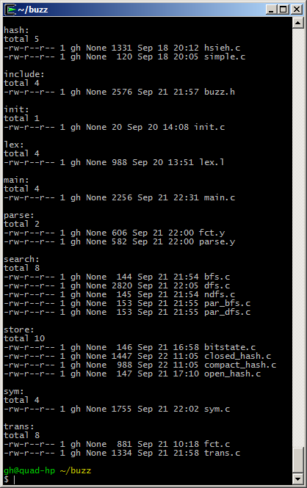
building
blocks
hashing
interface defs
lexical
analysis
parsing
search
storage
step
semantics

Slide 3
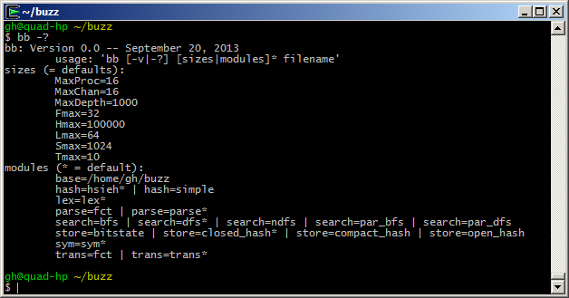
a builder interface (update: “bb” is now just “buzz”)

Slide 4
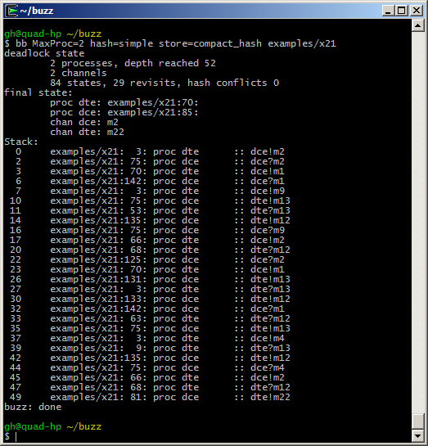
build your own

Slide 5
the default parse.y (no data)
%{
#include "buzz.h"
%}
%start system
%token PROC NAME NUMBER NEXT
%%
system : model { prep_ast(ast); }
;
model : proc { ast = $1; }
| proc model { ast = $1; $1->nxt = $2; }
;
proc : PROC NAME { procname = $2->nm; }
'{' seq '}' { $$->nm = $2->nm; $$->attr = $5; }
;
seq : /* none */ { $$ = 0; }
| stmnt ';' seq { $1->nxt = $3; }
;
stmnt : NAME '!' NAME { $$ = $2; $$->dst = $1; $$->msg = $3; }
| NAME '?' NAME { $$ = $2; $$->dst = $1; $$->msg = $3; }
| NAME ':' stmnt { $$ = $3; add_label($1->nm, $3); }
| NEXT NAME { $$->attr = $2; }
;
%%
two predefined message passing primitives

Slide 6
the alternating bit protocol
process sender
{
s0: s2r!m0; r2s?a0;
s2r!m1; r2s?a1;
next s0;
}
process receiver
{
s0: s2r?m0; r2s!a0;
s2r?m1; r2s!a1;
next s0;
}

Slide 7
control-flow: non-determinism selection& iteration dining philosophers
process p0
{
s0: fork0?tok; fork1?tok; next s1;
s0: fork1?tok; fork0?tok; next s1;
s1: fork0!tok; fork1!tok; next s0;
s1: fork1!tok; fork0!tok; next s0;
}
process p1
{
s0: fork0?tok; fork1?tok; next s1;
s0: fork1?tok; fork0?tok; next s1;
s1: fork0!tok; fork1!tok; next s0;
s1: fork1!tok; fork0!tok; next s0;
}
process init
{
fork0!tok;
fork1!tok;
}

Slide 8
adding functions (and data)
by replacing the parser
%{
#include "buzz.h"
%}
%start system
%token PROC NAME NUMBER NEXT
%%
system : model { prep_ast(ast); }
;
model : proc { ast = $1; }
| proc model { ast = $1; $1->nxt = $2; }
;
proc : PROC NAME { procname = $2->nm; }
'{' seq '}' { $$->nm = $2->nm; $$->attr = $5; }
;
seq : /* none */ { $$ = 0; }
| stmnt ';' seq { $1->nxt = $3; }
;
stmnt : NAME '(' args ')' { $$->attr = $3; }
| NAME ':' stmnt { $$ = $3; add_label($1->nm, $3); }
| NEXT NAME { $$->attr = $2; }
;
args : /* none */ { $$ = 0; }
| NUMBER { $$ = $1; }
| NUMBER ',' args { $$->attr = $3; }
;
%%
replace
predefined primitives
with user-defined
functions:

Slide 9
alternating bit with C functions
constant s2r, r2s, Msg, Ack
process sender
{
s0: snd(s2r, Msg, 0); rcv(r2s, Ack, 0);
snd(s2r, Msg, 1); rcv(r2s, Ack, 1);
next s0;
}
process receiver
{
s0: rcv(s2r, Msg, 0); snd(r2s, Ack, 0);
rcv(s2r, Msg, 1); snd(r2s, Ack, 1);
next s0;
}
%%

Slide 10
%%
int
snd(int dst, int tp, int seqno, ...)
{
if (state.c[dst]) { return 0; }
state.c[dst] = 2*tp + seqno;
return 1;
}
int
rcv(int src, int tp, int seqno, ...)
{
if (state.c[src] != 2*tp + seqno)
{ return 0;
}
state.c[src] = 0;
return 1;
}
functions must return 0
if they block, without
side-effects.
they must execute and
return non-zero otherwise.
they can access all the
data structures exposed in
the generic interface (e.g.,
the state vector)
void
init(void)
{
functions[0] = (Fct) { "snd", snd };
functions[1] = (Fct) { "rcv", rcv };
}

