Slide 1

ANT© Trucks data Analysis
Group 1
Anin, Jean Philippe
Dossou, Jean Arno Kodjo
Patel, Bindi Ghanshyambhai
Shaik, Umar Farooq

Slide 2
Business Questions
Identify the ideal truck model.
ANT wants to expand its operations outside California. For this, the company wants us to identify the 1 best truck model among its fleet. Based on historical MPG values and Risk Factor we would choose 1 model. With this information, ANT can partner with the truck company to buy all its trucks from them and get better deals on future purchases, and ease maintenance operations.
2) Identify top 5 risky drivers.
ANT wants information on the top 5 risky drivers so that it can analyze the causal factors and hire better employees to stay complaint with traffic rules.

Slide 3







Data Processing
ODBC
connector
RODBC
library
R

Slide 4
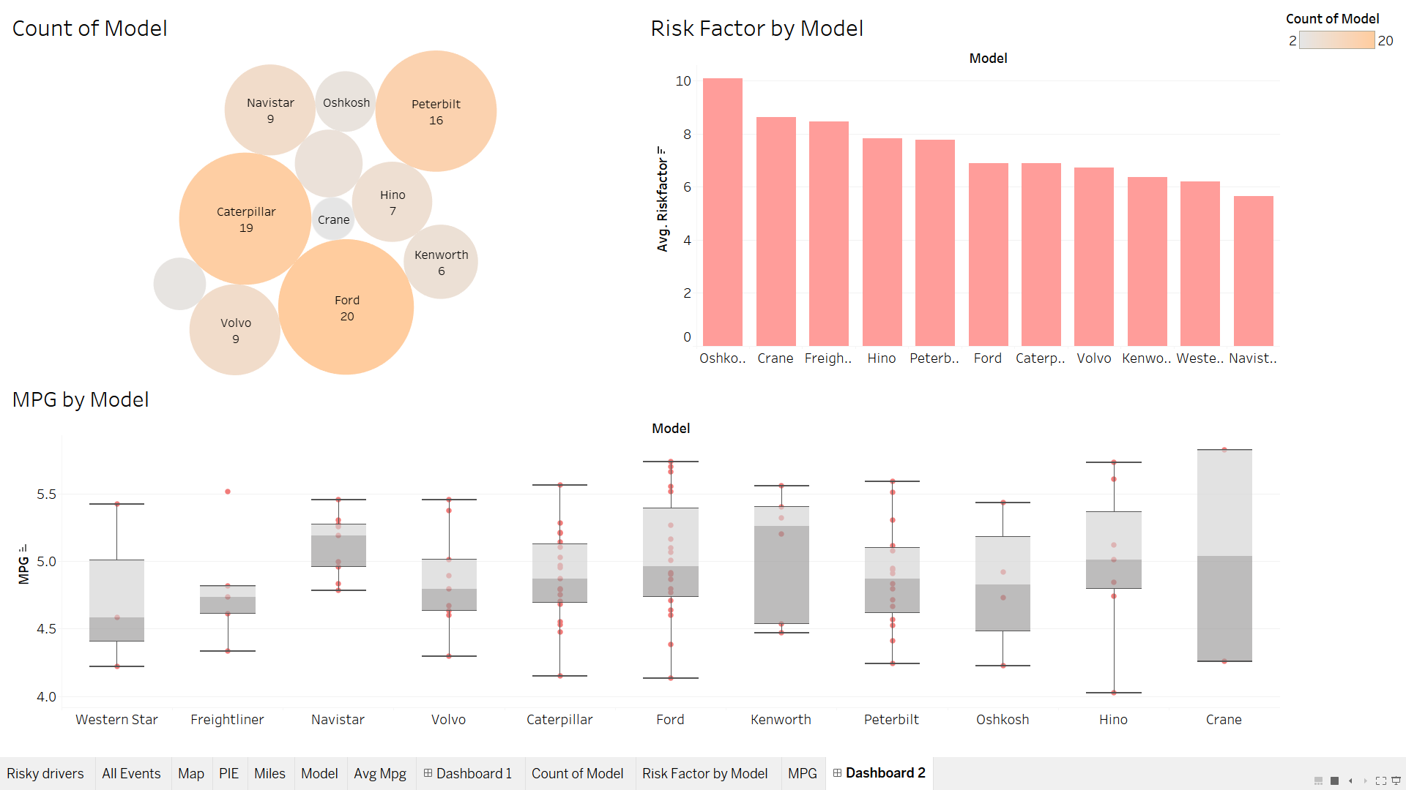
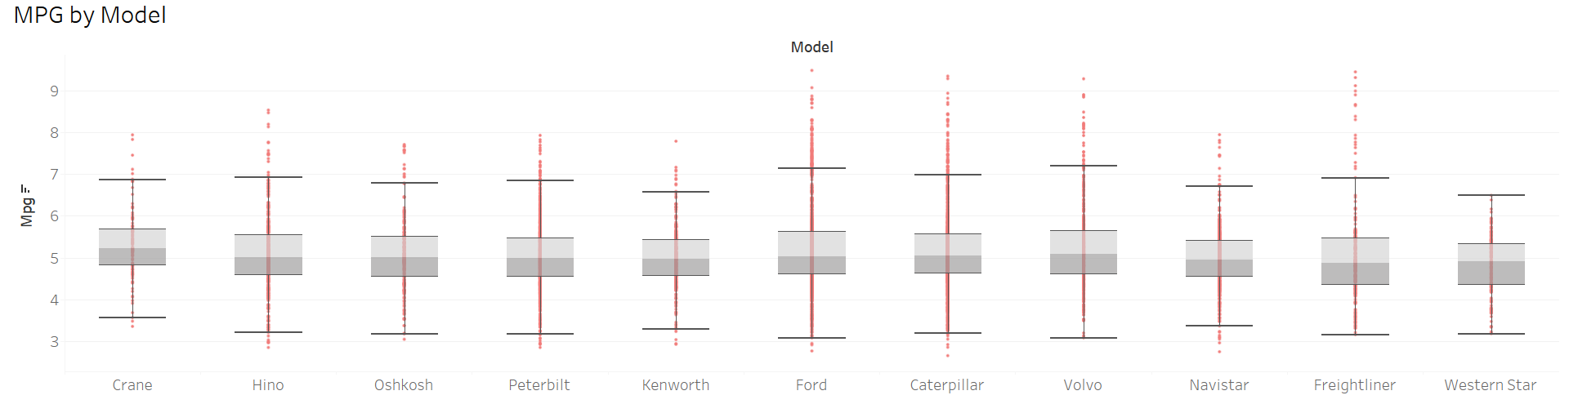
Dashboard 1 – Best model

Slide 5
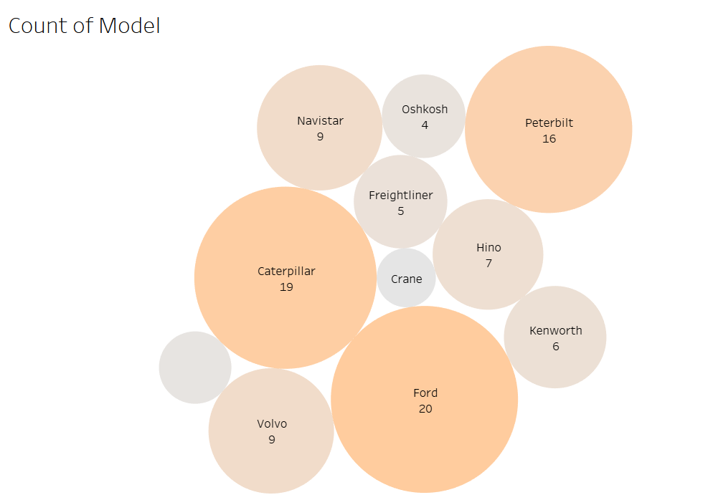
#1. Count by Model
The color and size of each bubble represents the count of Model:
By observation, Ford Caterpillar and Peterbilt add up to most count of our trucks
So it’s a good decision to pick from the top 3 models we have
We can decide on one of these 3 models by looking at their MPG and Risk Factor values

Slide 6
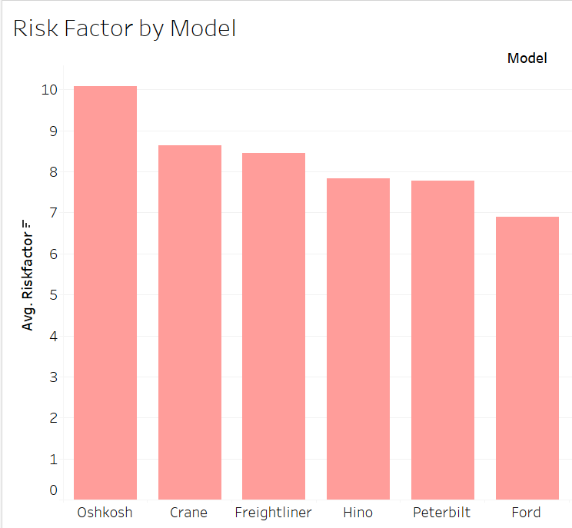
#2. Average Risk factor
While Risk Factor is more dependent on the driver more than the model.
This visualization is just to look at the numbers
Disclaimer:
The Management is advised to strictly not make any Causal relations based on this chart as it has not been tested for causality

Slide 7
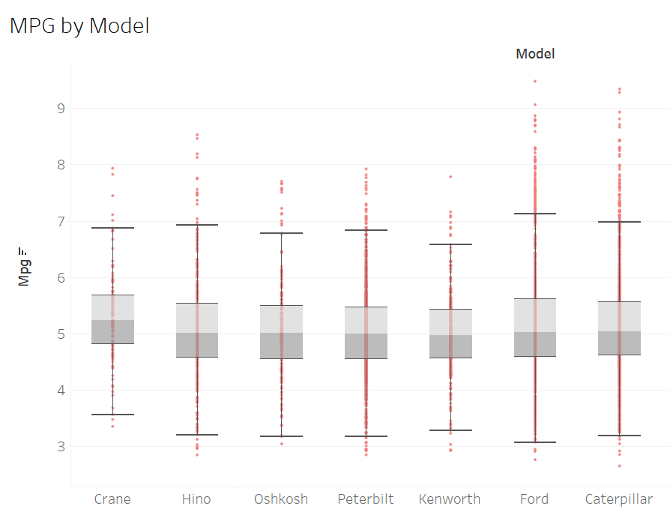
#3. MPG by Model
In this chart we see boxplots for MPG data of each model.
Assuming that all drivers maintain more or less similar range of speed, MPG is more dependent on Model than driver.
Among Ford, Caterpillar and Peterbilt, Ford has the highest median MPG.
Before jumping to any conclusions based on this visualization, we need to verify if the difference between the ratings is statistically significant or not using a statistic test.

Slide 8
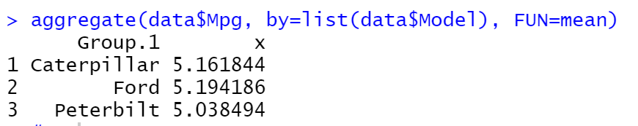
MPG Analysis
Model | Count
Ford | 20
Caterpillar | 19
Peterbilt | 16
The table shows the highest 3 number of trucks models currently in the company.
On initial analysis using MPG as a factor, Ford seems to have the highest mileage. However, we will need to verify this using statistical models.

Slide 9
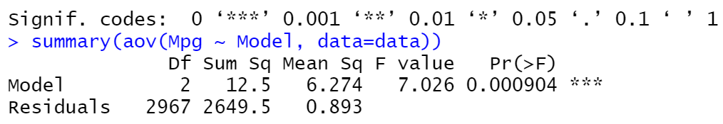
MPG Analysis – ANOVA test
We acquire all MPG data points of each month for each truck of these 3 models ( 2971 data points )
We are conducting ANOVA test to determine if the three models identified are significantly different or the difference is just by chance.
Based on the p-value, we reject null hypothesis that all the MPG means are equal, thus we conclude that at least two models have significantly different MPG ratings.

Slide 10
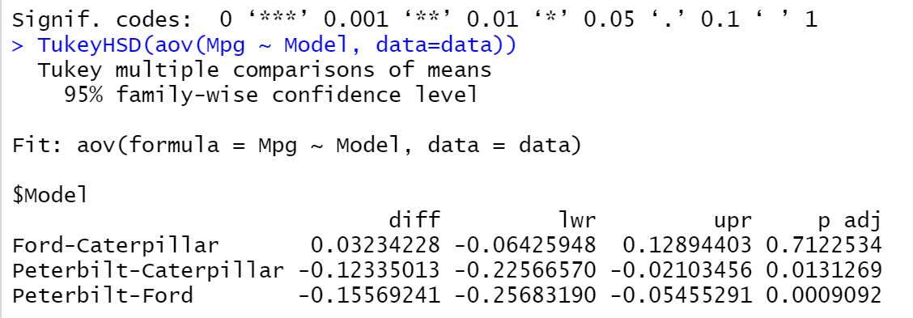
MPG Analysis – TukeyHSD()
Based on the TukeyHSD Test, when we look at p-values to compare each pair :
Ford v/s Caterpillar:- There is no significant difference between their MPG
Peterbilt v/s Caterpillar:- There is no significant difference at 99% Significance level. However, at 95% Confidence Interval there is significant difference between these models.
Peterbilt v/s Ford:- There is significant difference between Peterbilt and Ford at 99.9% level.

Slide 11
MPG Analysis - Conclusion
Based on the above analysis:
ANT should invest more in truck models from either Ford or Caterpillar, since there was no significant difference observed between their MPGs
As Peterbilt’s MPG was lowest among these 3 and it was proven statistically, ANT can reduce count of this model.

Slide 12
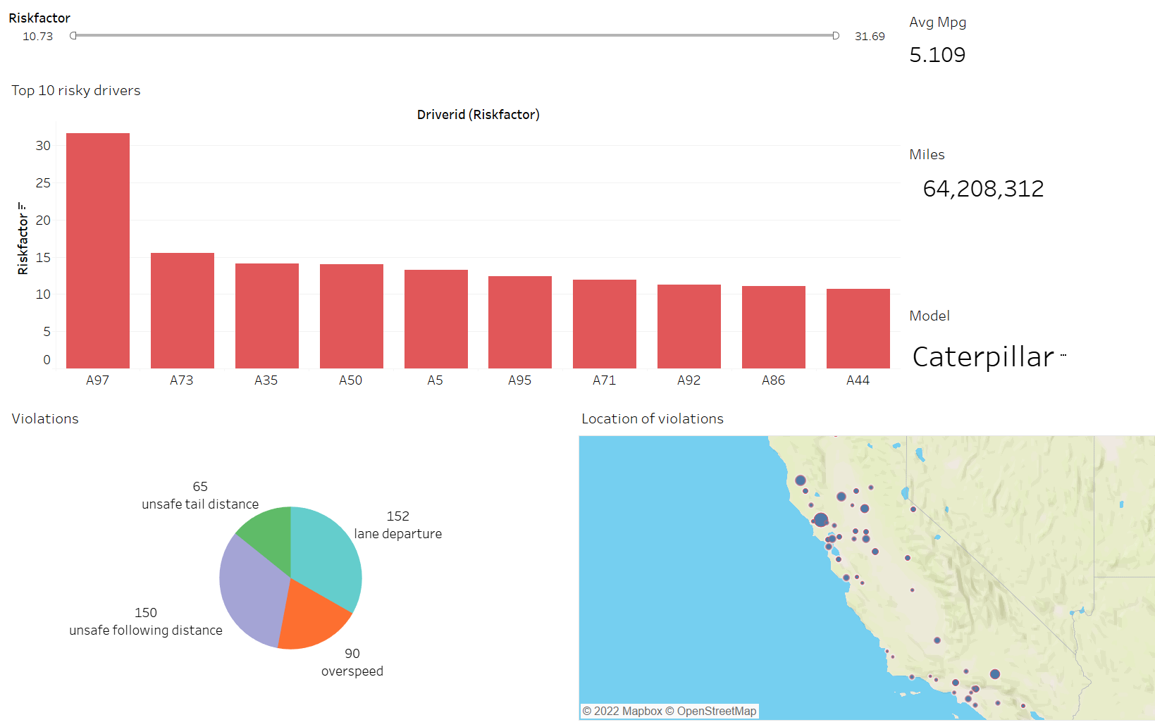
Dashboard 2 – Risky Drivers

Slide 13
Analysis of Truck driver Risk
The following factors were analyzed to identify risky drivers:
Risk Rating of each driver
Number of violations per driver
Types of violations
Location of violation

Slide 14
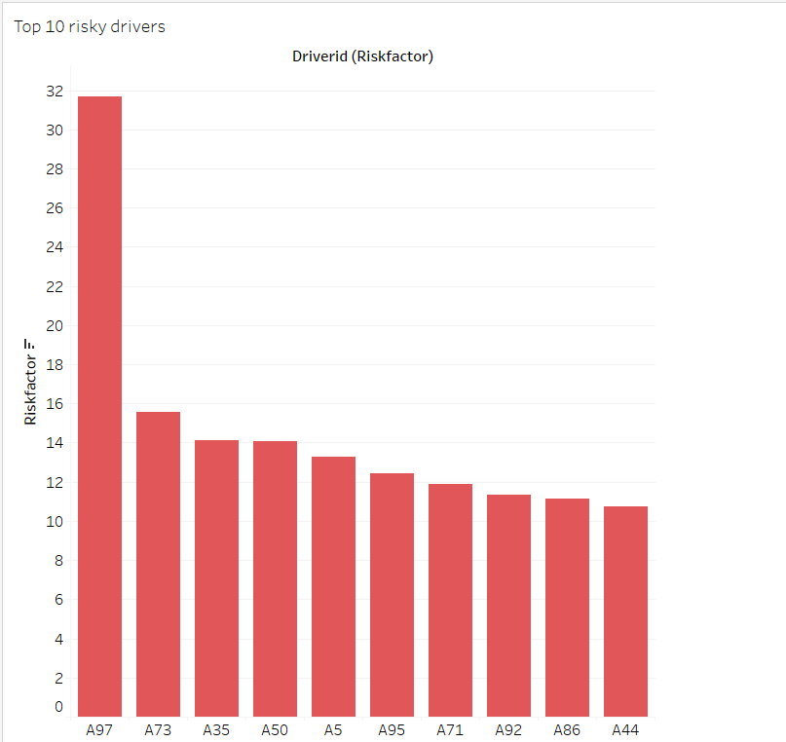
Risk Rating of drivers
Based on the Risk factor calculated by the company, we can see that the riskiest Driver is Driver “A97”, with a risk factor of 31. 69.
This is significantly higher than the second riskiest driver “A73” who had a risk rating of 15.57, thus implying that “A97” is more than twice as risky as “A73”.

Slide 15
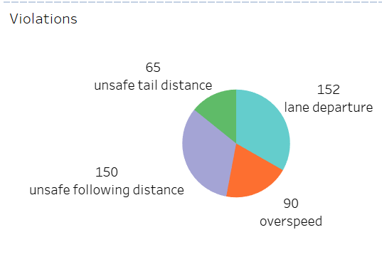
Violations per drivers
Based on number of violation events captured per driver:
“A97” has 20 violations captured which is twice the amount for “A73” who has 10 violations
An interesting observation is that drivers “A5” and “A50” have slightly different risk factors even though they have the same number of violations

Slide 16
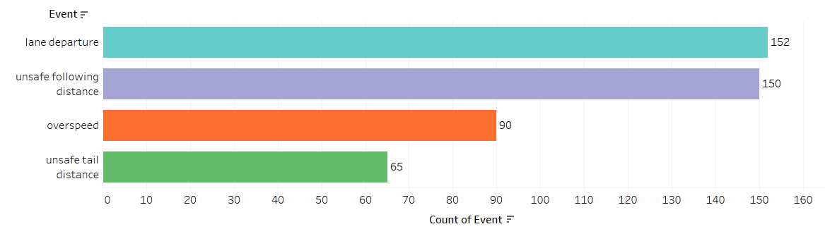
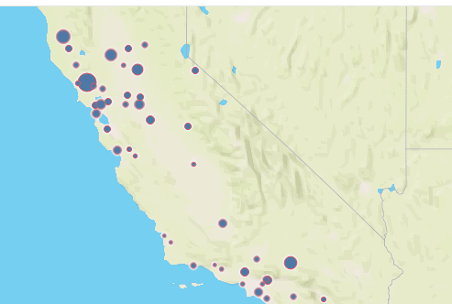
Violations events captured
Based on the various events captured by devices on the truck:
It can be observed the top two common violation occur when drivers are changing lanes or following some other vehicles
It can also be observed that most of the violations occurred in northwest part of California. Thus, truck drivers who drive in those locations, should be provided additional trainings

Slide 17
Analysis of Truck drivers - Observations and Conclusions
Hence, we should focus on the following to identify and mitigate the riskiest drivers:
Providing training to drivers with highest Risk factors
Creating awareness for drivers who drive on routes in northwest California on violations and safe driving might mitigate risk
Trainings provided to high-risk drivers should be given by drivers who have driven the greatest number of miles

Slide 18
END
Extra work below

Slide 19
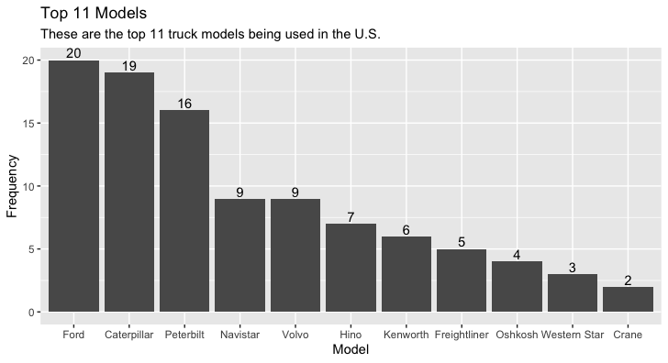
Other Data Visualizations – Exploration in R - 1
After extracting the 7 csv files from Hadoop, we showed the top 11 car models from the trucks_mg.csv dataset
As we can see on the right, Ford, Caterpillar, and Peterbuilt are leading the pack

Slide 20
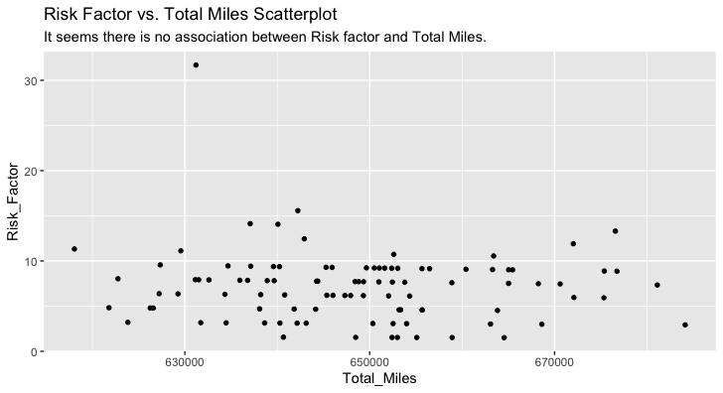
Other Data Visualizations – Exploration in R - 2
In this experiment, we wanted to check if there is a correlation between risk factor and total miles
As we can see, there wasn't any correlation

Slide 21
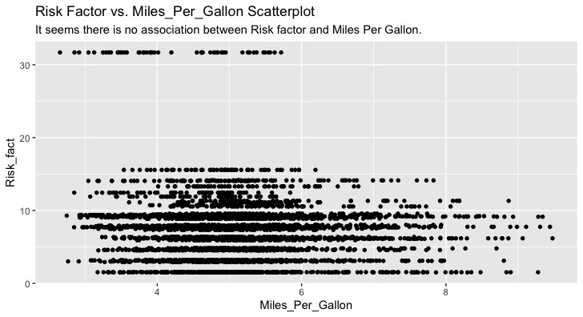

Other Data Visualizations – Exploration in R - 3
Next, we wanted to check if there is a correlation between risk factor and mpg
As we can see, there wasn't any correlation either

Slide 22
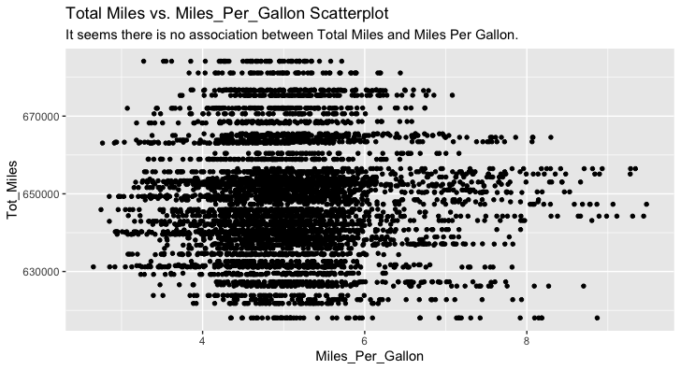

Other Data Visualizations – Exploration in R - 4
Lastly, we wanted to check if there is a correlation between total miles and mpg
As we can see, there wasn't any correlation either

