Slide 1
Debug-Inter-Net
Debugging Connetivity Interruptions
between large Network using
the Data Plane

Slide 2
Overview
Processing Chain
Standalone Tool-chain (SA)
- Ruby [c++]
- From scratch
- Integration into nf(dump/sens)

Slide 3
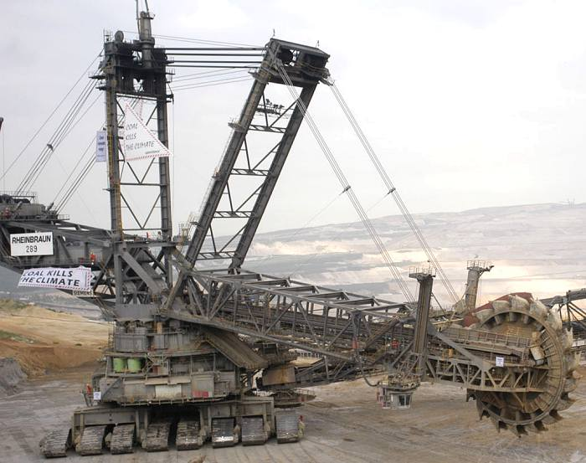
Data Parser
Read ***Flow data from Input (Files/Socket)

Slide 4
Data Parser
Mo
So

Slide 5
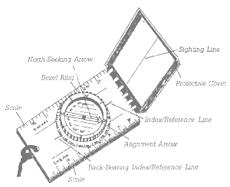
Topology: The Compass
What is Where?

Slide 6
Topology
Question
  What are the border interfaces?
  How much traffic is covered by the system?

Slide 7
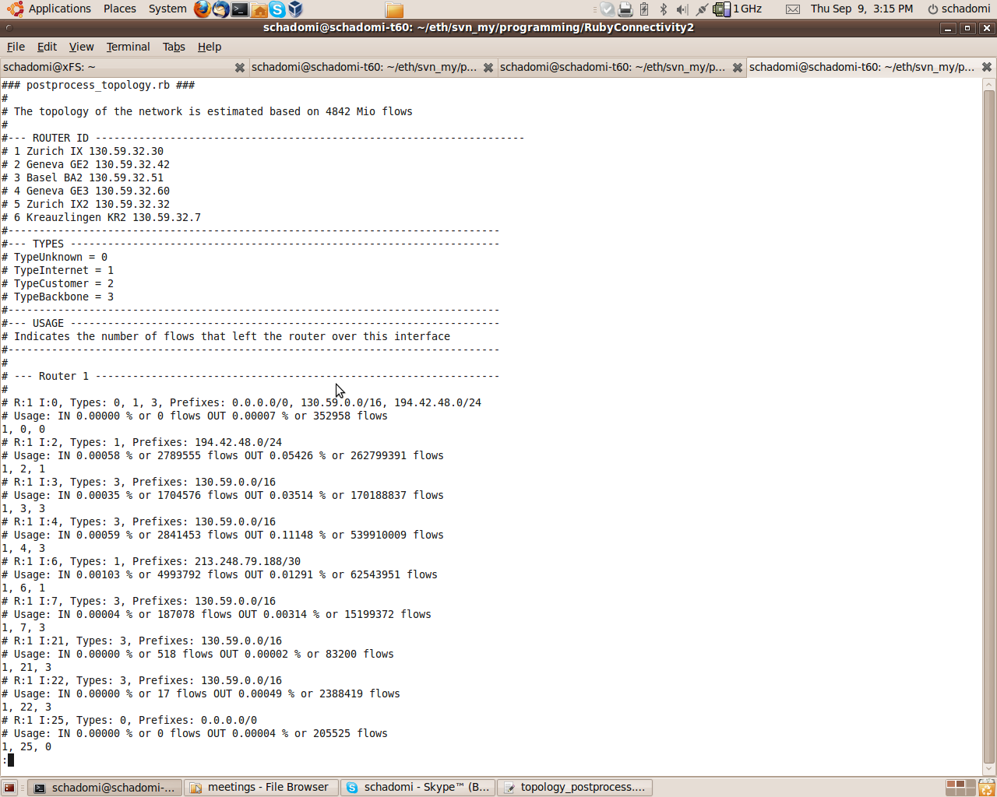
Topology
Input:
  Configuration: Interface.cfg, Router ID
  Netflow:
    OUTPUT_SNMP,
    INPUT_SNMP,
    IPV4_NEXT_HOP
Output:
  Router, Interface, Type
IN
R
If
Next
Hop
OUT

Slide 8
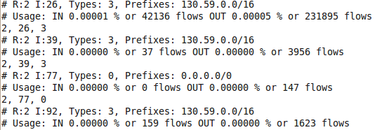
Topology - Problems
Next Hop 0.0.0.0 ?

Slide 9
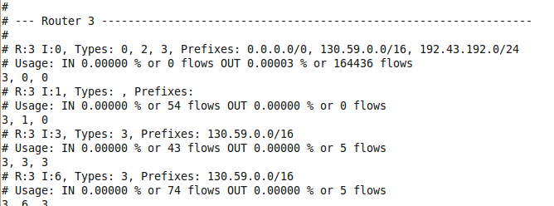
Topology - Problems
Interface 0

Slide 10
Topology - Problems
No Out Traffic

Slide 11
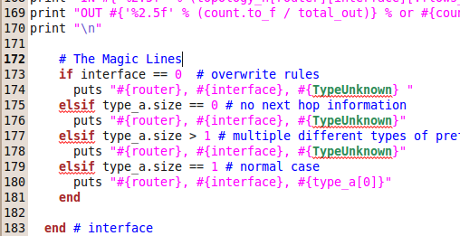
Topology: Rules
DEFAULT = Unknown

Slide 12
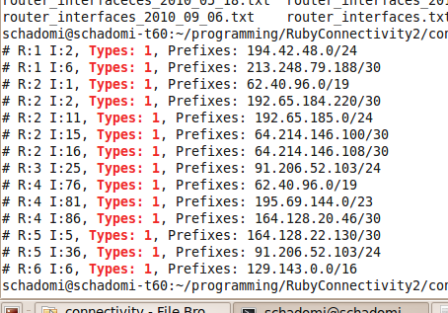
Topology: Rules

Slide 13
Topology
ToDos
  Discuss result with Simon
  Black-holes? (not covered by NetFlow)
    Weird connections (~10-100 per 300 s)
    Switch-CERT: Swisscom Uplink? (HIGH)

Slide 14

Filter Bank: The Bouncer
What goes IN and what should stay OUT

Slide 15
Filter Bank
Goal
  Performance:
    Minimize traffic in memory
  False Positives:
    Build the surface
    Eliminate well known 'problem puppies'
  Fix “Lack of Time” Problems

Slide 16
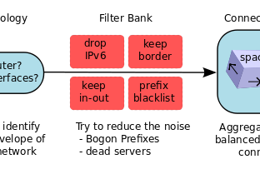
Filter Bank
Int ==> cheap
LCPM ==> costly

Slide 17
Filter Bank
30 %

Slide 18
Filter Bank: IPv6
Lack of time
  Most of the data structure are IPv6 ready
    But not all …

Slide 19
Filter Bank: Border
Goal: Performance
  Remove internal traffic
  Remove duplicated flows (multiple routers)
Problem: Unknown Interfaces

Slide 20
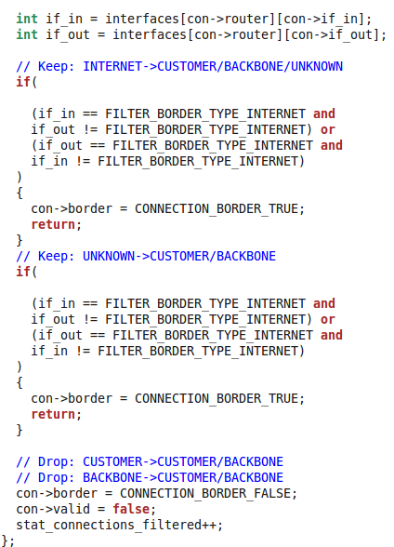

Slide 21
Filter Bank: IN-OUT
Goal: Build the surface
  Keep only IN-OUT Traffic
  Mainly removes transit traffic
Input Data: (route view = not checked)
    AS 559 Prefixes
    Longer Prefixes
Problem:
    Multi-Homed Prefixes?
    Prefix-Matching costs time ...
Out
IN AS 559

Slide 22
Filter Bank: IN-OUT

Slide 23
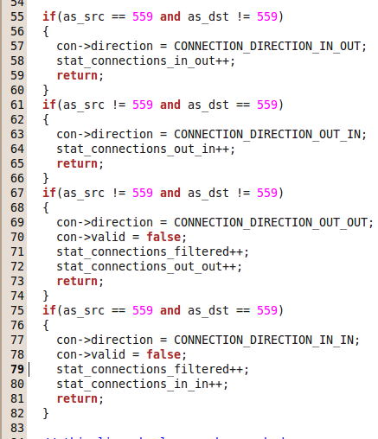
Filter Bank: IN-OUT

Slide 24
Filter Bank: IN-OUT
ToDo
  Check list with used Switch Prefixes (HIGH)

Slide 25
Filter Bank: Blacklist
Goal: Eliminate problem puppy
    Prefixes: Bogons IP Space, Multicast (224.0.0.0/4)
    Hosts: PlanetLab, Logitech Update Servers ...
    Capture Errors e.g. AS553 BELWUE

Slide 26
Filter Bank: ToDo
Check the Bogon-IP list (HIGH)
  Weird Prefixes …
Other EU-X Lab Nodes (low)
Manually / Semi-automated (low)
  Active Validation is faster
    but lets discuss this later

Slide 27

Connection Matrix: The Brain
Remember the Connections

Slide 28
Connection Matrix: The Brain
Goal: The Connection State Machine
  Track the connectivity of all connections
    Match forward and backward flows
    All traffic is used (including P2P, Skype ....)
    The last X min
It's a large “5TP” cache

Slide 29
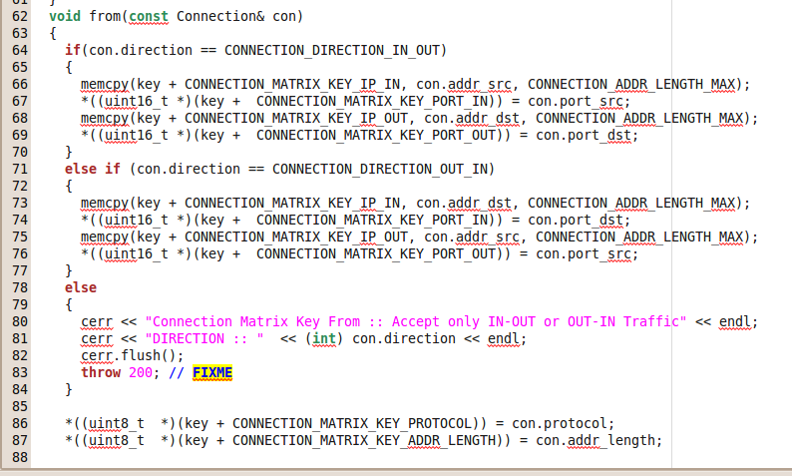
Connection Matrix
Hash KEY : fixed order

Slide 30
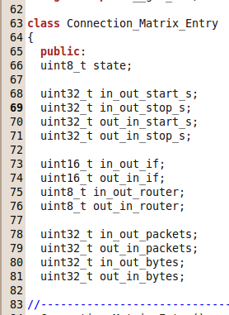
Connection Matrix

Slide 31
Connection Matrix
TCP Timeout
RST/FIN
Types of Connectivity
Flow Start
Flow Stop
Event
Span
Observation Window
Time
Not Now
Never

Slide 33
8

Slide 35
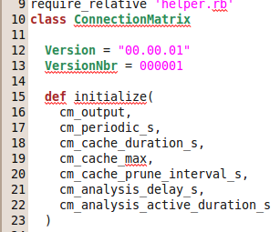
Connection Matrix: Parameters
A
D
time
now
next

Slide 36
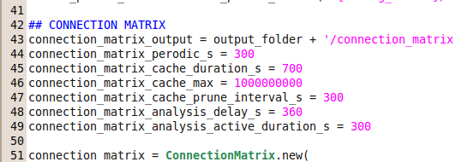
Connection Matrix: Parameters

Slide 37
Performance
Fixed Hash-Key
  KEY = IP_in + Port_in+IP_out+Port_out
Clean up as soon as possible (ToDo)
  Reduce Hash collisions
  Reduce Memory

Slide 38

Analyser

Slide 39
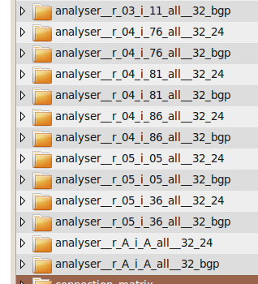
What 1
Flexible aggregation
  BGP Prefixes
  CIDR
Flexible focus
  All
  Router
  Interface

Slide 40
What 2
Connections Matrix
Net – Net Matrix
Net Matrix
Balanced == 0 => ALARM
Balanced (1,2,5,6):
- router and interf
- ANY Traffic
Unbalanced (4,5):
- router AND interf
- Singal traffic == true
- Not Weird (bpp)

Slide 41
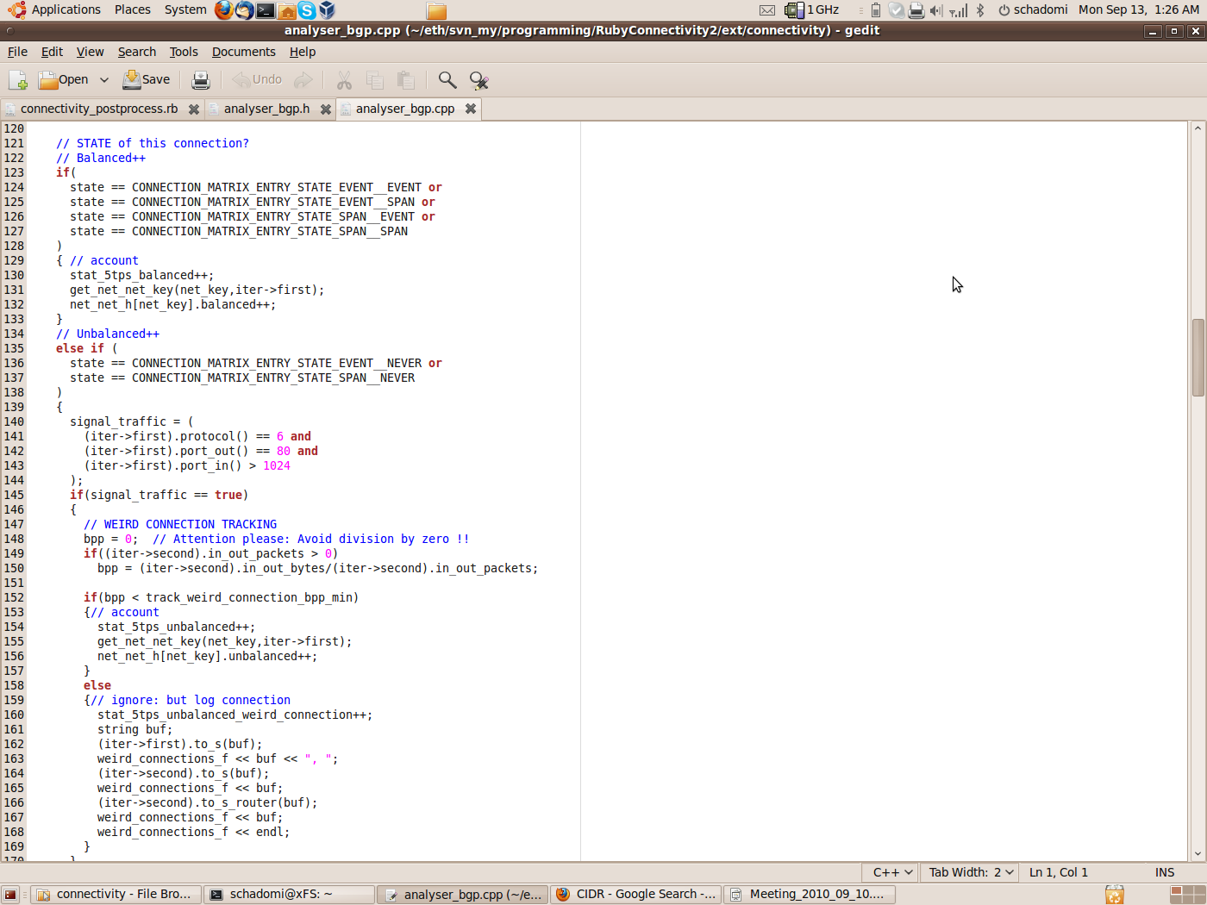

Slide 43
r_A_i_A_all__32_24__5tp
Whats that?
Data Leak?

Slide 44
r_A_i_A_all__32_24__key_net_net

Slide 45
r_A_i_A_all__32_24__key_net

Slide 46

r_A_i_A_all__32_24__density

Slide 47
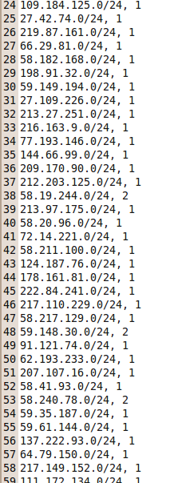
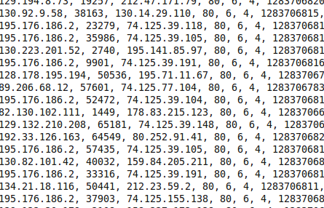
Additional Infos
Prefixes
Weird Connections

Slide 48
By Interfaces: TELIA (r1,i6)
~ ZERO

Slide 49
GBLX (r2,i15)

Slide 50
GBLX (r2,i16)

Slide 51
AMS-IX r4, 81

Slide 52
Swisscom r4,i86
Offset ??

Slide 53
Swisscom r5,i5

Slide 54
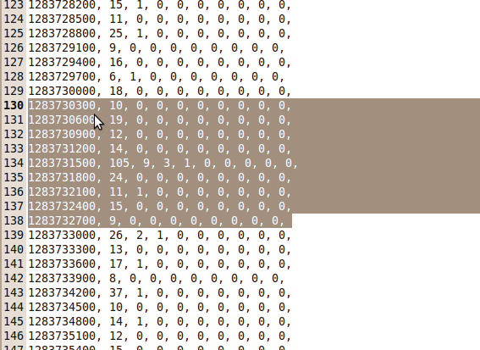
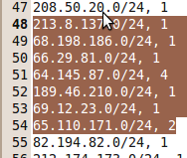

Slide 55
Now in BGP Prefixes

Slide 56
BGP All

Slide 57
ToDo
Extract unbalanced (60%)
  Unbalanced Connections
  Unbalanced Hosts (intern/extern)
Weird Host Tracker (75%)
  Root-cause Analysis
  Blacklis

Slide 58
Question
Do we need an Alarm?
  Is Debug Output enough?
  Problem SNR

Slide 59

Evaluation

Slide 60
Evaluation
2 Weeks of “Normalo”
    Problem quite some peaks
    Manual inspection takes too much time …
    Active Probing?
Past Events
  Youtube, Cogent ...

Slide 61
Evaluation
Passive:
  Collected Traffic including known events
Active:
  Run a live analysis
  Try to contact the prefixes

