Slide 1
Debug-Inter-Net

Slide 2


Overview

Slide 3
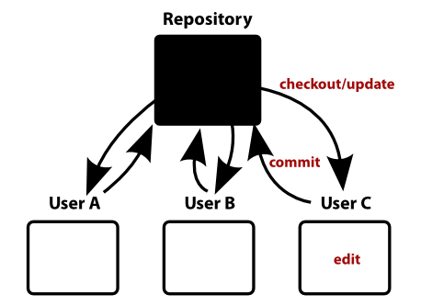
Change Log

Slide 4
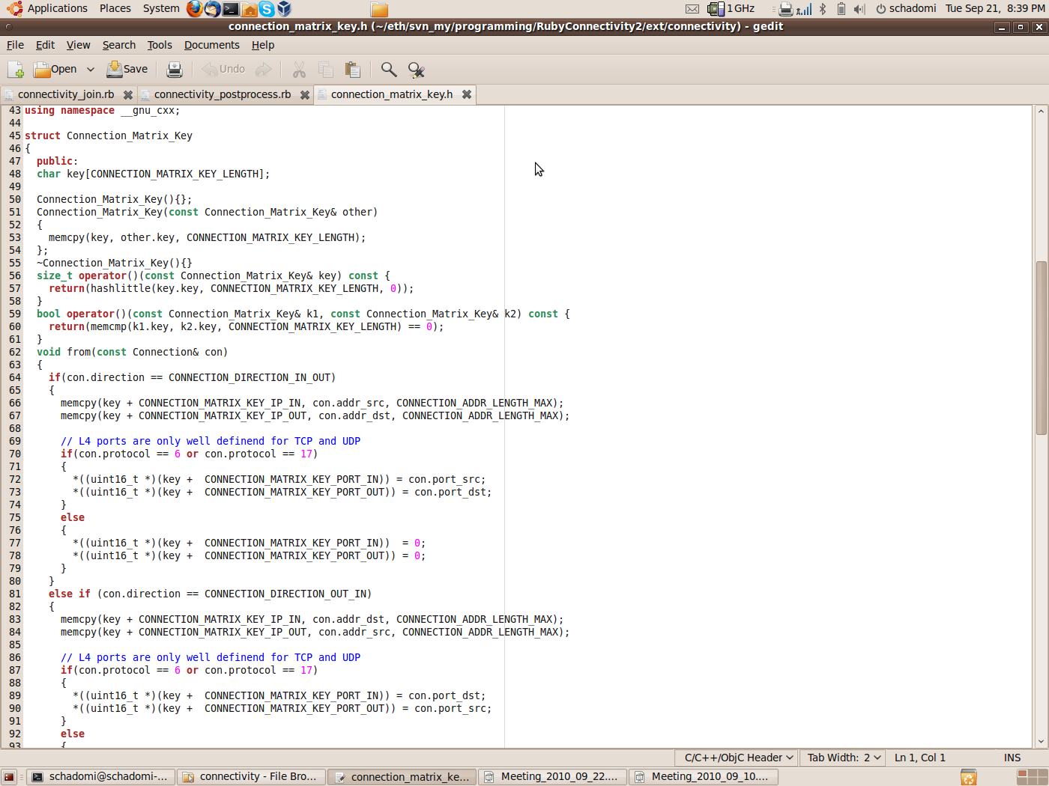
Change Log: Connection Matrix
Connection Matching (Jochen)
  5TP for TCP, UDP
  IP for the rest
h

Slide 5
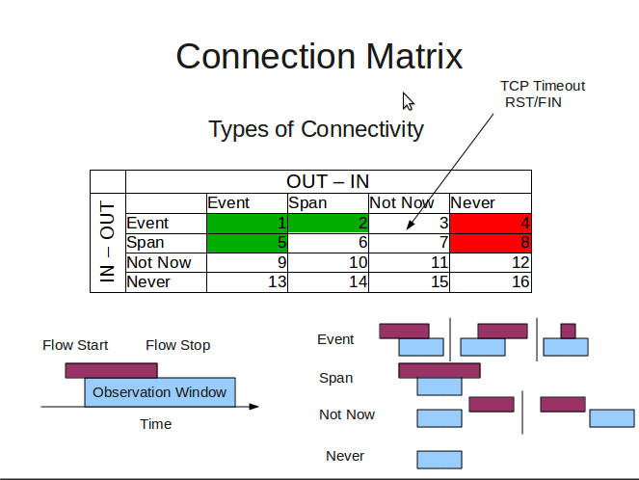
Change Log: Connection Matrix
States (Simon)
  Remove state 6 from balance

Slide 6
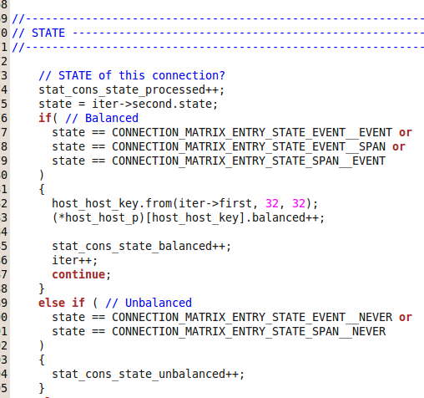

Slide 7
Change Log: Routing Information
Routeview → RIPE RIS
rrc00.ripe.net at, Amsterdam (default free)
Prefixes sorted by CIDR
Not perfect, but acceptable
> ./bgpdump ../bview.20100915.0800.gz |
grep PREFIX |
sed -e 's/PREFIX: //g' |
grep -v ":" |
sort -u |
sort -n --key=2 --field-separator=/ > ../prefixes.txt

Slide 8
Change Log: LCPM
MyOwnPrefix Matching
  Tested against: Net-Patricia-1.16 (→rpatricia)
  Routing Table form RIS
  Bruteforce Ipv4 addr-space
  100% Hitrate

Slide 9

Analyser

Slide 10
Connection Processing

Slide 11
Aggregation

Slide 12
System ToDos
Post Processing
Analyze weird connections
  Root Cause?
  Check internal prefixes (whois)

Slide 13

Evaluation

Slide 14
“Normal” Traffic

Slide 15
Filter Bank

Slide 16
Connection Matrix

Slide 17
Analyser: Connection Processing

Slide 18
Analyser: Connection Processing

Slide 19
Analyser: Connection Processing

Slide 21
Analyser: Connection Processing

Slide 22
Analyser: Aggregation

Slide 23
Host: ALL

Slide 24
Host: host_r_1_i_2

Slide 25
Net: All

Slide 26
Net: net_r_5_i_5.eps

Slide 27
BGP: ALL

Slide 28
BGP: bgp_r_5_i_5.eps

Slide 29
Density: BGP ALL

Slide 30
BGP: 1 1

Slide 31
Top Prefixses per Day
74.125.170.39/32, 2, 290
(dns-admin.google.com)
74.125.170.27/32, 2, 236
74.125.170.37/32, 2, 107
74.125.170.99/32, 2, 73
74.125.170.24/32, 2, 55
146.101.162.215/32, 249, 48
85.17.80.248/32, 1, 47
Every Day
  Summary of top hitter
    Prefix
    How many times
    Max(How many hosts)

Slide 32
Performance

Slide 34
Event:
# 2010.05.18 TeliaSonera
Gestern (2010-05-18) zwischen 10:30:34 (08:30:34 UTC) und 10:44:50
(08:44:50 UTC) hatten wir einen Verlust der Konnektivität in
mindestens einer Richtung zwischen SWITCH als Ganzem und dem Netz
206.53.176.0/24 (AS19626).

Slide 35
BGP ALL

Slide 36
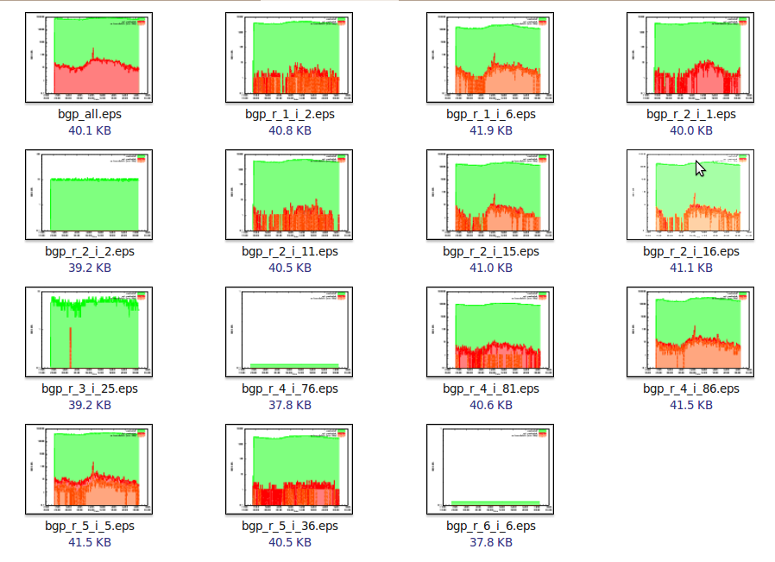

Slide 38
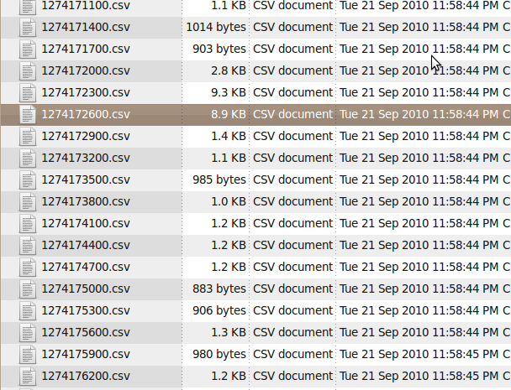
BGP Prefixes
seconds2date 1274172600
2010-05-18 (Tue) 08:50:00 +0000, week 20

