Slide 1

AI Agents in VS Code for Academic Work
From Prompting to Workflows
Nim Dvir, PhD, MBA
University at Albany
spoo.me/cHzhyF2
Notes:
SLIDE 1: AI Agents in VS Code for Academic Work
TIME: 0:30 (includes any demo on this slide)
PURPOSE: From Prompting to Workflows
SAY
Welcome. Today I will show how I use agents to work with real academic files. The aim is to make useful materials, inspect what changed, and keep a process we can repeat. You do not need a programming background. The QR code opens the companion site, which carries the detailed explanations and examples.
SHOW / DO
Leave the QR code visible while people settle. Invite participants to follow on a phone or laptop. Slides give the short version; the site remains available afterward.
TRANSITION
First, a little about the work that led me here.
SOURCE
https://nimdvir.github.io/cce-2026/
Current project materials reviewed September 30, 2026. Screenshots are prepared examples and may differ from the installed interface.

Slide 2

About me
I teach databases, SQL, and analytics.
I research HCI, UX, and AI.
I build courseware and a textbook.
ndvir@albany.edu
Notes:
SLIDE 2: About me
TIME: 0:25 (includes any demo on this slide)
PURPOSE: I teach databases, SQL, and analytics.
SAY
I am Nim Dvir, a Lecturer in Information Systems and Business Analytics at the University at Albany. My work connects human-computer interaction and AI with teaching and usable digital products. The examples today come from my own academic work. I bring the teaching goals and subject knowledge; agents help me produce and revise the materials.
SHOW / DO
Briefly introduce yourself. The complete biography, publications, and contact links are on the About page.
TRANSITION
My reason for using agents is quite personal.
SOURCE
https://nimdvir.github.io/cce-2026/about.html
Current project materials reviewed September 30, 2026. Screenshots are prepared examples and may differ from the installed interface.

Slide 3
Why am I doing this?
I always wanted to build things.
AI agents helped me turn ideas into working materials.
Now I can show you how I do it.
Notes:
SLIDE 3: Why am I doing this?
TIME: 0:40 (includes any demo on this slide)
PURPOSE: I always wanted to build things.
SAY
I always wanted to build things, but I did not feel I had all the engineering knowledge to do it. Agents changed what I could attempt. I can describe a goal, work through a plan, and examine the files they create. I still make decisions, and I still encounter mistakes. What changed is my ability to turn an idea into something I can inspect and improve.
SHOW / DO
Speak in your own voice. Connect this to a recurring task the audience recognizes, such as revising a syllabus each semester.
TRANSITION
Here are four concrete results.
SOURCE
https://nimdvir.github.io/cce-2026/lecture.html
Current project materials reviewed September 30, 2026. Screenshots are prepared examples and may differ from the installed interface.

Slide 4
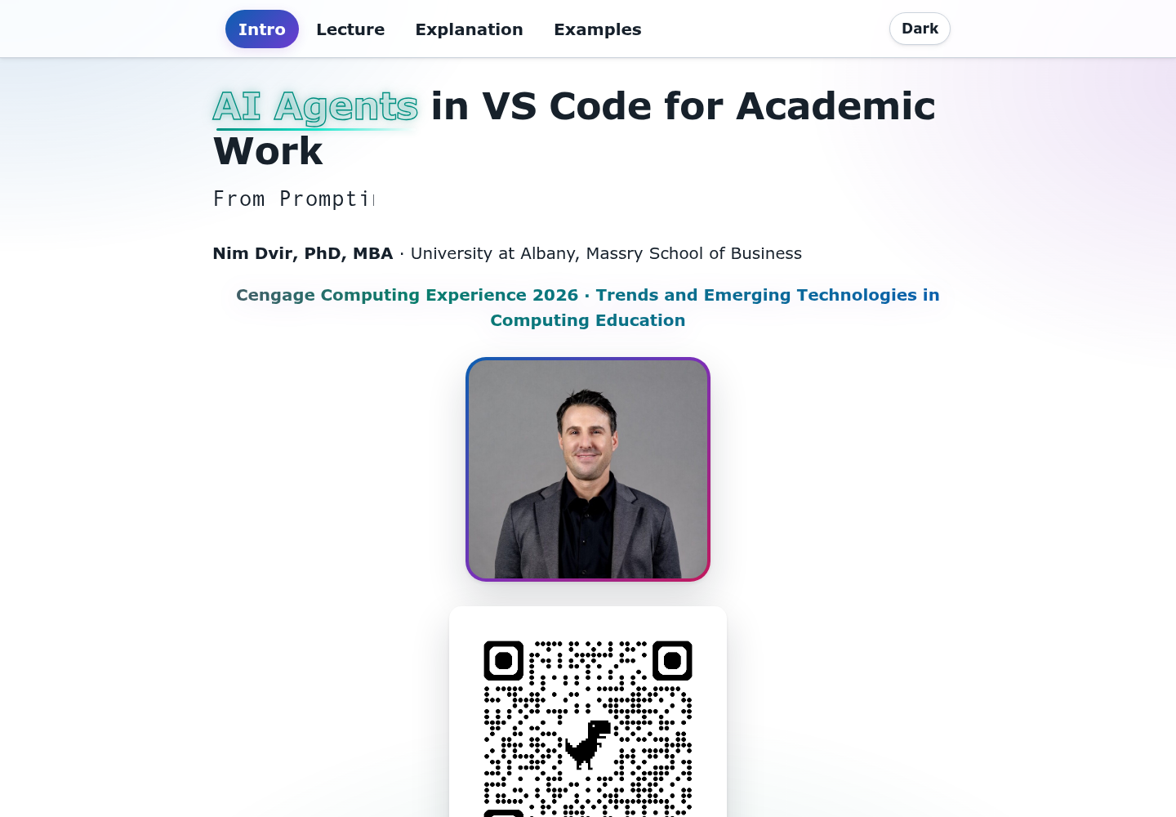
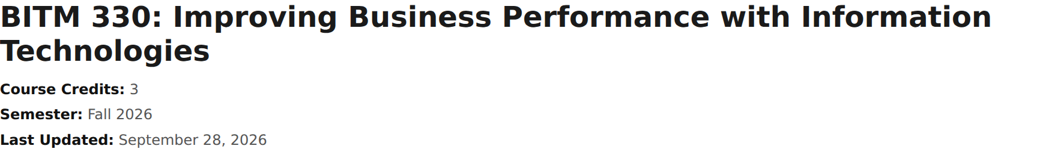
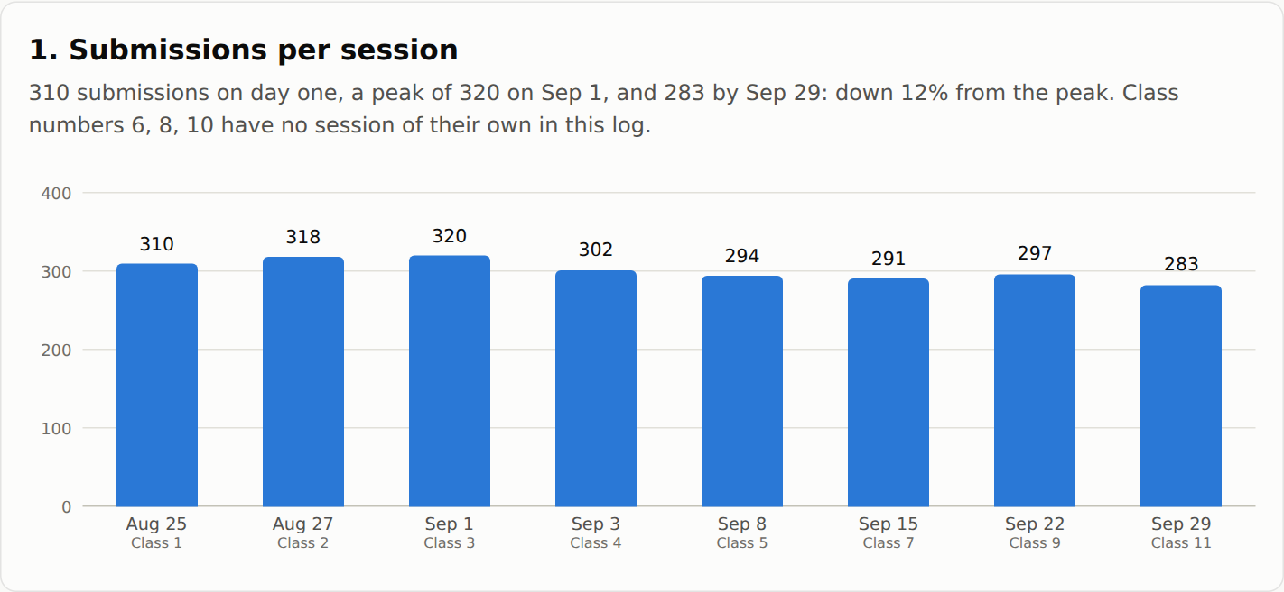
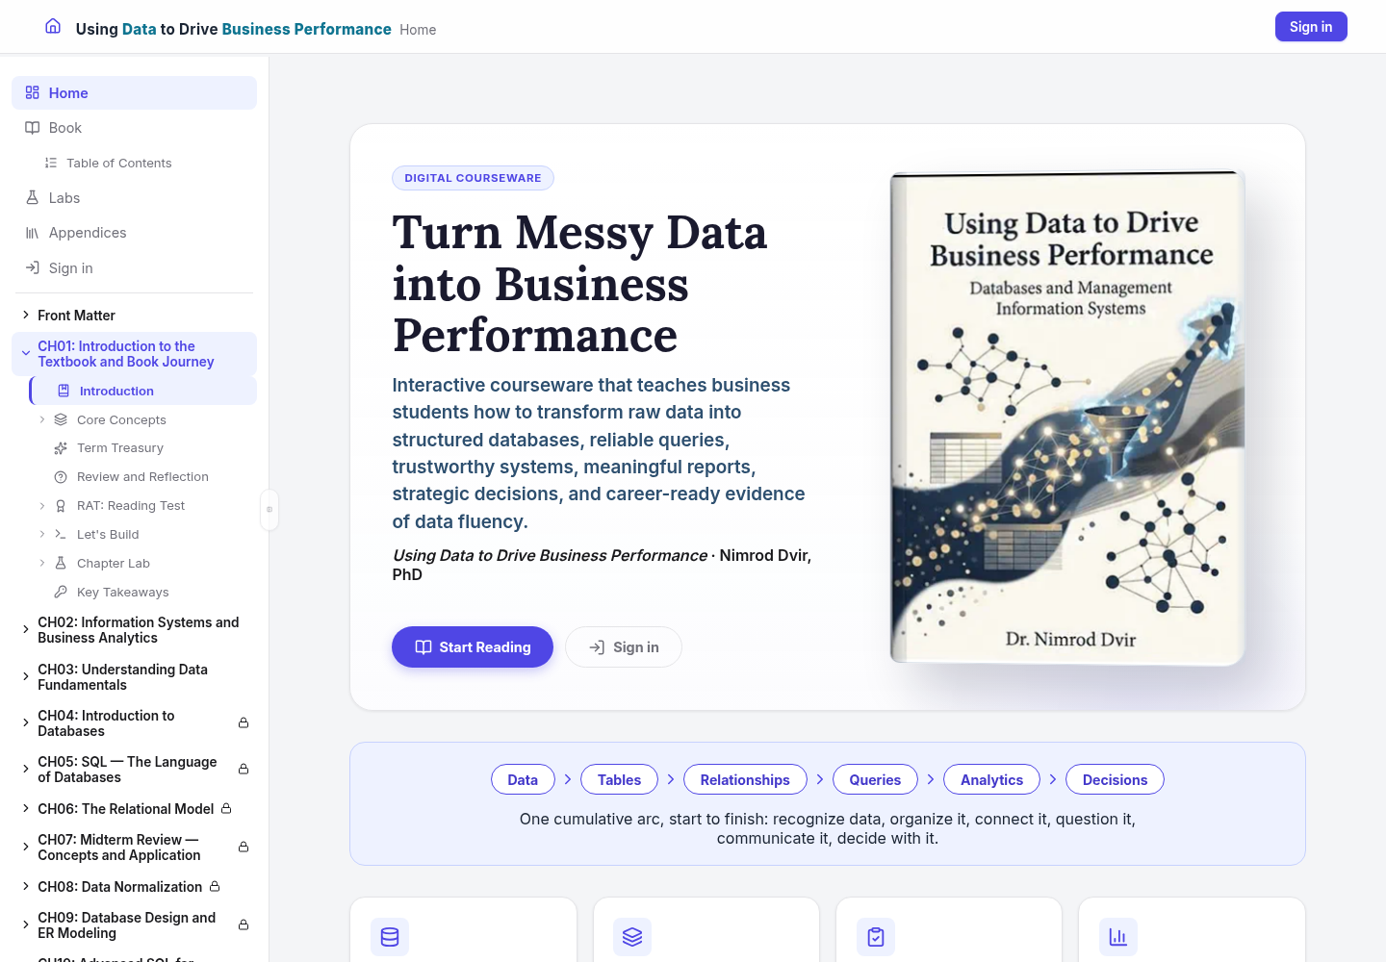
What agents helped me build
Conference website
HTML syllabus
Data reports
Interactive courseware
Browser tour
Notes:
SLIDE 4: What agents helped me build
TIME: 1:20 (includes any demo on this slide)
PURPOSE: Conference website
SAY
These are four completed projects, not promises about what an agent might someday do. Each began with source materials and a goal. I will briefly show the finished website now, then explain the concepts behind the work. Later we will inspect the examples and the review decisions that mattered.
SHOW / DO
D1: Open the companion site in the browser. Show the Intro page, then Examples. Point to the four outputs without opening every walkthrough. Spend about one minute away from the slides. Return to the five-part map.
IF IT STALLS
Stay on the four prepared screenshots and name the outputs. The rest of the session does not depend on this tour.
TRANSITION
The same five ideas connect all four projects.
SOURCE
https://nimdvir.github.io/cce-2026/examples.html
Current project materials reviewed September 30, 2026. Screenshots are prepared examples and may differ from the installed interface.

Slide 5
Today’s five parts
1. The Brain: agents, models, and context
2. The Infrastructure: files and tools
3. The Task: a useful request
4. The Workflow: repeatable work
5. The Examples: four academic projects
Notes:
SLIDE 5: Today’s five parts
TIME: 0:30 (includes any demo on this slide)
PURPOSE: 1. The Brain: agents, models, and context
SAY
We start with what the agent is using to reason. Then we give it somewhere to work, define a task, and build a reviewable workflow. Finally we return to the projects. Think of this as a map, not a list of products you need to memorize. Detailed setup instructions and terminology are on the site.
SHOW / DO
Point through the five parts. Let participants know the demonstrations are prepared and one small website edit is optional.
TRANSITION
Let us begin with the brain.
SOURCE
https://nimdvir.github.io/cce-2026/lecture.html
Current project materials reviewed September 30, 2026. Screenshots are prepared examples and may differ from the installed interface.

Slide 6
1. The Brain
Agents, models, tokens, and context
Notes:
SLIDE 6: 1. The Brain
TIME: 0:15 (includes any demo on this slide)
PURPOSE: Agents, models, tokens, and context
SAY
These few concepts explain both why agents are useful and why they can fail. The model reasons with the information available to it. The agent uses that reasoning to choose actions through tools.
SHOW / DO
Pause briefly at the section divider.
TRANSITION
What makes something an agent?
SOURCE
https://nimdvir.github.io/cce-2026/explanation.html#brain
Current project materials reviewed September 30, 2026. Screenshots are prepared examples and may differ from the installed interface.

Slide 7
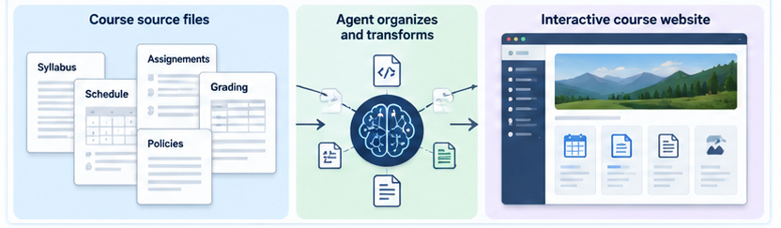
What is an AI agent?
An agent uses a model, context, instructions, and tools to work toward a goal.
It inspects, plans, acts, checks, and revises.
Notes:
SLIDE 7: What is an AI agent?
TIME: 1:00 (includes any demo on this slide)
PURPOSE: An agent uses a model, context, instructions, and tools to work toward a goal.
SAY
An agent is organized around a goal and a sequence of actions. It may read files, inspect a problem, suggest a plan, make a change, and check the result. A model generates the reasoning and proposed actions. Tools let the system do something with them. This loop can help with a multi-step academic task, but it does not guarantee the outcome is correct.
SHOW / DO
Trace the existing agent illustration from inputs through tools to output. Use a syllabus revision as the running example.
TRANSITION
We often meet an agent through a familiar chat window.
SOURCE
https://nimdvir.github.io/cce-2026/explanation.html#what-is-an-ai-agent
Current project materials reviewed September 30, 2026. Screenshots are prepared examples and may differ from the installed interface.

Slide 8
Chat and agent
Chat is the conversation interface.
An agent can use tools and take several steps toward a goal.
You review the resulting work.
Notes:
SLIDE 8: Chat and agent
TIME: 0:45 (includes any demo on this slide)
PURPOSE: Chat is the conversation interface.
SAY
A normal exchange might explain how to improve a syllabus, leaving you to make the changes. An agent can inspect the actual files and prepare a revised copy. Both can happen through a chat interface. So chat and agent are not mutually exclusive products. The distinction is what the system can do behind the conversation and which actions you have permitted.
SHOW / DO
Ask: When you last used AI, did it give you advice, or did it change an actual file? Take one quick response if time permits.
TRANSITION
Useful capabilities come with important limits.
SOURCE
https://nimdvir.github.io/cce-2026/explanation.html#chat-vs-agent
Current project materials reviewed September 30, 2026. Screenshots are prepared examples and may differ from the installed interface.

Slide 9
Capabilities and limits
Can: inspect files, edit, run tools, and check results.
Needs: clear goals, relevant sources, and boundaries.
Still needs your judgment and review.
Notes:
SLIDE 9: Capabilities and limits
TIME: 0:45 (includes any demo on this slide)
PURPOSE: Can: inspect files, edit, run tools, and check results.
SAY
An agent can search many files, write code, make a chart, or check a link. It can also misunderstand a policy, overlook a file, or make a technically valid change you did not want. Do not treat confidence as evidence. Today we work in a local project folder, but the selected model may run on a provider’s servers. Files being local does not by itself mean inference or data processing is local.
SHOW / DO
Use the example of a correct-looking grading table with one wrong weight. Mark this slide as skippable if time is short.
TRANSITION
The model is one component of this system.
SOURCE
https://nimdvir.github.io/cce-2026/explanation.html#what-can-an-agent-do
Current project materials reviewed September 30, 2026. Screenshots are prepared examples and may differ from the installed interface.

Slide 10
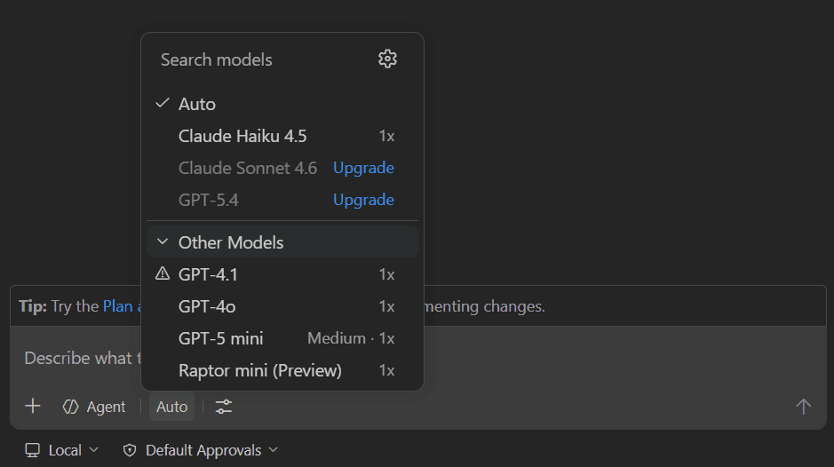
Models
The model generates responses and proposed actions.
Models differ in capabilities, speed, context, and cost.
Data location depends on how you run the model.
Notes:
SLIDE 10: Models
TIME: 0:55 (includes any demo on this slide)
PURPOSE: The model generates responses and proposed actions.
SAY
GPT, Claude, and Gemini are examples of model families. The model picker chooses a model for the current conversation. An agent adds instructions, context, and tools around that model. Open-weight models can sometimes run on your own hardware, but many people use them through hosted services. Check the actual provider and configuration before making any privacy assumption. We will keep one tested model selected for the demonstration.
SHOW / DO
Point to the model-picker screenshot as an illustration. Do not promise that every participant will see the same choices or prices.
TRANSITION
Models process information in units called tokens.
SOURCE
https://nimdvir.github.io/cce-2026/explanation.html#what-is-a-model
Current project materials reviewed September 30, 2026. Screenshots are prepared examples and may differ from the installed interface.
Model configuration reference: https://code.visualstudio.com/docs/agent-customization/language-models

Slide 11
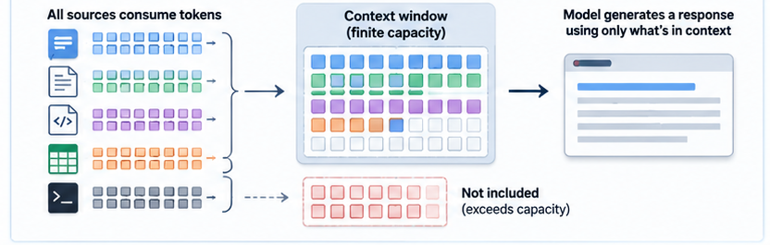
Tokens and context limits
Tokens are the units a model processes.
The context window has limited capacity.
Prompts, files, conversation, and output use that capacity.
Notes:
SLIDE 11: Tokens and context limits
TIME: 0:55 (includes any demo on this slide)
PURPOSE: Tokens are the units a model processes.
SAY
A token can be a word, part of a word, or punctuation. The model has a limit on what it can process in a request. Instructions, selected documents, conversation history, and tool results compete for space, and generation limits also matter. Larger context is useful, but it does not remove the need to select relevant material. A long conversation may be summarized or truncated by the tool.
SHOW / DO
Use the context-window illustration. Point out that extra material can crowd out what matters. The drawing is a conceptual illustration, not a numeric model specification.
TRANSITION
That leads to the practical question: what can the model actually see?
SOURCE
https://nimdvir.github.io/cce-2026/explanation.html#what-are-tokens
Current project materials reviewed September 30, 2026. Screenshots are prepared examples and may differ from the installed interface.

Slide 12
Context for the task
Prompt + conversation + selected files
Instructions + tool results
Give the agent the relevant evidence.
Notes:
SLIDE 12: Context for the task
TIME: 0:55 (includes any demo on this slide)
PURPOSE: Prompt + conversation + selected files
SAY
Context is the information available for the current request. A file somewhere on your computer is not automatically in the model’s context. The agent must locate and read it, or you must attach or reference it. Name the authoritative source and tell the agent to inspect it. Put stable project knowledge into files so you do not have to repeat it in every prompt. The site also maps these ideas to VS Code’s model, harness, context, tools, and prompt concepts.
SHOW / DO
Contrast “update my syllabus” with “read this syllabus and this approved calendar before proposing changes.”
TRANSITION
Now we give the agent a place to work.
SOURCE
https://nimdvir.github.io/cce-2026/explanation.html#what-is-context
Current project materials reviewed September 30, 2026. Screenshots are prepared examples and may differ from the installed interface.

Slide 13
2. The
Infrastructure
Files, folders, VS Code, and Copilot
Notes:
SLIDE 13: 2. The Infrastructure
TIME: 0:15 (includes any demo on this slide)
PURPOSE: Files, folders, VS Code, and Copilot
SAY
Infrastructure is simply the environment around the task. We will start with files and folders, then explain what Git and GitHub add. You can use an agent with a normal project folder without publishing anything.
SHOW / DO
Keep the terminology grounded in familiar academic files.
TRANSITION
The editor is the main window we will use.
SOURCE
https://nimdvir.github.io/cce-2026/explanation.html#infrastructure
Current project materials reviewed September 30, 2026. Screenshots are prepared examples and may differ from the installed interface.

Slide 14
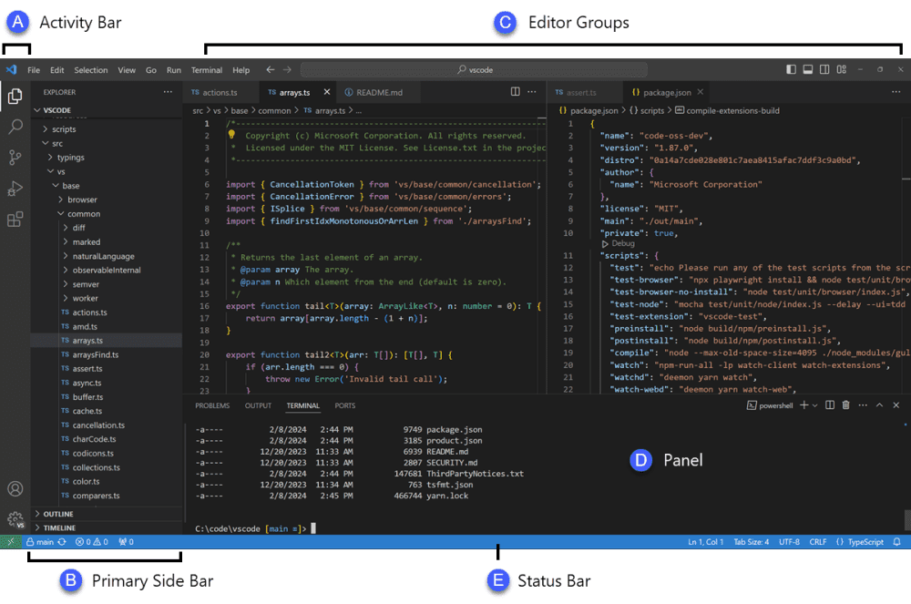
Text editor and VS Code
A text editor works directly with text files.
VS Code combines files, an editor, tools, and AI extensions.
Notes:
SLIDE 14: Text editor and VS Code
TIME: 0:45 (includes any demo on this slide)
PURPOSE: A text editor works directly with text files.
SAY
A text editor lets you read and change the contents of a file. VS Code also gives you a file explorer, a terminal, previews, version-control tools, and extensions. We are using it as an academic workspace. You do not have to learn every button. For this session, notice the files on the left, the open documents in the center, and the terminal below. The live tour will show chat.
SHOW / DO
Orient the audience to those three regions in the screenshot. The live view comes shortly.
TRANSITION
What matters first is where the project files live.
SOURCE
https://nimdvir.github.io/cce-2026/explanation.html#what-is-vs-code
Current project materials reviewed September 30, 2026. Screenshots are prepared examples and may differ from the installed interface.

Slide 15
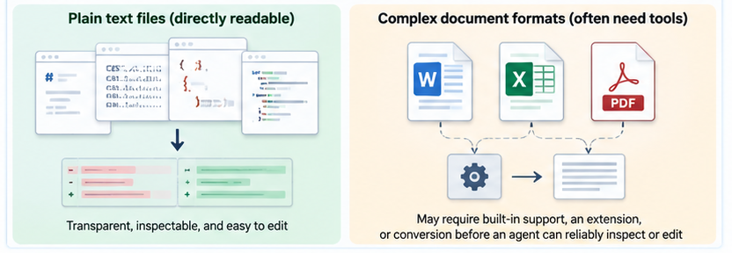
Files and folders
Local or synced folders hold working files.
I use Google Drive for working materials.
Plain text is easy to inspect; Word, PDF, and Excel may need extra tools.
Notes:
SLIDE 15: Files and folders
TIME: 0:50 (includes any demo on this slide)
PURPOSE: Local or synced folders hold working files.
SAY
A file stores information, and a folder groups related files. I usually work with Google Drive folders. On a synced computer, the editor can work with local copies, but I make demo files available offline and avoid simultaneous edits that create conflicts. Markdown, HTML, and CSV expose their structure as text. Office and PDF files are useful too, but reading or editing them reliably may require a conversion or specialized tool.
SHOW / DO
Explain a simple arrangement: sources stay together, drafts have a separate place, and approved outputs are easy to find. Workspace means the project folder or folders open in the editor.
TRANSITION
Version control adds a history to those files.
SOURCE
https://nimdvir.github.io/cce-2026/explanation.html#where-do-the-files-live
Current project materials reviewed September 30, 2026. Screenshots are prepared examples and may differ from the installed interface.

Slide 16
Repository, Git, GitHub
Repository
A project with tracked history
Git
Records and compares changes
GitHub
Hosts repositories online
Notes:
SLIDE 16: Repository, Git, GitHub
TIME: 0:40 (includes any demo on this slide)
PURPOSE: Repository: A project with tracked history
SAY
These terms describe different things. A repository is a project with tracked history. Git records checkpoints and shows differences between versions. GitHub is an online service where a repository can be hosted and shared. A repository can remain local, and a GitHub repository can be private. My working drafts live in Drive; GitHub is useful for reviewed versions, branching, and public projects.
SHOW / DO
Read the distinctions once. Do not imply that a GitHub account or repository is necessary for every file-based agent task.
TRANSITION
Three common actions connect the local and remote copies.
SOURCE
https://nimdvir.github.io/cce-2026/explanation.html#what-is-a-repository
Current project materials reviewed September 30, 2026. Screenshots are prepared examples and may differ from the installed interface.

Slide 17
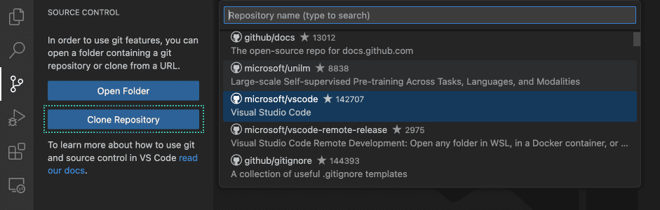
Clone, commit, push
Clone: get a local repository copy.
Commit: record a local checkpoint.
Push: send commits to the remote.
Notes:
SLIDE 17: Clone, commit, push
TIME: 0:40 (includes any demo on this slide)
PURPOSE: Clone: get a local repository copy.
SAY
Clone creates a local working copy with its history. Commit records a chosen set of changes locally. Push sends commits to the remote repository. Editing a file does not automatically mean you have committed, pushed, or published it. Review what is included at each stage. In a Drive-only demo, a separate saved copy can serve as a checkpoint instead of introducing Git halfway through.
SHOW / DO
Point to the clone screenshot. This is another optional cut if the audience already knows version control.
TRANSITION
Copilot adds AI assistance inside the editor.
SOURCE
https://nimdvir.github.io/cce-2026/explanation.html#clone-github-vs-code
Current project materials reviewed September 30, 2026. Screenshots are prepared examples and may differ from the installed interface.

Slide 18
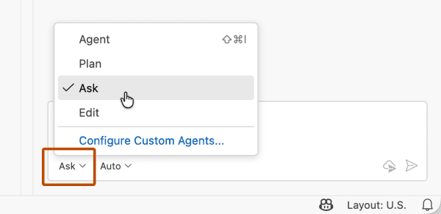
GitHub Copilot
Copilot brings AI assistance into VS Code.
It combines chat, model choices, and tools.
Extensions add other capabilities.
Notes:
SLIDE 18: GitHub Copilot
TIME: 0:40 (includes any demo on this slide)
PURPOSE: Copilot brings AI assistance into VS Code.
SAY
Copilot is the AI layer we use in this workspace. It provides a conversation interface and access to models and tools. Other extensions add capabilities such as Python support or document previews. Optional model connections can use a provider API key or a local runner. An API is a defined way for software to communicate with another program or service. Provider usage can create separate charges, so keep keys secure and use only a tested setup for the session.
SHOW / DO
Mention that optional models and MCP are further reading on the site. Avoid opening a configuration detour during the session.
TRANSITION
The next distinction is what kind of work you are asking the assistant to do.
SOURCE
https://nimdvir.github.io/cce-2026/explanation.html#what-is-github-copilot
Current project materials reviewed September 30, 2026. Screenshots are prepared examples and may differ from the installed interface.
Model configuration reference: https://code.visualstudio.com/docs/agent-customization/language-models

Slide 19
Ask, Plan, Agent
Ask
Understand and explain
Plan
Inspect and propose steps
Agent
Carry out approved work
VS Code tour
Notes:
SLIDE 19: Ask, Plan, Agent
TIME: 3:15 (includes any demo on this slide)
PURPOSE: Ask: Understand and explain
SAY
Ask is useful for understanding the project. Plan is useful for agreeing on the approach and boundaries. Agent carries out the work with available tools and permissions. This is the teaching sequence for our prepared setup; names and behavior vary by version and selected agent. Read actual permission requests and review output. A label alone does not guarantee a particular approval policy.
SHOW / DO
D2: Switch to VS Code for about three minutes. Show the Explorer, docs/content/intro.md, and Copilot Chat. Point to the mode or agent selector and model picker. In an available read-only mode ask: “Read docs/content/intro.md and summarize its purpose. Do not edit files or run commands.” Inspect the answer and return to Setup.
IF IT STALLS
If the model or network is slow, show the open source file and explain the prompt without waiting. Do not repair authentication on stage.
TRANSITION
Here is the setup participants can follow before or after the session.
SOURCE
https://nimdvir.github.io/cce-2026/explanation.html#copilot-chat-ask-plan-agent
Current project materials reviewed September 30, 2026. Screenshots are prepared examples and may differ from the installed interface.
Model configuration reference: https://code.visualstudio.com/docs/agent-customization/language-models

Slide 20

Setup checklist
1. Create a GitHub account
2. Check GitHub Education eligibility
3. Install VS Code
4. Sign in to GitHub
5. Open a folder or clone the example
6. Enable Copilot and try a question
Notes:
SLIDE 20: Setup checklist
TIME: 1:00 (includes any demo on this slide)
PURPOSE: 1. Create a GitHub account
SAY
The site has the full setup guide. Teacher verification may provide Copilot benefits, but approval is not instantaneous and access depends on eligibility and current terms. Install VS Code, sign in, open a working folder or clone the example, and confirm the chat answers a simple question. If you are following on a phone or are not set up, you can still follow the prepared results and try the task later.
SHOW / DO
Point to the GitHub Education screenshot. Tell people not to spend the live session troubleshooting installation. The setup page is linked in these notes and on the site.
TRANSITION
With the environment ready, the next step is a useful request.
SOURCE
https://nimdvir.github.io/cce-2026/explanation.html#setup
Current project materials reviewed September 30, 2026. Screenshots are prepared examples and may differ from the installed interface.
Education eligibility: https://docs.github.com/en/education/about-github-education/github-education-for-teachers/about-github-education-for-teachers

Slide 21
3. The Task
A clear goal, relevant sources, and boundaries
Notes:
SLIDE 21: 3. The Task
TIME: 0:10 (includes any demo on this slide)
PURPOSE: A clear goal, relevant sources, and boundaries
SAY
The quality of the request depends less on clever wording than on a clear outcome and the right material. We will use one syllabus request to make this concrete.
SHOW / DO
Keep this divider brief.
TRANSITION
A useful task has three parts.
SOURCE
https://nimdvir.github.io/cce-2026/explanation.html#task
Current project materials reviewed September 30, 2026. Screenshots are prepared examples and may differ from the installed interface.

Slide 22
Goal + Context + Constraints
Goal
Update a syllabus for Spring 2027
Context
The syllabus and approved calendar
Constraints
Keep weights; flag uncertain dates
Notes:
SLIDE 22: Goal + Context + Constraints
TIME: 1:05 (includes any demo on this slide)
PURPOSE: Goal: Update a syllabus for Spring 2027
SAY
“Fix my course” leaves too much unstated. A more useful request identifies the semester, the files to use, and what must remain unchanged. Read the worked request: “The course files are in live/syllabus/. Update the course for Spring 2027 without changing grading weights. Identify inconsistent dates and flag anything requiring judgment.” This is a teaching example from the site. Our prepared syllabus demonstration later is a different task: converting Word to HTML and reviewing a small heading change.
SHOW / DO
Point to goal, context, and constraints separately. Explain that the authoritative calendar must be supplied before any real semester update.
TRANSITION
The same pattern becomes a short checklist.
SOURCE
https://nimdvir.github.io/cce-2026/explanation.html#what-makes-a-good-agent-task
Current project materials reviewed September 30, 2026. Screenshots are prepared examples and may differ from the installed interface.

Slide 23
A useful prompting checklist
Name the outcome and source files.
Identify the authoritative version.
State boundaries and when to ask.
Inspect before editing; verify afterward.
Report changes and unresolved questions.
Notes:
SLIDE 23: A useful prompting checklist
TIME: 0:45 (includes any demo on this slide)
PURPOSE: Name the outcome and source files.
SAY
Say what a finished result looks like, what evidence to use, and what the agent may change. “Preserve grading weights” is a boundary. “Flag uncertain dates” tells it when human judgment is needed. Ask it to inspect before making changes and explain how it checked the result. That gives you something concrete to review. You can attach files or reference them through the workspace features available in your version.
SHOW / DO
Ask participants to think of one recurring academic task and identify one thing the agent must not change.
TRANSITION
Repeated context belongs in the project, not only in a long conversation.
SOURCE
https://nimdvir.github.io/cce-2026/explanation.html#prompting-agents
Current project materials reviewed September 30, 2026. Screenshots are prepared examples and may differ from the installed interface.

Slide 24
Project context
Keep course rules and source files together.
Name the authoritative version.
Reuse stable instructions across tasks.
Notes:
SLIDE 24: Project context
TIME: 0:40 (includes any demo on this slide)
PURPOSE: Keep course rules and source files together.
SAY
A long prompt can repeat the same policies and preferences every time. A project folder gives those facts a stable home. The prompt can then point to the current sources and describe the task. Saved chat history is useful background, but it should not be your only record of an approved decision. Keep durable decisions in project files and ensure the agent actually reads them.
SHOW / DO
Example: one approved syllabus, one approved calendar, and one instruction file. This slide is optional if time is tight.
TRANSITION
Now we turn a single request into a repeatable workflow.
SOURCE
https://nimdvir.github.io/cce-2026/explanation.html#context-instead-of-giant-prompts
Current project materials reviewed September 30, 2026. Screenshots are prepared examples and may differ from the installed interface.

Slide 25
4. The Workflow
Understand, plan, act, review, verify, repeat
Notes:
SLIDE 25: 4. The Workflow
TIME: 0:20 (includes any demo on this slide)
PURPOSE: Understand, plan, act, review, verify, repeat
SAY
A workflow makes the process repeatable and inspectable. The goal is not to repeat an identical answer; it is to repeat the steps that make the answer worth trusting. We plan the work, inspect the change, verify the outcome, and keep useful instructions for next time.
SHOW / DO
Use a brief pause between act and review.
TRANSITION
The review is where we compare the claim of success with evidence.
SOURCE
https://nimdvir.github.io/cce-2026/explanation.html#workflow
Current project materials reviewed September 30, 2026. Screenshots are prepared examples and may differ from the installed interface.

Slide 26
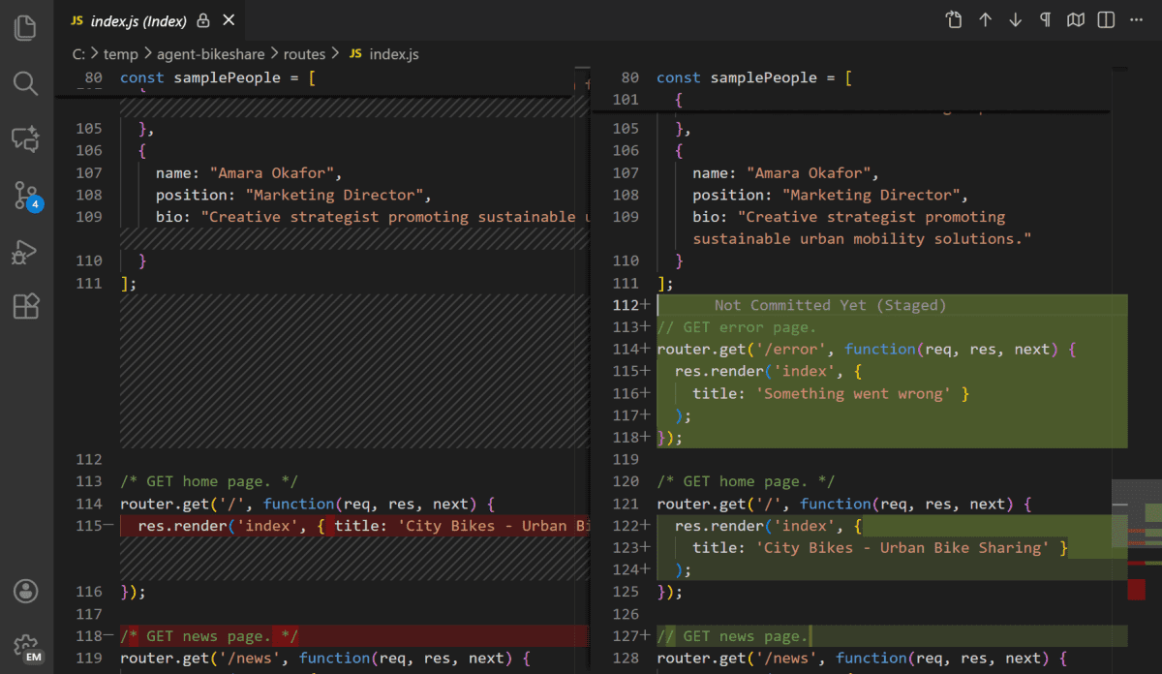
Reviewing the work
Read the changed files and the diff.
Check the output and required tests.
Ask for an execution report.
Accept, revise, or restore a checkpoint.
Notes:
SLIDE 26: Reviewing the work
TIME: 1:05 (includes any demo on this slide)
PURPOSE: Read the changed files and the diff.
SAY
A diff shows what changed between versions. Read it alongside the actual output: a page can look correct while a source value is wrong. Ask for an execution report listing files changed, commands run, checks performed, and anything skipped or uncertain. The report guides your inspection; it is not independent proof. A checkpoint or saved copy gives you a way back. Review existing work before committing or restoring anything.
SHOW / DO
Point out the before and after sides of the screenshot. Read this reusable line: “Report every file changed, what you verified and how, and anything you skipped or were unsure about.”
TRANSITION
Standing instructions help make this review process consistent.
SOURCE
https://nimdvir.github.io/cce-2026/explanation.html#reviewing-agent-work
Current project materials reviewed September 30, 2026. Screenshots are prepared examples and may differ from the installed interface.

Slide 27
Workspace instructions
A workspace holds related project files.
AGENTS.md records project guidance.
Personal instructions hold broader preferences.
Check which instructions the tool loaded.
Notes:
SLIDE 27: Workspace instructions
TIME: 1:00 (includes any demo on this slide)
PURPOSE: A workspace holds related project files.
SAY
We introduced the workspace as the open project folder. Now add standing instructions. AGENTS.md can describe project rules for tools that support it: inspect sources, keep naming conventions, and ask before publishing. Personal or user-level instructions can express preferences that apply across projects. Support and file locations vary by tool. Confirm what was loaded instead of assuming every assistant reads every file. These instructions guide behavior; they are not a substitute for access controls or review.
SHOW / DO
Describe source/, drafts/, output/, prompts/, and an instruction file at the project level. Save the live file opening for the short workflow tour.
TRANSITION
A recurring request can also become a saved prompt.
SOURCE
https://nimdvir.github.io/cce-2026/explanation.html#what-is-agentsmd
Current project materials reviewed September 30, 2026. Screenshots are prepared examples and may differ from the installed interface.
Customization references: https://code.visualstudio.com/docs/agent-customization/custom-instructions ; https://code.visualstudio.com/docs/agent-customization/prompt-files ; https://code.visualstudio.com/docs/agent-customization/agent-skills

Slide 28
Reusable prompts
Save the task once as a prompt file.
Supply the current sources each time.
Run it, inspect the result, and revise.
Notes:
SLIDE 28: Reusable prompts
TIME: 0:50 (includes any demo on this slide)
PURPOSE: Save the task once as a prompt file.
SAY
A saved prompt captures a task you expect to repeat. The site uses update-syllabus.prompt.md as an example. In a compatible Copilot setup, it can appear as /update-syllabus. Current VS Code behavior differs between Local and Agent Host sessions, and some newer workflows migrate prompt files to skills. For this talk, demonstrate the behavior you verified before the session. If the shortcut is unavailable, open the saved text and use it directly without changing the lesson.
SHOW / DO
Explain workspace-specific prompts versus personal prompts. Do not run the Spring 2027 update during this presentation.
IF IT STALLS
Open the saved prompt as a file and read its goal, source, and constraints.
TRANSITION
A skill packages a reusable procedure rather than one request.
SOURCE
https://nimdvir.github.io/cce-2026/explanation.html#reusable-prompts
Current project materials reviewed September 30, 2026. Screenshots are prepared examples and may differ from the installed interface.
Customization references: https://code.visualstudio.com/docs/agent-customization/custom-instructions ; https://code.visualstudio.com/docs/agent-customization/prompt-files ; https://code.visualstudio.com/docs/agent-customization/agent-skills

Slide 29
Skills
A skill describes how to do a type of task.
Syllabus consistency: dates, weights, policies, and links.
Its output includes findings and unresolved decisions.
Notes:
SLIDE 29: Skills
TIME: 0:50 (includes any demo on this slide)
PURPOSE: A skill describes how to do a type of task.
SAY
The syllabus-consistency example is a procedure for reviewing a revision. It specifies what to compare, what to preserve, and what to report. It may include supporting scripts or reference files. A skill can guide recurring work, but the quality still depends on its instructions and evidence. Ask for a report that points to the affected passages and separates confirmed errors from decisions for the instructor.
SHOW / DO
Name SKILL.md and describe the checks. The complete example is in the syllabus walkthrough. Tool discovery locations vary, so open the verified file rather than guessing a path on stage.
TRANSITION
These pieces work together.
SOURCE
https://nimdvir.github.io/cce-2026/explanation.html#skills
Current project materials reviewed September 30, 2026. Screenshots are prepared examples and may differ from the installed interface.
Customization references: https://code.visualstudio.com/docs/agent-customization/custom-instructions ; https://code.visualstudio.com/docs/agent-customization/prompt-files ; https://code.visualstudio.com/docs/agent-customization/agent-skills

Slide 30
From prompting to workflows
Prompt: one request
Saved prompt: a recurring request
Project instructions: standing guidance
Skill: a reusable procedure
Workflow: the steps and review together
VS Code files
Notes:
SLIDE 30: From prompting to workflows
TIME: 2:20 (includes any demo on this slide)
PURPOSE: Prompt: one request
SAY
These are different layers, not a ranking where the last one makes the others unnecessary. You give a task, reuse useful wording, provide project rules, and apply a procedure where it helps. A workflow connects those pieces to sources, outputs, and human decisions. The practical benefit is less repeated explanation and a clearer record of how the work was done.
SHOW / DO
D3: Switch to VS Code for about two minutes. Open the project AGENTS.md, the saved update-syllabus.prompt.md, and the syllabus-consistency SKILL.md from the prepared walkthrough. Point to one rule in each. Show the slash-command list only if preflight confirmed it works. Run nothing. Return to Examples.
IF IT STALLS
Stay on the slide and describe the three already-saved files. This two-minute tour is an easy cut if time is short.
TRANSITION
We can now inspect the four completed projects with these ideas in mind.
SOURCE
https://nimdvir.github.io/cce-2026/explanation.html#from-prompt-to-workflow
Current project materials reviewed September 30, 2026. Screenshots are prepared examples and may differ from the installed interface.
Customization references: https://code.visualstudio.com/docs/agent-customization/custom-instructions ; https://code.visualstudio.com/docs/agent-customization/prompt-files ; https://code.visualstudio.com/docs/agent-customization/agent-skills

Slide 31
5. The Examples
Website, syllabus, data reports, and courseware
Notes:
SLIDE 31: 5. The Examples
TIME: 0:15 (includes any demo on this slide)
PURPOSE: Website, syllabus, data reports, and courseware
SAY
The examples are prepared. We will inspect the result, explain the task, and identify what required review. Only one small website change may run live. If the tool is slow, the screenshots and saved examples carry the same teaching point.
SHOW / DO
D4 begins. Keep the Examples browser page as the navigation hub. The next seven slides are signposts and fallbacks for a roughly seventeen-minute demonstration block.
TRANSITION
First, the conference website itself.
SOURCE
https://nimdvir.github.io/cce-2026/examples.html
Current project materials reviewed September 30, 2026. Screenshots are prepared examples and may differ from the installed interface.

Slide 32
1. The conference website
Notes and an outline guide the pages.
Markdown and a template produce HTML.
Review precedes publishing.
Browser + VS Code
Notes:
SLIDE 32: 1. The conference website
TIME: 1:00 (includes any demo on this slide)
PURPOSE: Notes and an outline guide the pages.
SAY
The site began with notes, an outline, and the session description. The agent helped draft Markdown source pages. A build script combines them with a shared template and styles. Reviewed files can then go to GitHub Pages. The important relationship is source to generated output: changing the source and rebuilding is easier to review than hand-editing generated pages. The current site has an About page in addition to the original four-page structure.
SHOW / DO
Open the website walkthrough and the finished page. In VS Code, place docs/content/intro.md beside its rendered result. Identify one sentence that appears in both. Explain where build.py fits.
IF IT STALLS
Use the prepared site screenshot and explain the source-to-page relationship.
TRANSITION
Now a deliberately small edit makes the process visible.
SOURCE
https://nimdvir.github.io/cce-2026/examples/site/index.html
Current project materials reviewed September 30, 2026. Screenshots are prepared examples and may differ from the installed interface.

Slide 33
1. One small site edit
Change one welcome sentence.
Review the plan and the exact diff.
Rebuild and preview locally.
Publishing is a separate step.
Optional live edit
Notes:
SLIDE 33: 1. One small site edit
TIME: 3:00 (includes any demo on this slide)
PURPOSE: Change one welcome sentence.
SAY
We are giving the agent a narrow task with a visible result. First inspect its plan, then let it change only the welcome sentence. Afterward, look at the diff before accepting the result. A rebuilt page can look right even if unrelated files changed, which is why we inspect both. This example ends at a local preview. We are not committing, pushing, or publishing during the demonstration.
SHOW / DO
Open the prepared small-edit prompt. Ask Plan to describe the bounded change, then switch to the tested action mode. Prompt: “In docs/content/intro.md, change only the sentence marked LIVE BANNER to a short welcome for the CCE 2026 audience. Keep the marker and all links. Rebuild with python docs/build.py. Show the diff and a local preview. Do not commit or push.” Use the exact working folder already opened. Stop waiting after about 30 seconds if it stalls.
IF IT STALLS
Show the current source sentence and the prepared website screenshot. Explain the intended replacement and how a diff would isolate it. Use a saved before/after diff if preflight found one; do not pretend it ran live.
TRANSITION
The next example changes a document’s format while preserving its meaning.
SOURCE
https://nimdvir.github.io/cce-2026/examples/site/index.html#try
Current project materials reviewed September 30, 2026. Screenshots are prepared examples and may differ from the installed interface.

Slide 34

2. Word syllabus to HTML
Preserve the original content during conversion.
Review semester changes separately.
Browser walkthrough
Notes:
SLIDE 34: 2. Word syllabus to HTML
TIME: 1:30 (includes any demo on this slide)
PURPOSE: Preserve the original content during conversion.
SAY
The older Word syllabus and the current HTML syllabus are different semester versions. Their screenshots illustrate the format change, not proof that every word is identical. A safe conversion inventories headings, tables, policies, dates, and links, then compares the content. Semester decisions should be explicit rather than introduced silently while improving the layout. The instructor determines the current authoritative version.
SHOW / DO
Show the Word title screenshot, then the current HTML syllabus. Point to navigation and readable headings. Keep the original private source and meeting credentials off the projected screen.
IF IT STALLS
Use the two prepared screenshots on this slide. Explain what you would compare in a conversion.
TRANSITION
The review checks individual values as well as the overall appearance.
SOURCE
https://nimdvir.github.io/cce-2026/examples/syllabus/index.html
Current project materials reviewed September 30, 2026. Screenshots are prepared examples and may differ from the installed interface.

Slide 35
2. Checking the syllabus
Each grading component stays correct.
25 + 25 + 8 + 8 + 12 + 12 + 10 = 100
Dates, policies, and links need review.
One heading edit has an explicit change report.
Prepared diff
Notes:
SLIDE 35: 2. Checking the syllabus
TIME: 2:30 (includes any demo on this slide)
PURPOSE: Each grading component stays correct.
SAY
The current syllabus’s seven weights sum to 100. That total is necessary but not sufficient: two incorrect weights could still add to 100. Check each component against the authoritative source. The prepared edit changes “Course Schedule” to “Course Schedule and Deadlines.” Dates, policies, and weights remain outside that task. Inspect the diff and change report to see whether the scope was respected.
SHOW / DO
In the syllabus walkthrough, open the grading excerpt and the linked review files: syllabus-change.diff and syllabus-change-report.md. Point to the one heading change and the checks. Keep this prepared; a second live edit is optional only if ample time remains.
IF IT STALLS
Read the before/after heading aloud and explain the component-by-component check using the displayed sum.
TRANSITION
Data analysis adds another kind of review: what exactly was counted?
SOURCE
https://nimdvir.github.io/cce-2026/examples/syllabus/index.html#review
Current project materials reviewed September 30, 2026. Screenshots are prepared examples and may differ from the installed interface.

Slide 36
3. One dataset, two reports
2,436 form submissions; 9 columns
One record is one submission.
Both reports show eight main sessions.
No student ID supports unique-student counts.
Two prepared reports
Notes:
SLIDE 36: 3. One dataset, two reports
TIME: 2:00 (includes any demo on this slide)
PURPOSE: 2,436 form submissions; 9 columns
SAY
This export contains 2,436 parsed records and nine columns. It does not identify unique students. The two reports agree on eight main-session counts: 310, 318, 320, 302, 294, 291, 297, and 283. They selected dates with at least 50 submissions as sessions; 21 other date entries remain outside those groups. That threshold is a method choice. Also, a CSV record may contain line breaks, so counting physical lines is not a reliable row count.
SHOW / DO
Open the saved Claude and DeepSeek reports at their session charts. Show aggregate outputs only, not the raw CSV or free-text responses. Mention that the walkthrough checked the figures against the saved reports, not by rerunning both analysis scripts here.
IF IT STALLS
Use the prepared chart. Note that the eight session counts sum to 2,415, with 21 other-date submissions giving 2,436.
TRANSITION
Agreement on totals does not mean the reports ask every question in the same way.
SOURCE
https://nimdvir.github.io/cce-2026/examples/data-analysis/index.html
Current project materials reviewed September 30, 2026. Screenshots are prepared examples and may differ from the installed interface.

Slide 37
3. Different denominators
Claude: 253 / 283 = about 89%
DeepSeek: 244 / 262 = 93.1%
Session answers and question clusters select different records.
These reports are not a controlled model benchmark.
Compare methods
Notes:
SLIDE 37: 3. Different denominators
TIME: 4:00 (includes any demo on this slide)
PURPOSE: Claude: 253 / 283 = about 89%
SAY
The practice-test results look like competing answers, but the selection rules differ. Claude uses all 283 answers in the selected session. DeepSeek uses 262 responses in a normalized question-family cluster. Before choosing a percentage, decide which population answers your question. Exact model versions and identical historical prompts have not been verified, so we cannot call this a controlled model comparison. The lesson is to document grouping rules, denominators, exclusions, and interpretation.
SHOW / DO
Show the two practice-test result cards from the walkthrough. Ask the audience, “What exactly was counted?” Then identify each denominator. If time permits, mention that absence-category differences also reflect keyword and rule-order choices. Show the reusable analysis prompt, not raw responses. Finish by asking what evidence would resolve the methodological choice.
IF IT STALLS
Use the native numbers on this slide. Explain each denominator and ask which question the audience actually wants to answer.
TRANSITION
The final project uses the same bounded tasks across a much larger system.
SOURCE
https://nimdvir.github.io/cce-2026/examples/data-analysis/index.html#step-4
Current project materials reviewed September 30, 2026. Screenshots are prepared examples and may differ from the installed interface.

Slide 38
4. Interactive courseware
Chapters and labs become a learning environment.
Content, interface, access, and hosting work together.
Small changes still need review.
Browser tour
Notes:
SLIDE 38: 4. Interactive courseware
TIME: 3:00 (includes any demo on this slide)
PURPOSE: Chapters and labs become a learning environment.
SAY
This continuing project brings chapter content, activities, labs, and navigation together. The walkthrough describes Google Drive for working materials, GitHub for reviewed source history, React and TypeScript for the reader, Vite and content scripts for builds, Supabase for account access, and Vercel for hosting. Participants do not need to memorize the stack. The transferable process is to organize sources, make a bounded change, preview it, and verify the affected reading and access paths.
SHOW / DO
Tour the public landing page and learning structure for about three minutes. Use the walkthrough component table if useful. Do not open student accounts, modify access rules, or deploy. End the browser demonstration and return to the SWOT slide.
IF IT STALLS
Use the prepared landing-page screenshot and explain content, interface, access, and hosting in plain language.
TRANSITION
These examples show both the opportunity and the responsibility.
SOURCE
https://nimdvir.github.io/cce-2026/examples/courseware/index.html
Current project materials reviewed September 30, 2026. Screenshots are prepared examples and may differ from the installed interface.

Slide 39
Agents: a SWOT view
Strengths
Multi-step work with files and tools
Weaknesses
Errors and limited context
Opportunities
Repeatable academic workflows
Threats
Unreviewed changes and data exposure
Delegate work, not responsibility.
Notes:
SLIDE 39: Agents: a SWOT view
TIME: 1:30 (includes any demo on this slide)
PURPOSE: Strengths: Multi-step work with files and tools
SAY
Agents can make file-based work faster and help us build things we could not previously build. They can also make plausible errors at scale. Use reviewed sources, clear boundaries, checkpoints, and output checks. Know where data is processed, follow institutional requirements, and keep sensitive student information out of public demonstrations. For grading assistance, an agent can organize evidence against a rubric and draft feedback, while the instructor reviews the evidence and decides. This is a possible workflow, not a grading demonstration we ran today. Delegate work, not responsibility.
SHOW / DO
Read one point in each quadrant. Ask which risk the audience would want to control first. Connect each risk to a concrete safeguard instead of ending with generic caution.
TRANSITION
The companion site contains the material you can take away.
SOURCE
https://nimdvir.github.io/cce-2026/explanation.html#responsible-use
Current project materials reviewed September 30, 2026. Screenshots are prepared examples and may differ from the installed interface.

Slide 40
Take it with you
Choose one small, recurring task.
Use the relevant files and clear boundaries.
Review the result and save what worked.
spoo.me/cHzhyF2
Notes:
SLIDE 40: Take it with you
TIME: 0:35 (includes any demo on this slide)
PURPOSE: Choose one small, recurring task.
SAY
The site contains definitions, setup help, walkthroughs, and reusable prompts. Pick one small task where you already know what a good result looks like. Give the agent the relevant files, define the boundaries, and inspect the result. Save the prompt and instructions that helped. Begin with a manageable task before expanding to a whole course or system.
SHOW / DO
Leave the QR visible long enough to scan. The short URL is clickable; the companion site also links to the public repository. Avoid promising recordings or resources that have not been prepared.
TRANSITION
What would you try, and what would you check?
SOURCE
https://nimdvir.github.io/cce-2026/examples.html#resources
Current project materials reviewed September 30, 2026. Screenshots are prepared examples and may differ from the installed interface.

Slide 41
Questions and thank you
Which recurring task would you try?
What would you check before using the result?
Nim Dvir
ndvir@albany.edu
nimdvir.com
Notes:
SLIDE 41: Questions and thank you
TIME: 0:20 (includes any demo on this slide)
PURPOSE: Which recurring task would you try?
SAY
Thank you. I would like to hear about one recurring task you might try and the evidence you would want before trusting the output. If someone asks about a tool or model we did not test, distinguish the general workflow from a configuration that needs checking. Invite follow-up through the contact information here.
SHOW / DO
Use the remaining time for questions. Return to the QR slide if someone needs the site link. Q&A time is additional to the planned presentation route.
SOURCE
https://nimdvir.github.io/cce-2026/about.html
Current project materials reviewed September 30, 2026. Screenshots are prepared examples and may differ from the installed interface.

