Slide 1

Zang Toi
zangtoi.com
Project Contact: Nim Dvir | Nimrod.dvir@gmail.com | +1-646-244-2338
N.O.M Web Development
Goals
Branding - Transfer the essence of the brand
PR & Press Information - Information to be used by journalists and bloggers
Marketing - Creating, collecting and maintaining a mailing list
Conversion & Retention - Directing customers to store locations, sales and promotions

Slide 2
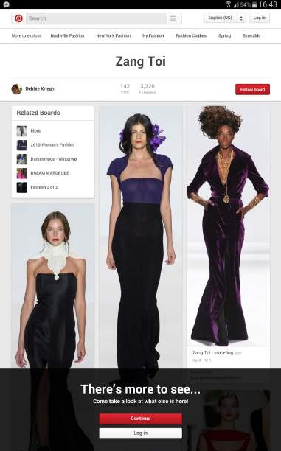
Scope / Products
Website (including mobile)
Pinterest
Wiki page
Web analytics
Directions
Clean, white, elegant. symmetric, no clutter, big images (little text / expendable)
Inspiration - France, Greece, chandelier, royalty, Marie Antoinette
Requirements
Mobile responsiveness - current website doesn’t display well on mobile devices
Lead collection - growing your mailing list using a form on the website

Slide 3
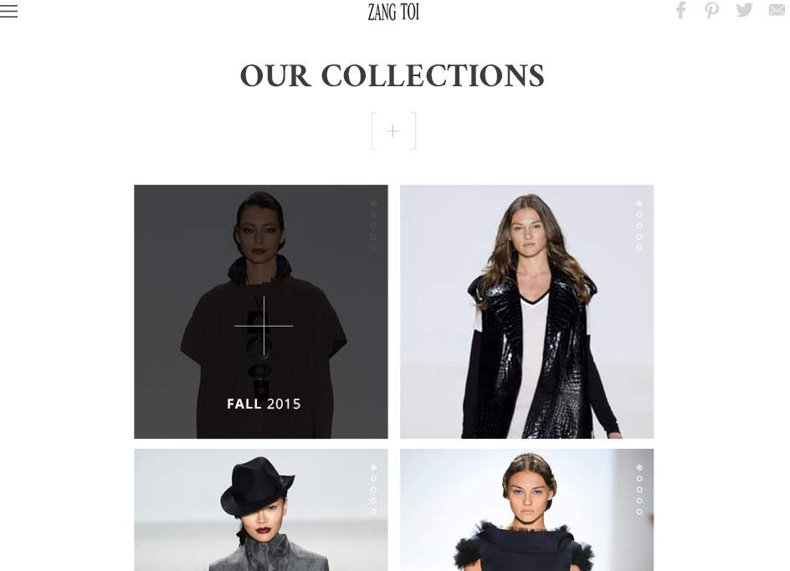
Big images, clean design
Image in center with expandable text and share buttons

Slide 4
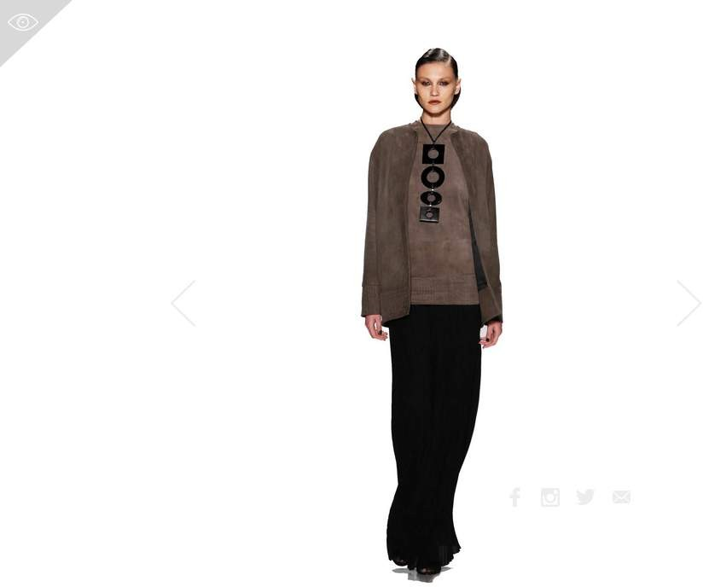

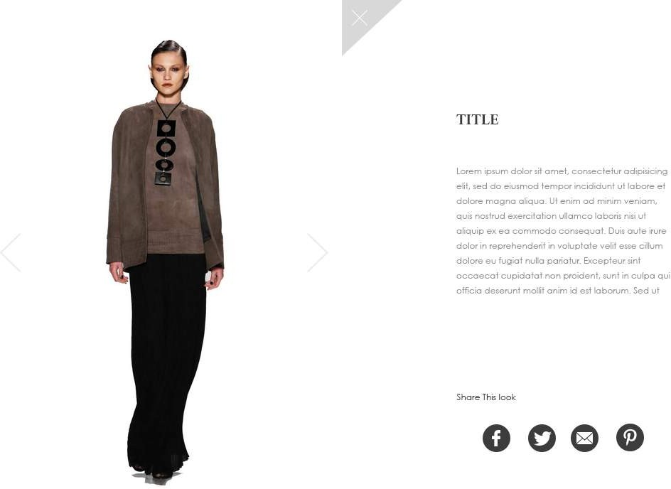
The text appears when you click the + or
on the image (details on the clothes)

Slide 5
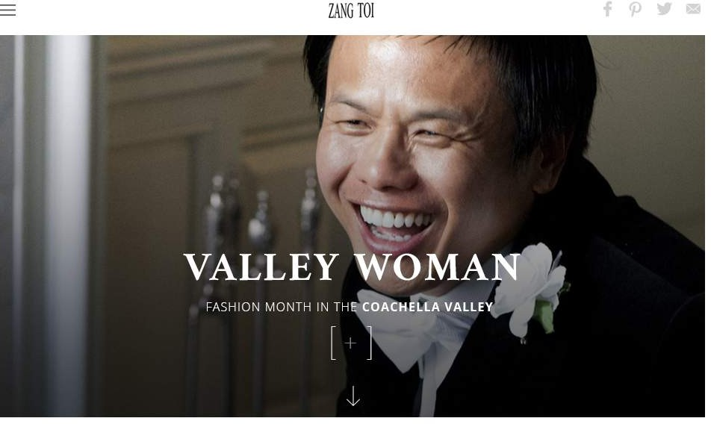
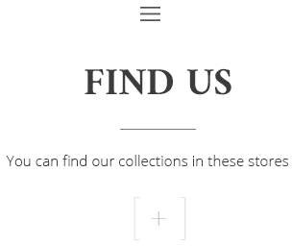
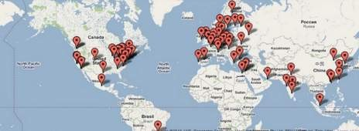
Latest news with video. clean design, image based.
Map visually indicating where you can buy the collections

Slide 6
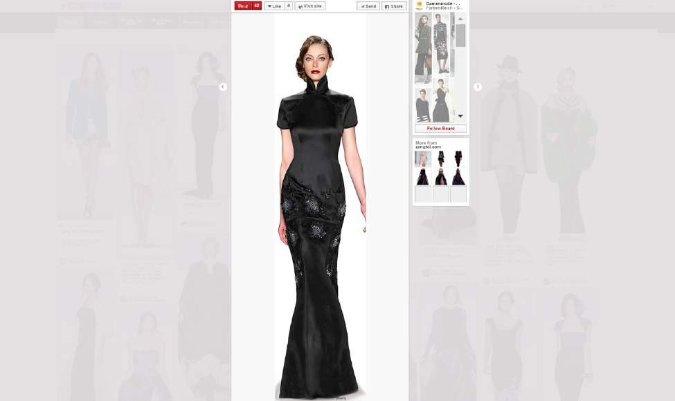
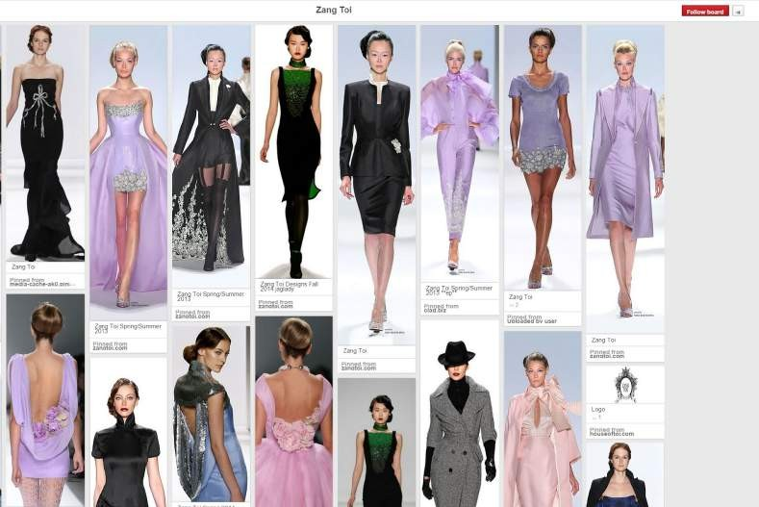
Integration with pinterest boards and social accounts

Slide 7
Thank You!
zangtoi.com

