Slide 1
Welcome to My Presentation

Slide 2
Today My Presentation Topic
On
Visiting Website of Bangladesh
Submitted By:
Md. Al-Amin Hossain
Id:142311063
6th Batch, 8th Semester
Dept. Of CSE
VU, Rajshahi
Submitted To:
Krishna Chandro Ray
Lecturer, Dept. of CSE
VU, Rajshahi

Slide 3
Title: Visiting Website of Bangladesh
Project Objectives:
This proposal summarizes the estimated features, schedule, and investment required to deliver a successful website for the Bangladesh Area Development Corporation.
The developer’s proposed website solution would help the project office to:
Establish an online portal to enhance and support the concept of a virtual town square.
Provide a clear online message and easy navigation.
Offer information on VCTS (Virtual Bangladesh Town Squares) products specific to its market and stakeholders.
Promote organizational brand awareness and increase visibility.
Increase customer convenience.
Broaden exposure with increased Internet marketing.
Promote the exchange of information and sharing of ideas in a secure and accessible environment.

Slide 4
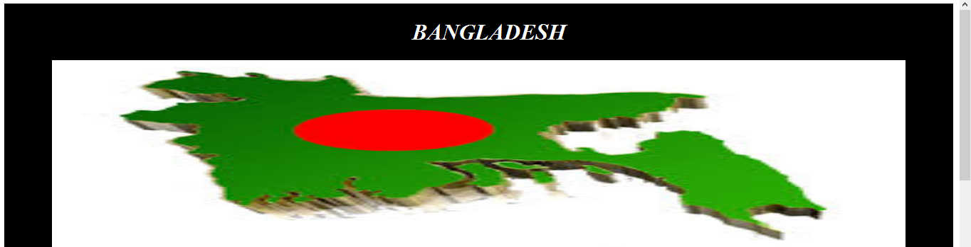
Website Structures
Header

Slide 5
Website Structures
Menu Bar (Home, Division, BD Map, Communication Way, Historical Places, Info Center etc.)

Slide 6
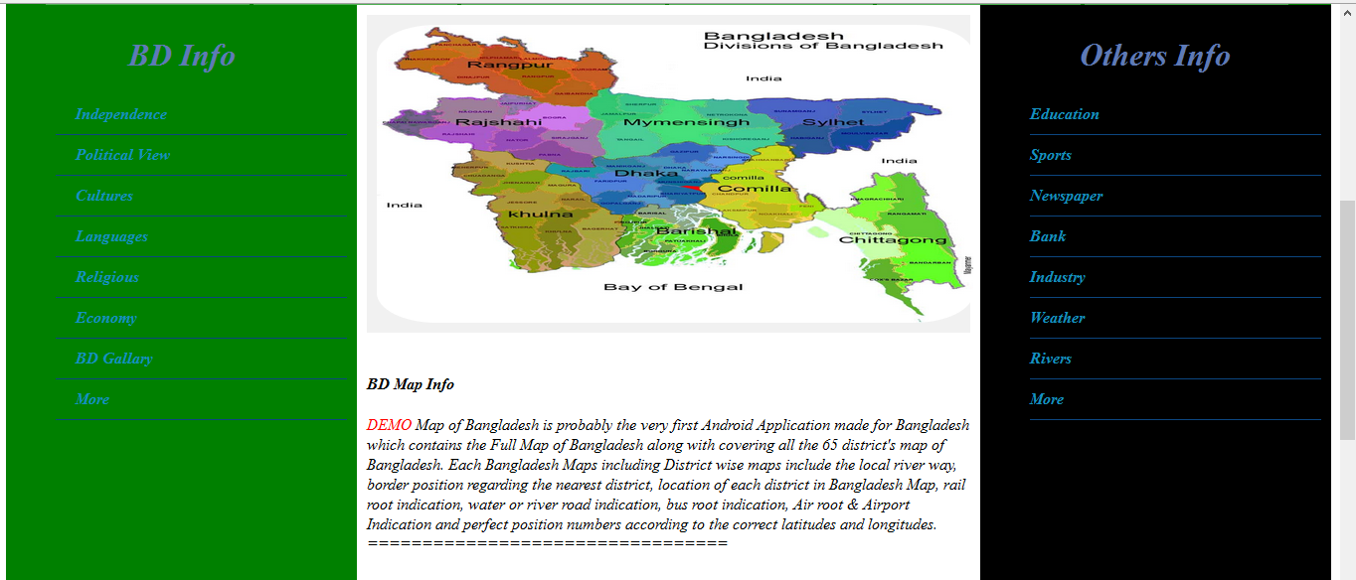
Website Structures
Body(Left, Middle and Right)

Slide 7
Website Structures
Footer

Slide 8
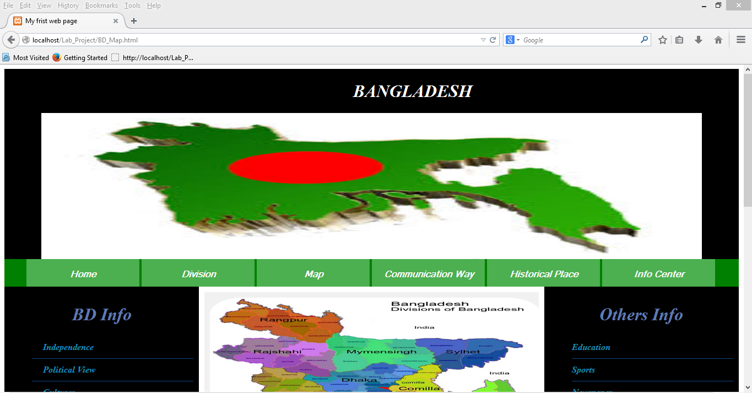
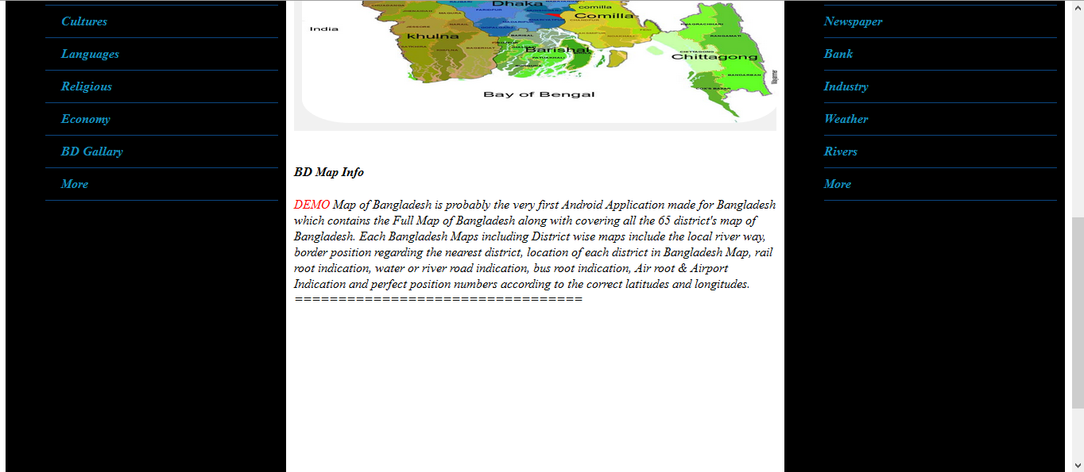
Demo

Slide 9
Uses Language
HTML
CSS
PHP and
JavaScript

Slide 10
Website Timeline and Schedules
Stage-1: Concept Development
Stage-2: Planning
Stage-3: Implementation
Stage-4: Testing
Stage-5: Launch and Phase Out
This plan presents an overview of the basic schedule in the development of your website. The proposed schedule is divided into five stages: Concept Development, Planning, Implementation, Testing and Launch & Phase Out.

Slide 11
Project Features
A date stamp on every page created with HTML, CSS, PHP, and JavaScript implemented to emphasize that the site is current and contains regularly updated content.
A Dynamic Site Map will help direct each visitor to specific VCTS (Virtual Bangladesh Town Squares) information. The site map will be designed with a graphic interface that represents the town square and contains illustrations to represent each of the features.
A feedback form for users to submit their email address to suggest improvements or requests for additional data.
This product allows VCTS (Virtual Bangladesh Town Squares) staff or other stakeholders in the Smart Community to install documents, videos, sound files, etc. to the website and associate it with a link visible to site visitors.
Three levels of security for data entry or for managing and sharing information through the website. Level 0 access identifies information available to the general public by public subscription, level 1 will refer to clerical access to back-end data entry, and level 2 will be administrative access to the data entry system.

Slide 12
Any Questions
???

Slide 13
That’s All About My Presentation
Thanks to All

