Slide 1
Dave Reed
Connectionist approach to AI
  neural networks, neuron model
  perceptrons
    threshold logic, perceptron training, convergence theorem
    single layer vs. multi-layer
  backpropagation
    stepwise vs. continuous activation function
  associative memory
    Hopfield networks, parallel relaxation

Slide 2
Symbolic vs. sub-symbolic AI
recall: Good Old-Fashioned AI is inherently symbolic
  Physical Symbol System Hypothesis: A necessary and sufficient condition for intelligence is the representation and manipulation of symbols.
alternatives to symbolic AI
  connectionist models – based on a brain metaphor
    model individual neurons and their connections
    properties: parallel, distributed, sub-symbolic
    examples: neural nets, associative memories
  emergent models – based on an evolution metaphor
    potential solutions compete and evolve
    properties: massively parallel,
    complex behavior evolves out of simple behavior
    examples: genetic algorithms, cellular automata, artificial life

Slide 3
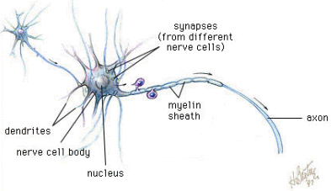
Connectionist models (neural nets)
  humans lack the speed & memory of computers
  yet humans are capable of complex reasoning/action
  → maybe our brain architecture is well-suited for certain tasks
general brain architecture:
  many (relatively) slow neurons, interconnected
  dendrites serve as input devices (receive electrical impulses from other neurons)
  cell body "sums" inputs from the dendrites (possibly inhibiting or exciting)
  if sum exceeds some threshold, the neuron fires an output impulse along axon

Slide 4
Brain metaphor
connectionist models are based on the brain metaphor
  large number of simple, neuron-like processing elements
  large number of weighted connections between neurons
    note: the weights encode information, not symbols!
  parallel, distributed control
  emphasis on learning
brief history of neural nets
  1940's theoretical birth of neural networks
  McCulloch & Pitts (1943), Hebb (1949)
  1950's & 1960's optimistic development using computer models
  Minsky (50's), Rosenblatt (60's)
  1970's DEAD
  Minsky & Papert showed serious limitations
  1980's & 1990's REBIRTH – new models, new techniques
  Backpropagation, Hopfield nets

Slide 5
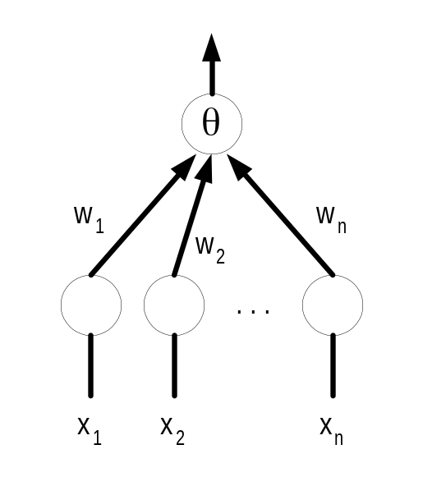
Artificial neurons
McCulloch & Pitts (1943) described an artificial neuron
  inputs are either excitatory (+1) or inhibitory (-1)
  each input has a weight associated with it
  the activation function multiplies each input value by its weight
  if the sum of the weighted inputs >= θ,
    then the neuron fires (returns 1), else doesn't fire (returns –1)
if Σw_{i}x_{i} >= θ, output = 1
if Σw_{i}x_{i} < θ, output -1

Slide 6
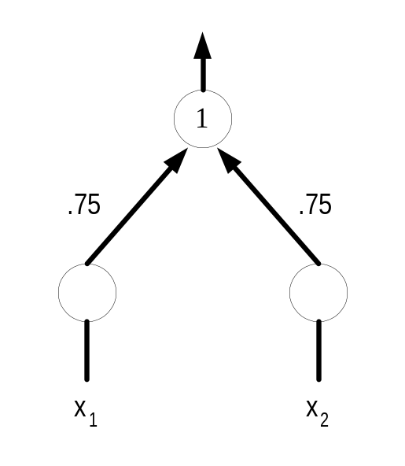
Computation via activation function
can view an artificial neuron as a computational element
  accepts or classifies an input if the output fires
INPUT: x₁ = 1, x₂ = 1
  .75*1 + .75*1 = 1.5 >= 1 ➔ OUTPUT: 1
INPUT: x₁ = 1, x₂ = -1
  .75*1 + .75*-1 = 0 < 1 ➔ OUTPUT: -1
INPUT: x₁ = -1, x₂ = 1
  .75*-1 + .75*1 = 0 < 1 ➔ OUTPUT: -1
INPUT: x₁ = -1, x₂ = -1
  .75*-1 + .75*-1 = -1.5 < 1 ➔ OUTPUT: -1
this neuron computes the AND function

Slide 7
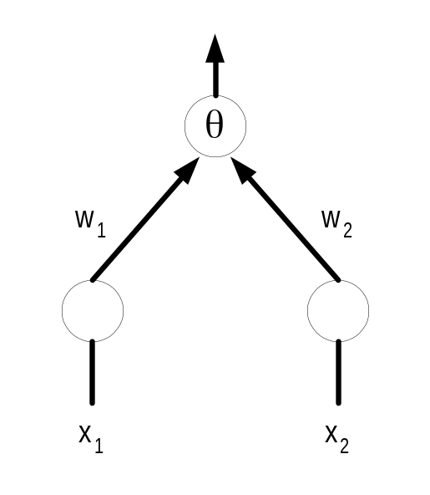
In-class exercise
specify weights and thresholds to compute OR
INPUT: x₁ = 1, x₂ = 1
  w₁*1 + w₂*1 >= θ ➔ OUTPUT: 1
INPUT: x₁ = 1, x₂ = -1
  w₁*1 + w₂*-1 >= θ ➔ OUTPUT: 1
INPUT: x₁ = -1, x₂ = 1
  w₁*-1 + w₂*1 >= θ ➔ OUTPUT: 1
INPUT: x₁ = -1, x₂ = -1
  w₁*-1 + w₂*-1 < θ ➔ OUTPUT: -1

Slide 8
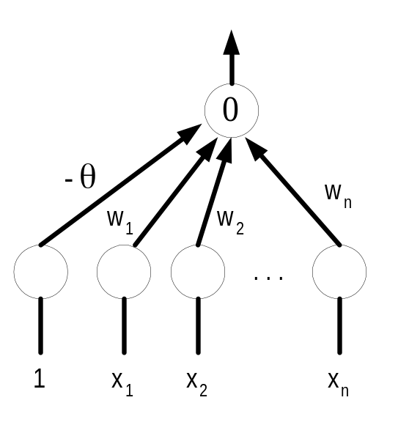
Normalizing thresholds
to make life more uniform, can normalize the threshold to 0
  simply add an additional input x₀ = 1, w₀ = -θ
advantage: threshold = 0 for all neurons
  Σw_{i}x_{i} >= θ ≡ -θ*1 + Σw_{i}x_{i} >= 0

Slide 9
Perceptrons
Rosenblatt (1958) devised a learning algorithm for artificial neurons
  given a training set (example inputs & corresponding desired outputs)
    start with some initial weights
    iterate through the training set, collect incorrect examples
    if all examples correct, then DONE
    otherwise, update the weights for each incorrect example
      if x₁, …,x_{n} should have fired but didn't, w_{i} += x_{i} (0 <= i <= n)
      if x₁, …,x_{n} shouldn't have fired but did, w_{i} -= x_{i} (0 <= i <= n)
    GO TO 2
artificial neurons that utilize this learning algorithm are known as perceptrons

Slide 10
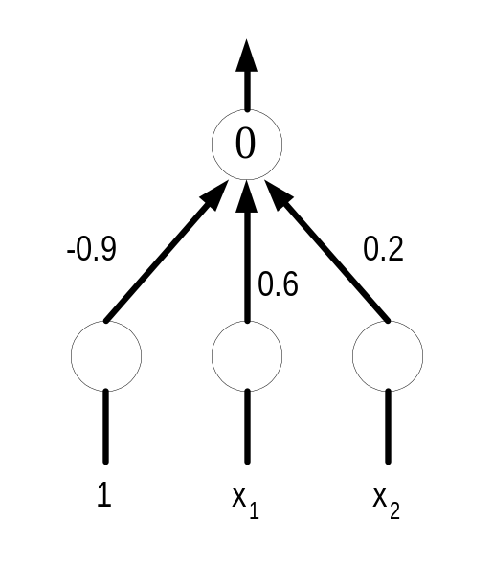
Example: perceptron learning
Suppose we want to train a perceptron to compute AND
  training set: x₁ = 1, x₂ = 1 → 1
  x₁ = 1, x₂ = -1 → -1
  x₁ = -1, x₂ = 1 → -1
  x₁ = -1, x₂ = -1 → -1
randomly, let: w₀ = -0.9, w₁ = 0.6, w₂ = 0.2
using these weights:
x₁ = 1, x₂ = 1: -0.9*1 + 0.6*1 + 0.2*1 = -0.1 → -1 WRONG
x₁ = 1, x₂ = -1: -0.9*1 + 0.6*1 + 0.2*-1 = -0.5 → -1 OK
x₁ = -1, x₂ = 1: -0.9*1 + 0.6*-1 + 0.2*1 = -1.3 → -1 OK
x₁ = -1, x₂ = -1: -0.9*1 + 0.6*-1 + 0.2*-1 = -1.7 → -1 OK
new weights: w₀ = -0.9 + 1 = 0.1
w₁ = 0.6 + 1 = 1.6
w₂ = 0.2 + 1 = 1.2

Slide 11
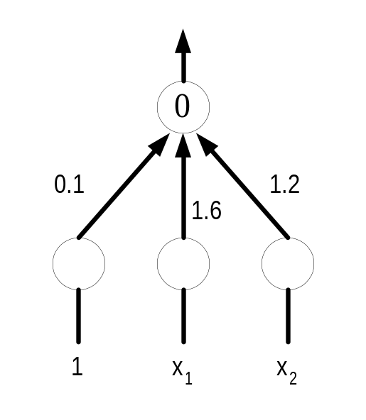
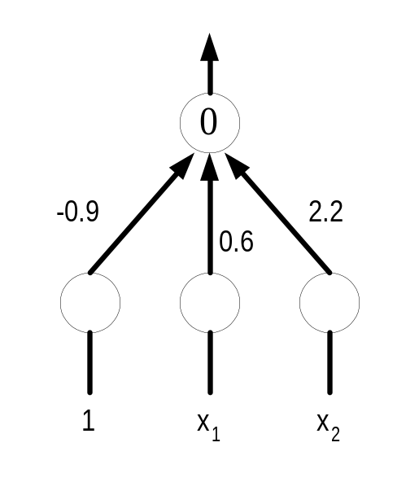
Example: perceptron learning (cont.)
using these updated weights:
x₁ = 1, x₂ = 1: 0.1*1 + 1.6*1 + 1.2*1 = 2.9 → 1 OK
x₁ = 1, x₂ = -1: 0.1*1 + 1.6*1 + 1.2*-1 = 0.5 → 1 WRONG
x₁ = -1, x₂ = 1: 0.1*1 + 1.6*-1 + 1.2*1 = -0.3 → -1 OK
x₁ = -1, x₂ = -1: 0.1*1 + 1.6*-1 + 1.2*-1 = -2.7 → -1 OK
new weights: w₀ = 0.1 – 1 = -0.9
w₁ = 1.6 – 1 = 0.6
w₂ = 1.2 + 1 = 2.2
using these updated weights:
x₁ = 1, x₂ = 1: -0.9*1 + 0.6*1 + 2.2*1 = 1.9 → 1 OK
x₁ = 1, x₂ = -1: -0.9*1 + 0.6*1 + 2.2*-1 = -2.5 → -1 OK
x₁ = -1, x₂ = 1: -0.9*1 + 0.6*-1 + 2.2*1 = 0.7 → 1 WRONG
x₁ = -1, x₂ = -1: -0.9*1 + 0.6*-1 + 2.2*-1 = -3.7 → -1 OK
new weights: w₀ = -0.9 – 1 = -1.9
w₁ = 0.6 + 1 = 1.6
w₂ = 2.2 – 1 = 1.2

Slide 12
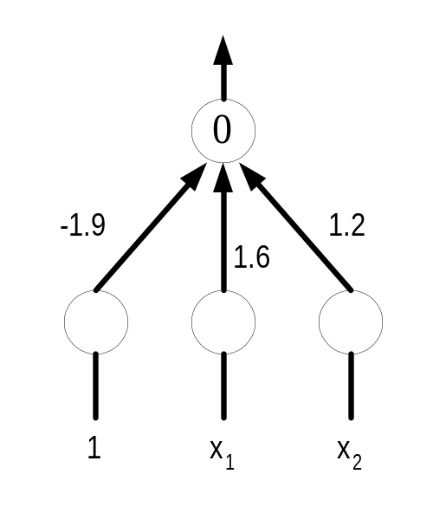
Example: perceptron learning (cont.)
using these updated weights:
x₁ = 1, x₂ = 1: -1.9*1 + 1.6*1 + 1.2*1 = 0.9 → 1 OK
x₁ = 1, x₂ = -1: -1.9*1 + 1.6*1 + 1.2*-1 = -1.5 → -1 OK
x₁ = -1, x₂ = 1: -1.9*1 + 1.6*-1 + 1.2*1 = -2.3 → -1 OK
x₁ = -1, x₂ = -1: -1.9*1 + 1.6*-1 + 1.2*-1 = -4.7 → -1 OK
DONE!
EXERCISE: train a perceptron to compute OR

Slide 13
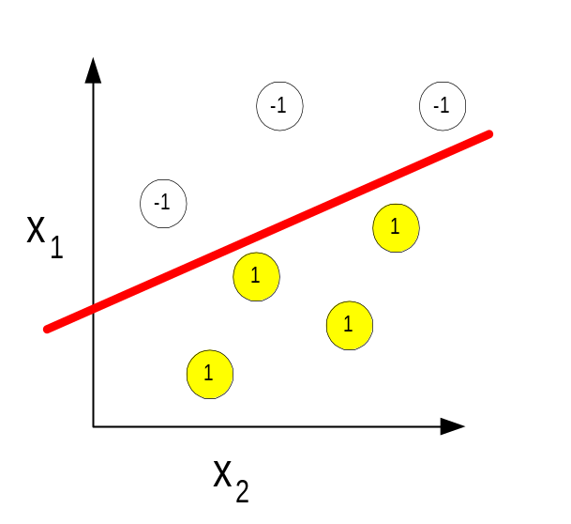
Convergence
key reason for interest in perceptrons:
  Perceptron Convergence Theorem
    The perceptron learning algorithm will always find weights to classify the inputs if such a set of weights exists.
  Minsky & Papert showed such weights exist if and only if the problem is linearly separable
  intuition: consider the case with 2 inputs, x₁ and x₂
if you can draw a line and separate the accepting & non-accepting examples, then linearly separable
the intuition generalizes: for n inputs, must be able to separate with an (n-1)-dimensional plane.

Slide 14
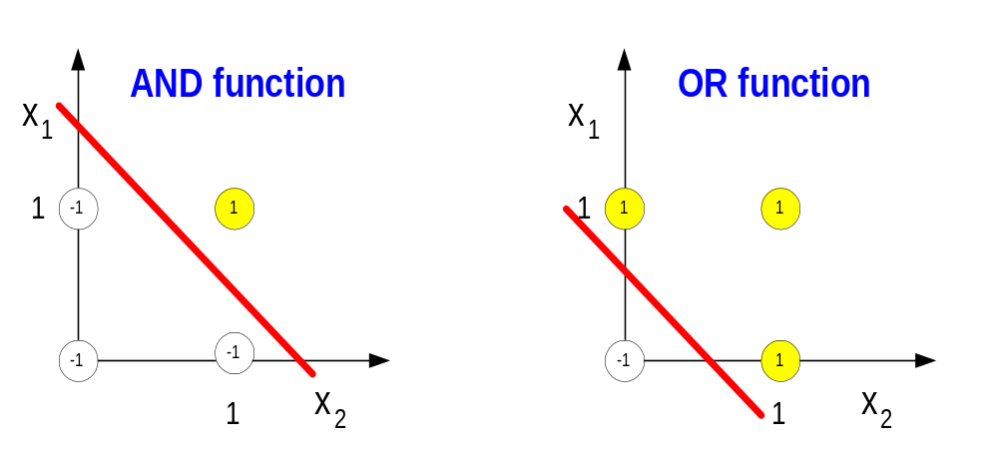
Linearly separable
why does this make sense?
  firing depends on w₀ + w₁x₁ + w₂x₂ >= 0
  border case is when w₀ + w₁x₁ + w₂x₂ = 0
  i.e., x₂ = (-w₁/w₂) x₁ + (-w₀ /w₂) the equation of a line
  the training algorithm simply shifts the line around (by changing the weight) until the classes are separated

Slide 15
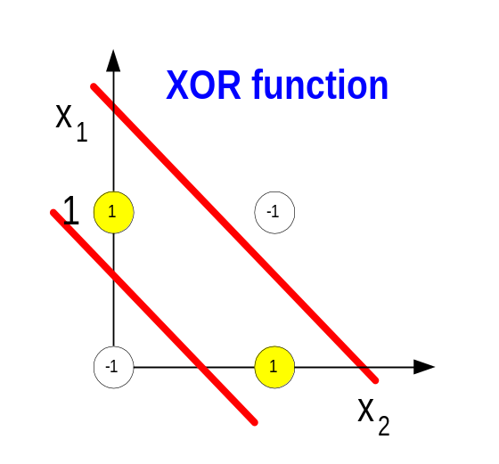
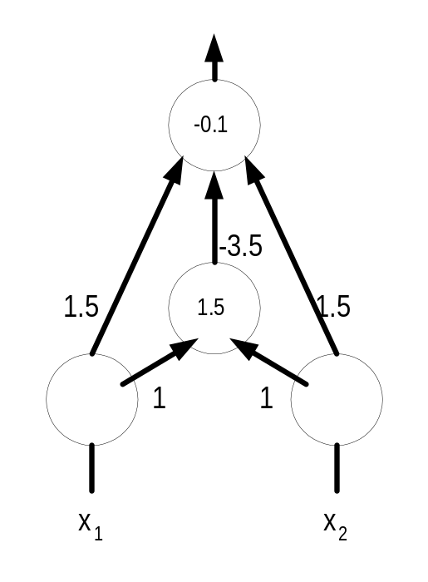
Inadequacy of perceptrons
inadequacy of perceptrons is due to the fact that many simple problems are not linearly separable
however, can compute XOR by introducing a new, hidden unit

Slide 16
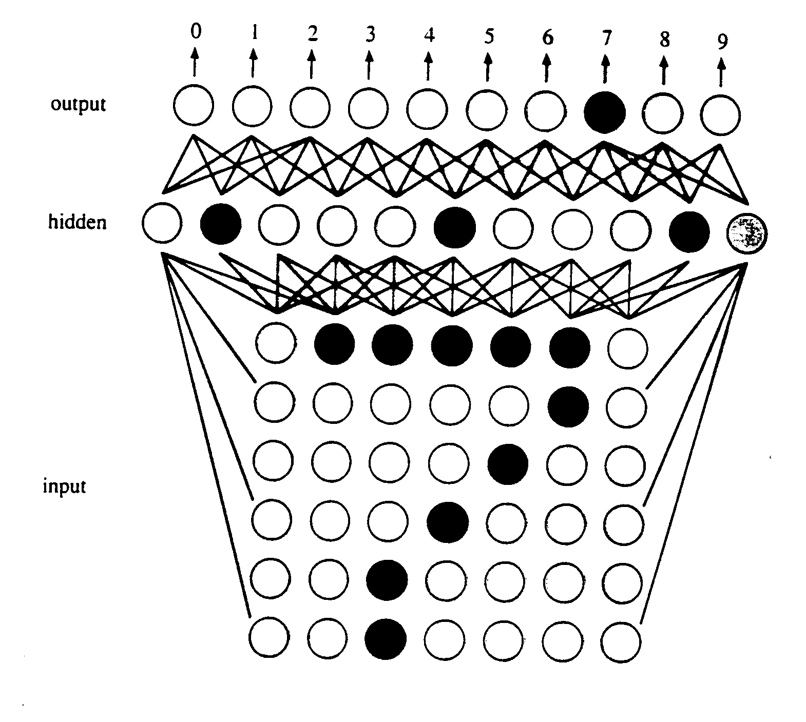
Hidden units
the addition of hidden units allows the network to develop complex feature detectors (i.e., internal representations)
e.g., Optical Character Recognition (OCR)
  perhaps one hidden unit
    "looks for" a horizontal bar
  another hidden unit
    "looks for" a diagonal
  the combination of specific
    hidden units indicates a 7

Slide 17
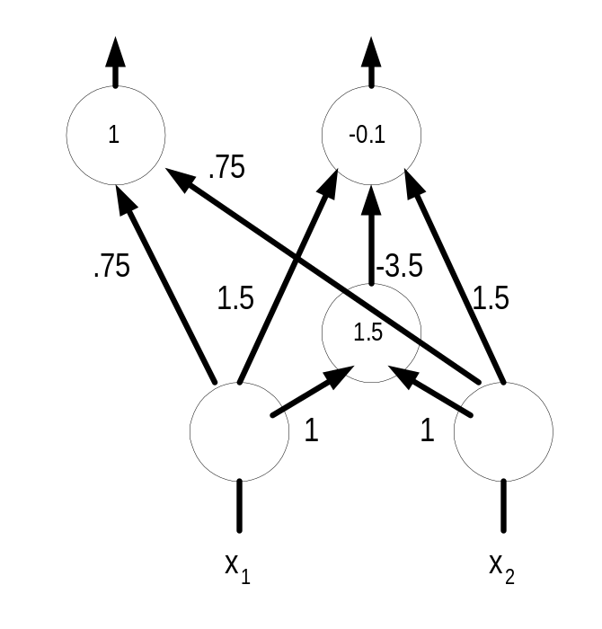
Building multi-layer nets
smaller example: can combine perceptrons to perform more complex computations (or classifications)
3-layer neural net
  2 input nodes
  1 hidden node
  2 output nodes
RESULT?
HINT: left output node is AND
right output node is XOR
FULL ADDER

Slide 18
Hidden units & learning
every classification problem has a perceptron solution if enough hidden layers are used
  i.e., multi-layer networks can compute anything
    (recall: can simulate AND, OR, NOT gates)
expressiveness is not the problem – learning is!
  it is not known how to systematically find solutions
  the Perceptron Learning Algorithm can't adjust weights between levels
Minsky & Papert's results about the "inadequacy" of perceptrons pretty much killed neural net research in the 1970's
rebirth in the 1980's due to several developments
  faster, more parallel computers
  new learning algorithms e.g., backpropagation
  new architectures e.g., Hopfield nets

Slide 19
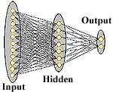
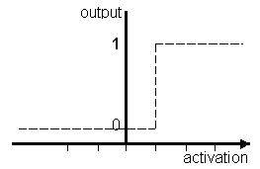
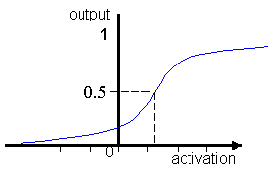
Backpropagation nets
backpropagation nets are multi-layer networks
  normalize inputs between 0 (inhibit) and 1 (excite)
  utilize a continuous activation function
perceptrons utilize a stepwise activation function
  output = 1 if sum >= 0
  0 if sum < 0
backpropagation nets utilize a continuous activation function
  output = 1/(1 + e^{-sum})

Slide 20
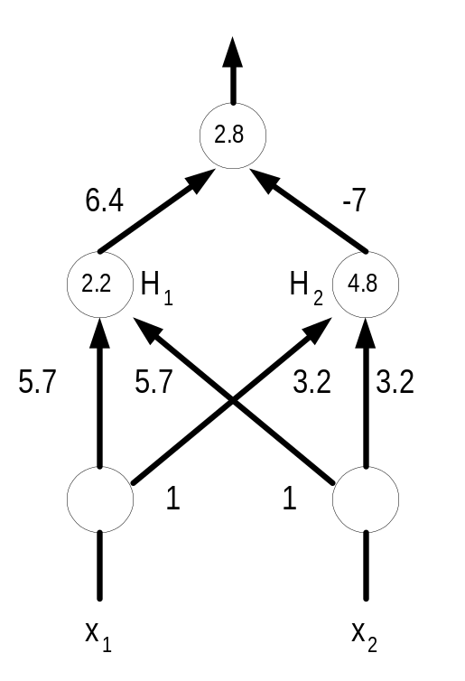
Backpropagation example (XOR)
x1 = 1, x2 = 1
  sum(H₁) = -2.2 + 5.7 + 5.7 = 9.2, output(H₁) = 0.99
  sum(H₂) = -4.8 + 3.2 + 3.2 = 1.6, output(H₂) = 0.83
  sum = -2.8 + (0.99*6.4) + (0.83*-7) = -2.28, output = 0.09
x1 = 1, x2 = 0
  sum(H₁) = -2.2 + 5.7 + 0 = 3.5, output(H₁) = 0.97
  sum(H₂) = -4.8 + 3.2 + 0 = -1.6, output(H₂) = 0.17
  sum = -2.8 + (0.97*6.4) + (0.17*-7) = 2.22, output = 0.90
x1 = 0, x2 = 1
  sum(H₁) = -2.2 + 0 + 5.7 = 3.5, output(H₁) = 0.97
  sum(H₂) = -4.8 + 0 + 3.2 = -1.6, output(H₂) = 0.17
  sum = -2.8 + (0.97*6.4) + (0.17*-7) = 2.22, output = 0.90
x1 = 0, x2 = 0
  sum(H₁) = -2.2 + 0 + 0 = -2.2, output(H₁) = 0.10
  sum(H₂) = -4.8 + 0 + 0 = -4.8, output(H₂) = 0.01
  sum = -2.8 + (0.10*6.4) + (0.01*-7) = -2.23, output = 0.10

Slide 21
Backpropagation learning
there exists a systematic method for adjusting weights, but no global convergence theorem (as was the case for perceptrons)
backpropagation (backward propagation of error) – vaguely stated
  select arbitrary weights
  pick the first test case
  make a forward pass, from inputs to output
  compute an error estimate and make a backward pass, adjusting weights to reduce the error
  repeat for the next test case
  testing & propagating for all training cases is known as an epoch
despite the lack of a convergence theorem, backpropagation works well in practice
  however, many epochs may be required for convergence

Slide 22
Problems/challenges in neural nets research
learning problem
  can the network be trained to solve a given problem?
  if not linearly separable, no guarantee (but backprop effective in practice)
architecture problem
  are there useful architectures for solving a given problem?
  most applications use a 3-layer (input, hidden, output), fully-connected net
scaling problem
  how can training time be minimized?
  difficult/complex problems may require thousands of epochs
generalization problem
  how know if the trained network will behave "reasonably" on new inputs?
  cross-validation often used in practice
    split training set into training & validation data
    after each epoch, test the net on the validation data
    continue until performance on the validation data diminishes (e.g., hillclimb)

Slide 23
Neural net applications
pattern classification
  9 of top 10 US credit card companies use Falcon
    uses neural nets to model customer behavior, identify fraud
    claims improvement in fraud detection of 30-70%
  Sharp, Mitsubishi, … -- Optical Character Recognition (OCR)
prediction & financial analysis
  Merrill Lynch, Citibank, … -- financial forecasting, investing
  Spiegel – marketing analysis, targeted catalog sales
control & optimization
  Texaco – process control of an oil refinery
  Intel – computer chip manufacturing quality control
  AT&T – echo & noise control in phone lines (filters and compensates)
  Ford engines utilize neural net chip to diagnose misfirings, reduce emissions
  recall from AI video: ALVINN project at CMU trained a neural net to drive
    backpropagation network: video input, 9 hidden units, 45 outputs

Slide 24
Interesting variation: Hopfield nets
in addition to uses as acceptor/classifier, neural nets can be used as associative memory – Hopfield (1982)
  can store multiple patterns in the network, retrieve
interesting features
  distributed representation
    info is stored as a pattern of activations/weights
    multiple info is imprinted on the same network
  content-addressable memory
    store patterns in a network by adjusting weights
    to retrieve a pattern, specify a portion (will find a near match)
  distributed, asynchronous control
    individual processing elements behave independently
  fault tolerance
    a few processors can fail, and the network will still work

Slide 25
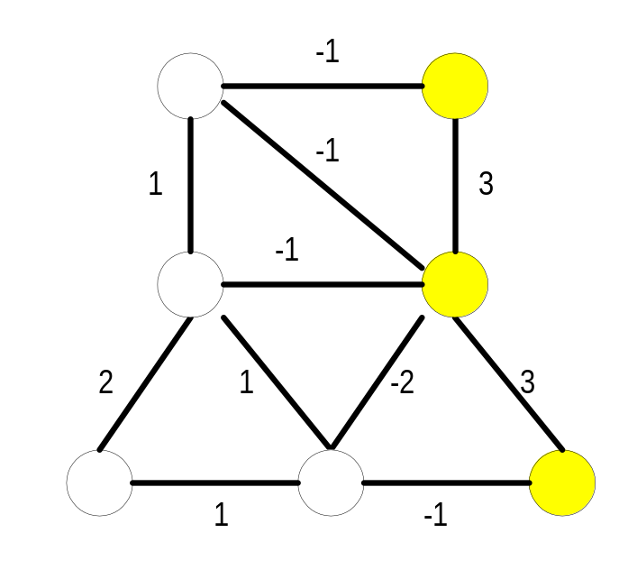
Hopfield net examples
processing units are in one of two states: active or inactive
units are connected with weighted, symmetric connections
  positive weight → excitatory relation
  negative weight → inhibitory relation
to imprint a pattern
  adjust the weights appropriately (algorithm ignored here)
to retrieve a pattern:
  specify a partial pattern in the net
  perform parallel relaxation to achieve a steady state representing a near match

Slide 26
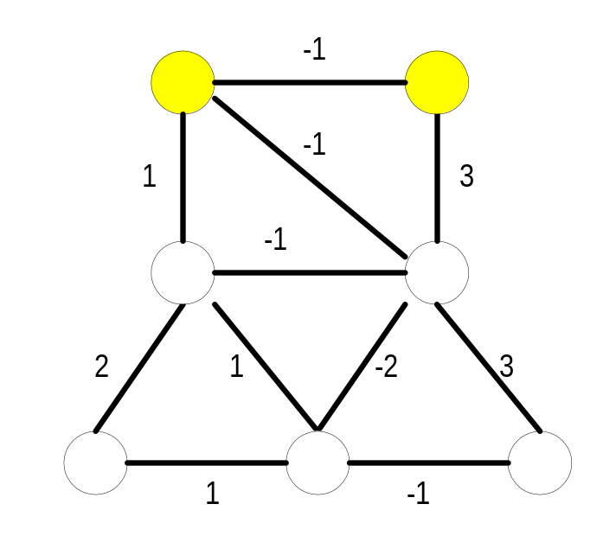
Parallel relaxation
parallel relaxation algorithm:
  pick a random unit
  sum the weights on connections to active neighbors
  if the sum is positive → make the unit active
  if the sum is negative → make the unit inactive
  repeat until a stable state is achieved
note: parallel relaxation = search
this Hopfield net has 4 stable states
  parallel relaxation will start with an initial state and converge to one of these stable states

