Slide 1
Connectionist Modeling
Some material taken from cspeech.ucd.ie/~connectionism and Rich & Knight, 1991

Slide 2
What is Connectionist Architecture?
Very simple neuron-like processing elements.
Weighted connections between these elements.
Highly parallel & distributed.
Emphasis on learning internal representations automatically.

Slide 3
What is Good About Connectionist Models?
Inspired by the brain.
  Neuron-like elements & synapse-like connections.
  Local, parallel computation.
  Distributed representation.
Plausible experience-based learning.
Good generalization via similarity.
Graceful degradation.

Slide 4
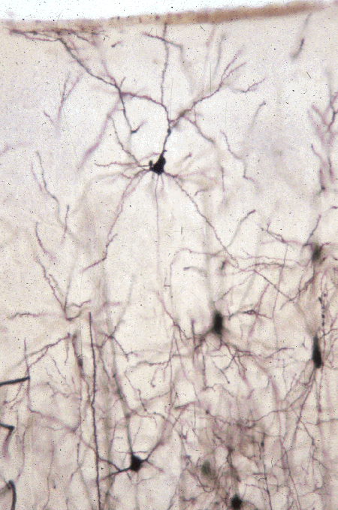
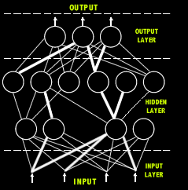
Inspired by the Brain

Slide 5
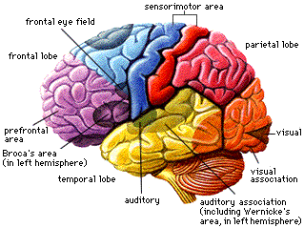
Inspired by the Brain
The brain is made up of areas.
Complex patterns of projections within and between areas.
  Feedforward (sensory -> central)
  Feedback (recurrence)

Slide 6
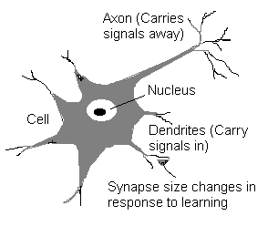
Neurons
Input from many other neurons.
Inputs sum until a threshold reached.
At threshold, a spike is generated.
The neuron then rests.
Typical firing rate is 100 Hz (computer is 1,000,000,000 Hz)

Slide 7
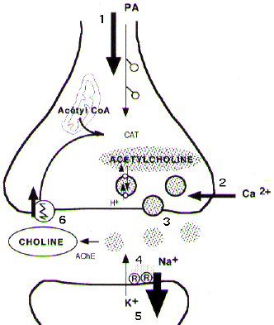
Synapses
Axons almost touch dendrites of other neurons.
Neurotransmitters effect transmission from cell to cell through synapse.
This is where long term learning takes place.

Slide 8
Synapse Learning
One way the brain learns is by modification of synapses as a result of experience.
Hebb’s postulate (1949):
  When an axon of cell A … excites cell B and repeatedly or persistently takes part in firing it, some growth process or metabolic change takes place in one or both cells so that A’s efficiency as one of the cells firing B is increased.
Bliss and Lomo (1973) discovered this type of learning in the hippocampus.

Slide 9
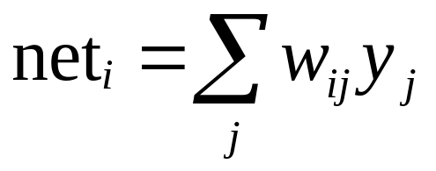
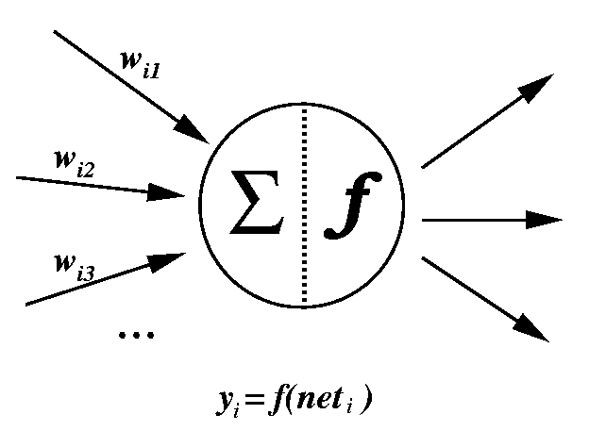
Local, Parallel Computation
The net input is the weighted sum of all incoming activations.
The activation of this unit is some function of net, f.

Slide 10
Local, Parallel Computation
1
.2
-.4
-1
.9
-.4
-.4
-.4
.3
1
-.4
net = 1*.2 + -1*.9 + 1*.3 = -.4
f(x) = x

Slide 11
Simple Feedforward Network
units
weights

Slide 12
Mapping from input to output
input layer
0.5
1.0
-0.1
0.2
Input pattern: <0.5, 1.0,-0.1,0.2>

Slide 13
Mapping from input to output
hidden layer
0.2
-0.5
0.8
input layer
0.5
1.0
-0.1
0.2
Input pattern: <0.5, 1.0,-0.1,0.2>

Slide 14
Mapping from input to output
Output pattern: <-0.9, 0.2,-0.1,0.7>
output layer
-0.9
0.2
-0.1
0.7
feed-forward processing
hidden layer
0.2
-0.5
0.8
input layer
0.5
1.0
-0.1
0.2
Input pattern: <0.5, 1.0,-0.1,0.2>

Slide 15
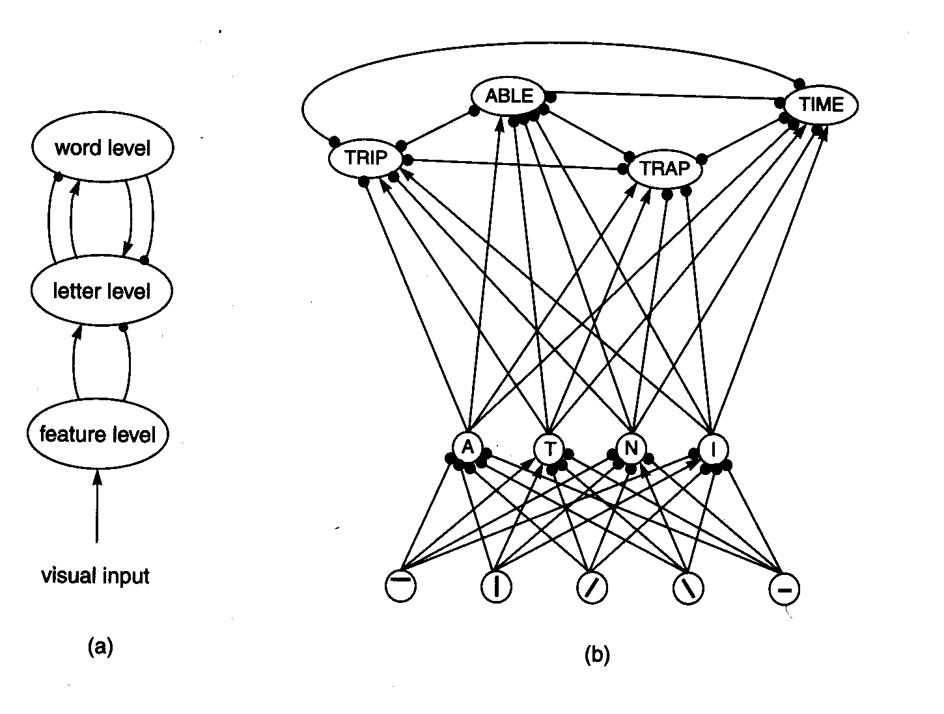
Early Network Models
McClelland and Rummelhart’s model of Word Superiority effect
Weights hand crafted.

Slide 16
Perceptrons
Rosenblatt, 1962
2-Layer network.
Threshold activation function at output
  +1 if weighted input is above threshold.
  -1 if below threshold.

Slide 17
Perceptrons
x₁
w₁
x₂
w₂
Σ
.
.
.
w_{n}
x_{n}

Slide 18
Perceptrons
x₀=1
w₀
x₁
w₁
Σ
.
.
.
w_{n}
x_{n}

Slide 19
Perceptrons
x₀=1
1 if g(x) > 0
0 if g(x) < 0
w₀
x₁
w₁
Σ
g(x)=w₀+x₁w₁+x₂w₂
w₂
x₂

Slide 20
Perceptrons
Perceptrons can learn to compute functions.
In particular, perceptrons can solve linearly separable problems.
B
A
and
B
B
A
B
xor
B
A

Slide 21
Perceptrons
Perceptrons are trained on input/output pairs.
If fires when shouldn’t, make each w_{i} smaller by an amount proportional to x_{i}.
If doesn’t fire when should, make each w_{i} larger.
x₀=1
w₀
x₁
w₁
Σ
.
.
.
w_{n}
x_{n}

Slide 22
Perceptrons
x₁ | x₂ | o
0 | 0 | 0
0 | 1 | 0
1 | 0 | 0
1 | 1 | 1
1
-.06
_x0010_0
-.1
0
.05
Σ
-.06
0
RIGHT

Slide 23
Perceptrons
x₁ | x₂ | o
0 | 0 | 0
0 | 1 | 0
1 | 0 | 0
1 | 1 | 1
1
-.06
0
-.1
1
.05
Σ
-.01
0
RIGHT

Slide 24
Perceptrons
x₁ | x₂ | o
0 | 0 | 0
0 | 1 | 0
1 | 0 | 0
1 | 1 | 1
1
-.06
_x0010_1
-.1
0
.05
Σ
-.16
0
RIGHT

Slide 25
Perceptrons
x₁ | x₂ | o
0 | 0 | 0
0 | 1 | 0
1 | 0 | 0
1 | 1 | 1
1
-.06
_x0010_1
-.1
1
.05
Σ
-.11
0
WRONG

Slide 26
Perceptrons
Fails to fire,
so add proportion,
η, to weights.
x₁ | x₂ | o
0 | 0 | 0
0 | 1 | 0
1 | 0 | 0
1 | 1 | 1
1
-.06
_x0010_
-.1
.05
Σ

Slide 27
Perceptrons
x₁ | x₂ | o
0 | 0 | 0
0 | 1 | 0
1 | 0 | 0
1 | 1 | 1
1
η = .01
-.06+.01x1
_x0010_
-.1+.01x1
.05+.01x1
Σ

Slide 28
Perceptrons
x₁ | x₂ | o
0 | 0 | 0
0 | 1 | 0
1 | 0 | 0
1 | 1 | 1
1
-.05
_x0010_
-.09
.06
Σ
nnd4pr

Slide 29
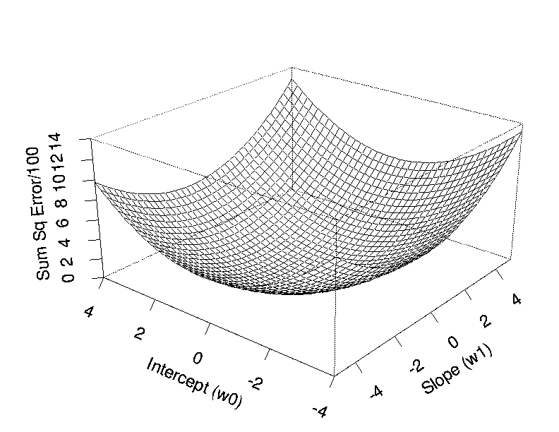

Gradient Descent

Slide 30
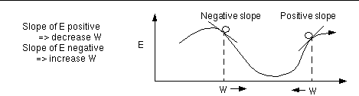
Gradient Descent
Choose some (random) initial values for the model parameters.
Calculate the gradient G of the error function with respect to each model parameter.
Change the model parameters so that we move a short distance in the direction of the greatest rate of decrease of the error, i.e., in the direction of -G.
Repeat steps 2 and 3 until G gets close to zero.

Slide 31
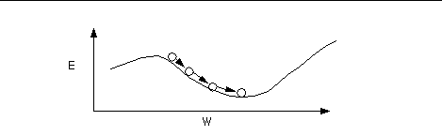
Gradient Descent

Slide 32
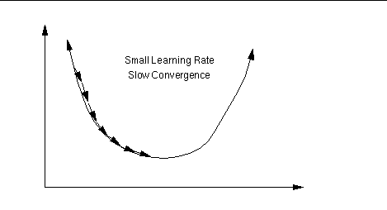
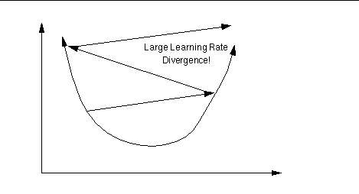
Learning Rate

Slide 33
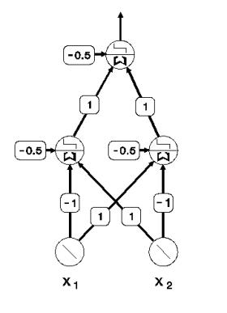
Adding Hidden Units
1
input space
0
1
hidden unit space

Slide 34
Minsky & Papert
Minsky & Papert (1969) claimed that multi-layered networks with non-linear hidden units could not be trained.
Backpropagation solved this problem.

Slide 35
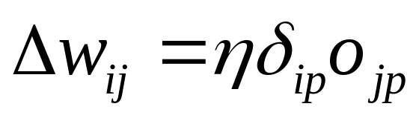
Backpropagation
For each pattern in the training set:
Compute the error at the output nodes
Compute Δw for each wt in 2nd layer
Compute delta (generalized error expression) for hidden units
Compute Δw for each wt in 1st layer
After amassing Δw for all weights and all patterns, change each wt a little bit, as determined by the learning rate
nnd12sd1
nnd12mo

Slide 36
Benefits of Connectionism
Link to biological systems
  Neural basis.
    Parallel.
    Distributed.
    Good generalization.
    Graceful degredation.
  Learning.
Very powerful and general.

Slide 37
Problems with Connectionism
Interpretability.
  Weights.
  Distributed nature.
Faithfulness.
  Often not well understood why they do what they do.
Often complex.
Falsifiability.
  Gradient descent as search.
  Gradient descent as model of learning.

