Slide 1

Problem Statement & Stakeholders
Context :
Urban waste management in public areas specially like railway stations requires efficient and automated waste collection systems.
Stakeholders :
Primary Users: Waste management workers / cleaning staff
Secondary Users: Public users of the area (students, visitors, residents)
Decision Makers: Municipal authorities / facility management
Observed Issue :
Manual waste collection is time-consuming, inefficient, and inconsistent, often leading to overflowing bins and delayed waste disposal.
Why It Matters :
Increases labor time and operational cost
Causes unhygienic environments and bad odors
Leads to inefficient waste management and delayed disposal
3/10/2026
1

Slide 2
Research Gap & Objectives
Research Gap :
Existing waste collection robots lack an integrated system that combines safe navigation, intelligent unloading, and real-time bin-level monitoring in dynamic environments like railway stations.
Main Objective :
Develop a cloud-integrated autonomous waste management system using IoT and machine learning to detect, collect, classify, and unload waste efficiently while enabling real-time monitoring of disposal bins.
3/10/2026
2

Slide 3
Solution Overview
How to Validate Success :
An IoT-, robotics-, and machine-learning-based autonomous waste management system that collects waste in railway stations, monitors bin levels, classifies garbage into plastic, paper, glass, and metal, and automatically segregates it using robotic arms to support efficient recycling.
Key features delivered :
FR1: Autonomous waste detection and collection
FR2: Machine learning–based waste classification
FR3: Cloud-integrated bin monitoring and real-time notifications
Non-Functional Focus :
High reliability, real-time performance, and user-friendly monitoring dashboard
Current Completion Status :
System development and integration ~90% completed
3/10/2026
3

Slide 4
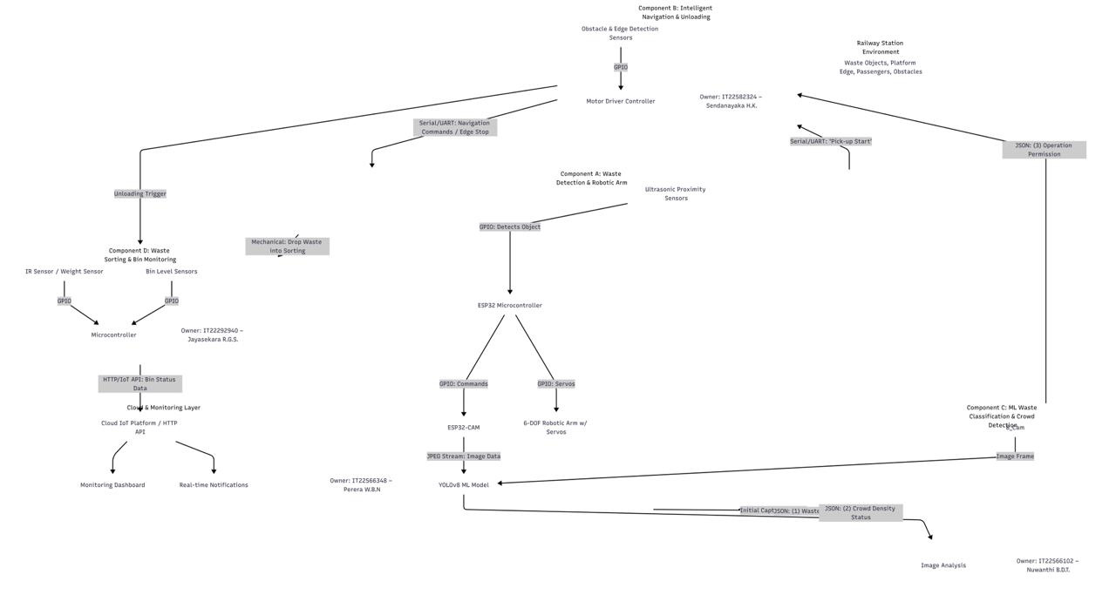
System Architecture & Integration
3/10/2026
4

Slide 5
Commercialization / Impact
Target Users / Market :
Sri Lanka Railways, railway station authorities, municipal waste management departments, and smart city initiatives.
Value Proposition :
Provides automated waste collection, intelligent classification, and real-time monitoring, reducing manual labor, improving cleanliness, and increasing recycling efficiency.
Cost and Feasibility :
Built using affordable sensors, microcontrollers, and open-source machine learning models, making it cost-effective and scalable for public infrastructure.
Adoption Plan / Next Steps :
Pilot implementation in a selected railway station, performance evaluation, followed by gradual deployment across major stations in Sri Lanka.
3/10/2026
5

Slide 6
Demo Plan (30 min) – What We Will Show
Demo Flow (End-to-End) :
Waste detection → Robot collects garbage → Puts the waste item to the robot’s bin → Robot’s Navigation (Obstacle Avoidance + Edge Detection) → Bin level monitoring → Robot moves to disposal station → Bin level monitoring → Again start navigation → Robot moves to disposal station → Waste classification → Robotic arm sorts waste into bins
Where Each Member Takes Over :
Perera W.B.N. → Waste detection model & Waste collecting arm
Sendanayaka H.K. → Robot navigation (Obstacle avoidance & edge detection) & Garbage disposal
Nuwanthi B.D.T. → Waste classification model & Head count detection model
Jayasekara R.G.S. → Classification robotic arm & Disposal bin monitoring
Backup Plan :
Recorded demo video, screenshots of system operation, and prepared test images/data for classification
What to Watch For :
Autonomous navigation, waste detection accuracy, classification accuracy, and successful waste segregation
3/10/2026
6

