Slide 1


Slide 2


Table Of Contents
Neo-Attendance
About the problem
Primary Reason
Existing System
Objectives
Working Methodology
Limitation of the system
Conclusion

Slide 3
Neo-Attendance
Neo-Attendance is the face recognition attendance system which automatically marks the attendance of the present students.
About the problem
Manual attendance is a more time-consuming task.
Attendance sheet could be lost or misplaced by anyone.
In the roll call system, present students can answer the roll call of absent students.
There is another practice also where each student signs the individual attendance sheet, this practice allows present students in the class to sign physically absent students.

Slide 4
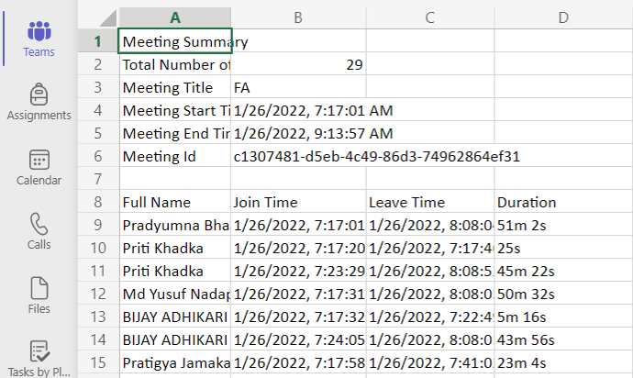
Primary Reason
Neo-Attendance is the modified attendance system compared to the manual attendance system. It uses artificial intelligence, machine learning and deep learning concepts. By integrating these concepts laborious tasks can be transformed to smart tasks.
Existing System
Microsoft Teams Online Attendance
2. MyClass Attendance app in paly store.

Slide 5
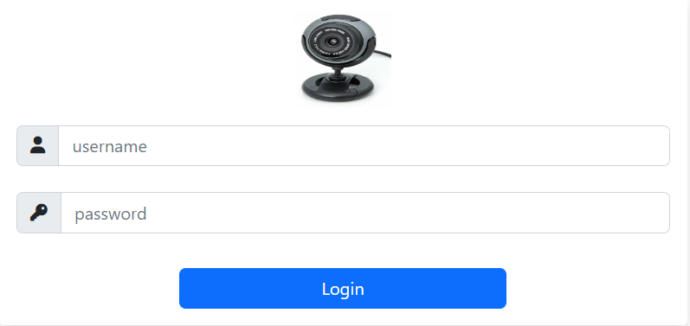
Objectives
Login Window
Only authenticated users can enter into the Neo-Attendance system.
For login error:

Slide 6
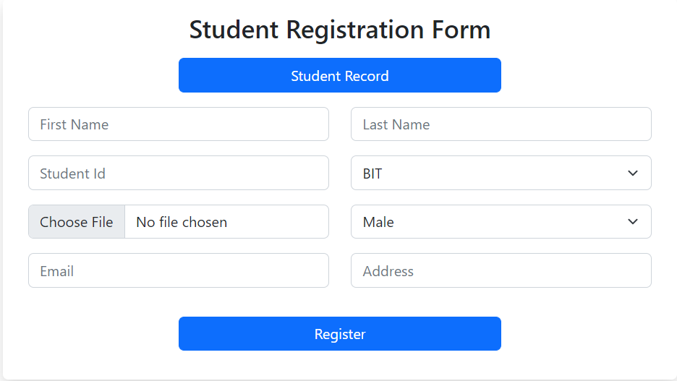
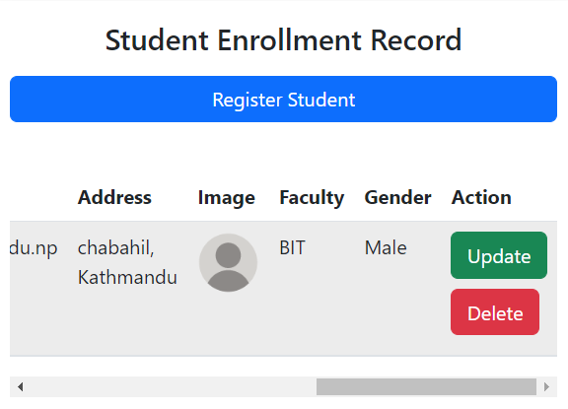
Objectives
2. Student Registration Window
Data of students are registered through the registration window. Face images and registered data are stored in the database.

Slide 7
Objectives
Face Recognition Window
Face recognition window perform 4 major tasks as:
Image Acquisition
The camera helps to acquire the image for the system.
Face Detection
Each face in the image is detected using a modeling algorithm available in OpenCV.
Face Recognition
Face detected in each frame is compared with the faces stored in the database.
Attendance Marking
After recognizing the student's face, attendance can be maintained.

Slide 8
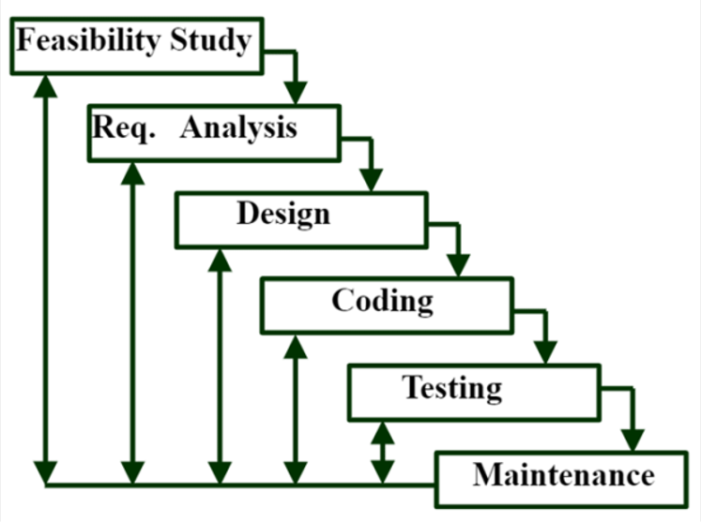
Working Methodology
The Iterative waterfall model is suitable for Neo-Attendance.

Slide 9
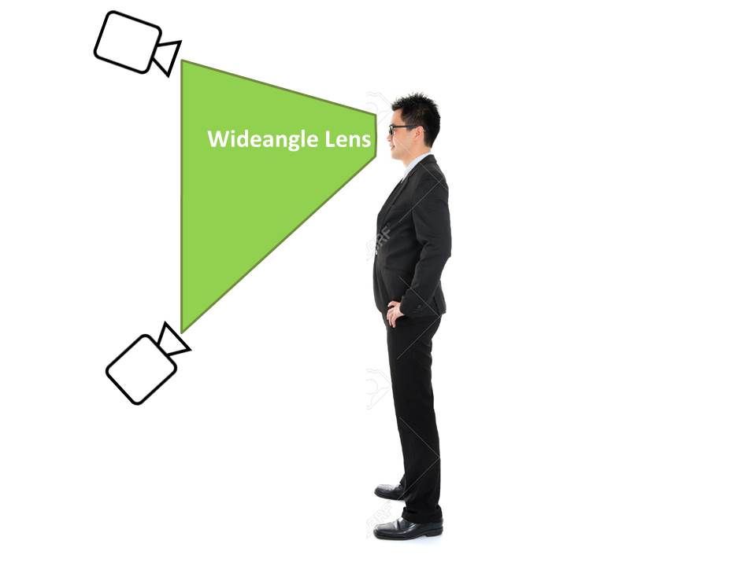
Limitation of the system
Development can be expensive.
Difficult with big data processing.
Weak camera angle, low-lighting and image quality.
System confused by the identical twins.

Slide 10
Conclusion
The aim of this project is to capture the video of the students. Video gets converted to frames. Each face from the fame is compared with the record present in the database and mark attendance of the present student. The automated classroom attendance system helps in increasing the accuracy and speed of taking real-time attendance.
Neo-Attendance system will be developed in Django framework. This system fully meets the objective of the system for which it is developed. System stability is main concern for the bug free performance. The system will have high advantage because of good run-time and performance efficiency. The system solves the real-world problems. It is based on requirement specification.

