Slide 1
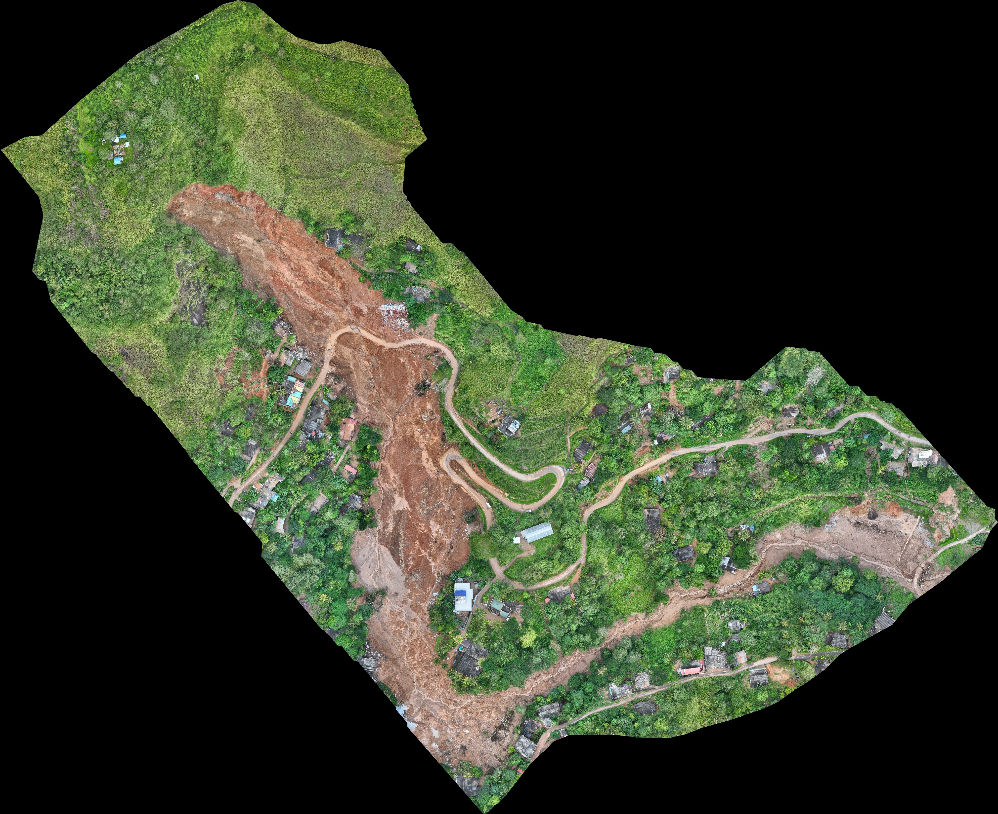
Universität
Münster
U-Net Segmentation of Landslides from Drone LiDAR
ifgi
Institut für Geoinformatik
Nimesh Akalanka · Vijay Kolanchinathan · Md Rafsan Jani
Institut für Geoinformatik (ifgi), University of Münster · Analysis of High Resolution Remote Sensing Imagery, SoSe 2026
Motivation
Methods
Results
Landslides cause severe casualties and infrastructure damage across Sri Lanka's central highlands. Post-event mapping is critical for emergency response and risk reduction, yet conventional visual interpretation of drone data is time-consuming and operator-dependent, especially when multiple simultaneous events occur after a single rainfall episode. Deep learning segmentation offers a path toward semi-automated mapping. Its performance depends critically on which input channels are available. This study asks: "Does fusing LiDAR-derived terrain features with RGB imagery improve U-Net landslide segmentation compared to spectral data alone?"
Data Processing and Segmentation Pipeline
Configuration | Acc. | Prec. | Recall | F1
RGB | 0.972 | 0.440 | 0.949 | 0.599
RGB + DTM ★ | 0.985 | 0.593 | 0.825 | 0.690
Site 11 (Uthuwan Kanda) | 0.987 | 0.663 | 0.911 | 0.768
Site 12 (Victoria Reservoir) | 0.982 | 0.522 | 0.738 | 0.612
RGB + Hillshade | 0.970 | 0.420 | 0.932 | 0.577
RGB + Slope | 0.972 | 0.439 | 0.911 | 0.589
LiDAR
Point Cloud
DTM
0.1 m grid
RGB Orthomosaic
Channel Stack
3 – 4 ch
U-Net
256×256
Landslide
Mask
Input Configurations
Table 1: Overall metrics on held-out sites 11 and 12. ★ = best-performing configuration (highest F1).
RGB 3 channels: red, green, blue from orthomosaic
Performance Comparison
RGB + DTM 4 channels: + digital terrain model at 0.1 m
RGB + Hillshade 4 channels: + terrain illumination (independent variant)
RGB + Slope 4 channels: + slope gradient (independent variant)
U-Net Architecture and Training
Architecture: Encoder–decoder (U-Net) with 4 downsampling stages and skip connections that preserve spatial detail. Encoder: 3×3 conv → BatchNorm → ReLU → 2×2 max-pool; feature channels: 64 → 128 → 256 → 512. Bottleneck: 1024-channel deepest representation before decoding. Decoder: Bilinear upsampling ×2 at each stage, concatenated with encoder skip features. Output: 1×1 conv → sigmoid → binary landslide probability map at full input resolution. Training hyperparameters: Optimiser: Adam | Learning rate: 1 × 10⁻⁴ | Batch size: 8 | Epochs: 25 Loss: binary cross-entropy with pos_weight (set to 0.2 — see Discussion) Tile size: 256 × 256 px, stride-based sampling | Prediction stride: 768 px Sigmoid threshold: 0.5 (default, not optimised) Terrain feature derivation: DTM: ground-classified LiDAR rasterised to 0.1 m grid. Hillshade: sun azimuth 315°, elevation 45° (single illumination angle). Slope: first-order gradient magnitude from DTM (degrees). Evaluation: Pixel-level Precision, Recall, and F1-Score on full held-out scenes.
Accuracy is reported but excluded from model selection due to class imbalance.
Figure 2: RGB + DTM achieves the best F1 (0.690); hillshade underperforms the RGB-only baseline despite deriving from the same DTM.
Discussion
All four configurations now produce functional detectors — recall ranges 0.825–0.949 and F1 ranges 0.577–0.690 across every variant, with none collapsing to background-only as in an earlier run with an inverted pos_weight. Recall is deliberately weighted above precision, favoring catching real landslides over avoiding false alarms. Raw elevation gives the clearest gain: RGB + DTM has the best F1 (0.690) and precision (0.593), improving on the RGB-only baseline (F1 0.599) mainly by reducing false positives — though performance still varies by site (F1 0.768 on Site 11 vs 0.612 on Site 12). Hillshade and slope underperform DTM: despite deriving from the same elevation model, hillshade actually falls below the RGB-only baseline (F1 0.577), suggesting raw elevation carries more usable signal for the network than either derived product. Accuracy is uninformative here: all four models score 97.0–98.5% accuracy since landslide pixels are a small minority class; F1 and Recall remain the decisive metrics.
Figure 1: Drone orthomosaic of a Sri Lanka landslide site (site 01, Alawathugoda) showing exposed soil deposit, road disruption, and surrounding vegetation.
Study Area & Dataset
12 post-landslide drone survey sites across Sri Lanka's central highlands: Alawathugoda · Aranayaka (×2) · Hunnasgiriya · Kohowala · Kotmale Kovil Ela · Kundasale · Makehelwala · Kansalagamuwa · Uthuwan Kanda · Victoria Reservoir Input data per site: LiDAR point cloud ground-classified to DTM at 0.1 m grid; RGB orthomosaic at <5 cm GSD; derived layers: Hillshade (azimuth 315°, elevation 45°) and Slope (first-order gradient). Coordinate reference system: EPSG:5235 (Sri Lanka Datum 1999) Train / test split: Sites 01 to 10 = training Sites 11 and 12 = held-out test Tiling and class balance: 256 × 256 px tiles with stride-based sampling. Sites 1,3,5,6,8,9 fully tiled; sites 2,4,7,10 partially tiled. Landslide pixels account for approximately 2% of each scene — severe class imbalance. Labelling: Binary masks (landslide / background) manually delineated per site from orthomosaic and DSM visual inspection.
Training and Validation Loss (early stopping, 21–28 epochs)
Outlook and Next Steps
1. Sweep the sigmoid threshold to trade recall for precision, especially for RGB + DTM 2. Test feature fusion (e.g. RGB + DTM + Slope) now that single features are validated independently 3. Investigate why hillshade underperforms slope and DTM despite deriving from the same elevation model 4. Site-stratified cross-validation to reduce site-to-site F1 variance (0.768 vs 0.612 on RGB + DTM) 5. Revisit foundation-model backbones (DOFA, SkySense) now that a reliable ResNet50 U-Net baseline exists 6. Extend full-site inference to additional held-out sites as more annotated data becomes available
References
Project Repository
[1] Ronneberger et al. (2015). U-Net: CNNs for Biomedical Image Segmentation. MICCAI.
[2] Ghorbanzadeh et al. (2021). Evaluation of ML Methods for Landslide Detection. Remote Sensing, 11(2).
[3] Prakash et al. (2020). CNN-Based Approach for Spectral-Spatial Image Classification. Remote Sensing, 12(6).
[4] Chen et al. (2018). DeepLab: Semantic Segmentation with Deep Convolutional Nets. IEEE TPAMI, 40(4).
Data and code publicly available
github.com/nimesh7814/landslide_extraction

