Slide 1
Index
Polynomial Curve Fitting
Genomic Sequence Analysis

Slide 2
Polynomial Curve Fitting

Slide 3
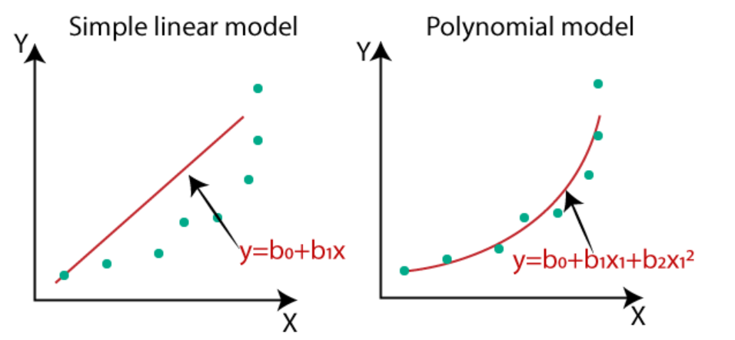
Introduction
Polynomial Regression is a form of linear regression in which the relationship between the independent variable x and dependent variable y is modeled as an nth degree polynomial. Polynomial regression fits a nonlinear relationship for e.g. progression of disease epidemics
Here y is dependent variable on x, a is y intercept and e is the error rate.
In general, we can model it for nth value.
y = a + b1x + b2x^2 +....+ bnx^n + ϵ
Since regression function is linear in terms of unknown variables, hence these models are linear from the point of estimation.

Slide 4
Problem Statement
To begin with, use only the first 20 data points in your file.
Solve the polynomial curve fitting regression problem using error function minimisation.
Define your own error function other than the sum-of-squares error.
Try different error formulations and report the results.
Use a goodness-of-fit measure for polynomials of different order.
Can you distinguish overfitting, underfitting, and the best fit?
Obtain an estimate for the noise variance.
Introduce regularisation and observe the changes. For quadratic regularisation, can you obtain an estimate of the optimal value for the regularisation parameter lambda? What is your corresponding best guess for the underlying polynomial? And the noise variance?
Now repeat all of the above using the full data set of 100 data points.
How are your results affected by adding more data? Comment on the differences.
What is your final estimate of the underlying polynomial? Why?

Slide 5
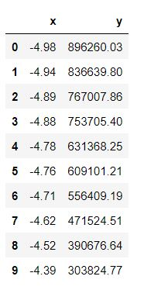
Data Description
Dataset - https://www.cse.iitd.ac.in/~sumantra/courses/ml/a3/group04.txt
Data of the form (x_i, y_i) for i = 1, ... 100. The relationship between x and y is of the form: y = w_0 + w_1 x + ... + w_M x^M + e. The error e is drawn from a Gaussian distribution with zero mean and unknown (but fixed, for a given input file) variance. M is also unknown.
First 10 data points:
Number of data points: 100
X ranges from : -4.98 to 4.86
Y ranges from : 0.04 to1760970

Slide 6
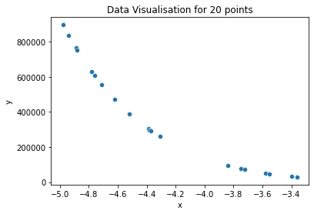
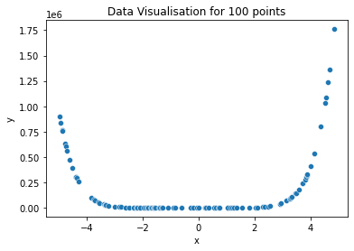
Data Visualization
20 data points
100 data points

Slide 7
Process Overview
Polynomial Degree Range : 0 to 10
Lambda Range ƛ: 1e-3 to 1e2
For each degree in degree range do:
Fit model
Calculate performance metrics (over lambda, if regularized)
Select the degree(and lambda, if regularized) which yields best goodness of fit

Slide 8
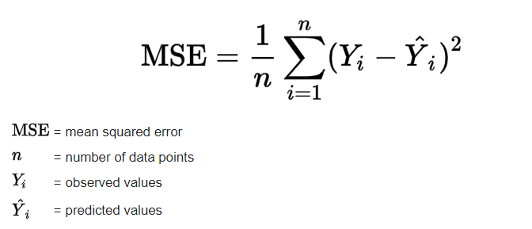
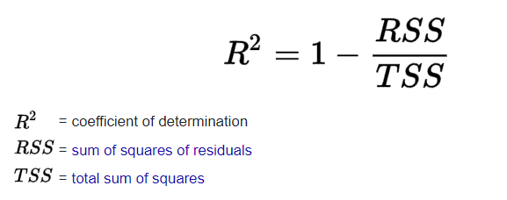
PERFORMANCE METRICS
Mean Square Error
2. Goodness of Fit ( R² )
0 ≤ R² ≤ 1[Generally]
R² is used to quantify the amount of variability in the data that is explained by the model.

Slide 9
Polynomial Regression

Slide 10
20 Data Points
Data with top 20 data points

Slide 11
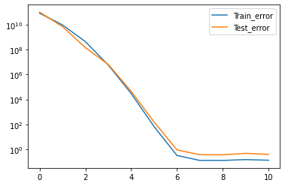
FIT OF THE MODEL
Degree = 0 : Train & Test error both are very high : UNDERFIT
Degree > 6 : Train error is low & Test error is high : OVERFIT
Degree = 6 : both Train & Test are stable and minimum : BEST-FIT

Slide 12
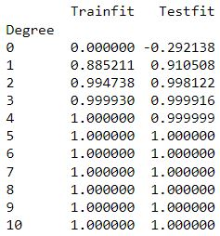
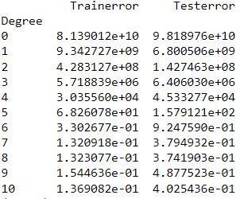
Errors and Goodness of Fit
MSE
R2
Optimal degree = 6

Slide 13
FINAL POLYNOMIAL REGRESSION MODEL
Polynomial Coefficients :
Variance : 0.478890488881427
Optimal degree: 6
Weights: [2.04762376e+06 3.43936158e+06 2.44808860e+06 9.51861112e+05
2.15694118e+05 2.75605335e+04 1.61119278e+03]

Slide 14
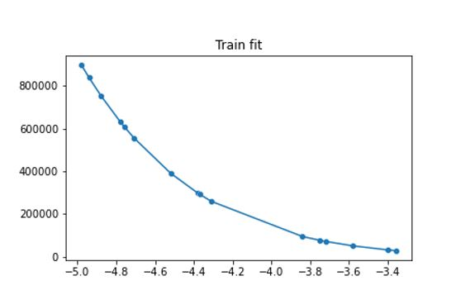
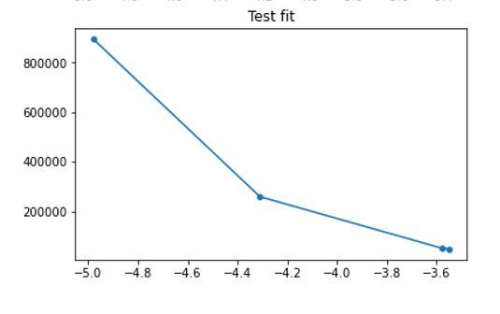
FITTING THE MODEL TO DATA
TRAIN TEST SPLIT = 80:20
TRAINING SET
TEST SET

Slide 15
100 Data Points
Complete data

Slide 16
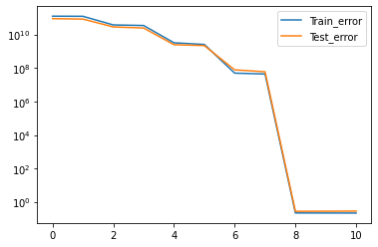
FIT OF THE MODEL
Degree = 0 : Train & Test error both are very high : UNDERFIT
Degree > 8 : Train error is low & Test error is high : OVERFIT
Degree = 8 : both Train & Test are stable and minimum : BEST-FIT

Slide 17
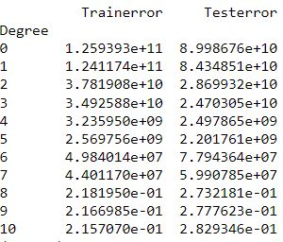
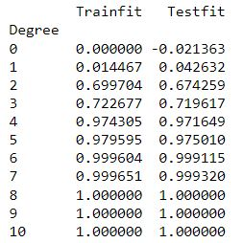
Errors and Goodness of Fit
MSE
R2
Optimal degree = 8

Slide 18
FINAL POLYNOMIAL REGRESSION MODEL
Polynomial Coefficients :
Variance : 0.2347019402632296
Optimal degree: 8
Weights: [1.74114628 7.33888993 7.82113602 1.80045723 1.51717286
1.50007544 4.59899414 7.99999913 3.80001803]

Slide 19
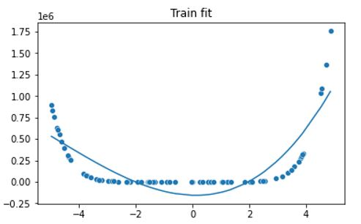
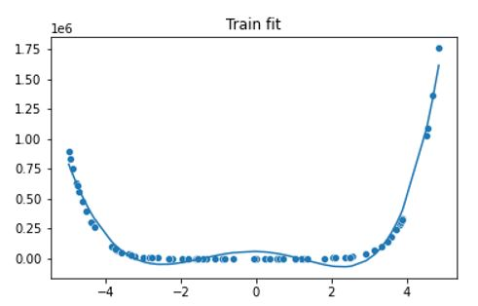
Model with less than optimal degree
DEGREE = 3
DEGREE = 5

Slide 20
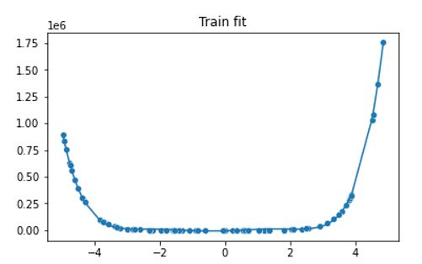
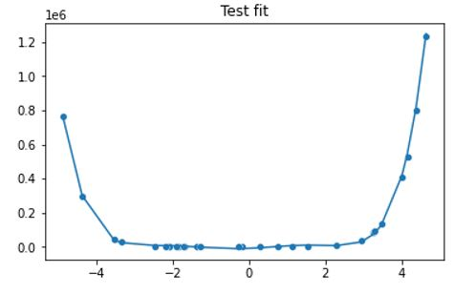
FITTING THE MODEL TO DATA
TRAIN TEST SPLIT = 80:20
TRAINING SET
TEST SET

Slide 21
Regularized Regression
(With a regularization parameter lambda)

Slide 22
20 Data Points
Data with top 20 data points

Slide 23
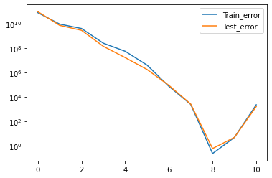
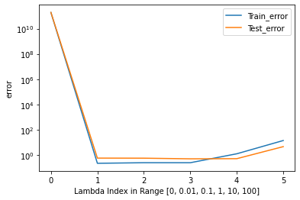
FIT OF THE MODEL
Error comparison for lambda = 0.01
Error vs Lambda for Degree = 8
Degree [0,10]

Slide 24
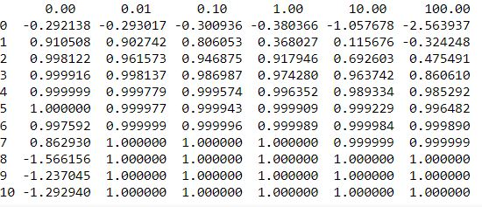
GOODNESS OF FIT(R²)
Regulariser Lambda [20 data points]

Slide 25
FINAL POLYNOMIAL REGRESSION MODEL
Polynomial Coefficients
Variance : 0.3166381783161861
Optimal degree: 8
Optimal lambda: 0.01
[ 1.53551882 0.0334909 0.86060912 -0.50573017 -0.26754296
0.04430138 4.07750555 7.91721796 3.79514525]

Slide 26
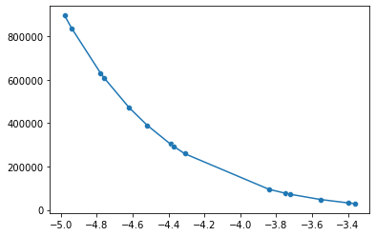
FITTING DATA TO MODEL

Slide 27
100 Data Points
Complete data

Slide 28
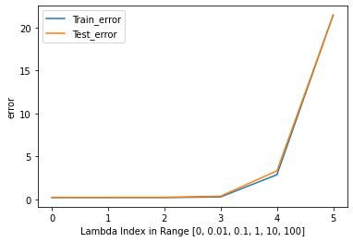
FIT OF THE MODEL
Error comparison for lambda = 0.01
Error vs Lambda for Degree = 8
Degree [0,10]

Slide 29
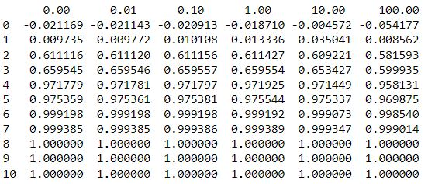
GOODNESS OF FIT(R²)
Regulariser Lambda [100 data points]

Slide 30
FINAL POLYNOMIAL REGRESSION MODEL
Polynomial Coefficients :
Variance :0.23405582073445683
Optimal degree: 10
Optimal lambda: 0.01
[ 1.77655711e+00 7.24654922e+00 7.76213989e+00 1.84210371e+00 1.54428081e+00 1.49343317e+00
4.59524706e+00 8.00041344e+00 3.80021809e+00 -8.57544651e-06 -3.63842426e-06]

Slide 31
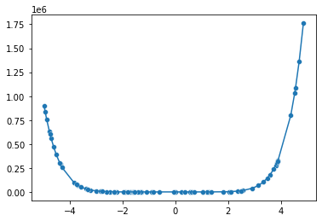
FITTING DATA TO MODEL

Slide 32
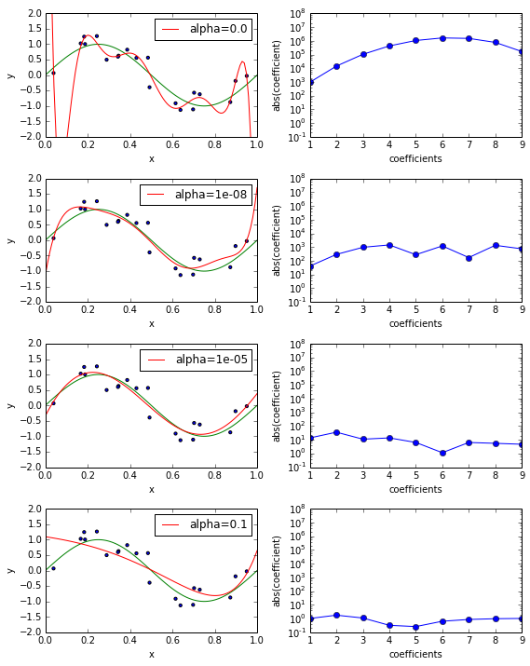
SIGNIFICANCE OF Lambda
The higher the value of lambda,
the lower would be the magnitude of the
polynomial coefficients. (under-fitting)
The lower the value of lambda
(approximately zero), the higher the value
of coefficients.(over-fitting)
In this case, the analysis approaches
the linear regression model.

Slide 33
Genomic Sequence Analysis

Slide 34
Our dataSet
Non-coding ribonucleic acids (ncRNA) are believed to have many roles in a cell, many of which remain to be discovered. However, it is difficult to detect ncRNAs using biochemical screening methods. Recent studies have shown that computational methods can accurately detect ncRNAs, which can be treated as supervised classification. To perform the classification, an 8-dimensional feature vector is used as input to a classifier, including the length of genomic sequence and nucleotide frequencies:
A feature value computed by the Dynalign algorithm http://www.ncbi.nlm.nih.gov/pubmed/11902836
Length of shorter sequence
`A' frequencies of sequence 1
`U' frequencies of sequence 1
`C' frequencies of sequence 1
`A' frequencies of sequence 2
`U' frequencies of sequence 2
`C' frequencies of sequence 2
Number of training points = 2000
Number of testing points = 1001

Slide 35
Our dataset cont..
Train file has 2000 data points
Test file has 1000 data points
Format of our data Class_label 1: feature_1, 2:feature_2,…………….8: feature 8
Missing features are replaced with value 0

Slide 36
Data processing
Missing features in any data points are replaced with value 0
Data_processing function is responsible for formatting data and returns a array containing feature information
Train_test_split() function is used to split data for cross validation.

Slide 37
Part A: Linear SVM
C_values [0.001,0.01,0.1,1,5,10,50,60,70,100,100000000]
For larger values of C, we can see in execution that the model is trying to overfit and accuracy is going down as the C value is very large processing time is also increasing as the model is trying to fit every point while training.
The optimal value of C is 5 and accuracy at this value is 95.15

Slide 38
Part B: non Linear RBF SVM
Implemented Steps
1. Split train data into 2 groups
2. Split the first group into 5 groups
C_values [0.001,0.01,0.1,1,5,10,50,60,70,100,100000000]
gamma_list = [0.001,0.01,0.1,1,5,10,100]

Slide 39
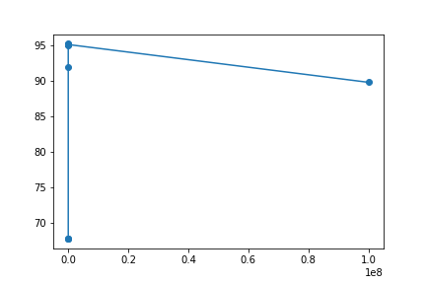
Accuracy vs C for linear model

Slide 40
Accuracy matrix
[[68.3 68.3 68.3 68.3 68.3 68.3 68.3]
[68.3 68.3 68.3 68.3 68.3 68.3 68.3]
[68.3 68.3 68.3 68.3 68.3 68.3 68.3]
[68.3 68.3 68.3 80.4 89.6 88.7 79.1]
[68.3 68.3 69. 92.9 91.5 90.9 79.4]
[68.3 68.3 90. 92.9 92.2 90.1 79.4]
[68.3 69.1 93.9 93.3 91.1 89.1 79.4]
[68.3 73.4 93.7 93.1 91.3 88.9 79.4]
[68.3 79.9 93.8 93.1 91.2 88.8 79.4]
[68.3 90.3 93.2 93.1 91. 88.3 79.5]
[93.3 91.4 88.3 86.9 84.6 85.4 79.9]]

Slide 41
Optimal values
C_values 0.1
Gamma values 50
Accuracy 95.16

