Slide 1
Workshop on Packet Tracer
Eminence 4
Shamika Lakshan

Slide 2

Overview
01
Basic Concepts
IP Addressing
Introduction to Packet Tracer
VLAN
Static Routing
02
03
04
05

Slide 3
1. Basic Concepts
What is a COMPUTER NETWORK ??
“ A collection of computers and devices connected together via communication devices and transmission media. ”
A network typically includes 4 things (except computers)
Network Interface card (NIC) : send and receive messages from other computers
Cables : medium to connect all the computers together
Hub / Switch / Router : hardware to perform traffic control
Protocol : set of communication rules to make sure that everyone speaks the same language

Slide 4
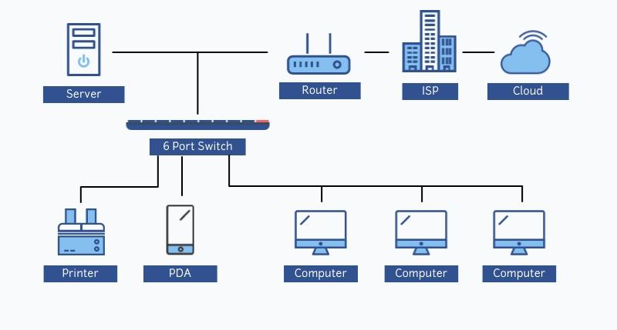
1. Basic Concepts

Slide 5
2. IP Addressing
An Ipv4 address is simply a series of 32 binary bits where 32 bits are grouped into 8-bit byte called octets.
Ex- 192.168.1.4 / 24
11000000.10101000.00000001. 00000100
11111111.11111111.11111111. 00000000
255.255.255.0 (Subnet Mask)
Ip address have two parts
Network
Host

Slide 6
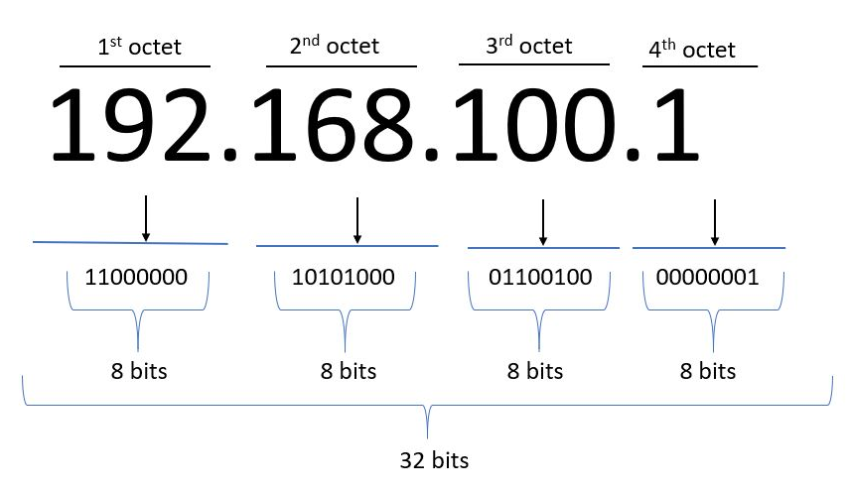
2. IP Addressing
ipconfig

Slide 7
2. IP Addressing
Subnet Mask
A subnet mask is a 32-bit number created by setting host bits to all 0s and setting network bits to all 1s.
In this way, the subnet mask separates the IP address into the network and host addresses.
Prefix length – the number of bits set to 1 in the subnet mask. It is written in “slash notation(/)” followed by the prefix length.
Ex:
255.255.255.0 /24
255.255.0.0 /16
255.0.0.0 /8

Slide 8
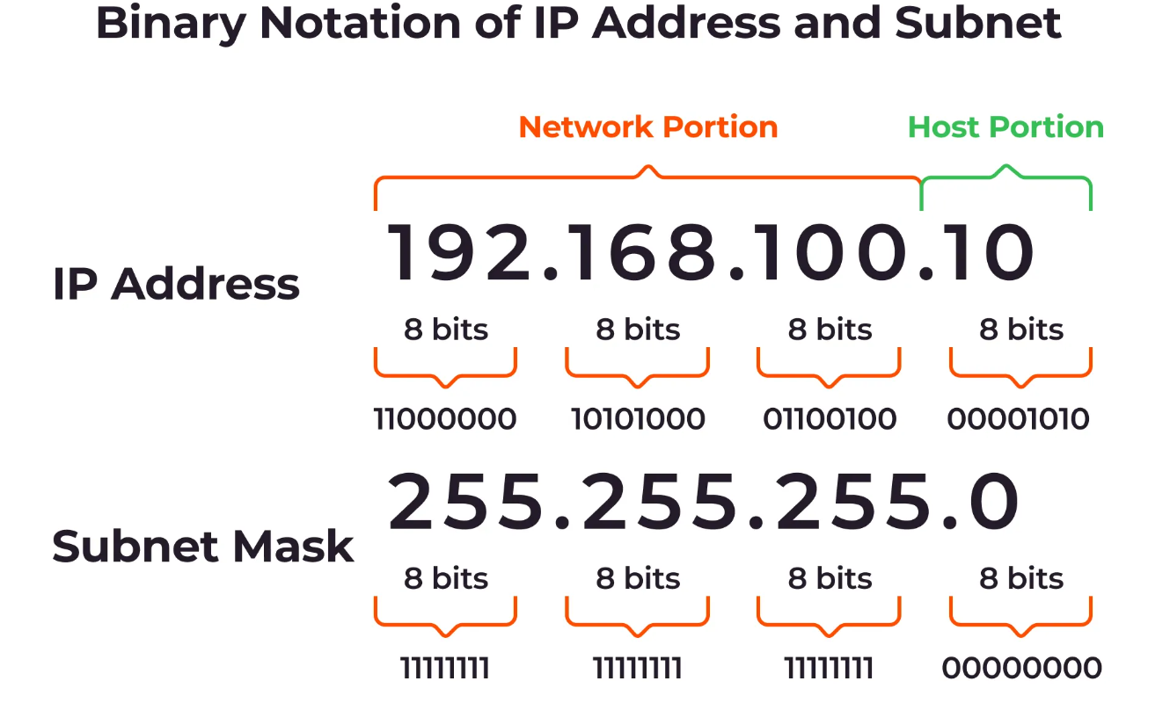
2. IP Addressing
192.168.100.10/24
Network Address : 192.168.100.0
First usable host address : 192.168.100.1
Last usable host address : 192.168.100.254
Broadcast Address : 192.168.100.255

Slide 9
2. IP Addressing
192.168.100.10/27
/27 = 255.255.255.224
IP Address | 192 | 168 | 100 | 10
IP Address (Binary) | 1100 0000 | 1010 1000 | 0110 0100 | 0000 1010
Subnet Mask | 1111 1111 | 1111 1111 | 1111 1111 | 1110 0000
Network Address | 1100 0000 192 | 1010 1000 168 | 0110 0100 100 | 0000 0000 0
Broadcast Address | 1100 0000 192 | 1010 1000 168 | 0110 0100 100 | 0001 1111 31
192.168.100.1 , 192.168.100.2 …….. 192.168.100.30

Slide 10
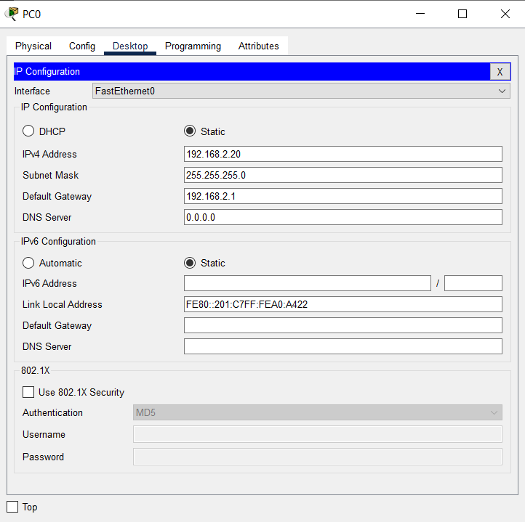
2. IP Addressing
Default Gateway
A default gateway is the network node, usually a router, that devices use to access other networks when no other routes are specified. It acts as the front door to the rest of the connected networks to let traffic in and out of your network.

Slide 11
3. Introduction to Packet Tracer
Connection Types
Straight-through – Used to connect different types of devices
Eg :- Router and Switch
Switch and Host
Cross-over – Used to connect same types of devices
Eg :- Router to Router
Switch to Switch
Router to Host
Serial DCE – Used to connect router to router in WAN network
Console – used to configure routers and switches

Slide 12
3. Introduction to Packet Tracer
Modes of cisco IOS
User EXEC Mode -
Command line prompt : Switch>
Privileged EXEC Mode
Command line prompt : Switch#
Global configuration Mode
Command line prompt : Switch(config)#

Slide 13
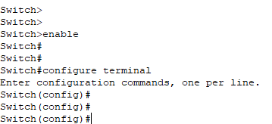
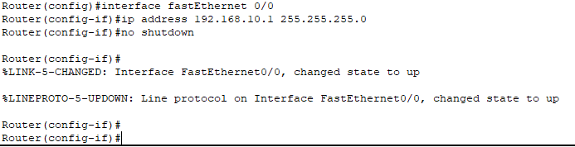


3. Introduction to Packet Tracer
Basic Commands
Configuring Interface
Save Configuration

Slide 14
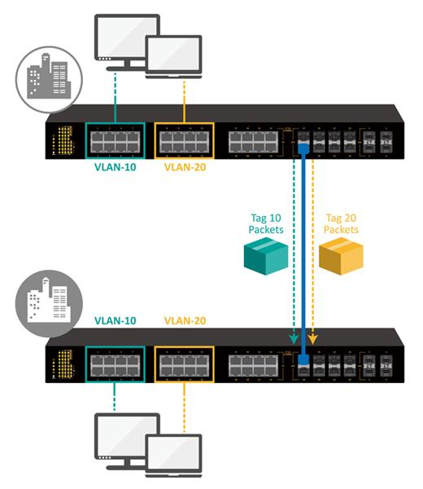
3. VLAN
VLAN is a logical overlay network that groups together a subset of devices that share a physical lan, isolating the traffic for each group
Access port – a port that can be assigned to a single VLAN. This type of interface is configured on switch ports that are connected to end devices such as workstations, printers, or access points.
Trunk port – a port that is connected to another switch. This type of interface can carry traffic of multiple VLANs, thus enabling you to extend VLANs across your entire network. Frames are tagged by assigning a VLAN ID to each frame as they traverse between switches.
Trunk Port
Access Ports

Slide 15
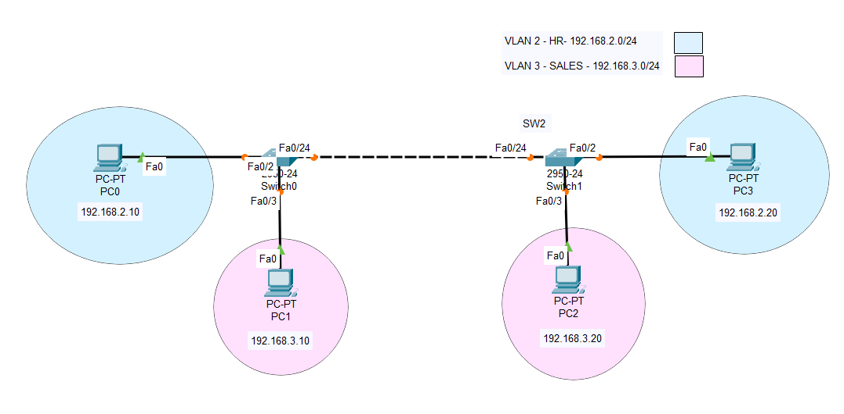
3. VLAN
Notes:
Show devices, conection types
Show reachability in every ports

Slide 16
3. VLAN
Switch(config)#vlan 2
Switch(config-vlan)#name HR
Switch(config-vlan)#exit
Switch(config)#vlan 3
Switch(config-vlan)#name SALES
Switch(config-vlan)#exit
Switch(config)#interface fastEthernet 0/2
Switch(config-if)#switchport mode access Switch(config-if)#switchport access vlan 2
Switch(config)#interface fastEthernet 0/3
Switch(config-if)#switchport mode access Switch(config-if)#switchport access vlan 3
Switch(config)#interface fastEthernet 0/24
Switch(config-if)#switchport trunk encapsulation dot1q Switch(config-if)#switchport mode trunk
Switch#write
Switch#show vlan
Switch#show interface trunk

Slide 17
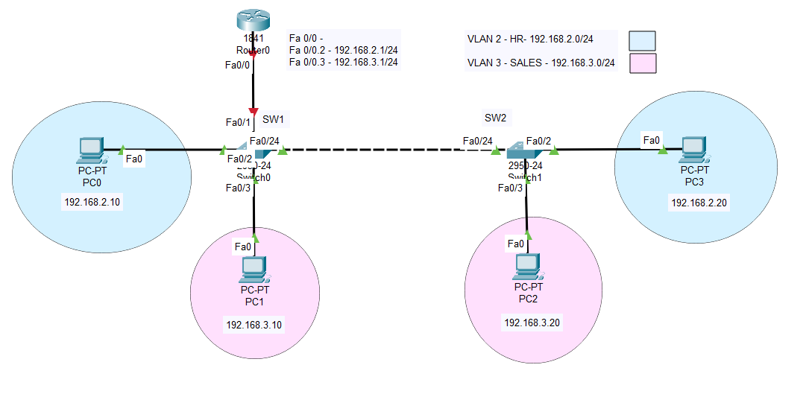
3. VLAN

Slide 18
3. VLAN
Router(config)#interface fastEthernet 0/0
Router(config-if)#no shutdown
Router(config)#interface fastEthernet 0/0.2 Router(config-subif)#encapsulation dot1q 2 Router(config-subif)#ip add 192.168.2.1 255.255.255.0
Router(config)#interface fastEthernet 0/0.3 Router(config-subif)#encapsulation dot1q 3 Router(config-subif)#ip add 192.168.3.1 255.255.255.0
Router#write
Router#show ip interface brief

Slide 19
4. Static Routing
Routing
“ The process of selecting the best path in a network along which the packets shall be sent to a destination. ”
Static Routing - Routes should be manually configured
Dynamic Routing - Learn routes dynamically
Eg: OSPF , EIGRP, ISIS, RIP

Slide 20
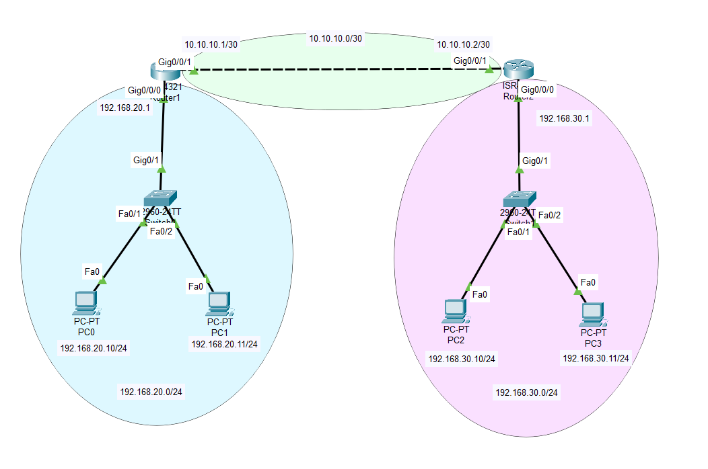
4. Static Routing
Router 1
192.168.20.0/24
10.10.10.0/24
Router 2
192.168.30.0/24
10.10.10.0/24

Slide 21
4. Static Routing
Router(config)#ip route {dest_network} {dest_subnet_mask} {next_hop}
Router1(config)#ip route 192.168.30.0 255.255.255.0 10.10.10.2
Router2(config)#ip route 192.168.20.0 255.255.255.0 10.10.10.1

Slide 22
Q & A

