Slide 1
SDLC

Slide 2
SDLC is the acronym of Software Development Life Cycle.
It is also called as Software Development Process.
SDLC is a framework defining tasks performed at each step in the software development process.
ISO/IEC 12207 is an international standard for software life-cycle processes. It aims to be the standard that defines all the tasks required for developing and maintaining software.

Slide 3
What is SDLC?
SDLC is a process followed for a software project, within a software organization. It consists of a detailed plan describing how to develop, maintain, replace and alter or enhance specific software. The life cycle defines a methodology for improving the quality of software and the overall development process.

Slide 4
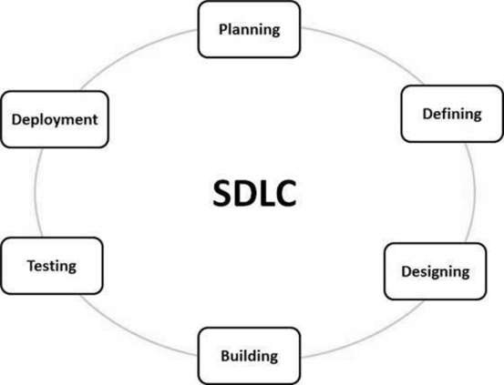

Slide 5
Stage 1: Planning and Requirement Analysis
Stage 2: Defining Requirements
Stage 3: Designing the Product Architecture
Stage 4: Building or Developing the Product
Stage 5: Testing the Product
Stage 6: Deployment in the Market and Maintenance

Slide 6
SDLC Models
Waterfall Model
Iterative Model
Spiral Model
V-Model
Big Bang Model

Slide 7
Waterfall Model - Design
The Waterfall Model was the first Process Model to be introduced. It is also referred to as a linear-sequential life cycle model.

Slide 8
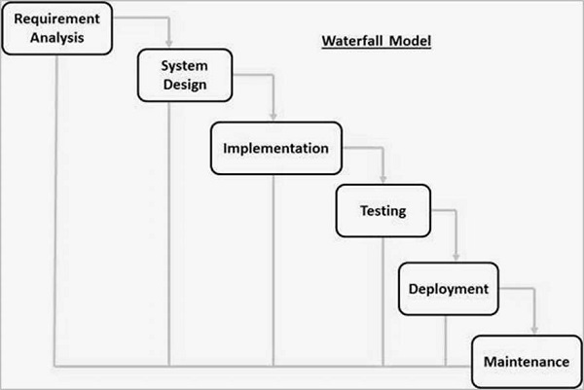

Slide 9
Waterfall Model - Application
Requirements are very well documented, clear and fixed.
Product definition is stable.
Technology is understood and is not dynamic.
There are no ambiguous requirements.
Ample resources with required expertise are available to support the product.
The project is short.

Slide 10
Waterfall Model - Advantages
Simple and easy to understand and use
Easy to manage due to the rigidity of the model. Each phase has specific deliverables and a review process.
Phases are processed and completed one at a time.
Works well for smaller projects where requirements are very well understood.
Clearly defined stages.
Well understood milestones.
Easy to arrange tasks.
Process and results are well documented.

Slide 11
Waterfall Model - Disadvantages
No working software is produced until late during the life cycle.
High amounts of risk and uncertainty.
Not a good model for complex and object-oriented projects.
Poor model for long and ongoing projects.
Not suitable for the projects where requirements are at a moderate to high risk of changing. So, risk and uncertainty is high with this process model.
It is difficult to measure progress within stages.
Cannot accommodate changing requirements.
Adjusting scope during the life cycle can end a project.
Integration is done as a "big-bang. at the very end, which doesn't allow identifying any technological or business bottleneck or challenges early.

Slide 12
Iterative Model - Design
Iterative process starts with a simple implementation of a subset of the software requirements and iteratively enhances the evolving versions until the full system is implemented.

Slide 13
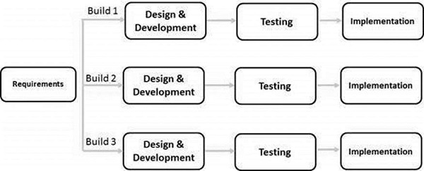

Slide 14
Iterative Model - Application
Requirements of the complete system are clearly defined and understood.
Major requirements must be defined; however, some functionalities or requested enhancements may evolve with time.
There is a time to the market constraint.
A new technology is being used and is being learnt by the development team while working on the project.
Resources with needed skill sets are not available and are planned to be used on contract basis for specific iterations.
There are some high-risk features and goals which may change in the future

Slide 15
Iterative Model - Pros
Some working functionality can be developed quickly and early in the life cycle.
Results are obtained early and periodically.
Parallel development can be planned.
Progress can be measured.
Less costly to change the scope/requirements.
Testing and debugging during smaller iteration is easy.
Risks are identified and resolved during iteration; and each iteration is an easily managed milestone.
Easier to manage risk - High risk part is done first.
With every increment, operational product is delivered.
Issues, challenges and risks identified from each increment can be utilized/applied to the next increment.
Risk analysis is better.
It supports changing requirements.
Initial Operating time is less.
Better suited for large and mission-critical projects.
During the life cycle, software is produced early which facilitates customer evaluation and feedback.

Slide 16
Iterative and Incremental SDLC Model-cons
More resources may be required.
Although cost of change is lesser, but it is not very suitable for changing requirements.
More management attention is required.
System architecture or design issues may arise because not all requirements are gathered in the beginning of the entire life cycle.
Defining increments may require definition of the complete system.
Not suitable for smaller projects.
Management complexity is more.
End of project may not be known which is a risk.
Highly skilled resources are required for risk analysis.
Projects progress is highly dependent upon the risk analysis phase.

Slide 17
Spiral Model - Design
The spiral model combines the idea of iterative development with the systematic, controlled aspects of the waterfall model.

Slide 18
Spiral Model - Design
Identification
Design
Construct or Build
Evaluation and Risk Analysis

Slide 19
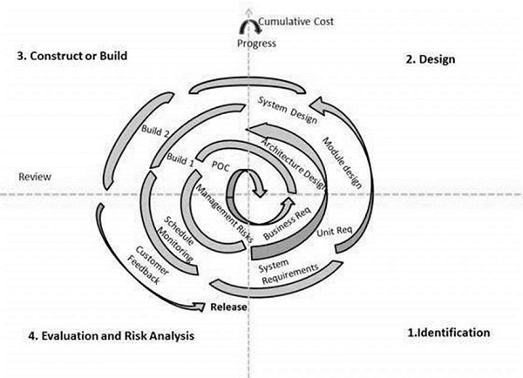

Slide 20
Spiral Model Application
When there is a budget constraint and risk evaluation is important.
For medium to high-risk projects.
Long-term project commitment because of potential changes to economic priorities as the requirements change with time.
Customer is not sure of their requirements which is usually the case.
Requirements are complex and need evaluation to get clarity.
New product line which should be released in phases to get enough customer feedback.
Significant changes are expected in the product during the development cycle

Slide 21
Spiral Model - Pros
Changing requirements can be accommodated.
Allows extensive use of prototypes.
Requirements can be captured more accurately.
Users see the system early.
Development can be divided into smaller parts and the risky parts can be developed earlier which helps in better risk management.

Slide 22
Spiral Model - Cons
Management is more complex.
End of the project may not be known early.
Not suitable for small or low risk projects and could be expensive for small projects.
Process is complex
Spiral may go on indefinitely.
Large number of intermediate stages requires excessive documentation.

Slide 23
V-Model
The V-model is an SDLC model where execution of processes happens in a sequential manner in a V-shape. It is also known as Verification and Validation model.

Slide 24
Verification is the process of evaluating products of a development phase to find out whether they meet the specified requirements.
Validation is the process of evaluating software at the end of the development process to determine whether software meets the customer expectations and requirements.

Slide 25
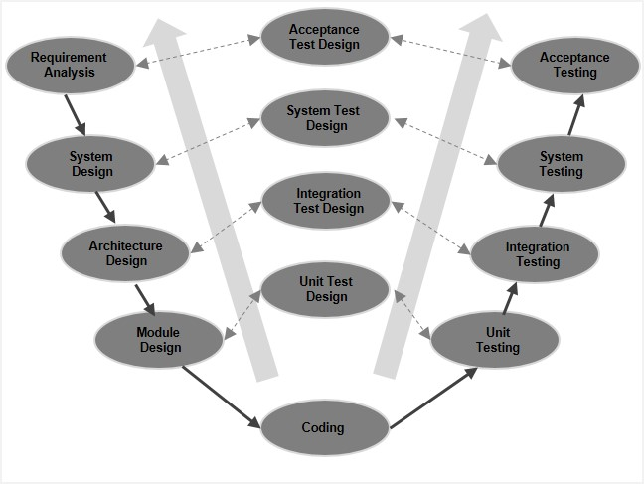
V-Model - Design

Slide 26
V-Model - Verification Phases
Business Requirement Analysis
System Design
Architectural Design
Module Design
Coding Phase

Slide 27
Validation Phases
Unit Testing
Integration Testing
System Testing
Acceptance Testing

Slide 28
V- Model ─ Application
Requirements are well defined, clearly documented and fixed.
Product definition is stable.
Technology is not dynamic and is well understood by the project team.
There are no ambiguous or undefined requirements.
The project is short.

Slide 29
V-Model - Pros
This is a highly-disciplined model and Phases are completed one at a time.
Works well for smaller projects where requirements are very well understood.
Simple and easy to understand and use.
Easy to manage due to the rigidity of the model. Each phase has specific deliverables and a review process.

Slide 30
V-Model-Cons
High risk and uncertainty.
Not a good model for complex and object-oriented projects.
Poor model for long and ongoing projects.
Not suitable for the projects where requirements are at a moderate to high risk of changing.
Once an application is in the testing stage, it is difficult to go back and change a functionality.
No working software is produced until late during the life cycle.

Slide 31
Big Bang Model
The Big Bang model is an SDLC model where we do not follow any specific process.
This Big Bang Model does not follow a process/procedure and there is a very little planning required.

Slide 32
Big Bang Model ─ Design and Application
The Big Bang Model comprises of focusing all the possible resources in the software development and coding, with very little or no planning. The requirements are understood and implemented as they come. Any changes required may or may not need to revamp the complete software.

Slide 33
Big Bang Model - Pros
This is a very simple model
Little or no planning required
Easy to manage
Very few resources required
Gives flexibility to developers
It is a good learning aid for new comers or students.

Slide 34
Big Bang Model - Cons
Very High risk and uncertainty.
Not a good model for complex and object-oriented projects.
Poor model for long and ongoing projects.
Can turn out to be very expensive if requirements are misunderstood.

Slide 35
Agile SDLC model
Agile SDLC model is a combination of iterative and incremental process models with focus on process adaptability and customer satisfaction by rapid delivery of working software product.
Agile Methods break the product into small incremental builds.

Slide 36
Agile SDLC Model
Planning
Requirements Analysis
Design
Coding
Unit Testing and
Acceptance Testing.

Slide 37
What is Agile?
Agile model believes that every project needs to be handled differently and the existing methods need to be tailored to best suit the project requirements.
The most popular Agile methods include Rational Unified Process (1994), Scrum (1995), Crystal Clear, Extreme Programming (1996), Adaptive Software Development, Feature Driven Development, and Dynamic Systems Development Method (DSDM) (1995).

Slide 38
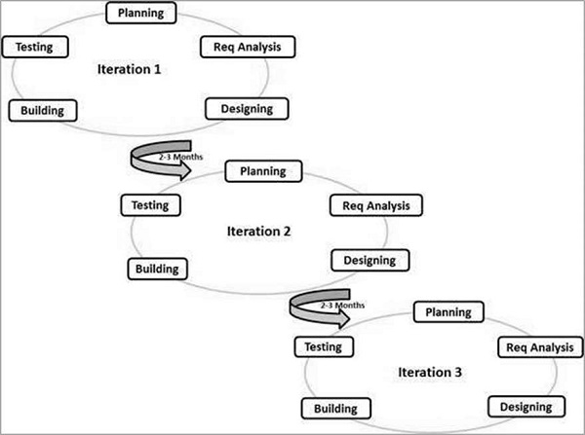

Slide 39
Agile Manifesto principles
Individuals and interactions − In Agile development, self-organization and motivation are important, as are interactions like co-location and pair programming.
Working software − Demo working software is considered the best means of communication with the customers to understand their requirements, instead of just depending on documentation.
Customer collaboration − As the requirements cannot be gathered completely in the beginning of the project due to various factors, continuous customer interaction is very important to get proper product requirements.
Responding to change − Agile Development is focused on quick responses to change and continuous development.

Slide 40
Agile Vs Traditional SDLC Models
Agile is based on the adaptive software development methods, whereas the traditional SDLC models like the waterfall model is based on a predictive approach.
Predictive teams in the traditional SDLC models usually work with detailed planning and have a complete forecast of the exact tasks and features to be delivered in the next few months or during the product life cycle.

Slide 41
The advantages of the Agile Model
Is a very realistic approach to software development.
Promotes teamwork and cross training.
Functionality can be developed rapidly and demonstrated.
Resource requirements are minimum.
Suitable for fixed or changing requirements
Delivers early partial working solutions.
Good model for environments that change steadily.
Minimal rules, documentation easily employed.
Enables concurrent development and delivery within an overall planned context.
Little or no planning required.
Easy to manage.
Gives flexibility to developers.

Slide 42
T The disadvantages of the Agile Model
Not suitable for handling complex dependencies.
More risk of sustainability, maintainability and extensibility.
An overall plan, an agile leader and agile PM practice is a must without which it will not work.
Strict delivery management dictates the scope, functionality to be delivered, and adjustments to meet the deadlines.
Depends heavily on customer interaction, so if customer is not clear, team can be driven in the wrong direction.
There is a very high individual dependency, since there is minimum documentation generated.
Transfer of technology to new team members may be quite challenging due to lack of documentation.

Slide 43
RAD (Rapid Application Development) model
The RAD (Rapid Application Development) model is based on prototyping and iterative development with no specific planning involved. The process of writing the software itself involves the planning required for developing the product.

Slide 44
What is RAD?
Rapid application development is a software development methodology that uses minimal planning in favor of rapid prototyping. A prototype is a working model that is functionally equivalent to a component of the product.

Slide 45
RAD Model Design
Business Modeling
Data Modeling
Process Modeling
Application Generation
Testing and Turnover

Slide 46
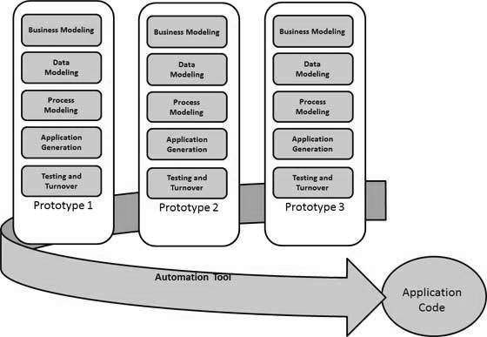

Slide 47
RAD Model Vs Traditional SDLC
The traditional SDLC follows a rigid process models with high emphasis on requirement analysis and gathering before the coding starts.

Slide 48
RAD Model - Application
RAD should be used only when a system can be modularized to be delivered in an incremental manner.
It should be used if there is a high availability of designers for modeling.
It should be used only if the budget permits use of automated code generating tools.
RAD SDLC model should be chosen only if domain experts are available with relevant business knowledge.
Should be used where the requirements change during the project and working prototypes are to be presented to customer in small iterations of 2-3 months.

Slide 49
RAD Model - Pros
Changing requirements can be accommodated.
Progress can be measured.
Iteration time can be short with use of powerful RAD tools.
Productivity with fewer people in a short time.
Reduced development time.
Increases reusability of components.
Quick initial reviews occur.
Encourages customer feedback.
Integration from very beginning solves a lot of integration issues.

Slide 50
RAD Model - Cons
Dependency on technically strong team members for identifying business requirements.
Only system that can be modularized can be built using RAD.
Requires highly skilled developers/designers.
High dependency on modeling skills.
Inapplicable to cheaper projects as cost of modeling and automated code generation is very high.
Management complexity is more.
Suitable for systems that are component based and scalable.
Requires user involvement throughout the life cycle.
Suitable for project requiring shorter development times.

Slide 51
Software Prototyping
Prototype is a working model of software with some limited functionality. The prototype does not always hold the exact logic used in the actual software application and is an extra effort to be considered under effort estimation.

Slide 52
Basic Requirement Identification
Developing the initial Prototype
Review of the Prototype
Revise and Enhance the Prototype

