Slide 1
LSEG LiveOps
By: Nimeshika Ranasinghe

Slide 2
MY SELF
Educational Background
Graduated from SLIIT with a B.Sc (Special) (Hons) Degree in IT
Following RHCSA certification
Working Experience
Worked as a Information Security inter for CDB Finance for 3 moths
Working for MIT as TechOps intern for 8 months
Interested in scripting and working in Linux environment
Interest in social volunteer works

Slide 3
MY FAVORITE SUPER HERO
Felicity Smoak
Actor in Arrow TV Series
Real World name - Emily Bett Rickards
Master mind in technical world
Focus on what she doing
The way she acts in critical situations – Calmness, Getting right Decisions

Slide 4

Millennium IT
Founded by Tony Weerasinghe in 1996 as a systems integrator and Sun Microsystems authorized reseller.
Later moved to specializes in electronic trading systems, systems integration services including IT infrastructure and consultation services .
Since 2009 it works under LSEG by providing agile, efficient IT solution for group's business while sells and licenses technology over 30 capital markets.

Slide 5


London Stock Exchange Group (LSEG)
An international markets infrastructure business which was created in 2007 October by London Stock Exchange merging with Milan Stock Exchange, Borsa Italiana.
Diversified global business focuses on capital formation, intellectual property and risk and balance sheet management.
Leading developer and operator of high performance technology solutions, including trading, market surveillance and post trade systems for over 40 organizations and exchanges.
MIT is under LSEG Technology.

Slide 6

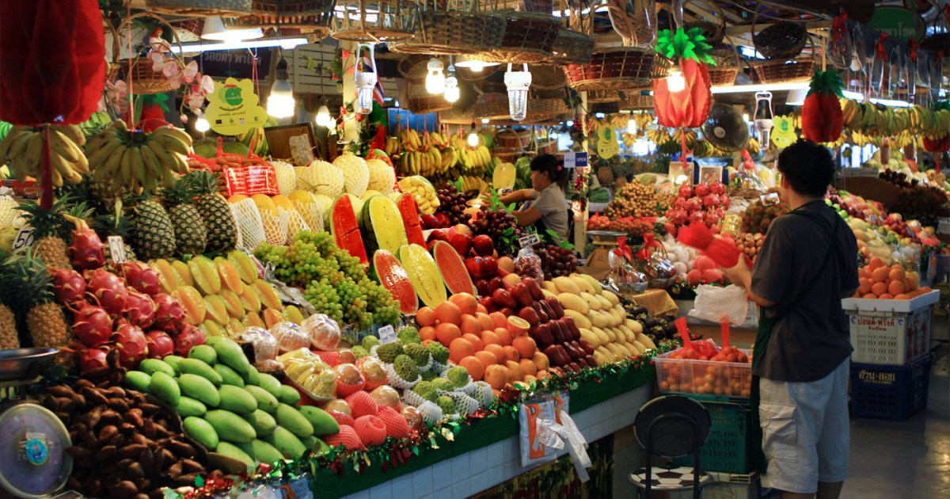
Capital Markets
Capital + Market
Place where money is exchanged between people who have excess of it, to those who are in deficit.

Slide 7
Continue Capital Market ...
The part of financial system which is concerned with raising capital funds by dealing in Shares, Bonds and other long-term investments
The market where Investment instruments like Bonds, equities and mortgages are traded
Functions of capital market
Mobilization of Savings
Capital Formation
Speed up Economic Growth and Development
Proper regulation of funds
Provision of investment Avenue

Slide 8
LSEG LiveOps
Provide level 2 technical advice and risk assessment based on knowledge of applications, & underlying infrastructure
Take ownership of operational live service issues and drive their resolution in order to reduce the number of recurring technical issues
Ensure changes are correctly impact assessed and implemented successfully within the agreed Service Levels

Slide 9
ISO/IEC 20000
The international Standard for best practice in IT Service Management system
Provides a set of standardized requirements for an ITSMS
Why ISO 20000?
Ensure the effective running and delivery of IT services
Continually improve process
Drive customer focus

Slide 10
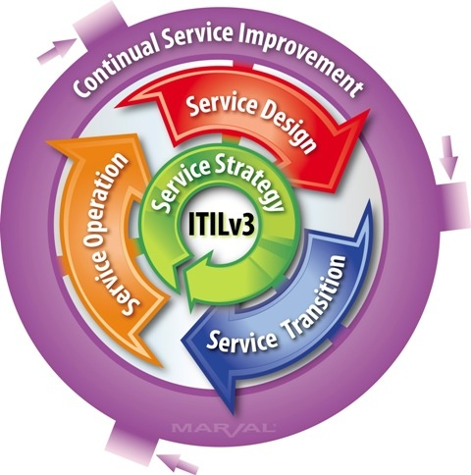
ITIL
Systematic approach to high quality IT service delivery
Documented best practice for IT Service Management
Provides common language with well-defined terms

Slide 11
Importance of an Application Support Engineer for a Production System
Understanding & analysis of user requirement for minor enhancements.
Ensure that all operational responsibilities are performed including monitoring systems and deploying releases
Improve business performance and strategy by taking responsible for using technology
Responsible for ensuring new users of an application have a smooth onboarding process

Slide 12
Thank YOU

