Slide 1
Helm Chart Strategy
Nimesh Jain

Slide 2
Objective
Create a strategy for helm chart from ICDS to deploy containers in ICP.
Develop helm chart(for Std. Patterns) that can be used to deploy software components to ICP.
Reuse as much as possible the existing ICDS components.
Solution:
Developed a solution using the following technologies:
Docker container.
Kubernetes
Helm chart
Chef Cook books already available.

Slide 3
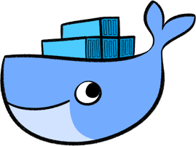
Background - Docker
What is Docker & Container
Container is a light weight, stand alone executable package that contains everything that the software needs to run.
Helps in packaging applications so that multiple applications can run in the same computer.
Platform independent, Mainly in Linux.
Docker is a company that provides a container technology.
Container 1
Container 2
Container 3
Container 4
Docker Container engine
Operating System
Physical Layer
Processor
Storage
Network

Slide 4
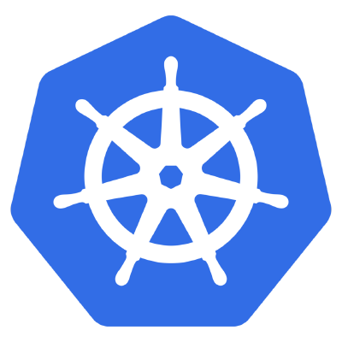
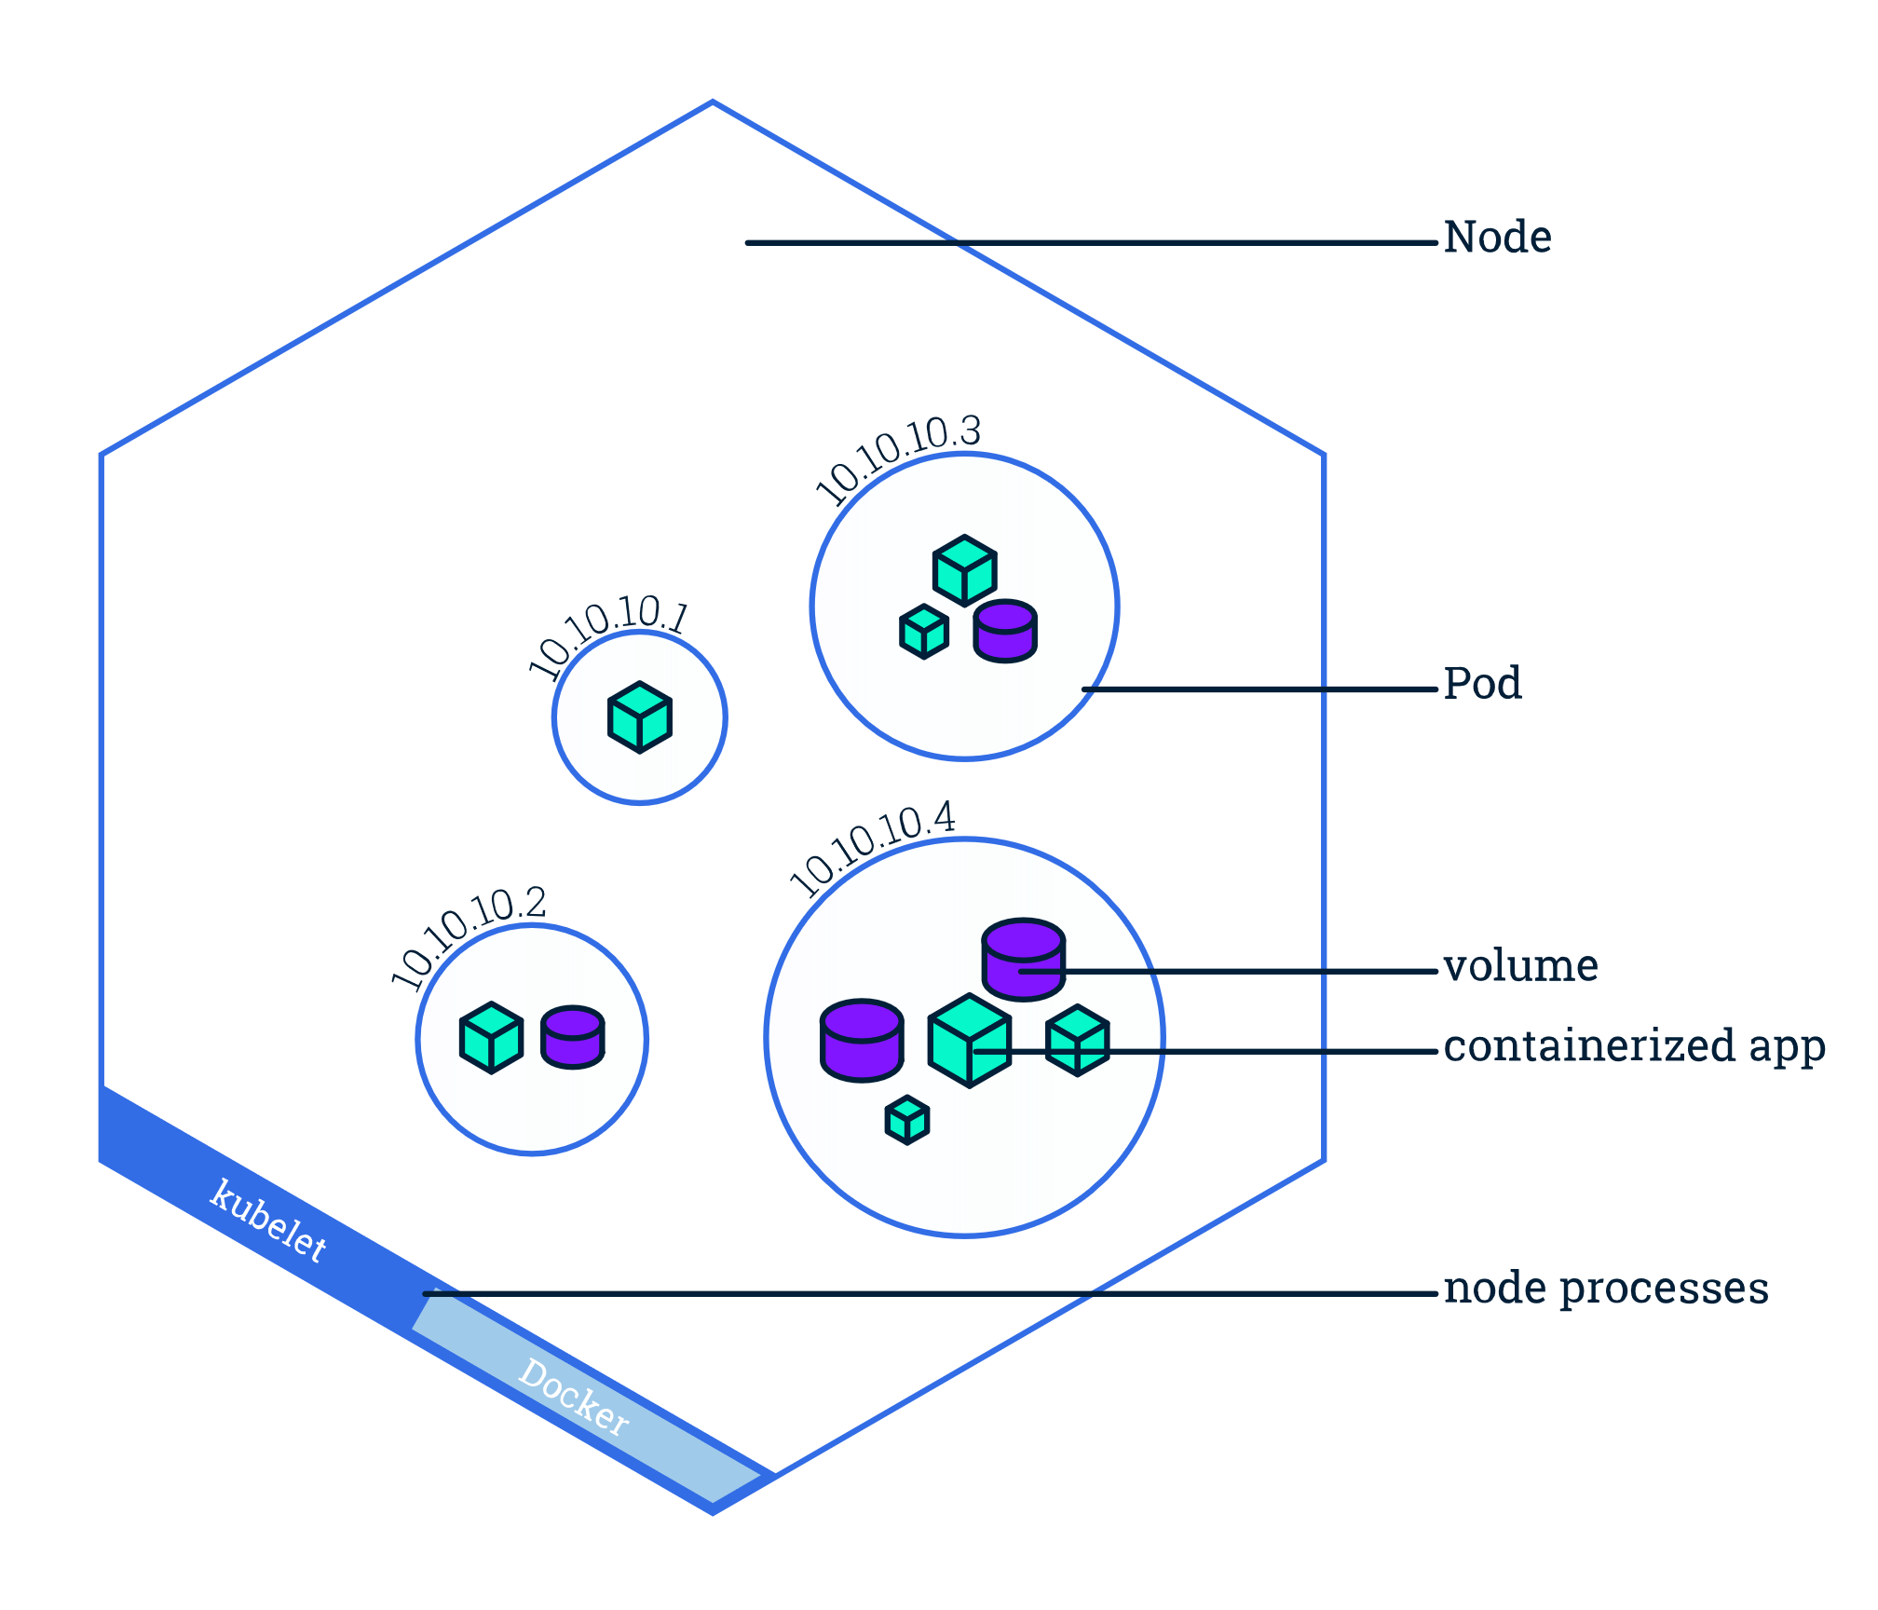
Background - Kubernetes
Definition:
Orchestration tool for automating deployment, scaling and management of containerized applications.
Comprises Master and Worker nodes.
Master controls assignment of pods in worker nodes.
Smallest unit is Pod.
Cluster
Worker Node
Worker Node
Master Node

Slide 5
BackGround - CHEF

Slide 6

Helm
Used to install/ upgrade/ remove the software component in kubernetes
The basic unit for helm is chart.
Chart contains definition for software component and any dependent charts.
Provides hooks that can be called during the lifecycle.
Provides option to include tests for the chart.
Based on YAML File.
Sample Chart:
mychart /
chart.yaml
values.yaml
charts/
templates/
deployment.yaml
service.yaml
_helpers.tpl
Notes.txt

Slide 7
Steps in creating a Helm chart
Create Chart
Update Chart.yaml / Values.yaml
Package it
Install/
upgrade/
delete
Update Deployment /Service.yaml files.
Create a Helm chart.
Basic Skeleton of the chart is ready.
Update the chart.yaml/Values.yaml with the chart details.
Update Deployment.yaml & Service.yaml to indicate the image, replica count etc.
Update Notes.txt
Package it(Compress it to .tgz file)
Install the chart

Slide 8
Available Options
Option 1: Convert all of them including the managed services to helm chart.
Option 2: Make a generic helm chart that calls already developed chef component to install software.
Option 3: Make a bare minimum docker image with the helm chart for each component. Make this component to install/configure the software.
Option 4: ??

Slide 9
Option 1
Description:
Each pattern will have a corresponding one image containing all the software comp & Make Managed Components.
PROS:
Each of the image is isolated and can be changed without changing any interfering with other images.
CONS:
It is a laborious job of creating a image for each container.
Once the image is created, the image can not be updated.
Each image may have the secure credentials for a component, that if kept in the image may be vulnerable.

Slide 10
Option 2
Chef Server
Smallest unit for Kubernetes is POD.
Pod Contains a container.
Container can be created with the chef client embedded.
The top thin writable layer can be used for the installing/upgrading or removing the softwares (middleware/db etc. ).
The image/container is provided as arguments the ip address of the chef server and the list of cookbooks to install.
Container on creation makes a connection to the chef server and downloads the cookbook.
Sw from chef server
Top Thin Layer
Chef-client
Layers
Kubernetes
node
node

Slide 11
Option 2
PROS:
Only one solution for all the images.
All possible configurations for a image can be created.
The software can be configured as and when needed.
The new patches for the software can be updated automatically.
CONS:
A software component that needs a new port to be exposed in an existing image cannot be installed.

Slide 12
Solution Overview
Have a docker image that exposes the port for the software that it contains.
Install the chef-client in the docker image.
Use Chef server to configure and update patches to the software.
Pass in docker image the chef server details and the run list.
Use helm chart to pass the credentials of the chef-server to secure the password. (pass validation.pem as secret volume)
Any data that needs to be persisited can be defined as a volume in helm chart.
Chef Server
Top Thin Layer
Exposed Port
Layers
Chef Client
Docker Image
Persisted data

Slide 13
Solution
Docker Image
Have a docker image that contains the bare minimum software component.
The image should contain a chef client installed and other bare minimum softwares.
The image can be passed the following details through the env variables:
Chef Server details.
cookbook to execute from the chef server.
The port of the software component to be installed should be exposed.
Helm Chart:
The password to be used for the chef server can be provided as a secret.
Persisted data can be defined in a nfs volume.
Helm Deployment.yaml can be used to provide the custom deployment/pod definition.
Service.yaml can be used to expose the deployed application as a service outside.

Slide 14
Demo
Create a Docker image
Insert image in the Docker Trusted Registry
Create a Helm chart
Update the chart values used for provisioning.
Install the chart
Docker container gets executed.
Executes the cookbook and install/configure software.

Slide 15
Next Steps
Things Pending:
Solution needs to be tried in Centos/RHEL
Reduce the memory footprint of the image.
Convert the chef-server credential ( validation.pem ) as a secret volume.
Try the solution with an existing chef cookbook and executables available for standard patterns.
Infrastructure needed:
Private Docker Trusted Registry(DTR): This is needed to keep the docker images in a registry.
Binaries: Server containing all the binaries that we support for different platforms (like RHEL or ubuntu. )
Chef server: To keep the chef cookbooks in a common place that can be connected by the image to pick the cookbooks.

Slide 16
Thank You

