Slide 1
To Predict the Fraud in auto Insurance Claims
INSoFe Phd Hackathon
Prepared by: Nimesh harishbhai katoriwala

Slide 2
BUSINESS CASE
Fraud detection of INSURAnce Claims

Slide 3
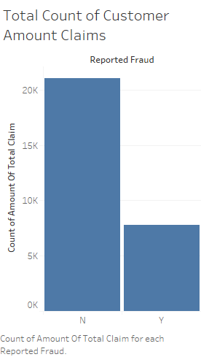
Reported Fraud: N
Total no of normal Claim : 21,051
Reported Fraud: Y
Total no of normal Claim : 7785

Slide 4
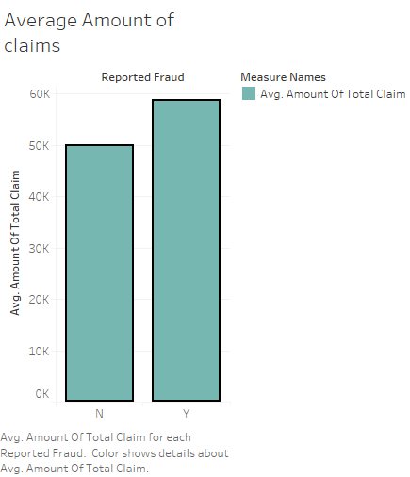
Reported Fraud: N
Avg. Amount of Total Claim : 49,848
Reported Fraud: Y
Avg. Amount of Total Claim : 58,626

Slide 5
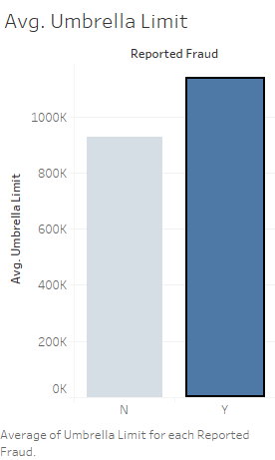
Reported Fraud: N
Avg. Amount of Umbrella limit : 928,178
Reported Fraud: Y
Avg. Amount of Umbrella limit : 1,133,982

Slide 6
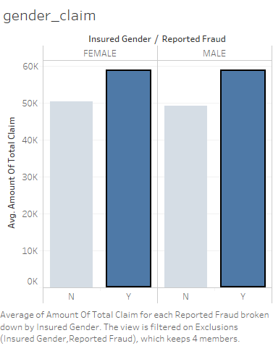
Insured Gender: Female
Avg. Claim amount: 58,641
Insured Gender: Male
Avg. Claim amount: 58,617

Slide 7
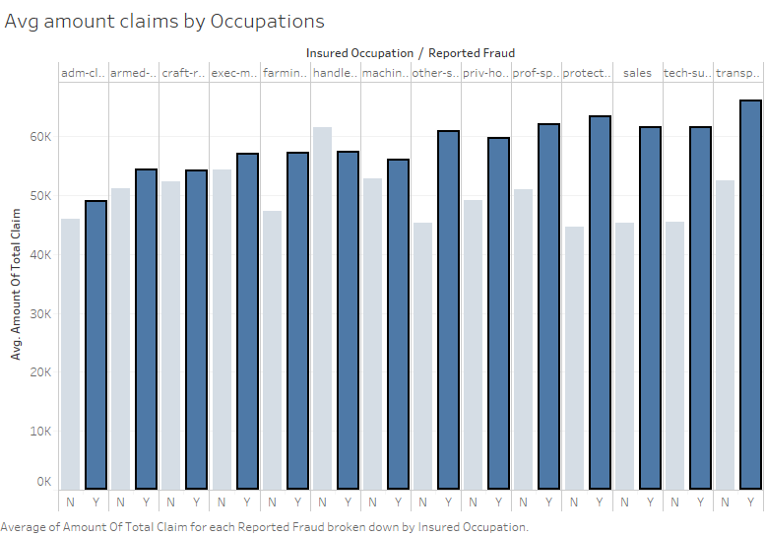

Slide 8
Transport Moving | 65,933
Protective – Serv | 63,157
Prof – Specialty | 61,936
Tech – Support | 61,442
Sales | 61,302
Other services | 60,639
Prev house serv | 59,519
Handler – Cleaners | 57,147
Farming-fishing | 57,068
Exec – Managerial | 56,862
Machine-op-Inspect | 55,891
Armed forces | 54,121
Craft Repair | 53,961
Admin Clerical | 48,885

Slide 9
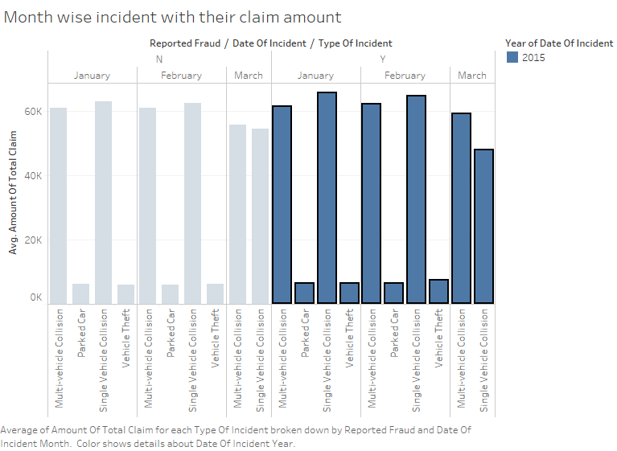

Slide 10
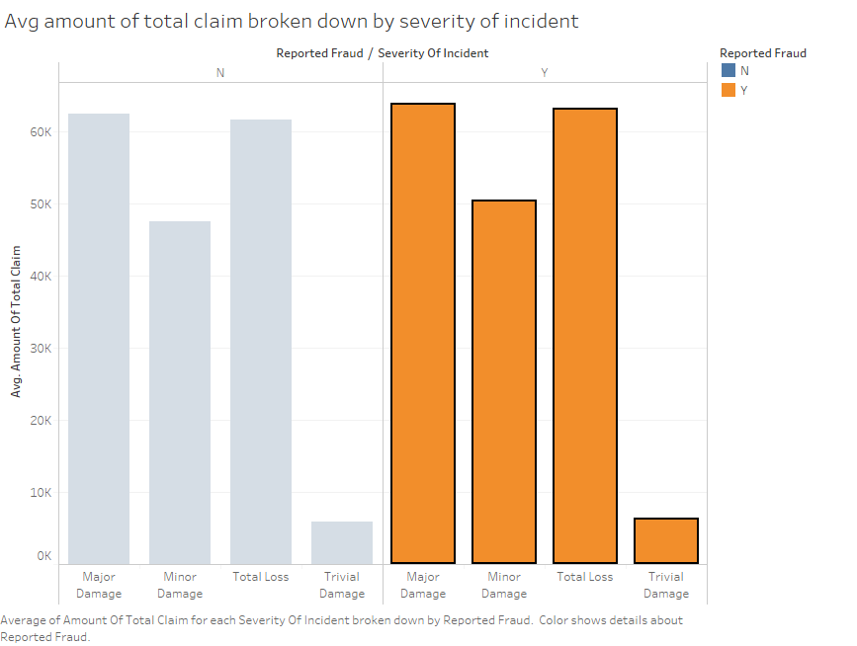

Slide 11
Problem Statement
TO Predict the fraud in auto insurance claims using machine learning techniques

Slide 12
Why Machine Learning in Fraud Detection….?

Slide 13
Objectives of Machine Learning
Data Handling
Data Cleaning
Transformation
Sampling
Detection Layer
Business Rules
ML Algorithms
OUT COMES
Predictions
Reports
Deployment

Slide 14
Dataset Descriptions
There are two folders: Train Data and Test Data
Each folders contains 5 subfolders having name as:
Train/Test Data
Train/Test Vehicle Data
Train/Test Policy Data
Train/Test Claims Data
Train/Test Demographics Data
Each folders has one common column: “CustomerID”
Merge all the files with common column “CustomerID”
Problem with “Train/Test Vehicle Data file is:

Slide 15
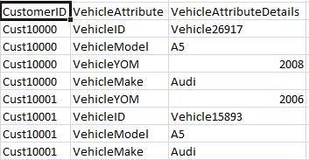
Continue….
CustomerID VehicleID VehicleMake VehicleModel VehicleYOM

Slide 16
Continue….
Train data consist of 28,836 and 42 Features
Test data consist of 9662 and 41 Features
24 Features are categorical
18 Features are numeric
Target variable is: “ReportedFraud”

Slide 17
Exploratory Data Analysis
Summary Statistics
Structure of the data
Head
Tail
Standardization
Correlation between numerical data
Missing values handling
Outliers detections
Feature engineering
Remove unredudant features

Slide 18
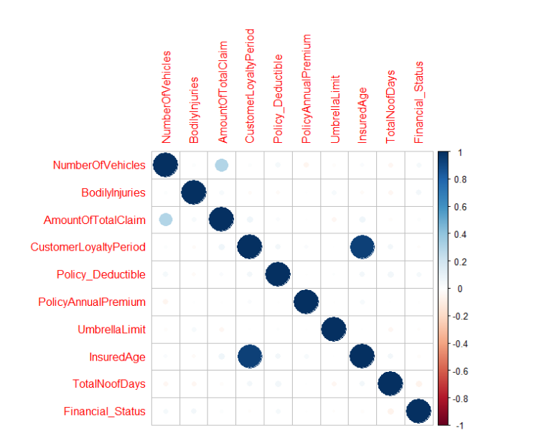
Correlation Plot for Numeric Data

Slide 19
Missing Values Detection
Features | Missing Values
VehicleMake | 50
TypeOfCollission | 5162
IncidentTime | 31
PropertyDamage | 10459
Witness | 46
PoliceReport | 9805
AmountTotalClaim | 50
PolicyAnnualPremium | 141
Country | 2
Features | Missing Values
VehicleMake | 8
TypeOfCollission | 1797
IncidentTime | 7
PropertyDamage | 3511
Witness | 12
PoliceReport | 3262
AmountTotalClaim | 8
PolicyAnnualPremium | 51
Country | 4

Slide 20
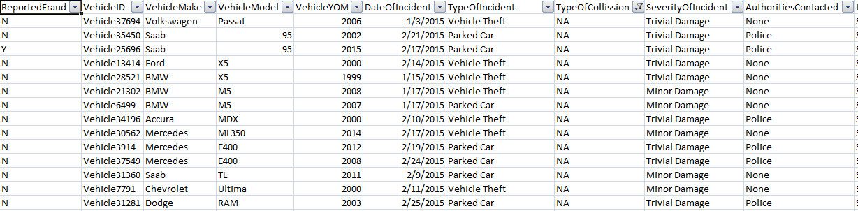
Continue…

Slide 21
Replace NAs…
Features | Replacement
VehicleMake | None
TypeOfCollission | Other
IncidentTime | Not Known
PropertyDamage | Not Aware
Witness | Not Mention
PoliceReport | Not Registered
AmountTotalClaim | 0
PolicyAnnualPremium | 0
Country | Delete the rows

Slide 22
Feature Engineering
Better features, results in better performance
Better features, reduce the complexity
Better features and better models yield to get highly valuable outcome

Slide 23
Engineered Features
New Features | Derived From
TotalNoOfDays | Derived from DateOfIncident and DateOfPolicyConverge
VehicleAge | Derived from VehicleYOM and DateOfIncident
Policy_SplitLimit | Derived from Policy_CombinedSinsleLimit
Policy_CombineLimit | Derived from Policy_CombinedSingleLimit
FinancialStatus | Derived from CapitalGain and CapitalLoss

Slide 24
Remove Unredudant Features
Features
CustomerID
VehicleID
AmountOfInjuryClaim
AmountOfPropertyClaim
AmountOfVehicleDamage
IncidentAddress
InsuredZipcode
InsurancePolicyNumber
InsuredEducationalLevel
InsuredRelationship
Country

Slide 25
Imbalance Dataset
Train data has dependent variable which contain 2 category (0/1)
Proportion of (0/1):
0 – Normal Claims: 21051
1 – Fraud Claims: 7785
For solving imbalance problem, used different sampling technique.
Over Sampling
Under Sampling
SMOTE

Slide 26
Model Building

Slide 27
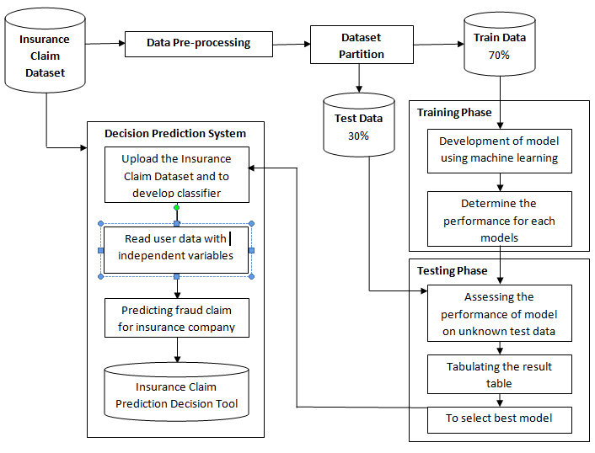

Slide 28
Model Performance and Comparison
Model | Recall (%) | Precision (%) | F1 Score (%)
Random Forest | 79 | 90 | 83.37
GBM | 74 | 89 | 81
Decision Tree(C50) | 66 | 79 | 71.86
Decision Tree(CART) | 65 | 71 | 68
Logistic Regression | 45 | 77 | 56

Slide 29
Important Features
Features
SeverityOfIncident | VehicleModel
InsuredHobbies | IncidentState
VehicleMake | InsuredOccupation
PolicyAnnualPremium | AmountOfTotalClaim
IncidentCity | UmbrellaLimit
VehicleAge | InsuredAge
CustomerLoyaltyPeriod | TotalNoofDays
TypeOfIncident

Slide 30
Result on Important Features
Model | Recall (%) | Precision (%) | F1 Score (%)
Random Forest | 68 | 83 | 76
Decision Tree(C50) | 66 | 79 | 71.86

Slide 31
Conclusion
Given inherent characteristics of various datasets, it would be impractical to a' priori define optimal algorithmic techniques or recommended feature engineering for best performance.
However, it would be reasonable to suggest that based on the model performance on back-testing and ability to identify new frauds, the set of models offer a reasonable suite to apply in the area of insurance claims fraud.
The models would then be tailored for the specific business context and user priorities.

Slide 32
THANK YOU

