Slide 1
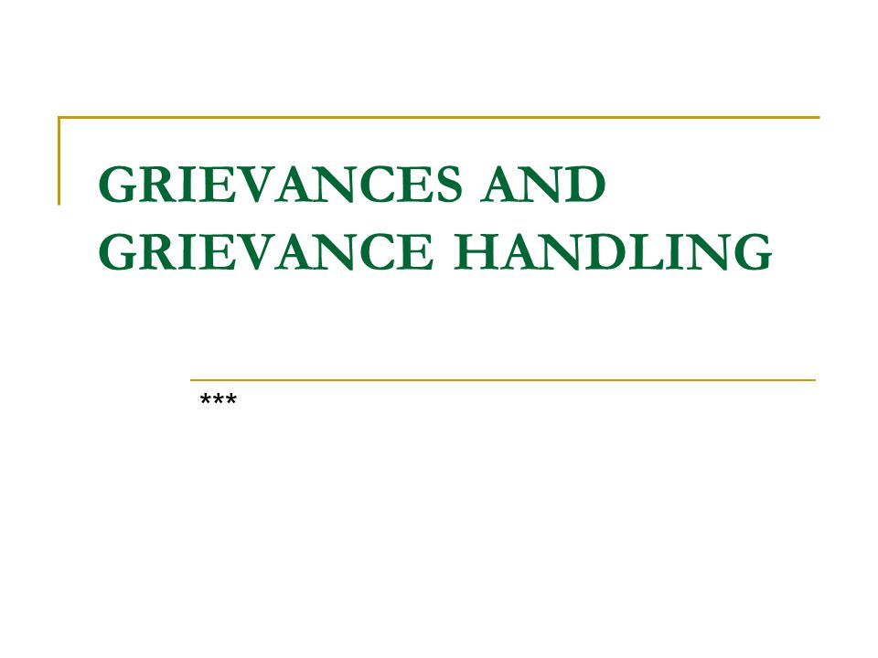
Nimesh Shrestha !
Sujan Bajgain
Saugat Wagle
Anurag Jha
Pooja Pokhrel
Ishita Bhattarai
Sujata Bhatta
Ankit Buda Magar

Slide 2
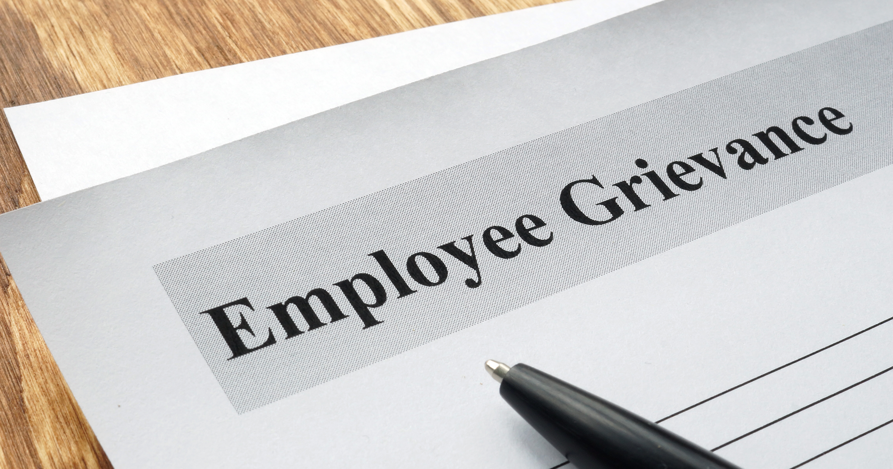

Slide 3
Grievance K ho ?
A grievance is any dissatisfaction or feeling of injustice having connection with one’s employment situation which is brought to the attention of management.
It is a formal written complaint.
Keith Davis: "Grievance is any real or imagined feeling of personal injustice that an employee has about the employment relationship."
Wendell French: "Grievance is a formal complaint filed by an employee following an established grievance procedure."

Slide 4
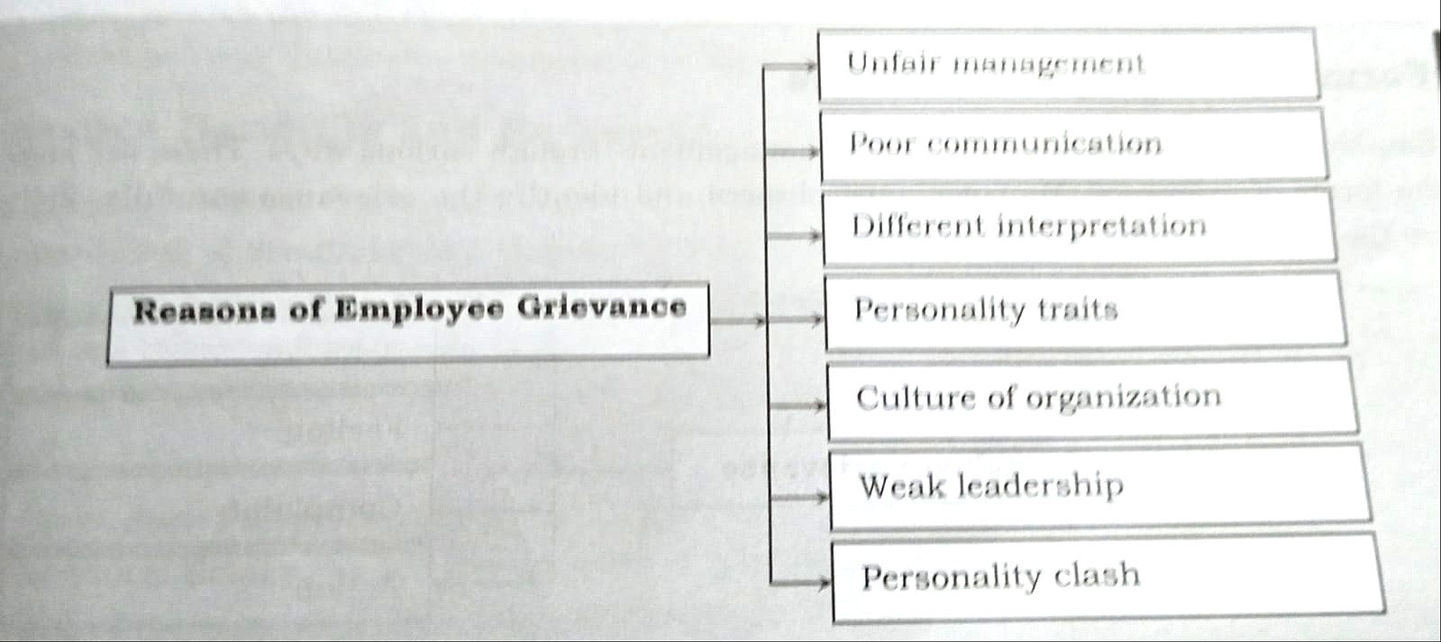

Slide 5
Cause / Reasons of Grievance !
1. Unfair Management Practices Grievances arise when employees face favoritism, biased decisions, or inconsistent rule enforcement, leading to a sense of injustice.
2. Poor Communication Lack of clear and timely communication causes confusion, misunderstandings, and frustration among employees.
3. Different Interpretation of Policies or Roles Ambiguity in rules or job roles can lead to conflicting expectations and workplace disputes.
4. Personality Traits Clashes due to ego, temperament, or poor interpersonal skills can cause interpersonal conflicts and dissatisfaction.
5. Culture of the Organization A toxic or unsupportive work culture can make employees feel devalued, leading to disengagement and complaints.
6. Weak Leadership Ineffective or unresponsive leadership results in lack of direction, support, and employee motivation, triggering grievances.

Slide 6
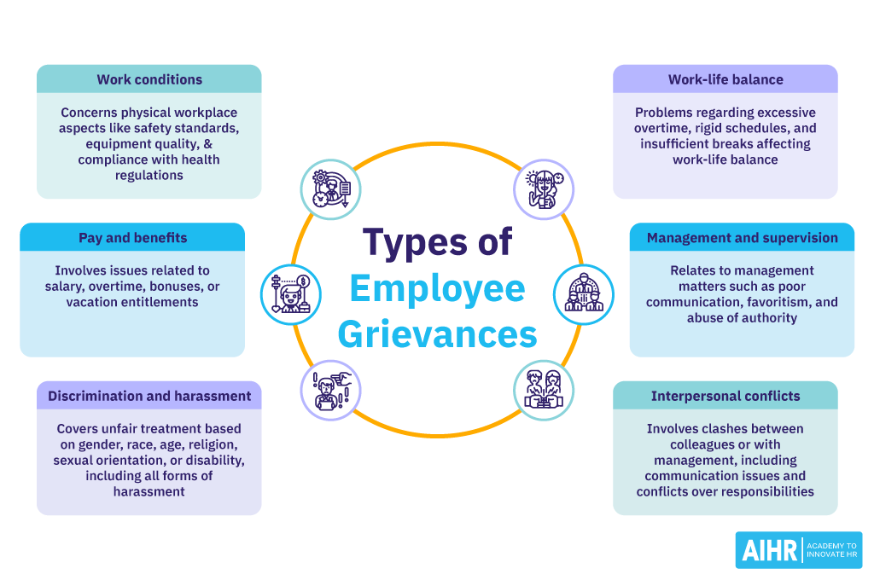

Slide 7
Forms of Grievance !
Work conditions: These relate to the physical conditions of the workplace, including safety standards, equipment quality, workspace environment, and compliance with health and safety regulations.
Compensation and benefits: These grievances involve disputes over earnings, salary adjustments, overtime pay, bonuses, and other compensation issues, as well as benefits like health insurance, retirement plans, and vacation entitlements.
Discrimination and harassment: Complaints related to unfair treatment based on gender, race, age, religion, sexual orientation, disability, or any other protected characteristic fall into this category. It also includes all forms of harassment, whether sexual, verbal, or psychological.
Work-life balance: This category involves concerns over excessive overtime, inflexible work schedules, insufficient breaks, and anything else that affects an employee’s ability to balance work with personal life.
Management and supervision: Concerns related to management practices, including lack of communication, poor management style, favoritism, lack of support, or abuse of authority.
Interpersonal conflicts: Problems between colleagues or employees and management that affect the working environment. This can include personality clashes, communication problems, or disputes over responsibilities.

Slide 8
Grievance Handling
Grievance handling refers to the formal process an organization follows to address employee complaints or concerns related to work conditions, treatment, or policies.
It ensures issues are resolved fairly, promptly, and respectfully, helping maintain a positive work environment and preventing escalation.

Slide 9
Importance of Grievance Handling
Maintains employee trust and morale
Prevents conflicts from escalating
Encourages open communication
Strengthens organizational fairness and transparency

Slide 10
How to Prevent a Grievance
Identify potential causes : Look for things that might upset employees—like unfair treatment, unclear rules, or poor communication. Catching small problems early can stop them from becoming big ones.
Correct problems promptly : When an issue is found, fix it quickly. This shows employees that their concerns are taken seriously and helps avoid more complaints.
Encourage corrective suggestions : Invite employees to share their ideas for fixing problems or improving the workplace. This makes them feel heard and involved.
Establish and reaffirm policies and work rules : Make sure everyone understands the rules and company policies. Talk about them regularly to keep things clear and consistent for everyone.

Slide 11
Role of Managers to resolve grievances
To maintain a culture of high performance.
Must be educated about the importance of the grievance process and their roles (not getting panic)
Effective grievance handling is an essential part of cultivating good employee relations and running a fair, successful, and productive workplace.

Slide 12
Conclusion
To sum up, employee grievances can happen in any workplace. But if they are handled quickly and fairly, it helps build trust and keeps the workplace peaceful. By knowing the reasons behind grievances and following the right steps to solve them, companies can avoid bigger problems.
The best way to deal with grievances is to prevent them by talking openly, having clear rules, and fixing problems early.

Slide 13
Dhanayabaaad ! !

