Slide 1
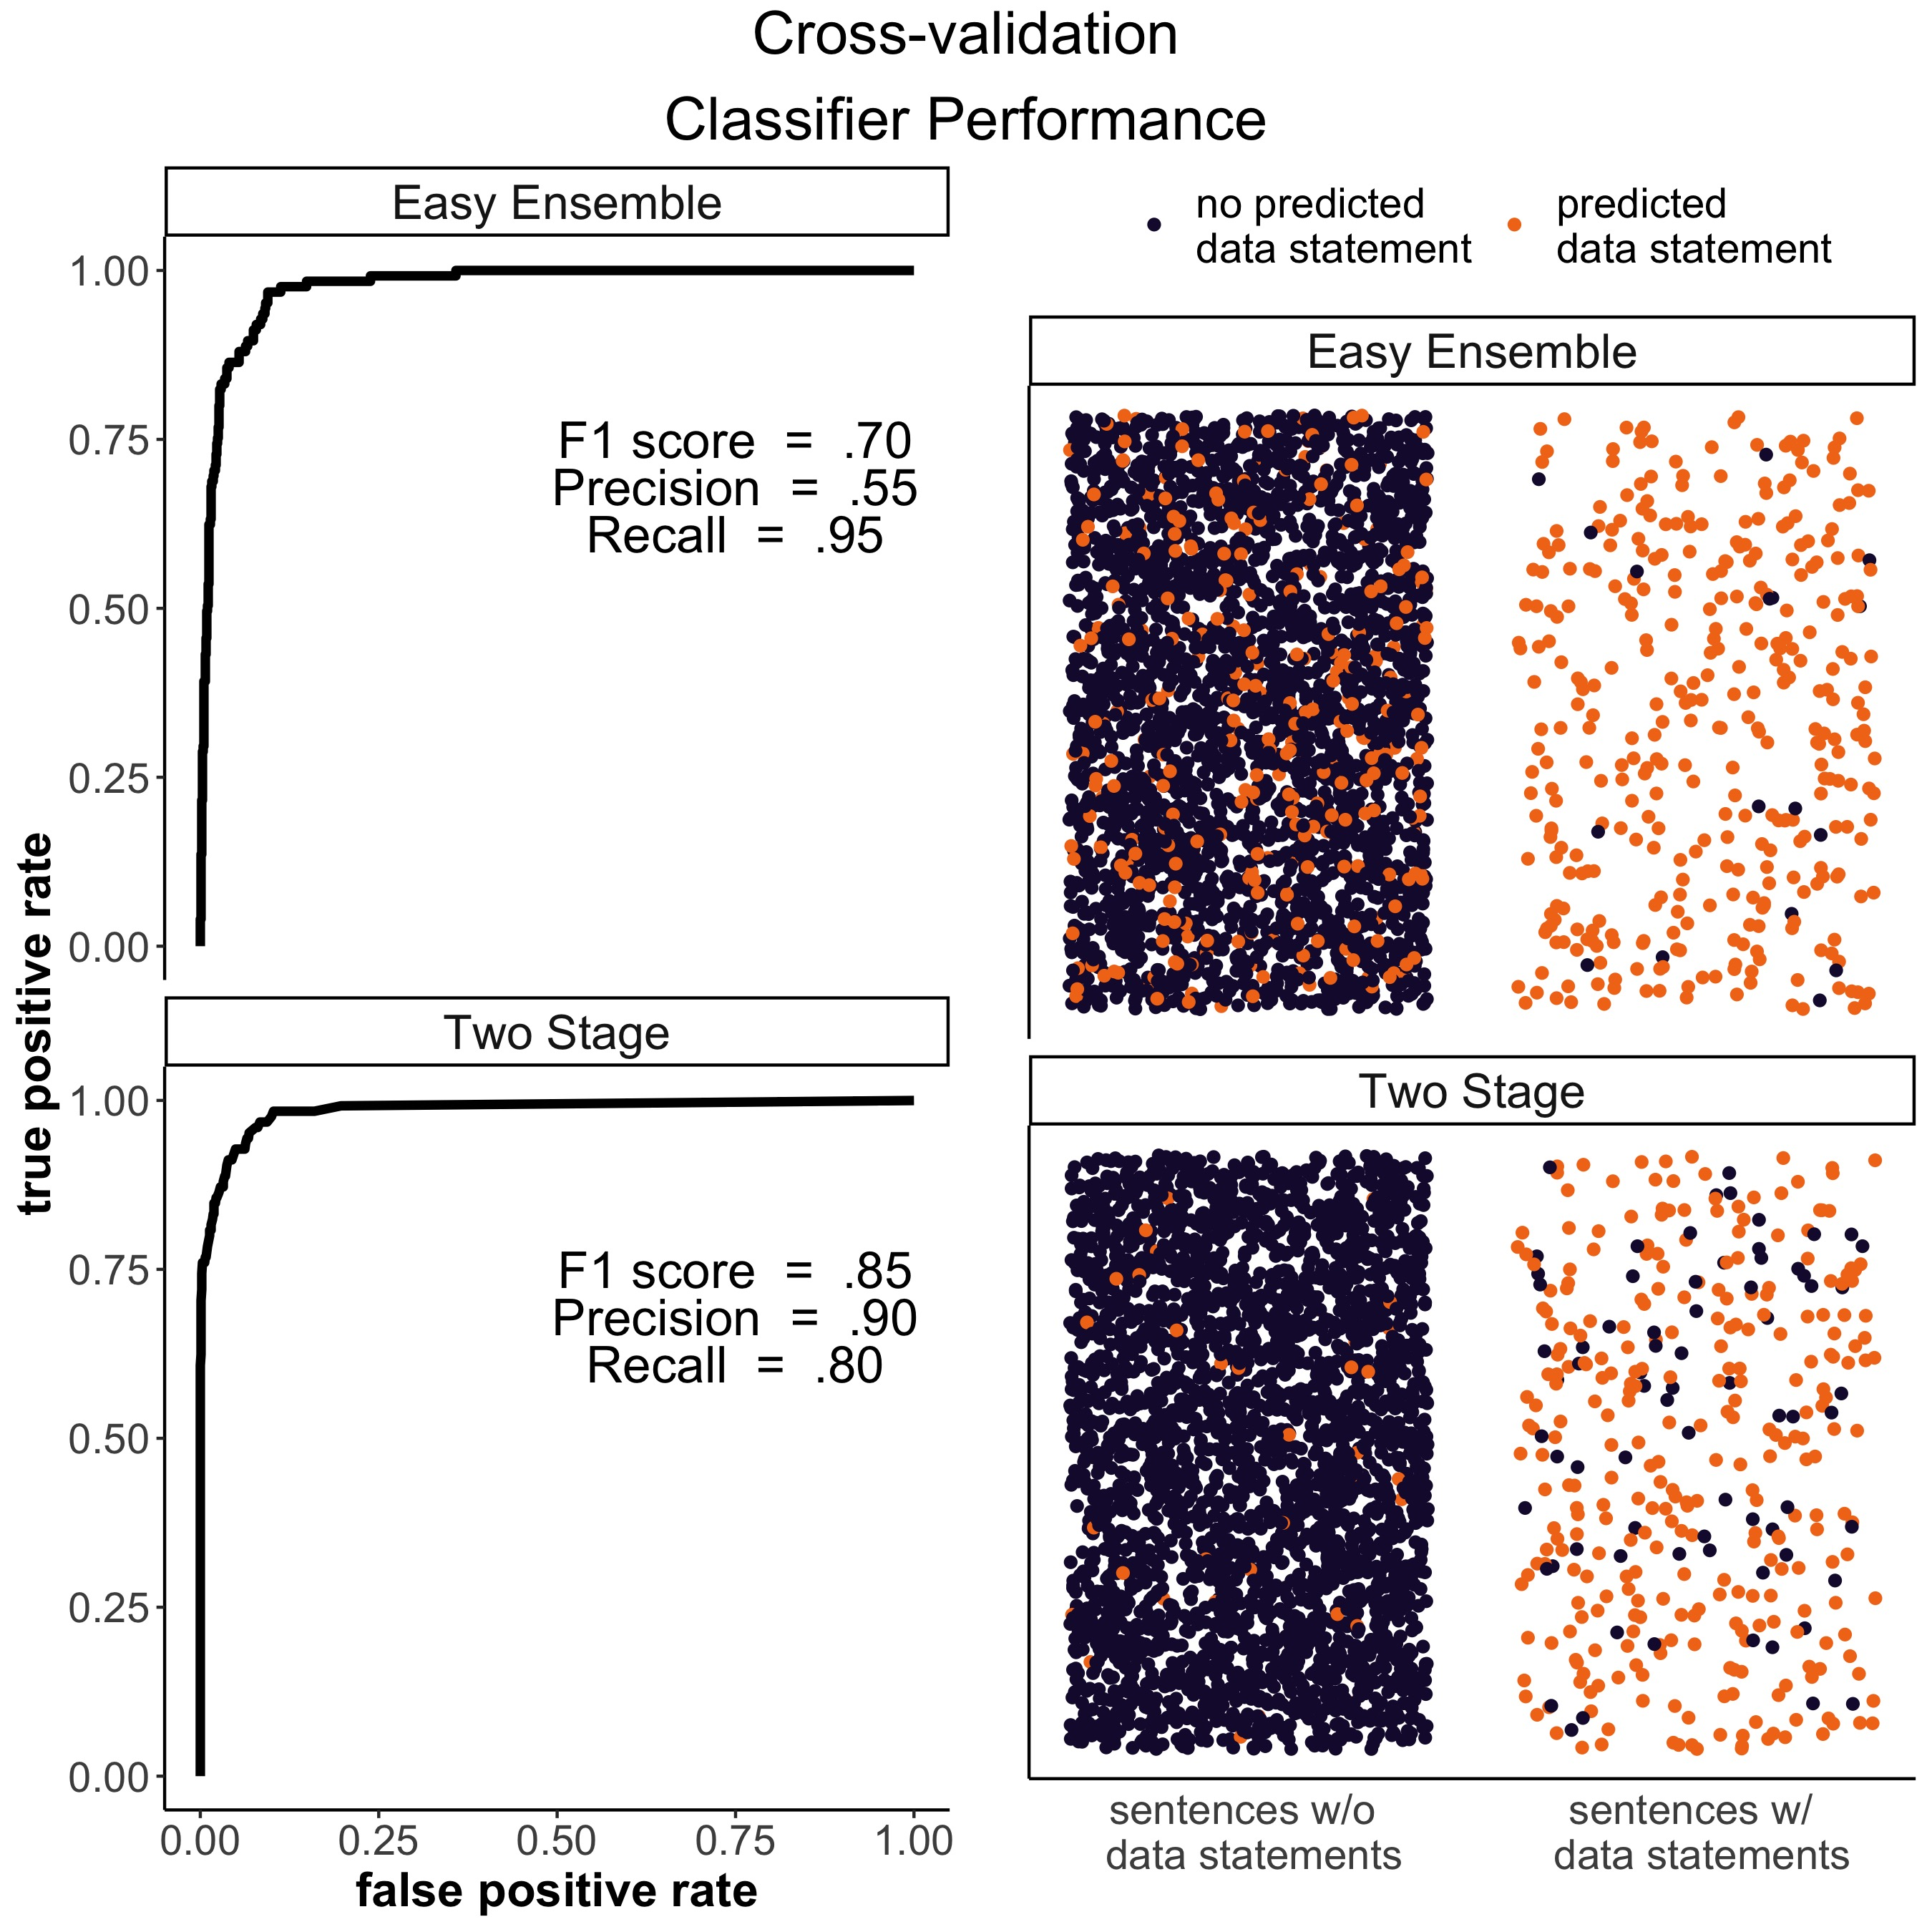
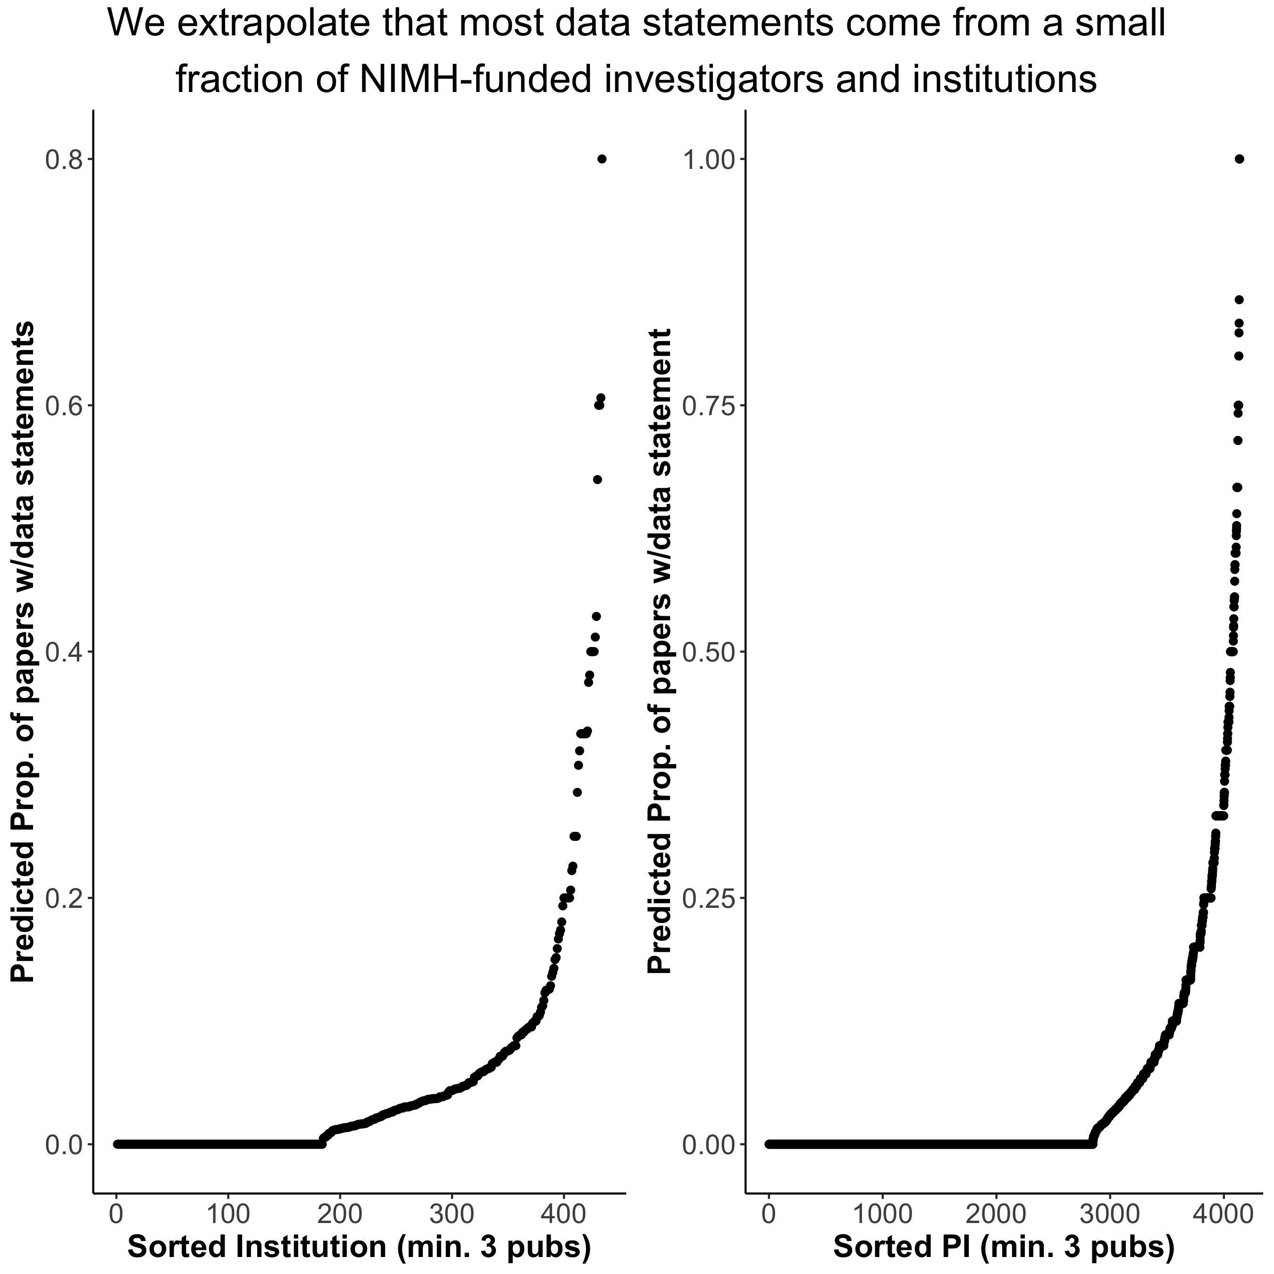
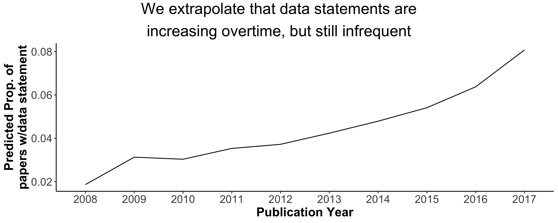




Identifying Data Sharing and Data Reuse in Full-text NIMH-funded papers
Travis Riddle¹, Francisco Pereira¹, Adam Thomas¹
¹Data Science and Sharing Team, National Institute of Mental Health, Bethesda, MD
Key Points
We developed a series of classification systems to identify data statements
Applying the top-performing classifier to a corpus of 57k NIMH funded papers published since 2008, we extrapolate that 4.5% are predicted to contain data sharing/reuse statements
By our predictions, a large majority of data statements come from a small handful of investigators
Introduction
Materials & Methods
The 2017 Cures Act authorizes NIH Director to require award recipients to share data in a manner consistent with applicable laws and regulations¹
Identifying and measuring data sharing and data reuse serves a number of goals that are important for scientists, funding agencies, and the public more generally.
The unmet objective of an efficient and accurate system for identification and tracking of datasets is a conspicuous shortcoming of the larger open science community.
We sought to develop a classification system to automate labeling of data statements in full-text NIMH-funded papers from PubMed Central
We used our top-performing classifier to predict the presence of data statements and examined the distribution of these predictions as a function of paper meta-data
Data
The population of papers is any paper on PubMed Central found to have been listed as a paper produced from an NIMH funded grant on FederalReporter (total = 57,692)
Labeled data consist of 3,355 sentences from 1,559 papers. Samples were drawn through a mixture of random samples, regex searches, and active learning.
Of these, 375 sentences from 314 papers were found to contain data statements.
Paper metadata was obtained through FederalReporter, PubMed Central, and iCite.
Analysis
We tested two classification approaches using 3-fold cross validation
Easy Ensemble²
Two stage classifier with SVM and Random Forest
Results
Unigrams, paper section, journal, year published
Features
EZ Ensemble
SVM
Classifier
Easy Ensemble Predictions
SVC predicted Probabilities, code/data keywords, repository mention, parentheses, URL
Two Stage Predictions
Random Forest
Error Examples
Conclusion
False Alarms
-----
Misses
---
Though data sharing is expected for those with NIMH funding, these results suggest that rates of data sharing are likely very low.
Of the 4,139 PIs with at least 3 publications represented in our data, we extrapolate that just 210 (5%) have data statements in more than a third of their papers.
Our classifier could be improved by more consistent handling of software tools and other data resources (e.g. manuals), or by using features derived from parsing sentences
Future directions could capitalize on list of data DOIs (e.g. datacite), though a rough perusal of our data suggests that DOIs are not consistently cited.
Detailed NHANES survey operations manuals are available on the NHANES Web site (http://www.cdc.gov/nchs/nhanes.htm).
Sequence data were aligned and variants called by the Picard (http://picard.sourceforge.net) zBWA GATK pipeline.
European and African-American participants from the Clinical Antipsychotic Trials of Intervention Effectiveness (CATIE) project were obtained from the National Institutes of Mental Health repository (http://www.nimhgenetics.org).
Note: Any Supplementary Information and Source Data files are available in the online version of the paper.
Majumder, M.A. et al (2017). Sharing data under the 21st century Cures act. Genetics in Medicine, 19, 1289-1294
X. Y. Liu, J. Wu and Z. H. Zhou, (2009) Exploratory Undersampling for Class-Imbalance Learning. IEEE Transactions on Systems, Man, and Cybernetics, Part B, 39(2), 539-550
Github Repo link goes here

Slide 2
Results
 | Original Study | HCP500 | HCP1200
Permutations | 100,000 | 10,000 | 10,000
Correlation of Mode 1 weights | r=0.87 p<10⁻⁵ | r=0.8715 p<10⁻⁴ | r=0.7432 p<10⁻⁴
% Variance Explained (Z-score)
Connectome | 0.53% (7.7) | 0.526% (7.428) | 0.366% (5.796)
SMs | 1.7% (9.2) | 1.749% (9.307) | 1.963% (10.708)
Next highest Z-scores
Connectome | 2.7 | 2.8101 | 3.424
SMs | 2.4 | 2.7275 | 6.672
TABLE 1: Results of the computational replications using the HCP 500 and HCP 1200 datasets, compared to the original study results.

