Slide 1
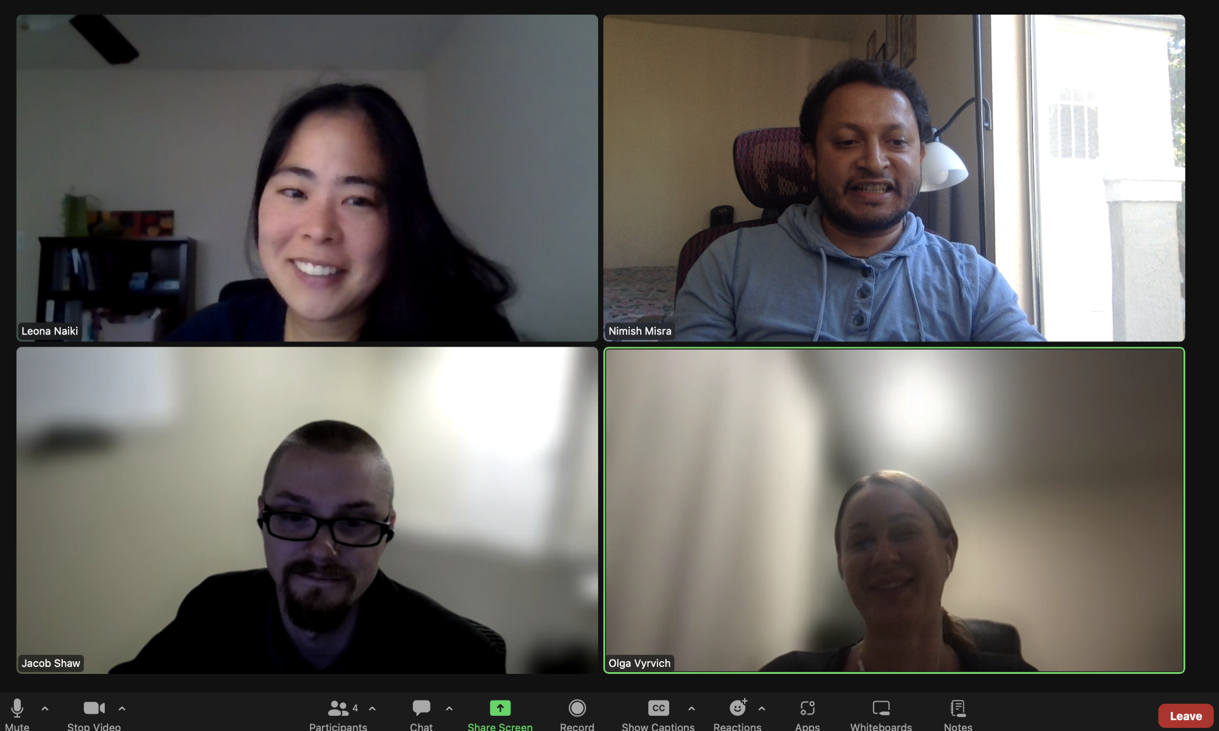
Home Credit Default Risk (HCDR)
CSCI-P556 Applied Machine Learning Final Project – Phase 2
GroupN_HCDR_1
Leona Chase | Nimish Misra | Jacob Shaw | Olga Vyrvich

Slide 2

HCDR Project Phase 2 Outline
Project Description
Summary of Exploratory Data Analysis
Visual EDA
Overview of Modeling Pipelines
Results and Metrics
Conclusion and Next Steps
The 4 Ps
Notes:
Today we will be presenting our findings for Phase 2, starting with a quick description of the project, followed by a summary of our EDA, an overview of our pipelines, and our results.

Slide 3
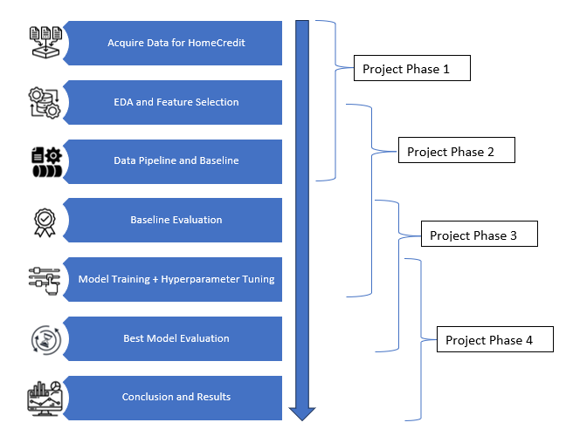
Project Description
Home Credit is an international financial institution focused on lending financial services to underserved customers with minimal credit history by providing a positive and safe borrowing experience.
The goal of the project is to predict whether such a client will repay a loan.
While this project uses various statistical and machine learning methods to make predictions, it will also contribute expertise to developing more effective models and strategies for credit risk assessment. The ultimate objective is to enhance financial inclusion and provide fair and positive loan experiences for a broader segment of the population.
Phase 2 Steps:
Exploratory Data Analysis
Data Preprocessing
Feature Engineering
Baseline Model
In-depth Data Analysis
Model Improvement
Model Evaluation
Conclusions/ Next Steps
Notes:
Home Credit is a company focused on getting financial services to underserved customers by providing positive borrowing experiences.
Our goal is to successfully predict whether a client will repay a loan or not.
We feel this project has significance past prediction. Findings could contribute expertise to the field of credit risk assessment and we might say that the ultimate objective is to enhance financial inclusion, providing positive loan experiences to more people.

Slide 4
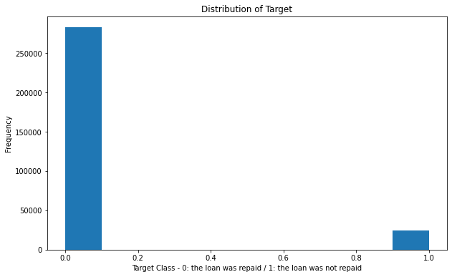
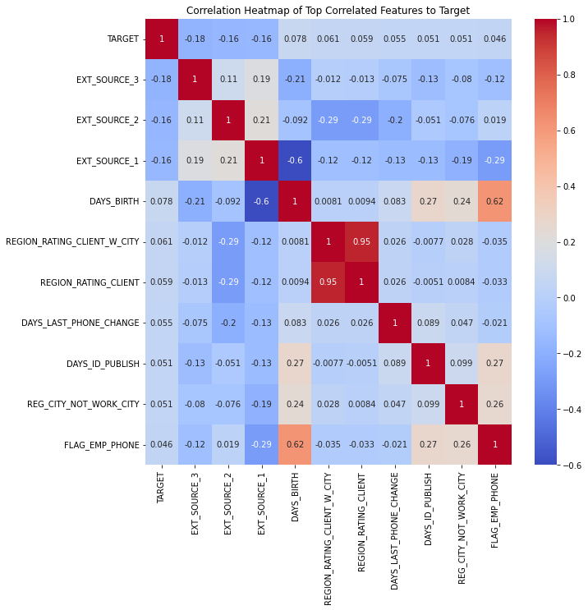
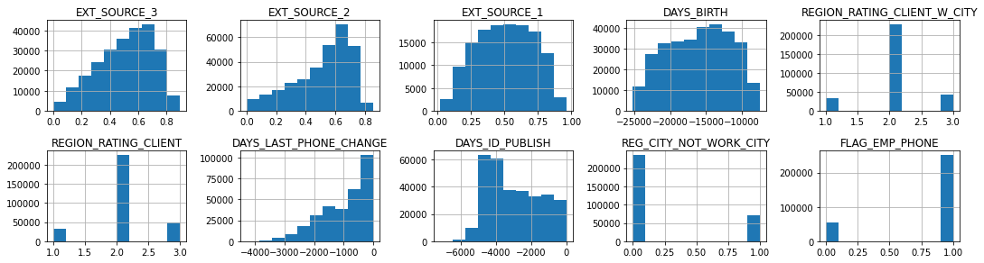
Summary of EDA
One immediate challenge we faced in this project was the vast dataset with many input features and lots of missing data. We also noticed that we were working with a very unbalanced data set.
The top 10 application training set features most correlated (by absolute value) with the Target Variable are shown here:
Histograms of the top 10 features most correlated with the Target Feature

Slide 5
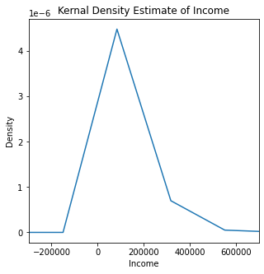
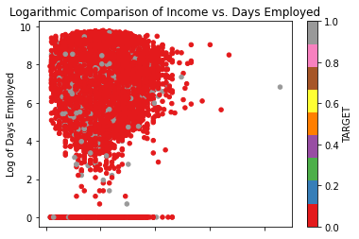
Visual EDA Summary

Slide 6
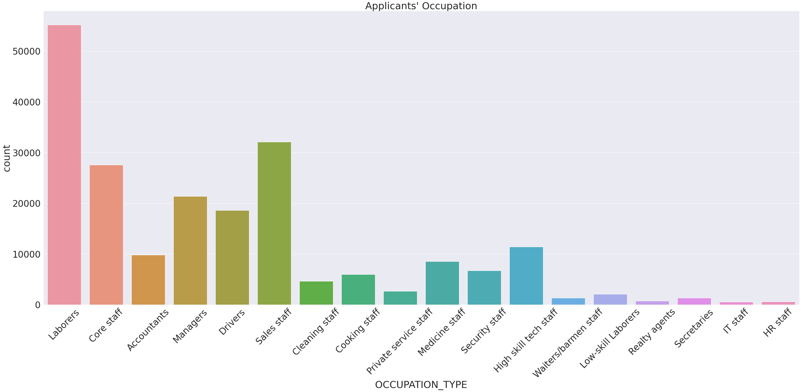
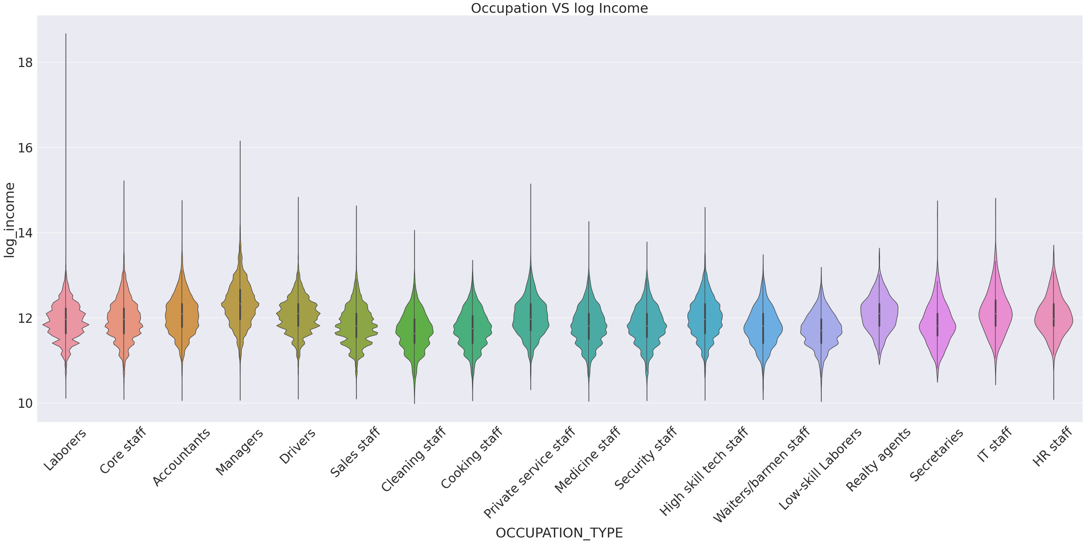

Slide 7
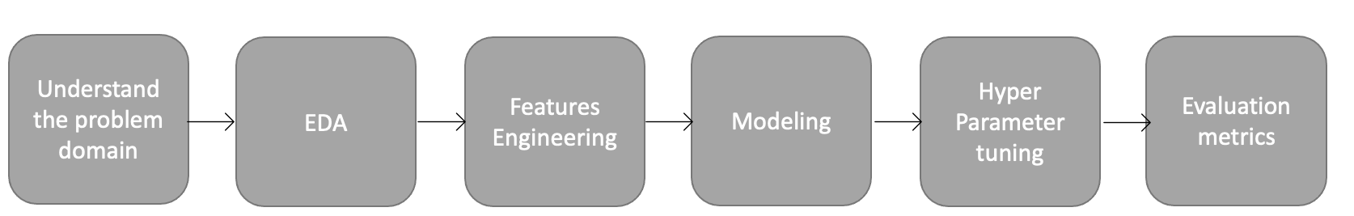
Overview of Modeling Pipelines
In Phase 2, pipelines were primarily used to preprocess our data.
Imputing missing data values
Standardizing numerical data
OHE Categorical data
A Column Transformer was used to combine our preprocessing pipelines with our classifiers.
Our Baseline Pipelines:
Linear regression model with 14 features based on recommendations
Linear regression model with 28 features, including the 5 most positively correlated features, the 5 most negatively correlated features, and all categorical features.
Linear regression model with all 120 features.
Random Forest model with hyper tuning using all 120 features.

Slide 8
Evaluation Metrics Used:
Accuracy Score
Good but simple snapshot of success.
Evaluates Overall Success
Problem: Assumes a balanced dataset
AUROC
Plots the relationship between the True Positive Rate and the False Positive Rate.
F1 Score
Combines Precision and Recall Scores, evaluating class-wise performance rather than the overall performance.
A good metric to evaluate imbalanced data

Slide 9
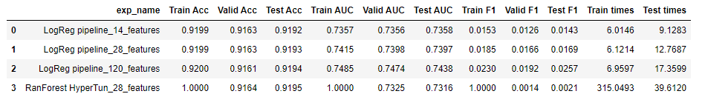
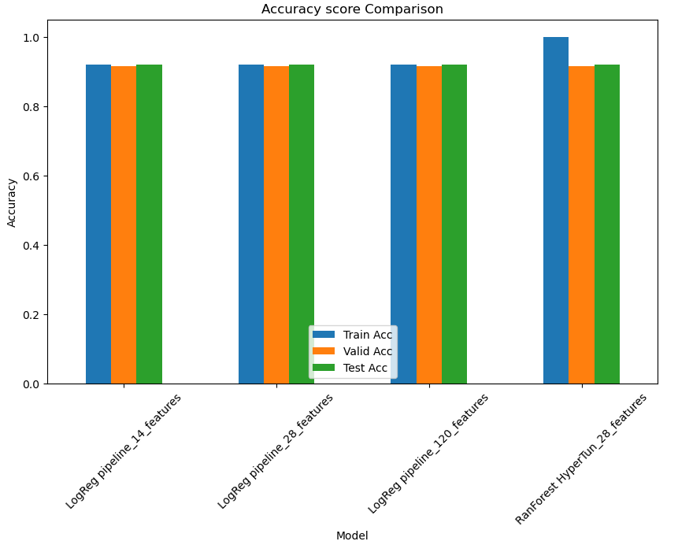
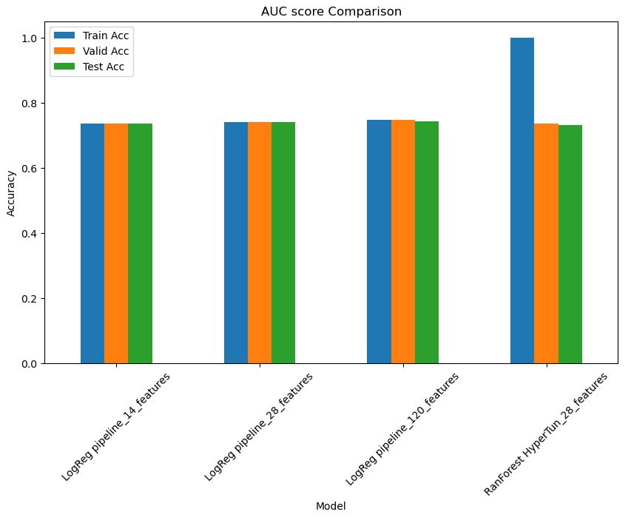
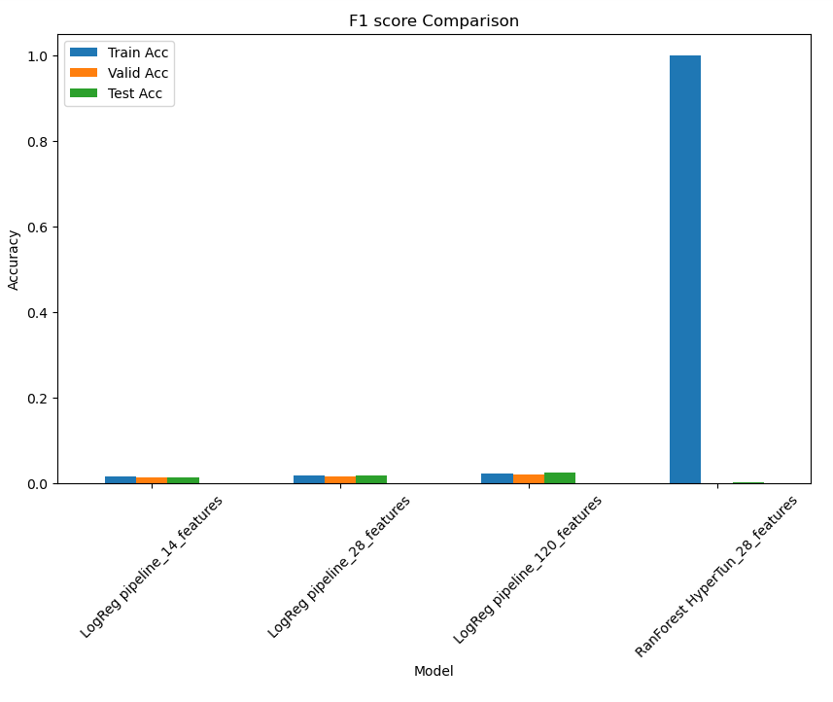
Experiment Results:
Notes:
We built several baseline models that were evaluated by the performance metrics: accuracy score, F1 score, and AUROC. All four of our models showed promising accuracy scores and our logistic regression models all performed comparably despite varying degrees of feature engineering. By all three metrics, the Random Forest model performed better on the training set than both the validation and test sets. This tells us we may have a problem with overfitting during training.

Slide 10
Conclusion and Next Steps
In Phase 2 of the HCDR Project, we used the HCDR data set to build baseline models to accurately predict whether a client with minimal credit history would pay back a loan.
This is a real-world problem that is highly relevant today’s world of rapidly growing wealth disparities.
Our baseline models that were evaluated by the performance metrics: accuracy score, F1 score, and AUROC. All four of our models showed promising accuracy scores but our AUROC and especially F1 scores could use improvement.
As we continue into Phase 3 of this project, we will focus on feature engineering and hyper tuning our models, with the goal of improving our F1 and AUROC scores.

Slide 11
Four-P Summary
Past
Develop best pipelines to predict whether a client will repay a loan.
Present (Phase 2)
Conducted extensive EDA
Pre-processed features and Feature Engineered optimum variables
Built baseline model for classification predictions
Planned (Phase 3)
Improve performance metric scores through improved feature engineering and selection techniques.
Increase hyperparameter tuning
Incorporate ensemble methods
Problems
Large dataset led to computationally expensive models.
Low F1 and AUROC Scores
Rudimentary Feature Engineering Techniques

