Slide 1

BHARATI VIDYAPEETH (DEEMED TO BE UNIVERSITY) COLLEGE OF ENGINEERING , PUNE, 411043
DEPARTMENT OF INFORMATION TECHNOLOGY
Subject: IT Infrastructure Management
PROJECT BASED LEARNING
ON
DEVELOP AN IT INFRASTRUCTRE
MANAGEMENT SYSTEM
SEMESTER:IV
1

Slide 2

Develop an IT Infrastructure Management System
DEVELOP AN INFRASTRUCTRE
MANAGEMENT SYSTEM
Under the guidance of Prof. T.B. PATIL
Submitted by
ROLL NO. | NAME | PRN NO.
36 | Riya Singh | 2214110270
54 | Bhumi | 2214110288
2
BHARATI VIDYAPEETH (DEEMED TO BE UNIVERSITY ) COLLEGE OF ENGINEERING, PUNE DEPARTMENT OF INFORMATION TECHNOLOGY

Slide 3
Develop an IT Infrastructure Management System
INTRODUCTION
IT Infrastructure management is a method of monitoring and maintaining critical Information Technology (IT) infrastructure to ensure the best use of resources, protect against data loss, and monitor key aspects of local and cloud-based service utilization.
IT Infrastructure Management further divide into so many parts Some of them are :
Security management
Data management
Storage management
3
BHARATI VIDYAPEETH (DEEMED TO BE UNIVERSITY ) COLLEGE OF ENGINEERING, PUNE DEPARTMENT OF INFORMATION TECHNOLOGY

Slide 4
Develop an IT Infrastructure Management System
STORAGE MANAGEMENT
Storage Management is defined as it refers to the management of
the data storage equipment’s that are used to store the user/computer
generated data.
This involves managing the physical and virtual storage devices where
data is stored. It also allocating storage resources to users or
applications based on their needs.
In our project we have managed to store the data(messages) into a
database once user enters the message with its sender and receiver.
Example : There are lot of software applications that store the data efficiently like Instagram, Facebook, amazon and many websites also store a lot of data.
4
BHARATI VIDYAPEETH (DEEMED TO BE UNIVERSITY ) COLLEGE OF ENGINEERING, PUNE DEPARTMENT OF INFORMATION TECHNOLOGY

Slide 5
Develop an IT Infrastructure Management System
SECURITY MANAGEMENT
Security management managing user access to resources to ensure
that only authorized individuals or systems can access sensitive data
or perform specific actions. Protecting data both at rest and in transit
by encrypting it using encryption algorithms and secure protocols.
It also helps in preventing unauthorized access and data breaches. In
our project we are storing the message after encrypting it with a specific
algorithm and it will display the message after decrypting it.
Example : The use of multi-factor authentication (MFA) for employee access to company systems, combination of passwords and a secondary form of authentication, biometric scan, reducing the risk of unauthorized access to sensitive data.
5
BHARATI VIDYAPEETH (DEEMED TO BE UNIVERSITY ) COLLEGE OF ENGINEERING, PUNE DEPARTMENT OF INFORMATION TECHNOLOGY

Slide 6
Develop an IT Infrastructure Management System
DATA MANAGEMENT
Data management involves managing the organizations data (in our case messages) including its storage and recovery.
It ensures that the data is accessible , has low latency and secured.
Example: Customer Relationship Management (CRM) system within a company.
CRM systems collect, organize, and manage customer-related data such as contact information, interactions, purchase history, and preferences , centralizes it and uses it accordingly to increase the sales.
6
BHARATI VIDYAPEETH (DEEMED TO BE UNIVERSITY ) COLLEGE OF ENGINEERING, PUNE DEPARTMENT OF INFORMATION TECHNOLOGY

Slide 7
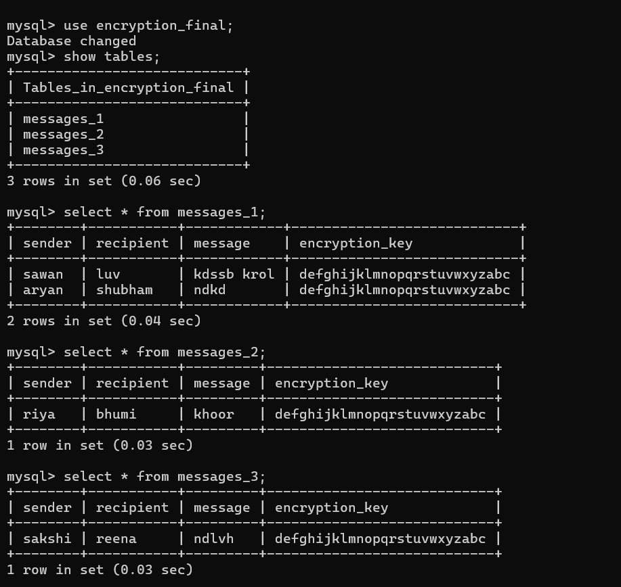
Develop an IT Infrastructure Management System
OUTPUT
7
BHARATI VIDYAPEETH (DEEMED TO BE UNIVERSITY ) COLLEGE OF ENGINEERING, PUNE DEPARTMENT OF INFORMATION TECHNOLOGY

Slide 8
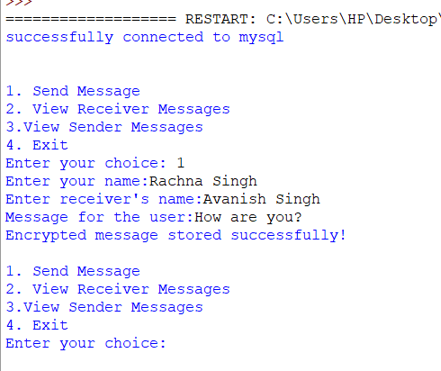
Develop an IT Infrastructure Management System
OUTPUT
8
BHARATI VIDYAPEETH (DEEMED TO BE UNIVERSITY ) COLLEGE OF ENGINEERING, PUNE DEPARTMENT OF INFORMATION TECHNOLOGY

Slide 9
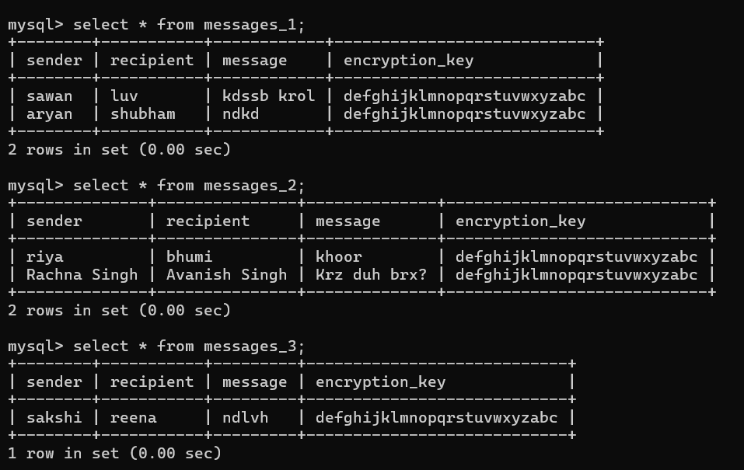
Develop an IT Infrastructure Management System
OUTPUT
9
BHARATI VIDYAPEETH (DEEMED TO BE UNIVERSITY ) COLLEGE OF ENGINEERING, PUNE DEPARTMENT OF INFORMATION TECHNOLOGY

Slide 10
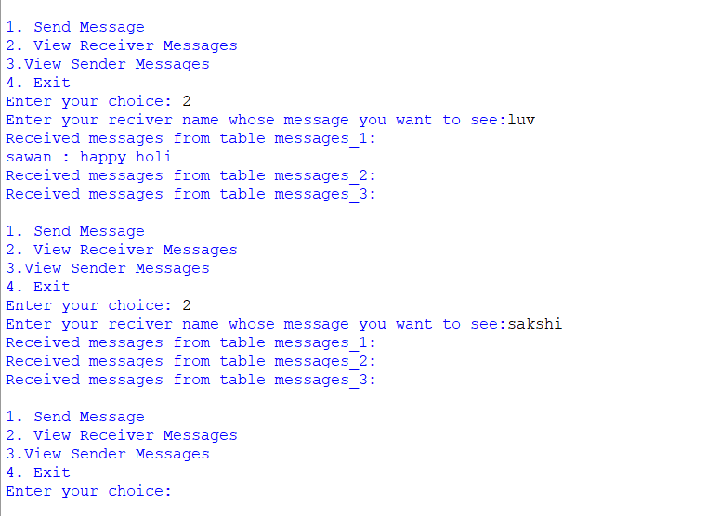
Develop an IT Infrastructure Management System
OUTPUT
10
BHARATI VIDYAPEETH (DEEMED TO BE UNIVERSITY ) COLLEGE OF ENGINEERING, PUNE DEPARTMENT OF INFORMATION TECHNOLOGY

Slide 11
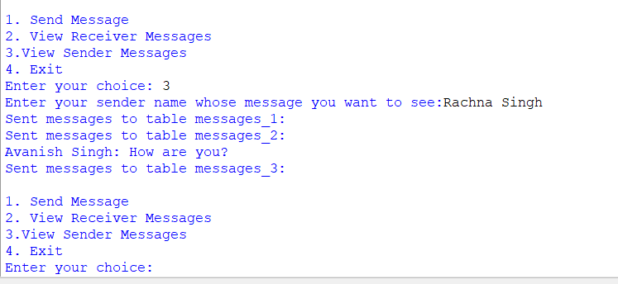
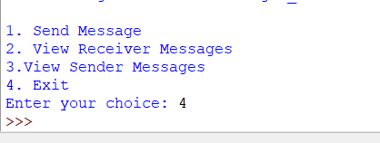
Develop an IT Infrastructure Management System
OUTPUT
11
BHARATI VIDYAPEETH (DEEMED TO BE UNIVERSITY ) COLLEGE OF ENGINEERING, PUNE DEPARTMENT OF INFORMATION TECHNOLOGY

Slide 12
Develop an IT Infrastructure Management System
!! THANK YOU !!
12
BHARATI VIDYAPEETH (DEEMED TO BE UNIVERSITY ) COLLEGE OF ENGINEERING, PUNE DEPARTMENT OF INFORMATION TECHNOLOGY

