Slide 1
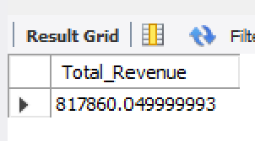
A. KPI’s
1. Total Revenue:
SELECT SUM(total_price) AS Total_Revenue FROM pizza_sales;

Slide 2
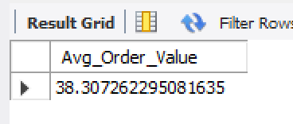
2. Average Order Value:
SELECT SUM(total_price) / COUNT(DISTINCT order_id) AS Avg_Order_Value FROM pizza_sales;

Slide 3
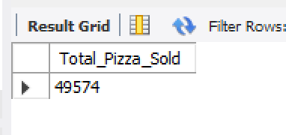
3. Total Pizzas Sold:
SELECT SUM(quantity) AS Total_Pizza_Sold FROM pizza_sales;

Slide 4
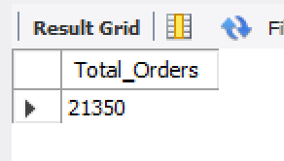
4. Total Orders:
SELECT COUNT(DISTINCT order_id) AS Total_Orders FROM pizza_sales;

Slide 5
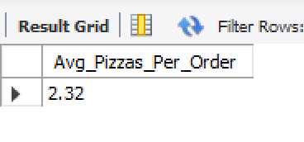
5. Average Pizzas Per Order:
SELECT CAST(SUM(quantity) / COUNT(DISTINCT order_id) AS DECIMAL(10, 2)) AS Avg_Pizzas_Per_Order FROM pizza_sales;

Slide 6
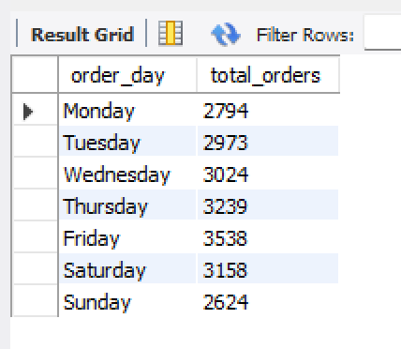
B. Daily Trend for Total Orders
SELECT DAYNAME(STR_TO_DATE(order_date, '%d-%m-%Y')) AS order_day, COUNT(DISTINCT order_id) AS total_orders FROM pizza_sales WHERE order_date IS NOT NULL GROUP BY order_day ORDER BY FIELD(order_day, 'Monday', 'Tuesday', 'Wednesday', 'Thursday', 'Friday', 'Saturday', 'Sunday');

Slide 7
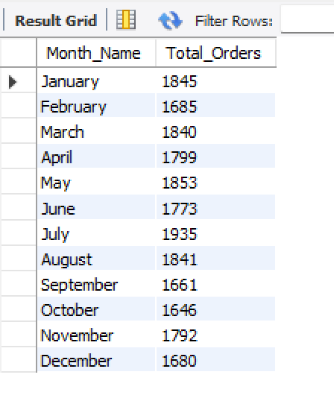
C. Monthly Trend for Total Orders
SELECT MONTHNAME(STR_TO_DATE(order_date, '%d-%m-%Y')) AS Month_Name, COUNT(DISTINCT order_id) AS Total_Orders FROM pizza_sales WHERE order_date IS NOT NULL GROUP BY MONTHNAME(STR_TO_DATE(order_date, '%d-%m-%Y')), MONTH(STR_TO_DATE(order_date, '%d-%m-%Y')) ORDER BY Total_Orders DESC;

Slide 8
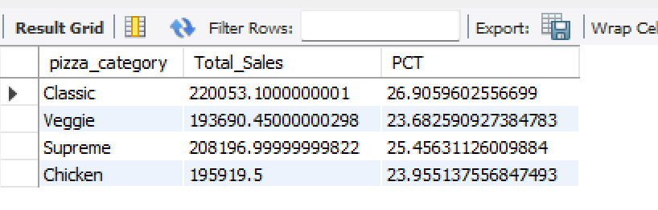
D. Percentage of Sales by Pizza Category
SELECT pizza_category, SUM(total_price) AS Total_Sales, SUM(total_price) * 100 / NULLIF((SELECT SUM(total_price) FROM pizza_sales), 0) AS PCT FROM pizza_sales GROUP BY pizza_category;

Slide 9
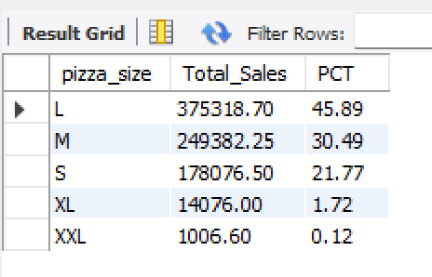
E. Percentage of Sales by Pizza Size
SELECT pizza_size, CAST(SUM(total_price) AS DECIMAL(10,2)) AS Total_Sales, CAST(SUM(total_price) * 100 / NULLIF((SELECT SUM(total_price) FROM pizza_sales), 0) AS DECIMAL(10, 2)) AS PCT FROM pizza_sales GROUP BY pizza_size ORDER BY PCT DESC;

Slide 10
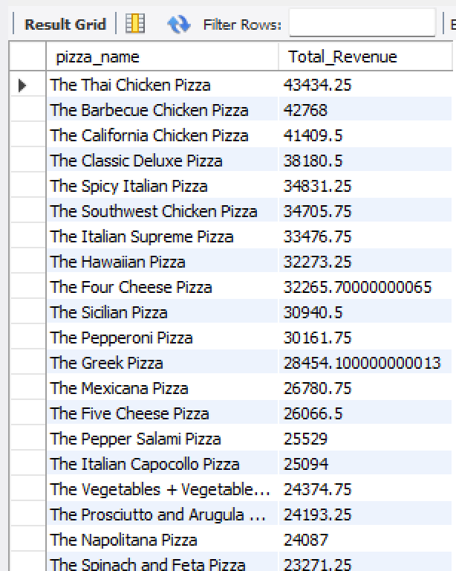
F. Total Pizzas Sold by Pizza Category
SELECT pizza_name, SUM(total_price) AS Total_Revenue FROM pizza_sales GROUP BY pizza_name ORDER BY Total_Revenue DESC;

Slide 11
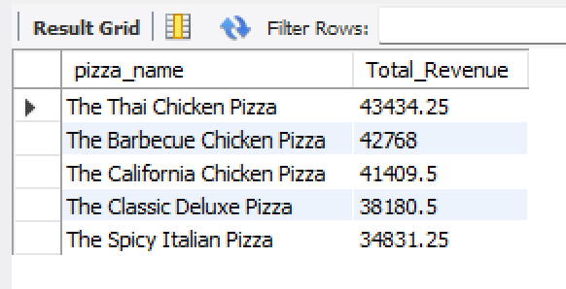
G. Top 5 Pizzas by Revenue
SELECT pizza_name, SUM(total_price) AS Total_Revenue FROM pizza_sales GROUP BY pizza_name ORDER BY Total_Revenue DESC LIMIT 5;

Slide 12
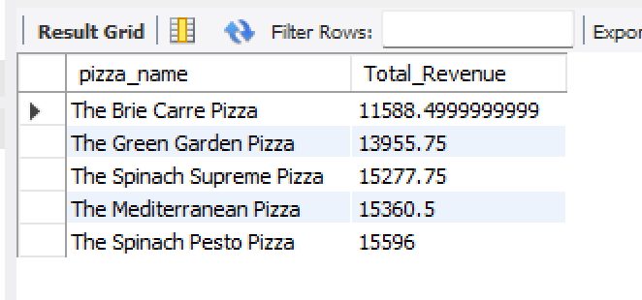
H. Bottom 5 Pizzas by Revenue
SELECT pizza_name, SUM(total_price) AS Total_Revenue FROM pizza_sales GROUP BY pizza_name ORDER BY Total_Revenue ASC LIMIT 5;

Slide 13
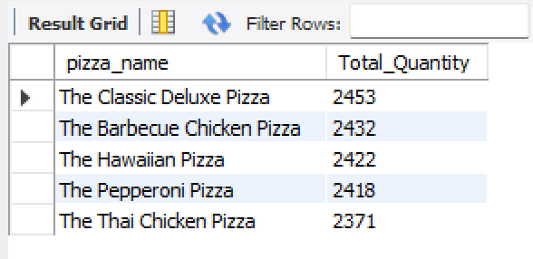
I. Top 5 Pizzas by Quantity
SELECT pizza_name, SUM(quantity) AS Total_Quantity FROM pizza_sales GROUP BY pizza_name ORDER BY Total_Quantity DESC LIMIT 5;

Slide 14
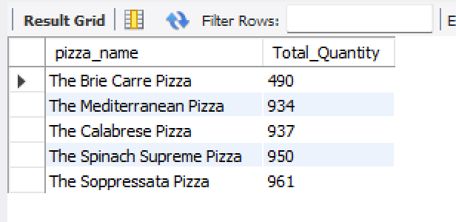
J. Bottom 5 Pizzas by Quantity
SELECT pizza_name, SUM(quantity) AS Total_Quantity FROM pizza_sales GROUP BY pizza_name ORDER BY Total_Quantity ASC LIMIT 5;

Slide 15
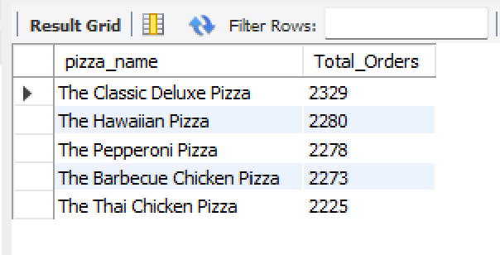
K. Top 5 Pizzas by Total Orders
SELECT pizza_name, COUNT(DISTINCT order_id) AS Total_Orders FROM pizza_sales GROUP BY pizza_name ORDER BY Total_Orders DESC LIMIT 5;

Slide 16
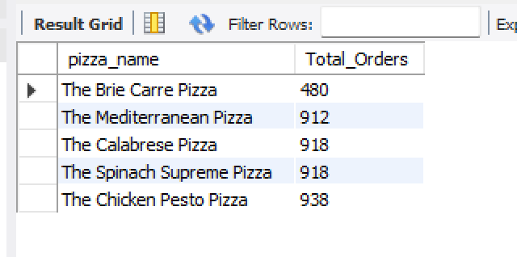
L. Bottom 5 Pizzas by Total Orders
SELECT pizza_name, COUNT(DISTINCT order_id) AS Total_Orders FROM pizza_sales GROUP BY pizza_name ORDER BY Total_Orders ASC LIMIT 5;

