Slide 1
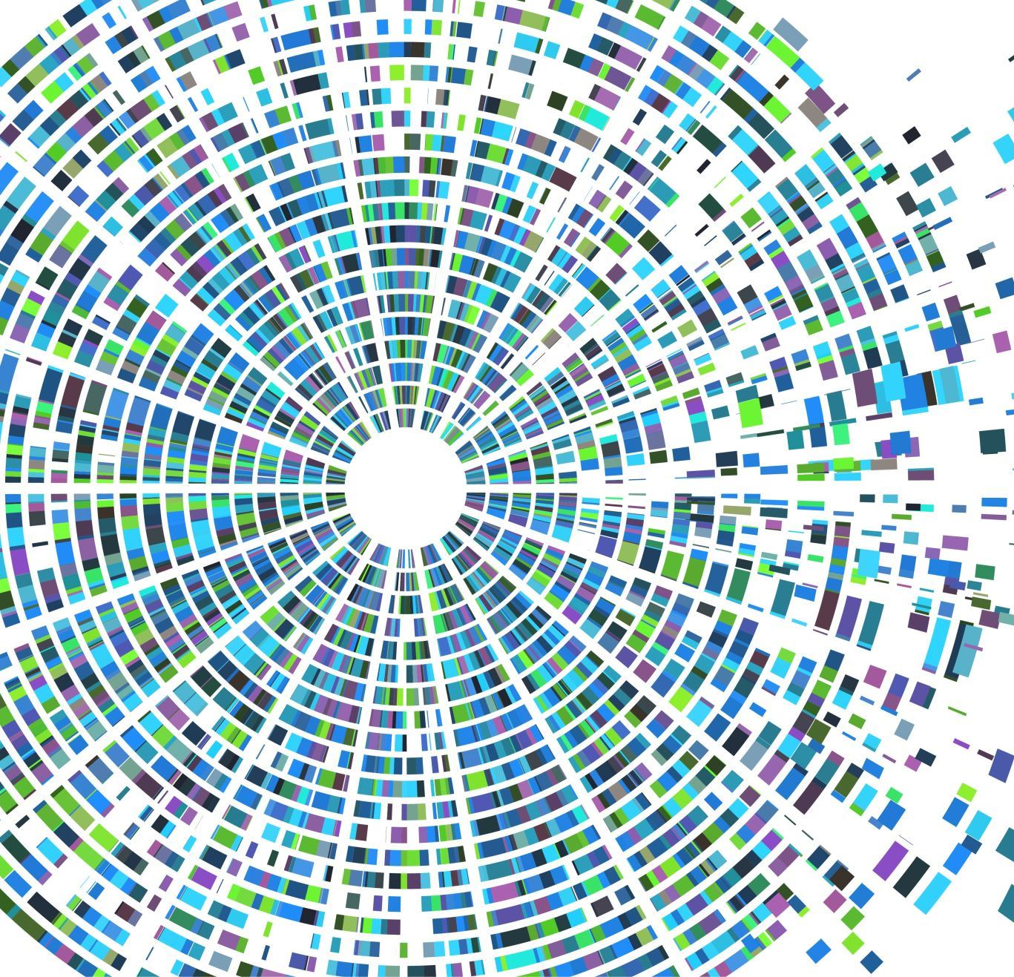



WhatsApp Chat Sentiment Analysis

Slide 2
Introduction
Sentiment analysis is a powerful natural language processing technique that involves determining the emotional tone expressed in a piece of text
This project focuses on sentiment analysis of WhatsApp chat data using the Naive Bayes Classifier and the Natural Language Toolkit

Slide 3
Objectives
Understand user sentiments in WhatsApp chat data
Provide insights into emotional states within conversations
Demonstrate the application of machine learning in sentiment analysis

Slide 4
Project Overview
The project involves training a Naive Bayes Classifier on the 'movie_reviews' dataset provided by NLTK
NLTK is utilized for natural language processing, and Matplotlib is employed for data visualization
The trained model is then applied to analyze sentiments in WhatsApp chat data

Slide 5
Code Overview
Data Preprocessing: Initial phase involves cleaning and organizing WhatsApp chat data
Model Training: Utilizes the 'movie_reviews' dataset to train the Naive Bayes Classifier
Testing and Evaluation: Reserves a portion of the dataset for testing the classifier's accuracy
Application to WhatsApp Chat: Applies the trained model to perform sentiment analysis on custom sentences and real-world WhatsApp chat data
Exporting and Loading the Model: Includes sections for exporting the trained model to a file using pickle

Slide 6
Naive Bayes Classifier
Probabilistic Approach: The Naive Bayes Classifier employs a probabilistic approach to categorize instances
Simplicity and Independence Assumption: One of the key strengths of the Naive Bayes Classifier is its simplicity
Effective for High-Dimensional Data: In the context of natural language processing, text data is often high-dimensional due to the vast vocabulary

Slide 7
NLTK and Matplotlib
NLTK for natural language processing tasks
Matplotlib for data visualization, including pie charts and bar charts
Essential roles in processing and presenting data in this project

Slide 8
Training the Model
Use of 'movie_reviews' dataset for training and testing
Splitting data into negative and positive features
Training the Naive Bayes Classifier and assessing accuracy

Slide 9
Sentiment Analysis Results
Demonstrations of sentiment analysis on custom sentences
Application of the trained model to WhatsApp chat data
Visualizations of sentiment analysis results using Matplotlib

Slide 10
Real-world Applications
Insights into user sentiments in real-time
Valuable for businesses in customer feedback analysis
Potential applications in social media monitoring

Slide 11
Challenges and Limitations
Challenges Faced During the Project
During the development of the sentiment analysis project, certain challenges were encountered
Identifying and addressing these challenges were integral parts of the project development process
Limitations of the Current Approach
Every machine learning model and approach has its limitations
Additionally, the classifier's performance can be influenced by the quality and representativeness of the training data

Slide 12
Conclusion
This project successfully demonstrates the application of sentiment analysis using the Naive Bayes Classifier on a WhatsApp chat export file
The classifier is trained on a movie reviews dataset, and its accuracy is tested
The sentiment analysis results are visualized using pie and bar charts, providing insights into the positive and negative sentiments expressed in the chat

