Slide 1
CHIRAYU
Problem Code: SH1
Problem Statement: Ayurveda Pharma-covigilance Portal(Web & App)
Team Name: Hack ‘O’ Holics
Team Leader: Nimisha Mittal
College Name: Maharaja Agrasen Institute of Technology College Code: 1-3512564504

Slide 2
Introduction
Problem Statement
Women safety has always been a gnawing issue. With the hideous attempts of molesters ,women have always suffered grave repercussions. There had been certain attempts to mince the number of women crime but were not efficacious enough to ensure women safety. The purpose of programme is to devise a system which is invincible enough to ensure women safety. The system will help the women as well as the authorities to analyze the crime rates in a particularly unsafe region and accordingly take actions to improve the safety. The software involves proper use of hardware and software to achieve the task.
Proposal
We propose an android application and web portal in the name of ‘ ’ to ensure women safety. Our project includes minuscule sized button integrated with the android application which will work as a weapon for safety by sending alert message, surrounding voice recording and captured image of molester to the victim’s guardian, nearby stores and authority’s web portal for help. The web portal for the authority will be developed keeping in mind the process for safety of women by analyzing unsafe areas from suggestions and identify the molester from existing records in database. Apart from the mentioned methods we will be implementing device for personal conveyance and cabs which will immediately send alert to the passenger’s guardians if the vehicle is stopped for more than a specific time. This feature will be useful for the women travelling from personal or public conveyance.

Slide 3










TECHNOLOGY STACK
ANDROID DEVELOPMENT MACHINE LEARNING
Python
Android Studio
Java
Tensorflow
Numpy
WEB DEVELOPMENT
CSS
SQL
HTML
MongoDB
Java Script
MS SQL SERVER

Slide 4
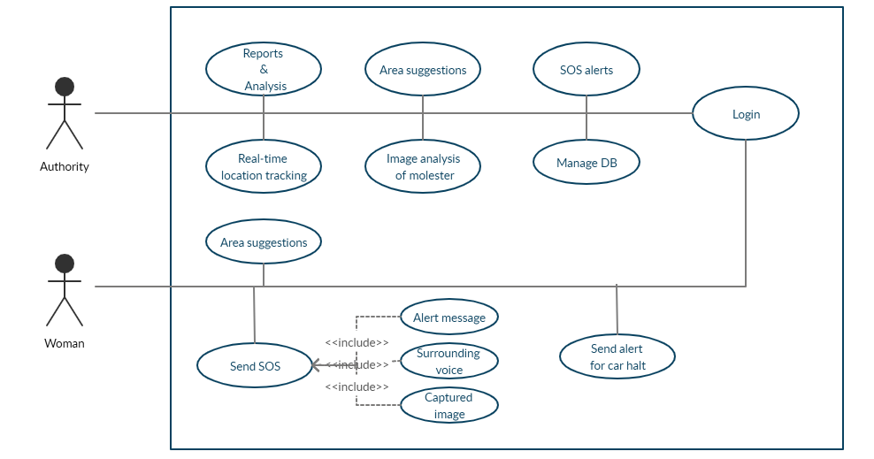




Slide 5
Android Application
Working Prototype of CHIRAYU App
Sign In / Sign Up of App User based on Aadhaar no data and OTP authentication of new registration.
Biometric technique(fingerprint) for login and validating data of user in database.
ADR form filling according to the form provided by the Ministry.
ADR form design is divide in following levels :
Reporter’s Details
Notifier’s Details
Patient Details
Reaction Details,
Drug Details(multiple drugs for a specific form).
Geolocation is also being fetched at the time of ADR report submission for further authentication of Reporter.
Detailed Statistical Reports , Track of ADR’s for coordinators and APP users

Slide 6
Android Application
Enhanced Features of CHIRAYU App (For Future)
Simplifying the App login process using face recognition technique .
Simplifying ADR registration process by using new innovations like
Speech to text conversion
OCR Technique
Streamlining the review process, thereby providing the statistical analysis for the same.
Notification to respective coordinator whenever new ADR is reported by various users.
Notification to NPRC within 24 hours if adverse reaction is reported.
CHATBOT – For clarification and detailed knowledge about the project and common drugs will be implemented using Machine Learning. Users can directly receive information without involvement
of any manual intervention.
ADR reporting forms on android applications are not in vernacular languages but can be incorporated in future version of project.

Slide 7


WEB portal
SALIENT FEATURES
• SOS alert from the victim will be received.
• Suggestions would be analyzed by the authorities to maintain security in a particular region.
• Real time location tracking of cars and the women entering unsafe region at a specific time.
• Culprits face matching could be done from the existing database by the authorities for quick action.

