Slide 1


US News and World Report
Kaggle.com
Only the 230 top-ranked schools.
A data gathering tool for tracking colleges for admission
A greater number of schools.

Slide 2
My hypotheses
We have data pulled from the US News and World Report. This data shows what (we limited it to the top 80) a limited number of schools’ statistics are.
In analyzing this, I came to the conclusion that it was not a sufficient sample to draw any realistic conclusions. To test this theory, I supplemented the data with another set, with many more colleges and different variables. When we merged the two, our data set got more variables, but not more items.

Slide 3
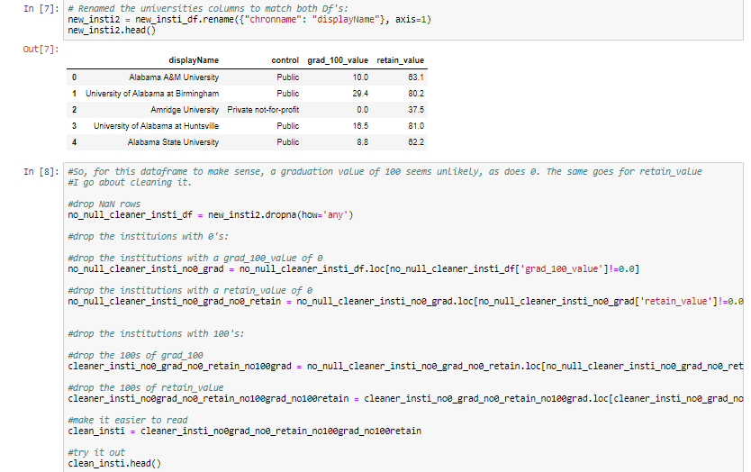

Slide 4
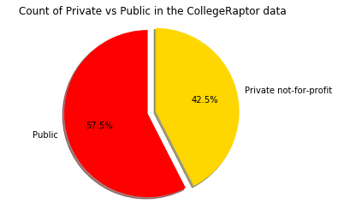
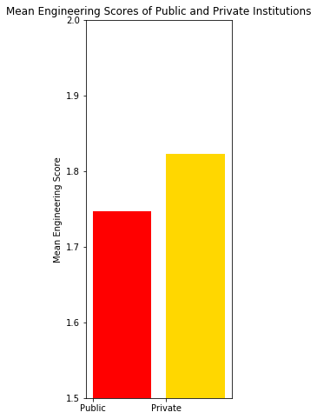
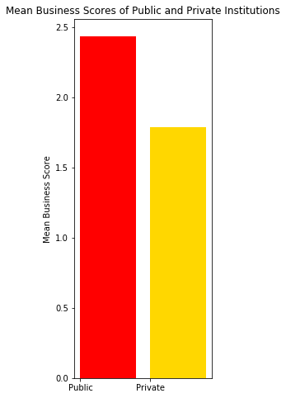
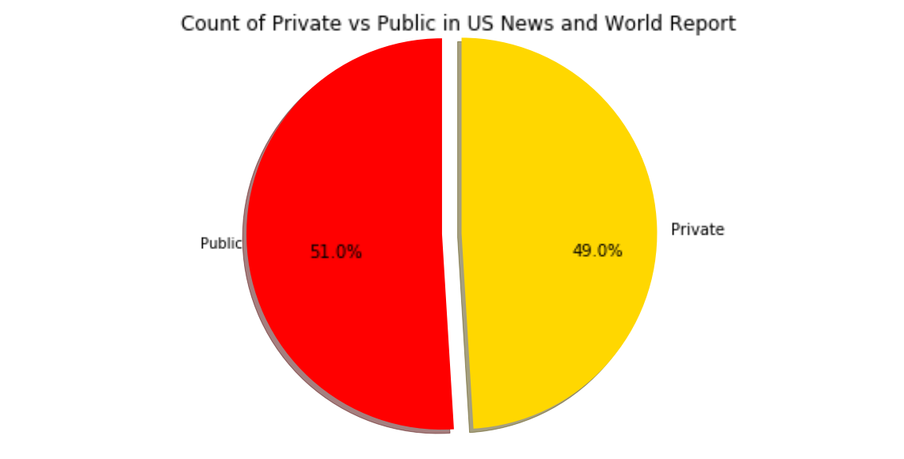

Slide 5
