Slide 1
Make hiring smarter.
An AI system that ranks candidates the way a great recruiter would —
reasoning about who actually fits, not who has the most keywords.
Redrob · Intelligent Candidate Discovery & Ranking
Senior AI Engineer JD · 100,000-candidate pool · Nimisha Agarwal

Slide 2
Keyword filters can't see fit
The dataset is built with four traps. A keyword/embedding matcher walks straight into them.
1
Keyword stuffers
Non-engineering profiles padded with AI skill tags. Look perfect on paper; can't do the job.
2
Plain-language Tier-5s
Built a real recommendation system but never wrote “RAG” or “Pinecone.” Easy to miss.
3
Behavioral twins
Identical skills, opposite reachability — one responds to recruiters, one vanished months ago.
4
Honeypots (~80)
Subtly impossible profiles. Ranking them in your top 10 means you aren't reading profiles.

Slide 3
Rank on what the JD means, not what it says
A great recruiter reads between the lines. So does this system.
WHAT IT SAYS
“5–9 years of experience”
A list of 20+ skills
“embeddings, vector DBs, NDCG”
Location: Pune / Noida
WHAT IT MEANS
A range, not a cutoff — senior judgment
Shipped a ranking/search/recsys system
at a product company, to real users
Reachable & open — or it's not a hire

Slide 4
One interpretable score
Every term lives in [0,1], so the pieces read straight into each candidate's reasoning line.
0.45 · Semantic + 0.55 · Rubric
what they did + structured fit
×
Disqualifier gates
do-NOT-want rules
×
Behavioral
reachable?
×
Location
Tier-1 / relocate
×
Honeypot
sink impossible
×
Experience
soft 5–9y
Career evidence is weighted above the skills list (defeats stuffers, surfaces plain-language fits). The multipliers are the recruiter's judgment: the JD's explicit rejections, whether the person is actually available, and whether the profile is internally consistent.
Pure standard-library Python — no model downloads, no API calls, fully auditable.

Slide 5
Read what they did, not what they tagged
The semantic signal is computed over career prose — summary + job descriptions — never the skills tags.
0.45
How
TF-IDF cosine between each candidate's narrative and a JD concept-query (retrieval, ranking, recommendation, embeddings, vector search, NDCG, production, NLP/IR).
Why prose, not tags
A “Marketing Manager” can list every AI keyword. They can't fake “owned search relevance and shipped a re-ranker to production.” Prose is where real fit — and plain-language Tier-5s — live.
weight on the semantic term
1,141
term corpus vocabulary
prose
summary + every job description

Slide 6
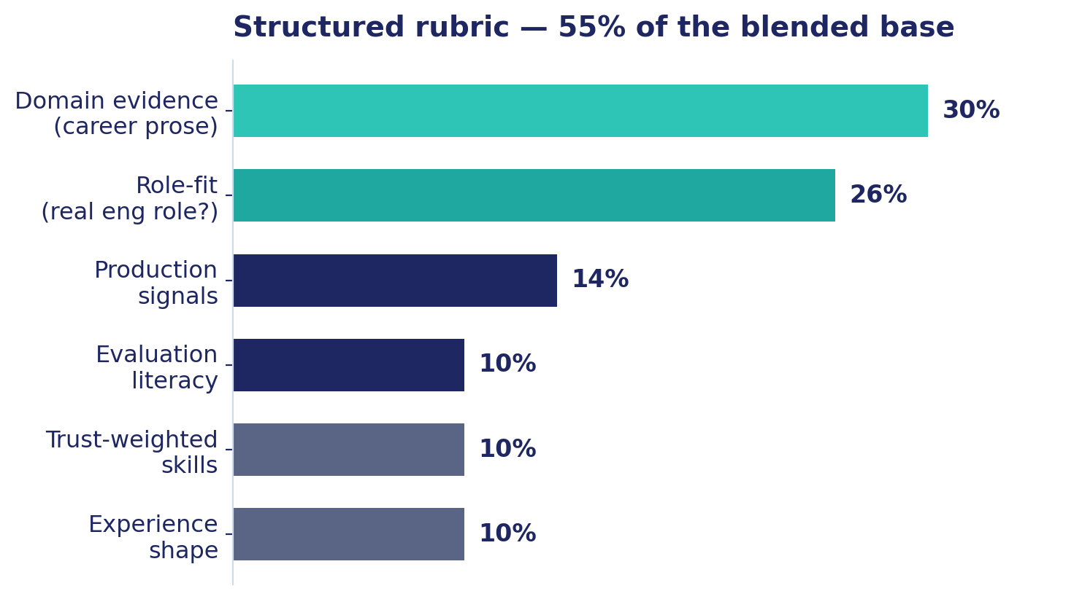
A structured rubric carries the rest
55% of the base — domain evidence leads, role-fit guards against keyword stuffers.
Skill-trust, not skill-count
Each core skill is weighted by
proficiency × √duration × endorsements
An “expert” skill with 0 months used and 0 endorsements counts as padding (×0.1) — so keyword stuffing earns almost nothing here.

Slide 7
The JD's “do NOT want,” encoded
Each rejection is a multiplicative penalty — strong elsewhere can still partly recover.
Pure research, no production
×0.30
Entire career at IT-services / consulting
×0.28
✕
✕
CV / speech / robotics, little NLP-IR
×0.45
AI = recent LangChain/OpenAI wrapping only
×0.55
✕
✕
Senior who no longer writes code
×0.62
Title-chaser — many short stints
×0.78
✕
✕

Slide 8
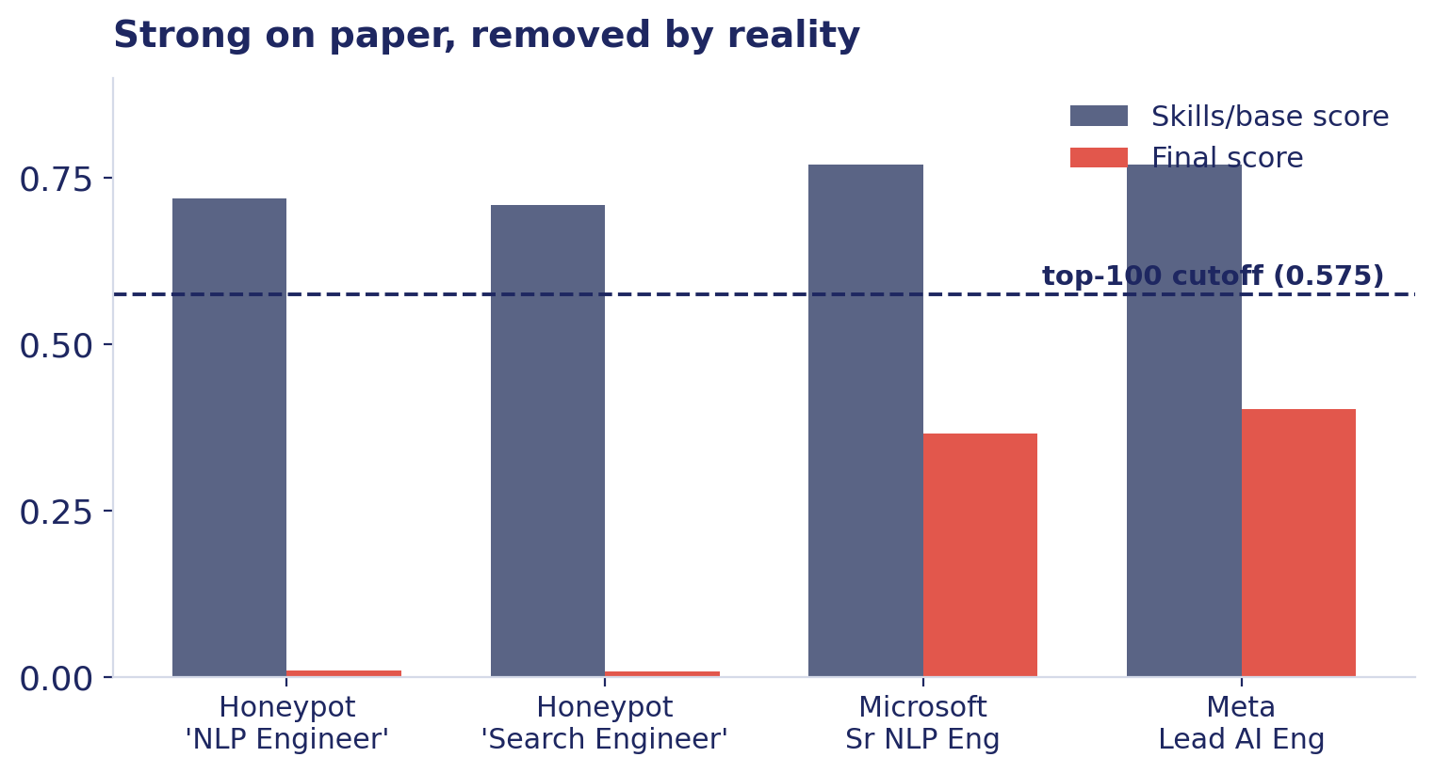
A perfect profile that's unreachable isn't a hire
Activity recency, response rate, open-to-work and notice period modulate every score.
The JD is explicit
“A perfect-on-paper candidate who hasn't logged in for 6 months and has a 5% response rate is, for hiring purposes, not actually available.”
A Meta Lead AI Engineer and a Microsoft Senior NLP Engineer both fall below the top-100 cutoff — on availability alone, not skill.

Slide 9
Reading for consistency, not keywords
Honeypots are caught by internal contradictions — no special-casing, just careful reading.
Tenure exceeds experience — role months sum to more years than the stated career
1
0 / 100
Dates contradict duration — duration_months disagrees with start/end by >18 months
2
Ghost “expert” skills — 4+ advanced/expert skills with 0 months and 0 endorsements
honeypots in our top 100.
Flagged profiles are multiplied by 0.02 and sink. (>10% in the top 100 is an automatic disqualification.)
3
A single role longer than the whole career — impossible by construction
4

Slide 10
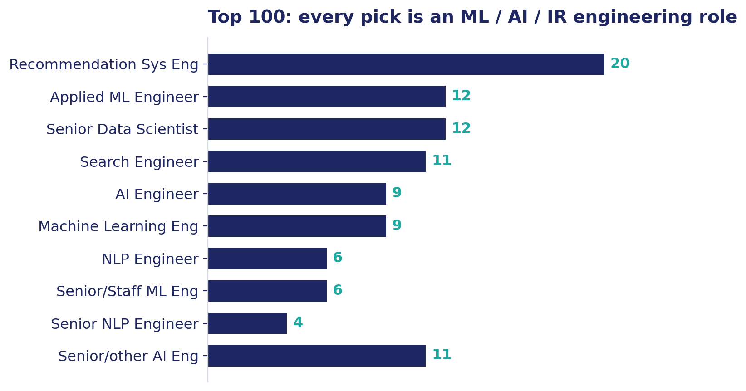
The shortlist a recruiter can trust
Top of the list: Zomato, Genpact AI, Razorpay, Paytm, Salesforce, Sarvam AI, CRED, Ola.
0
88/100
non-engineering titles in the top 100
inside the 5–9 year band
47 + 51
100
in Tier-1 cities / willing to relocate
unique, specific reasoning lines

Slide 11
Production-grade by construction
Built for the constraint the JD actually cares about: scale, not a benchmark.
0
CPU
~2 min
third-party deps in the ranking step
no GPU, no network, no API calls
to rank all 100,000 candidates
< 1 GB
1
stdlib
RAM — two streaming passes
command reproduces submission.csv
fully auditable, trivially reproducible

Slide 12
Understand the role. Read the career. Down-weight the unreachable.
That's how a great recruiter works — and it's exactly what this ranker does.
Delivered: clean GitHub repo · top-100 submission.csv · runnable Colab sandbox

