Slide 1
Salary prediction Model using web based application framework using flask.
Submitted by
Nimisha Vilayatarani
7219293

Slide 2
Introduction
This web-based project, built using Flask, predicts salaries based on years of experience and scores in theoretical tests and interviews. Flask is a lightweight web framework in Python, and pickle is a module used for serializing and deserializing Python objects, enabling users to view prediction outputs directly through a user interface.

Slide 3
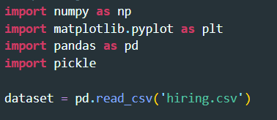
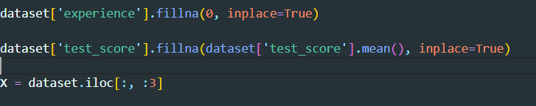
Steps involved in Machine Learning process (ML mind map)
Step 1. Load Data
Import necessary libraries and load the data into a pandas DataFrame.
Step 2. Data Cleaning
Convert categorical experience values to numerical values.
Handle missing values in the test scores by filling them with the mean.

Slide 4
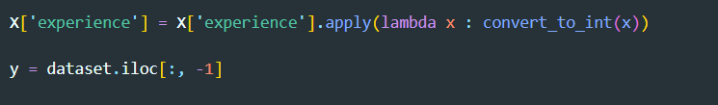
Step 3: Feature Selection
Step 4: split the data.
Step 4: Train Different Models. But save one
from sklearn.linear_model import LinearRegression
regressor = LinearRegression()

Slide 5
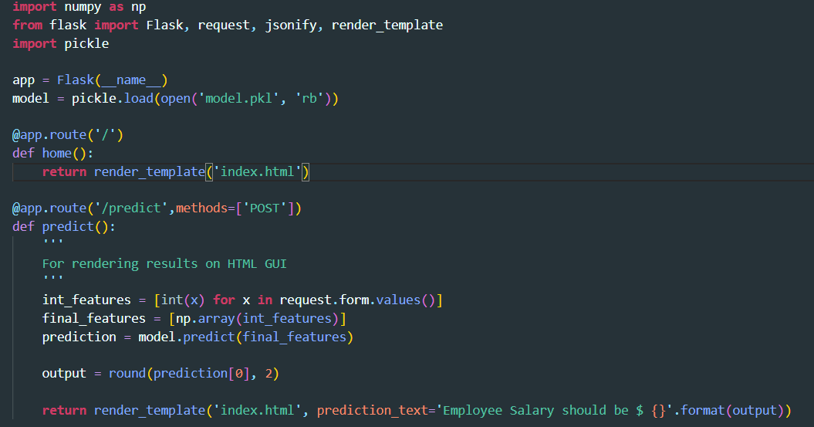
Step 5: Create a flask application

Slide 6
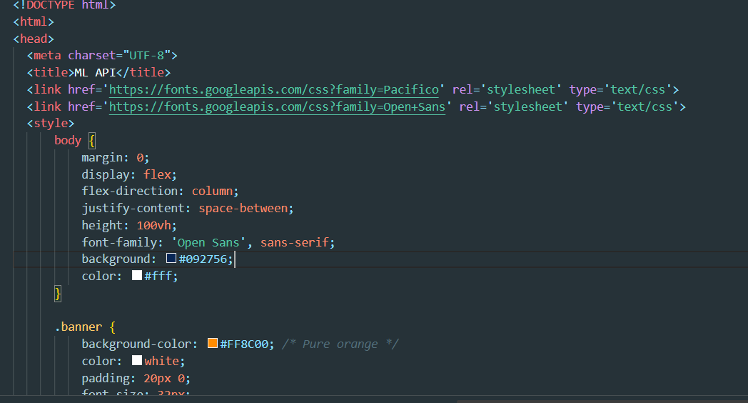
Step 6: create an html template

Slide 7
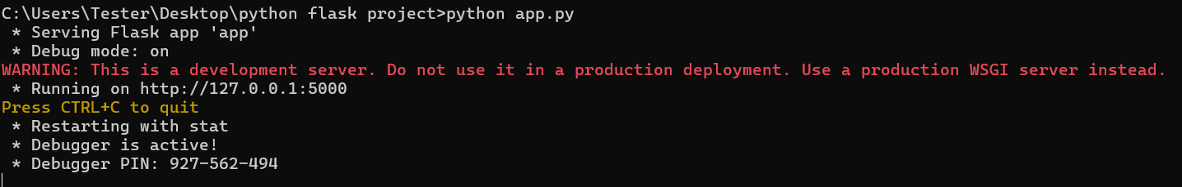
Step 7: involved for the project to run, input, and output
Open a terminal or command prompt Navigate to the directory where Flask project files are located in my case it is c:/user/Tester/Desktop/folder name.
, type python app.py.
Run the Flask application using (type python app.py)
Note the port number displayed in the terminal(type the port received http://127.0.0.1.5000)

Slide 8
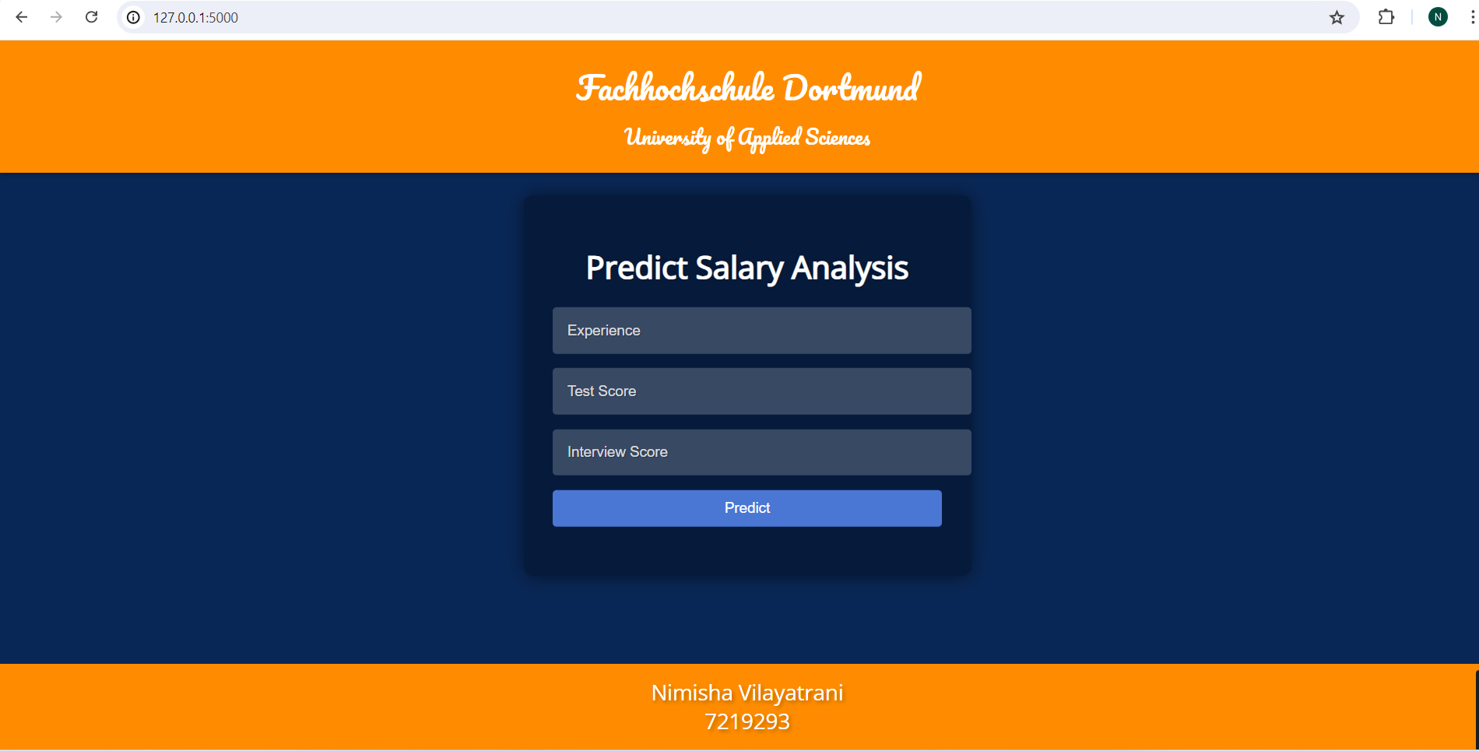
On typing the port received on the browser we have the following output on the screen as flask is ready to post the request.

Slide 9
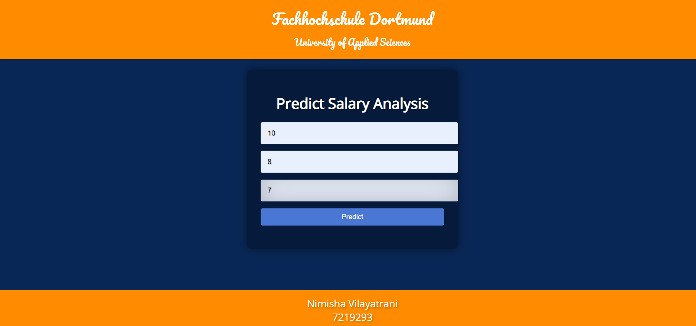
We have give certain input to the model to predict the output such as several years of experience, score received in interviews and theory test out of 10 and this model will predict salary.

Slide 10

output
The output as per the model predicted the Employee Salary.

Slide 11
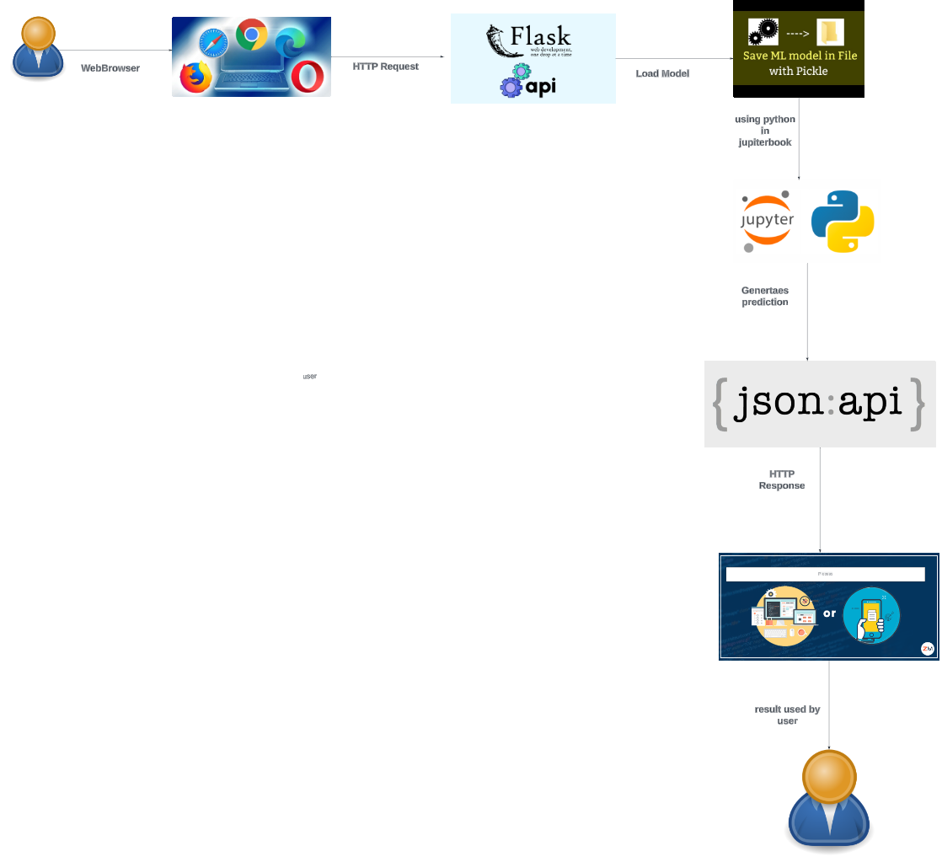
Architecture

Slide 12


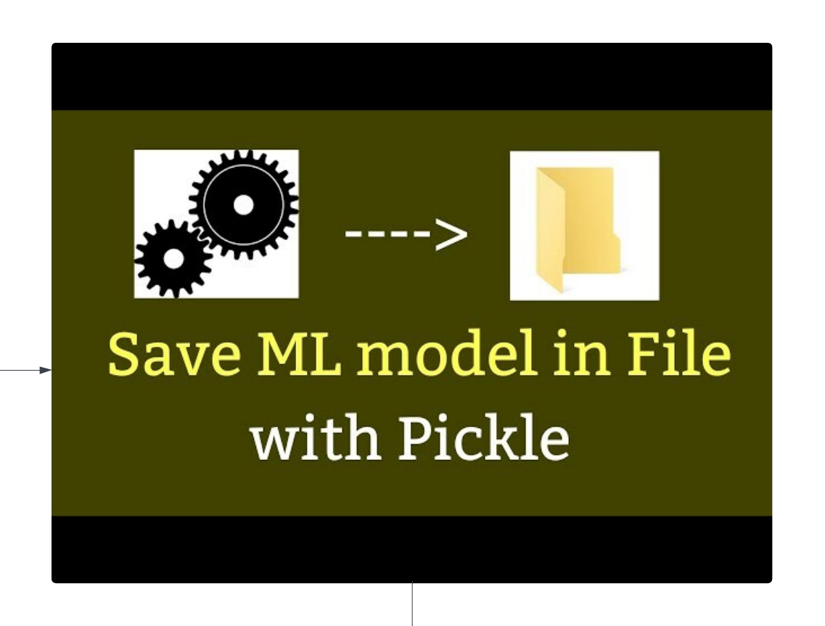
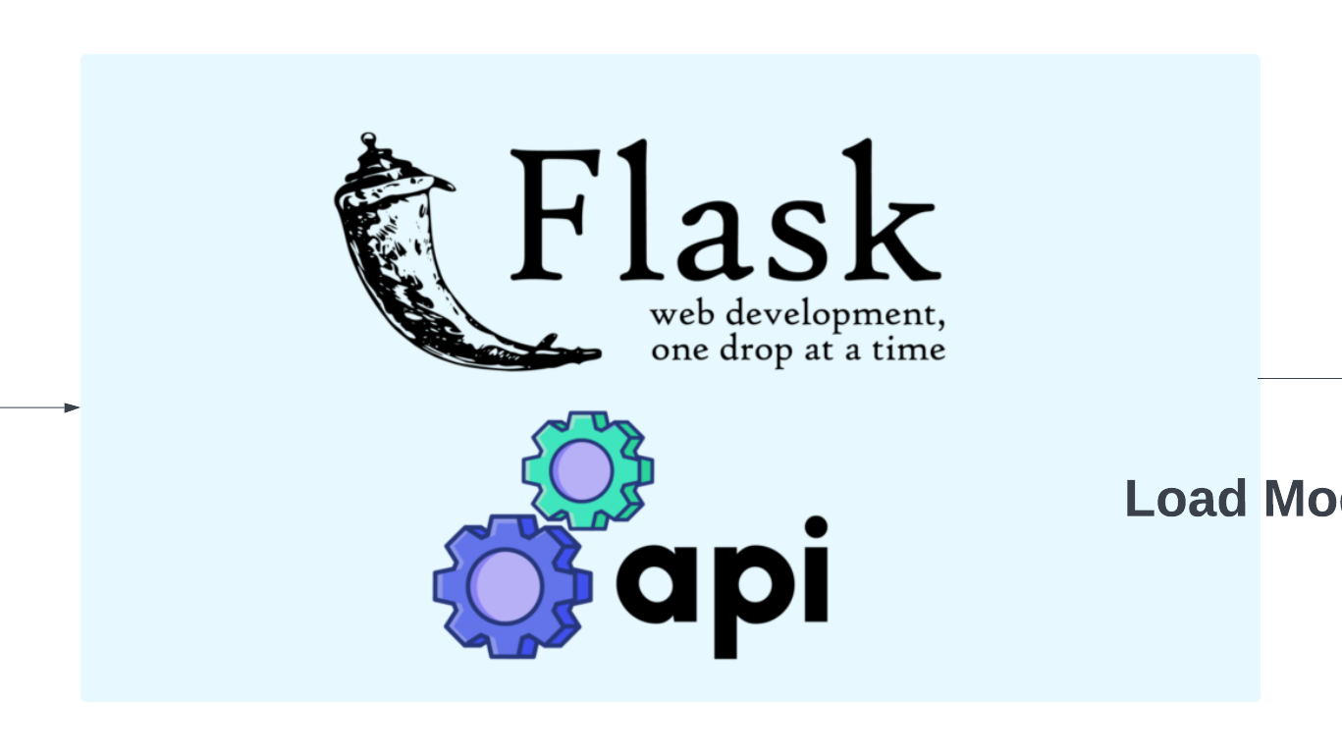

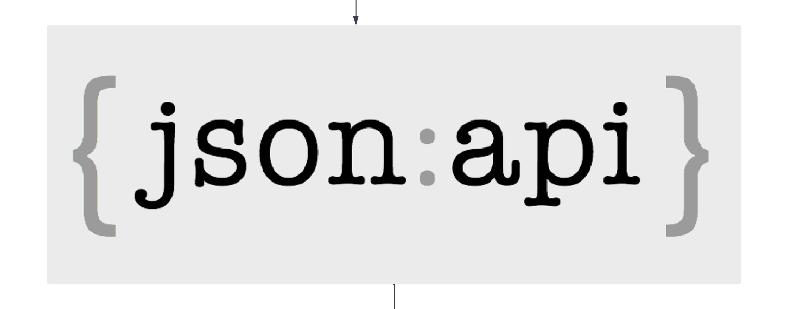

Detail explanation of architecture.
User interact by sending request to web browser
This HTTP request using flask communicates with our ML model where file is saved using pickle.
Where codes are written in python and response generated in json
Response received by user

Slide 13
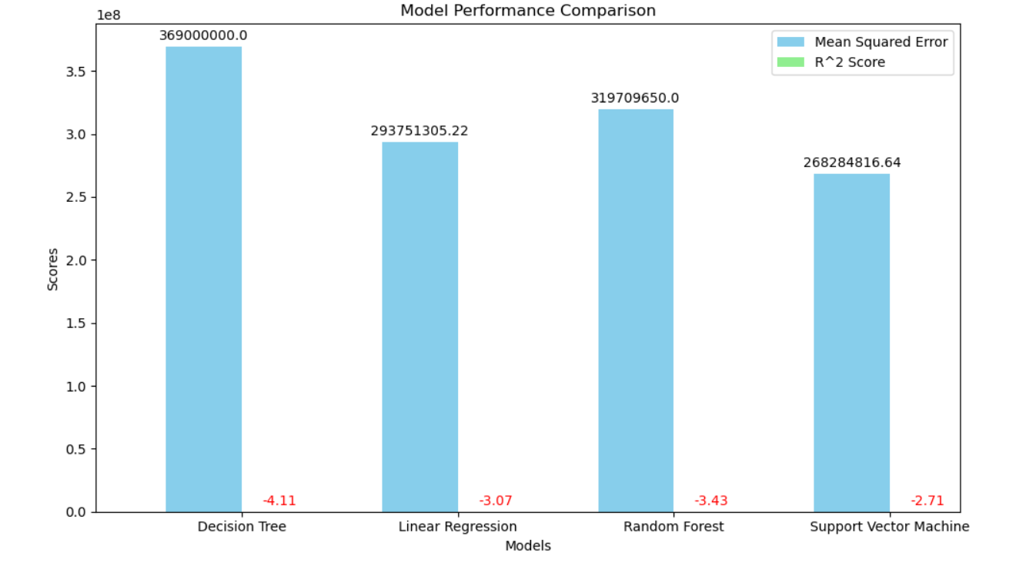

Slide 14
conclusion
Model | Mean Squared Error | R² Score
Decision Tree | 369,000,000.0 | -4.107266435986159
Linear Regression | 293,751,305.22 | -3.0657620099941925
Random Forest | 293,751,305.22 | -3.4250470588235293
Support Vector Machine | 268,284,816.64 | -2.7132846593553337
CNN | 2932894880.496121 | -39.5937007681124
Based on these metrics, Support Vector Machine shows the best performance among the models tested in terms of predicting salary based on the given dataset.

Slide 15
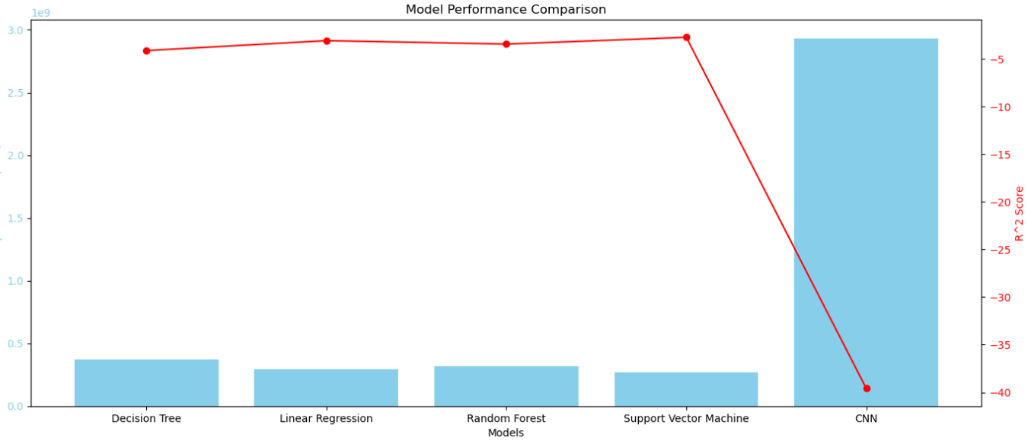
When a comparison is made with CNN Convolutional Neural Network.

Slide 16
Thank you!

