Slide 1
CASE STUDY NO. 139 | JAVA PROGRAMMING
Machine Maintenance Scheduler
139
CASE STUDY
A Java Swing application to schedule preventive maintenance, assign technicians and track repairs.
Nimish Bordiya
Roll No: 150096725027 | B.Tech CSE (Semester III)
School of Future Tech, ITM Skills University

Slide 2
Problem Statement & Objectives
1
Maintain machine and technician records
Problem
A factory wants to maintain preventive-maintenance schedules for machines, record service tasks, assign technicians, and track breakdown and repair history.
Schedule maintenance tasks
2
3
Track due dates
4
Record repairs
5
Generate maintenance history
Machine Maintenance Scheduler | Nimish Bordiya | 150096725027
2

Slide 3
Java Concepts & Justification
1
OOP
2
Interfaces
Abstract class BaseRecord is inherited by Machine and Technician. Fields are private (encapsulation), one class per real-world object.
Identifiable and RecordManager are reusable contracts for IDs and for add / update / find / search behaviour.
3
HashMap
4
ArrayList
Machines and technicians are stored by ID, giving fast lookup, instant duplicate checks and quick updates.
Tasks and repair records grow dynamically, keep their order, and are easy to sort by due date.
Machine Maintenance Scheduler | Nimish Bordiya | 150096725027
3

Slide 4
System Design & Modules
Swing GUI
(MainFrame)
MaintenanceService
(business rules)
HashMap + ArrayList
(data in memory)
maintenance_data.txt
(saved data)
Six modules (tabs)
1
2
3
4
5
6
Machines
Technicians
Tasks
Repairs
History
Summary
Add, update, search, status
Records and skills
Schedule and due dates
Breakdown and fix
Log per machine
9 live counts
Machine Maintenance Scheduler | Nimish Bordiya | 150096725027
4

Slide 5
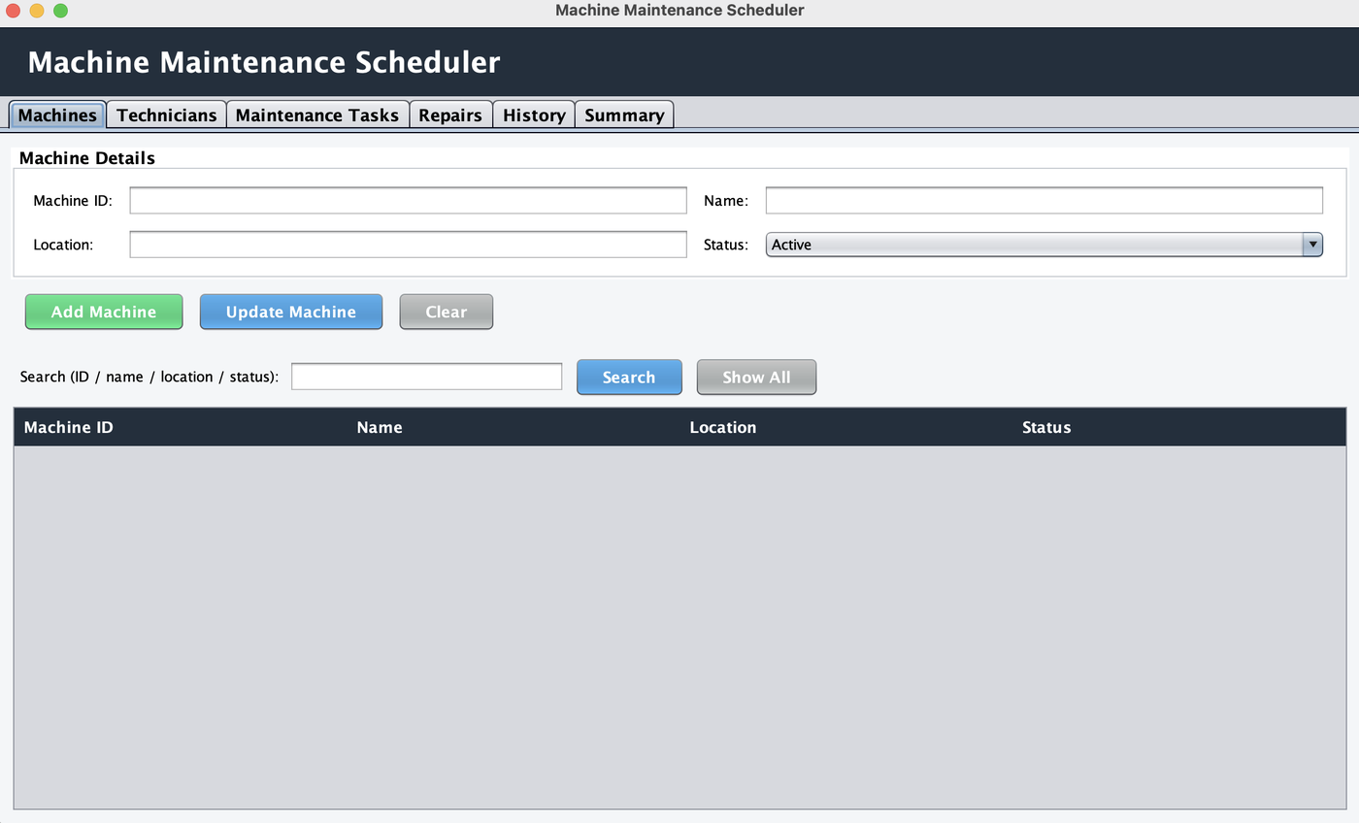
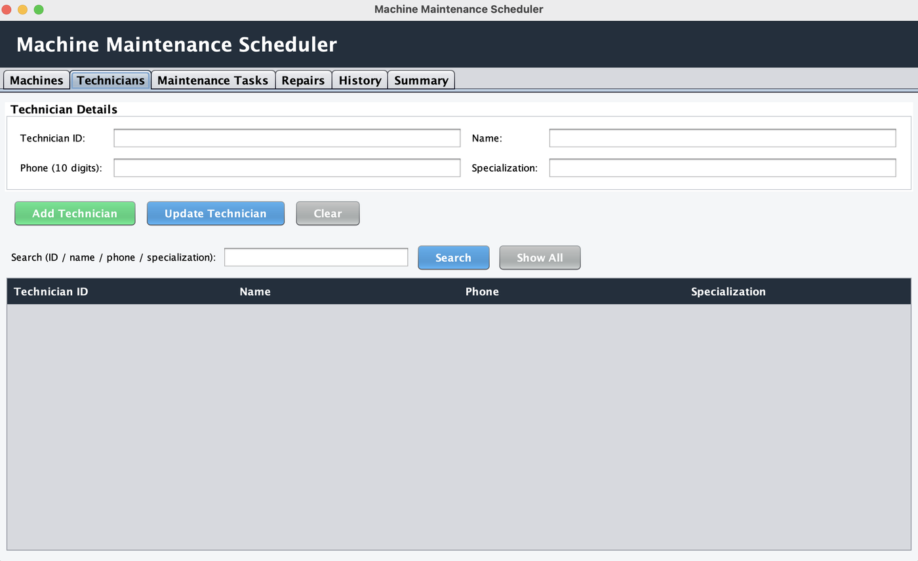
Screenshots: Machines & Technicians
Machines tab: add, update, search, status
Technicians tab: records and search
Machine Maintenance Scheduler | Nimish Bordiya | 150096725027
5

Slide 6
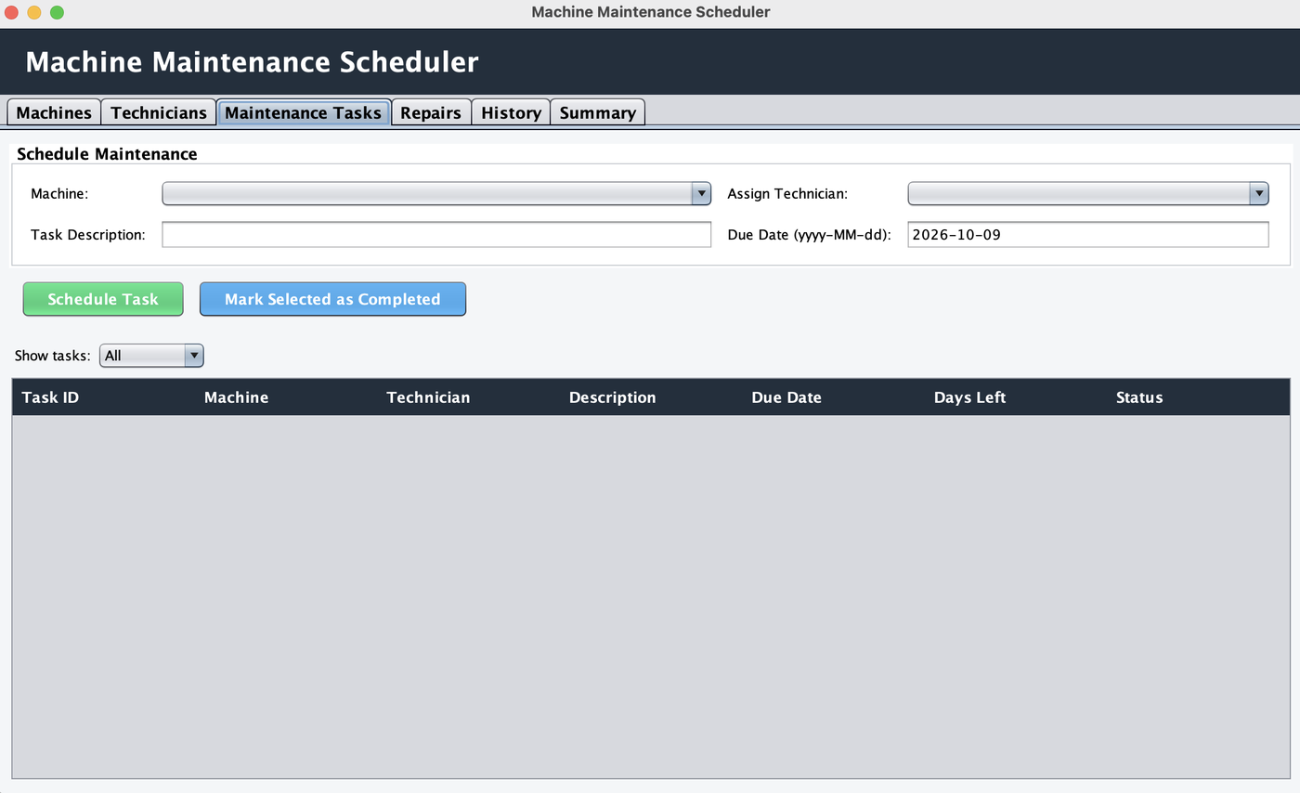
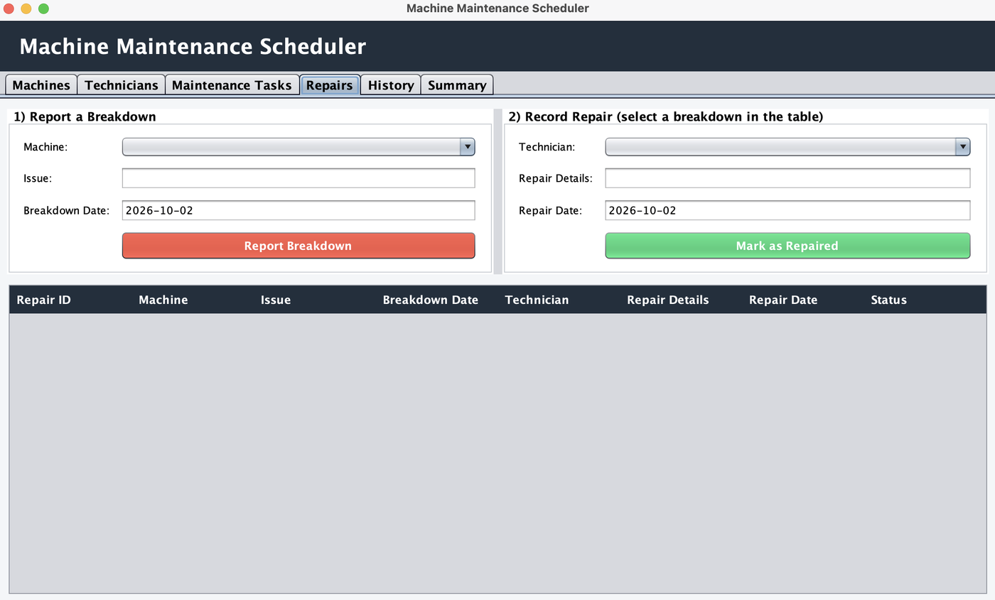
Screenshots: Tasks & Repairs
Maintenance Tasks tab: schedule and due dates
Repairs tab: breakdown and repair
Machine Maintenance Scheduler | Nimish Bordiya | 150096725027
6

Slide 7
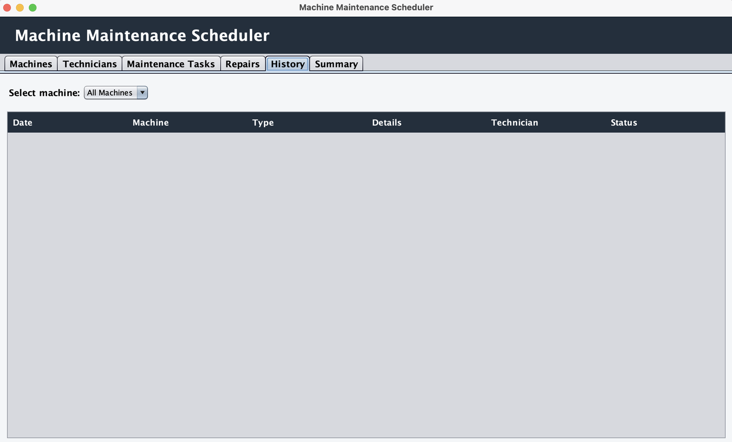
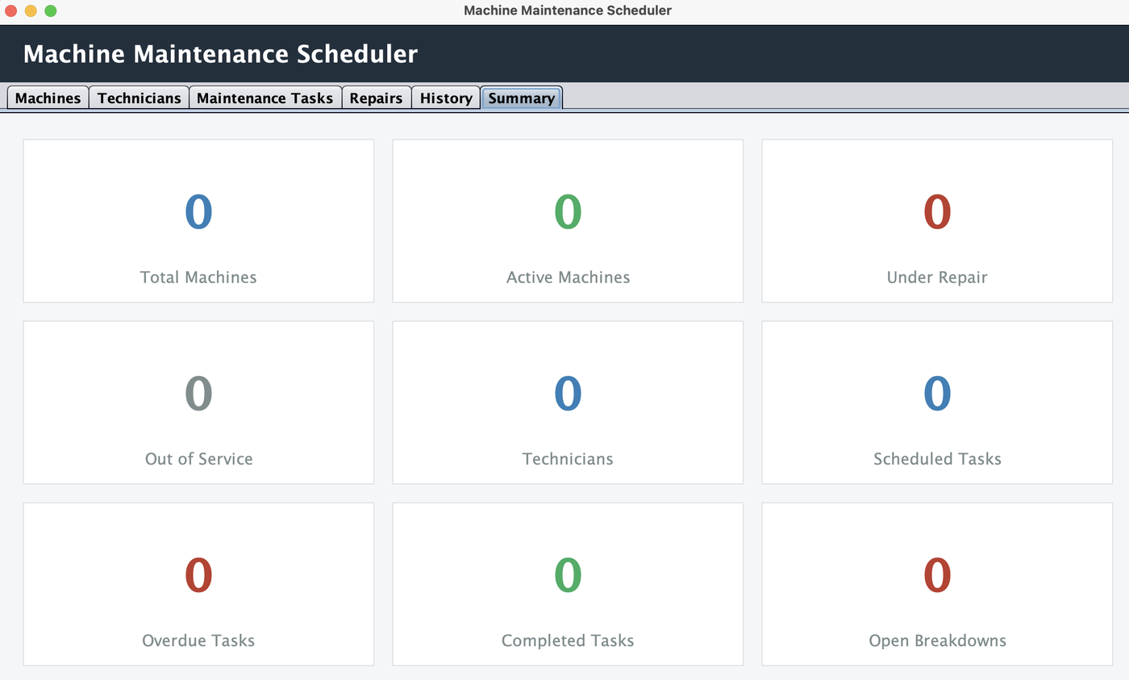
Screenshots: History & Summary
History tab: log per machine
Summary tab: nine live counts
Machine Maintenance Scheduler | Nimish Bordiya | 150096725027
7

Slide 8
Validation & Exception Handling
Business rules
Safe handling & storage
IDs must be unique
No empty fields
Phone must be 10 digits
Dates in yyyy-MM-dd format
Due date cannot be in the past
No tasks for Out of Service machines
Repair date not before breakdown
Custom MaintenanceException
Friendly popup instead of a crash
Auto-save to a text file after every action
Data loads again on next start
Damaged lines are skipped safely
Machine Maintenance Scheduler | Nimish Bordiya | 150096725027
8

Slide 9
Outcomes Achieved
✓
Functional Java prototype
6
modules
✓
Create, update, search and status management
4
core Java concepts
✓
Java Collections and OOP design
✓
Invalid input and business rules handled safely
9
summary counts
✓
Clear GUI with useful summaries
Machine Maintenance Scheduler | Nimish Bordiya | 150096725027
9

Slide 10
Conclusion
The project demonstrates the practical application of core Java concepts, collections, validation, exception handling, and GUI programming in a machine maintenance scheduler.
Thank you
Nimish Bordiya | 150096725027 | B.Tech CSE, School of Future Tech, ITM Skills University

