Slide 1
USEREADY / AI ENGINEER
FROM RAW LOGS TO INCIDENTS
SolrCloud AI
Observability & RCA
01
Detect anomalies
Rules + robust statistics
02
Correlate findings
Deterministic incident grouping
An evidence-first platform for detecting, correlating and investigating SolrCloud operational incidents.
03
Investigate selectively
Optional two-stage LLM RCA
DESIGN · WORKING PROTOTYPE · EVALUATION
NO LLM REQUIRED FOR CORE DETECTION
AI Engineer Case Study • October 2026
01 / 09

Slide 2
USEREADY / AI ENGINEER CASE STUDY
02 / 09
MY UNDERSTANDING OF THE BRIEF
The problem I am solving
Make periodic SolrCloud + JVM GC logs faster to investigate and easier to act on.
TODAY: REACTIVE TROUBLESHOOTING
Detect meaningful anomalies
GC pressure, slow queries, HTTP errors, ZooKeeper / leader events
Logs are reviewed manually.
Signals are spread across nodes.
Correlate and assess health
Relate nearby events across nodes; infer node and cluster condition
SOLR + GC
MANUAL REVIEW
SLOW RCA
Explain root cause + next steps
Hypotheses, operational impact, cited evidence, safe remediation guidance in a UI
Desired shift: from raw lines to evidence-backed, reviewable incidents.
BRIEF: LOG PARSING • ANOMALIES • CORRELATION • RCA + IMPACT + REMEDIATION • SIMPLE UI

Slide 3
USEREADY / AI ENGINEER CASE STUDY
03 / 09
SOLUTION APPROACH
Evidence first; AI only where useful
A working deterministic baseline, with an optional bounded LangGraph investigation.
ALWAYS RUNS / PYTHON
ON DEMAND / LANGGRAPH
01
Ingest
Bundled coupled synthetic files, uploaded logs, or folder polling
01
Evidence dossier
Relevant log excerpts + valid references, bounded by token budget
02
Normalize
parser.py → events with timestamps, nodes, fields and evidence IDs
02
Stage 1 LLM
Propose cause and pick at most one approved diagnostic
03
Detect
analyzer.py → hard rules + rolling median / MAD / CUSUM
03
Read-only Python
GC/query timeline, indexing, ZooKeeper or error breakdown
04
Correlate
Union-find over time, node, anomaly family and shared ZK topology
04
Stage 2 LLM
Evidence-grounded RCA + impact + operator checks
05
Explain
Rule-based RCA, risk signals, cluster/node status and JSON output
05
Validate / fallback
Check schema & citations; else return deterministic answer
SURFACES: STREAMLIT DASHBOARD • HEADLESS CLI • PERIODIC WATCH MODE • OPTIONAL SQLITE

Slide 4
USEREADY / AI ENGINEER CASE STUDY
04 / 09
ASSUMPTIONS AND DECISIONS
What I assumed—and why I designed it this way
I prioritized a defensible same-day prototype over a production-complete observability platform.
ASSUMPTIONS
DESIGN DECISIONS
01
Synthetic demo, not customer logs
01
Deterministic signal extraction
Three nodes; separate Solr and GC files coupled by one simulated node state.
Auditable rules + relative shifts (MAD/CUSUM), not LLM-only detection.
02
Log-derived view, not live truth
02
Conservative incident grouping
Health and impact are inferred; liveness and business impact are not verified.
DSU edges require compatible fault families and short time windows.
03
Approximate, supplied topology
03
Bounded and reviewable AI
Shared ZooKeeper dependency and replica mapping inform grouping.
One allowlisted diagnostic; source IDs validated; no auto-remediation.
KNOWN GAPS: NO LIVE SOLR API • NO DURABLE STREAM CHECKPOINTS • NO INDEPENDENT PRODUCTION ACCURACY ESTIMATE

Slide 5
USEREADY / AI ENGINEER CASE STUDY
05 / 09
ARCHITECTURE FLOWCHART
From raw logs to reviewable RCA
The optional AI path starts only when the operator selects an incident.
01
02
03
04
05
SOURCES
NORMALIZE
DETECT
CORRELATE
INCIDENT
Solr + JVM GC logs
3 demo nodes
parser.py
Timestamp + event IDs
Hard rules
MAD + CUSUM
DSU: time / family
shared ZK
Evidence + severity
deterministic RCA
OPTIONAL • OPERATOR-TRIGGERED AI
SELECT
LLM #1
PYTHON
LLM #2
VALIDATE
Incident dossier
Hypothesis + tool
Read-only check
Reassess RCA
Citations / JSON
cited excerpts
allowlist only
in-memory events
context + diagnostics
review or fallback
SAFE BOUNDARY: DIAGNOSTIC READS PARSED EVENTS ONLY; MODEL CANNOT ISSUE SHELL COMMANDS OR MODIFY THE CLUSTER

Slide 6
USEREADY / AI ENGINEER CASE STUDY
06 / 09
LLM ESCALATION STRATEGY
Why the LLM does not read every log
The deterministic pipeline runs on every batch; AI is invoked only when a user requests deeper investigation.
01 INGEST
›
02 DETECT
›
03 CORRELATE
›
04 EXPLAIN
Solr + JVM GC
MAD / CUSUM + rules
DSU + topology
Deterministic RCA
Why this is the better first-pass design
Operator requests AI?
COST
Avoid sending every noisy event to a paid API.
RELIABILITY
Structured, repeatable rules still work offline.
NO → Stop here
YES → LLM
No token cost; RCA shown
2-stage + diagnostic
EVIDENCE / SECURITY
Only bounded, authorized log excerpts leave the system if hosted AI is selected.
AI adds value for ambiguous causal hypotheses and operator guidance—not for basic parsing, thresholds or grouping.
IMPLEMENTED NOW: USER-TRIGGERED ESCALATION • FUTURE: EVIDENCE/UNCERTAINTY-BASED AUTO-ROUTING

Slide 7
USEREADY / AI ENGINEER CASE STUDY
07 / 09
MODEL AND DEPLOYMENT CHOICE
Hosted speed vs local privacy and control
Typically two LLM calls per selected incident (more if retried); any OpenAI-compatible endpoint can be configured.
MODEL / RUNTIME
WHERE IT RUNS
API $ / 1M TOKENS
(INPUT / OUTPUT)
TRADE-OFF
Qwen3:8B + Ollama
Local machine / private VM
No per-token API fee
Privacy + offline use; ~5.2 GB model download, extra RAM; CPU inference may be slow.
Qwen3.5-Flash
Alibaba hosted API
$0.029 / $0.287
Very low token price (global ≤128K tier); external processing, regional tiers.
GPT-OSS 120B
Groq hosted API
$0.15 / $0.60
Recommended in project README: fast API, no local GPU; logs leave environment.
GPT-5 mini
OpenAI hosted API
$0.25 / $2.00
Another structured-reasoning option; higher example spend; verify quality empirically.
Illustrative 2-stage investigation: 12K input + 2K output tokens total
Qwen hosted ≈ $0.00092 • Groq ≈ $0.0030 • GPT-5 mini ≈ $0.0070 • Local = compute/electricity
List prices vary by region / tier, token mix and date. Costs are illustrative—not measured prototype usage.
PRICES: GROQDOCS • ALIBABA CLOUD • OPENAI API • OLLAMA / QWEN3 | CHECKED 27 OCT 2026
GROQ
ALIBABA
OPENAI
OLLAMA

Slide 8
USEREADY / AI ENGINEER CASE STUDY
08 / 09
TESTING
Reproducible checks and honest evaluation
Unit tests validate code paths; scenario tests assess fault-family matching—not causal truth.
39
Tests discovered
8 / 8
Synthetic targets matched
82,955
Generated lines evaluated
36 passed • 3 skipped*
0 unmatched • 0 missed
8 controlled scenarios
Representative scenario outcomes
What the tests actually cover
Scenario
Expected
Baseline
Enhanced
✓
Parsing, GC classification, hard rules
GC pressure
1
2
1
✓
MAD/CUSUM and topology correlation
Slow queries (no GC)
1
0
1
Safe tool allowlist & evidence IDs
✓
Benign ZK reconnect
0
1
0
✓
Token budgets, JSON validation, fallbacks
Mixed failures
2
3
2
*Three LangGraph-dependent tests skipped here because LangGraph was not installed.
SYNTHETIC PRECISION / RECALL = 1.00 ON GENERATOR-LABELED SCENARIOS; NOT A MEASURE OF PRODUCTION ACCURACY

Slide 9
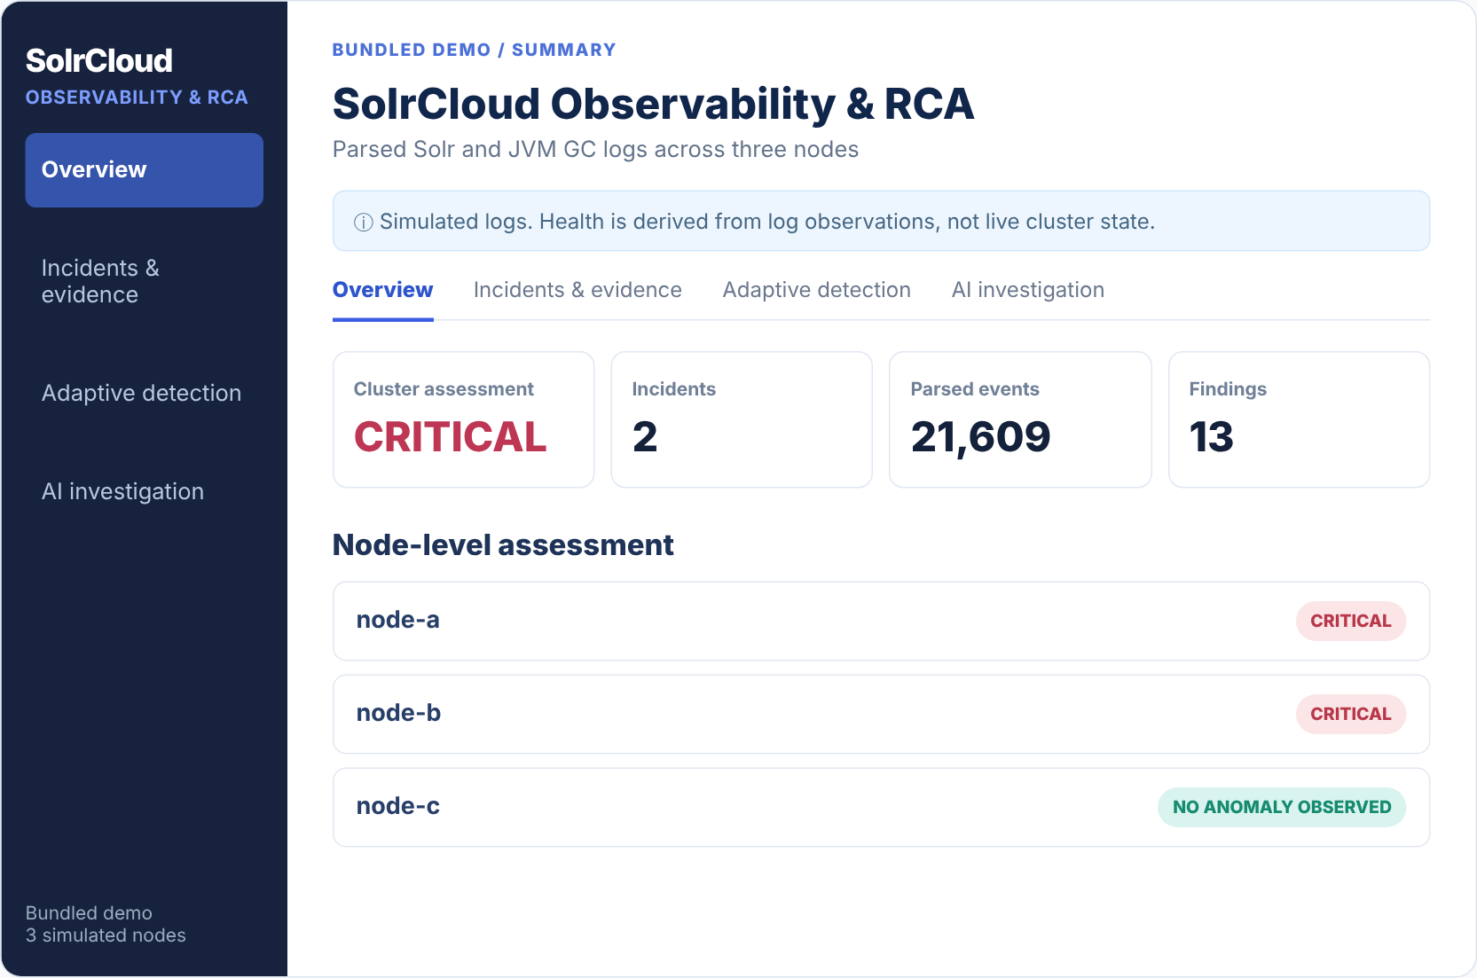
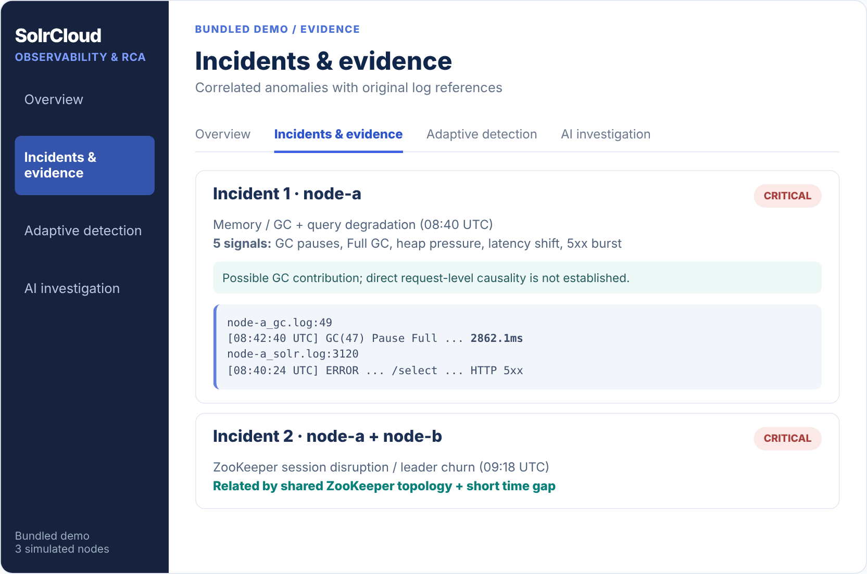
USEREADY / AI ENGINEER CASE STUDY
09 / 09
DEMO SNAPSHOTS
What the bundled demonstration shows
Two incident families surfaced with source evidence and conservative RCA.
01 / Cluster + node summary
02 / Incident correlation + original evidence
Visual recreations from real cli.py demo results — not captured from a running Streamlit session.
BUNDLED RUN: 21,609 PARSED EVENTS • 13 FINDINGS • 2 INCIDENTS • NO LIVE SOLRCLUSTER CONNECTION

