Slide 1
In-House Training On 'Applications of Artificial Intelligence' Titled "Rotten Eggs"
Submitted by :
Sureena Wadhwa

Slide 2
What is Artificial Intelligence?
Field of Computer Science that aims on making the machines smarter and intelligent.
It's man made intelligence.
it's like giving a machine a brain of it's own which becomes intelligent the more it's used.

Slide 3
The Idea behind the Project...
Sentiment analysis is a crucial and latest research area.
The project associates prototype-based machine learning and supervised learning together.
The algorithms were tested on movie reviews and they provide with the sentiment found within comments and reviews that the users input or give.
The result is a hybrid of various classifiers and clustering techniques used in the program to get the correct sentiments of the user’s movie review.

Slide 4
The Idea behind the Project...
The sentiment which is found in reviews, whether constructive or destructive criticism give helpful suggestions for various purposes.
Such estimations can be categorized into two types:
Positive
Negative.
This gives organizations a way to evaluate the degree of product acknowledgment and to decide on functions to enhance the product quality further.
The technique is that in the event that one classifier neglects to characterize a report, the classifier will pass the archive onto the following classifier, until the point when the record is ordered or no other classifier exists.

Slide 5
Languages used
Python 3.5
Java 8.0

Slide 6
Classifiers used and the concept behind them
Naïve Bayes
It is a family of classifiers based on Bayes theorem
Known for making easy yet efficient models in the area of classifying and predicting
a Naive Bayes classifier assumes that the presence of a particular feature in a class is unrelated to the presence of any other feature

Slide 7
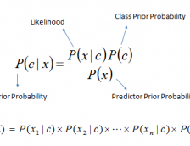
How it works
Step 1 : Converts the data set into a frequency table
Step 2 : Converts the likelihood tables by finding the similar probabilities
Step 3 : Now, use Naive Bayesian equation to calculate the posterior probability for each class. The class with the highest posterior probability is the outcome of prediction.

Slide 8
Classifiers used and the concept behind them
2. Support Vector Machine
Supervised machine learning algorithm
Can be used for both classification or regression challenges.
In this algorithm, we plot each data item as a point in n-dimensional space (where n is number of features you have) with the value of each feature being the value of a particular coordinate.
Then, we perform classification by finding the hyper-plane that differentiate the two classes very well

Slide 9
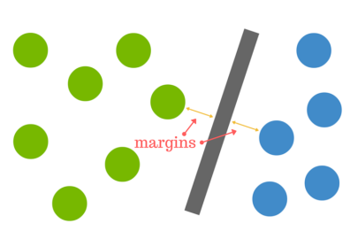
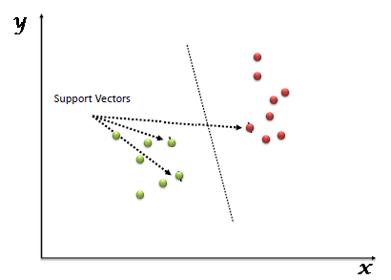
How it works
What is a hyperplane?
Think of a hyperplane as a line that linearly separates and classifies a set of data.
the further from the hyperplane our data points lie, the more confident we are that they have been correctly classified
How to find the right hyperplane?
The distance between the hyperplane and the nearest data point from either set is known as the margin.
The goal is to choose a hyperplane with the greatest possible margin between the hyperplane and any point within the training set, giving a greater chance of new data being classified correctly.

Slide 10
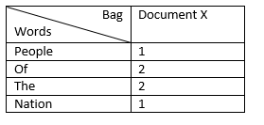
3. Bag of words (BoW)
simple model used in Natural Language Processing.
represents text as a multiset of words. A multiset - which is a set where multiple entries are allowed - is also known as a bag, hence the name.
In BoW model a sentence or a document is considered as a 'Bag' containing words. It will take into account the words and their frequency of occurrence in the sentence or the document disregarding semantic relationship in the sentences.
As you can see in the table, if Bag of Words model is applied to ‘Document X’, the word occurrence frequency will be calculated for all the words in the document.

Slide 11
4. Tokenization
The basic tokenizer (like in NLTK) will split your text into sentences and your sentences into typographic tokens. That means isolating punctuation (trickier that it looks : you will want "the/cat/eat/the/mouse/." but not "Mr./Jack")
In lexical analysis, tokenization is the process of breaking a stream of text up into words, phrases, symbols, or other meaningful elements called tokens.
tokenization is a method to simplify content prior to the next step of processing.

Slide 12
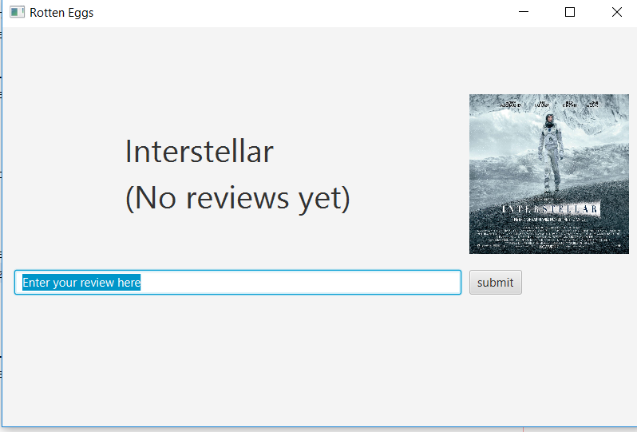
About the application
This is the interface of 'Rotten Eggs'. The front-end application is java based. The user can see the name of the movie, it's poster and can add reviews in the text box. All previous reviews of the movie can be viewed below the text box.

Slide 13
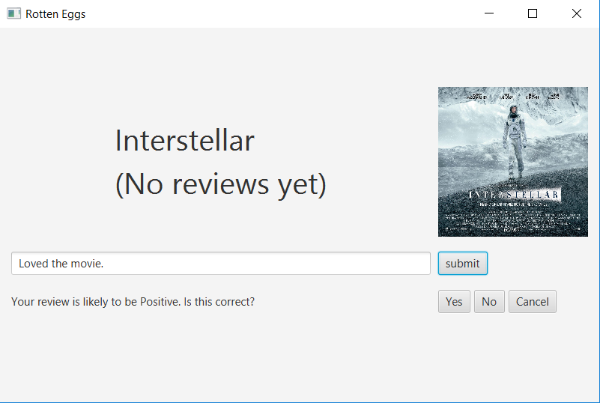
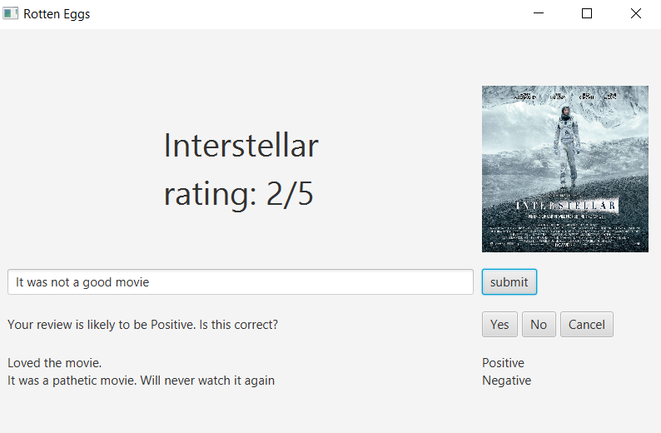
I added a review and clicked on submit. The classifier, which is based python working at the back-end classified the review as a positive one. The application gives an option to the user to correct the prediction if it's wrong
To test, I also added a negative review which was predicted correctly and was added to the review section which became the second review. Now, I added a new review and clicked on submit but this time it predicted it wrong. So, I have provided with a feature to correct this prediction manually by pressing on 'No'

Slide 14
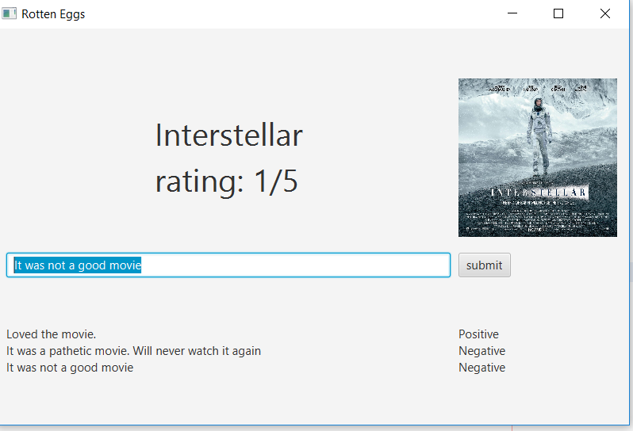
At this point, the classifier is retrained taking input of the new reviews/data that was entered. Hence, the application becomes more intelligent every time it's being used.

Slide 15
Result
In the end, the result was an application which uses Artificial Intelligence to make reviewing movies easier and effortless.
It helps in giving real-time reviews and is helpful for the movie industry as well.
This software makes calculating rating and categorizing reviews automated perhaps reducing labor.
This application collects movie reviews by the users (classified) which makes classifiers smarter and more powerful with time.

Slide 16
References
https://pythonprogramming.net/
https://www.youtube.com/watch?v=FLZvOKSCkxY&t=1s
http://www.cs.cornell.edu/people/pabo/movie-review-data/
https://www.youtube.com/watch?v=rISOsUaTrO4&t=5s

Slide 17
THANK YOU

