Slide 1
Stallion V2: with vs without the box
Flight simulation, updated with the CFD study's assumptions
Gazebo Harmonic + ArduPlane SITL · same flight for both: take off, hover, fly forward at about 20 m/s, land

Slide 2
What changed in the flight sim
The flight sim now uses the same assumptions as the CFD study
 | Before | Now
Mass with box | 2451 g | 2268 g (CFD)
Mass without box | 2301 g | 2228 g (CFD)
Box mass | 150 g (placeholder) | 40 g (CFD)
Drag (CD at 0°) | same for both | 0.0665 with box, 0.0583 without (CFD)
Simulated world | 2 aircraft: ran at half speed | 1 aircraft: full speed for both
Height measurement | autopilot estimate | GPS
The old weights came from a guessed plastic mass and a 150 g box. They are now matched to the CFD mass model.
Gazebo + ArduPlane SITL · assumptions from the CFD study (0.8 mm walls) | 1

Slide 3
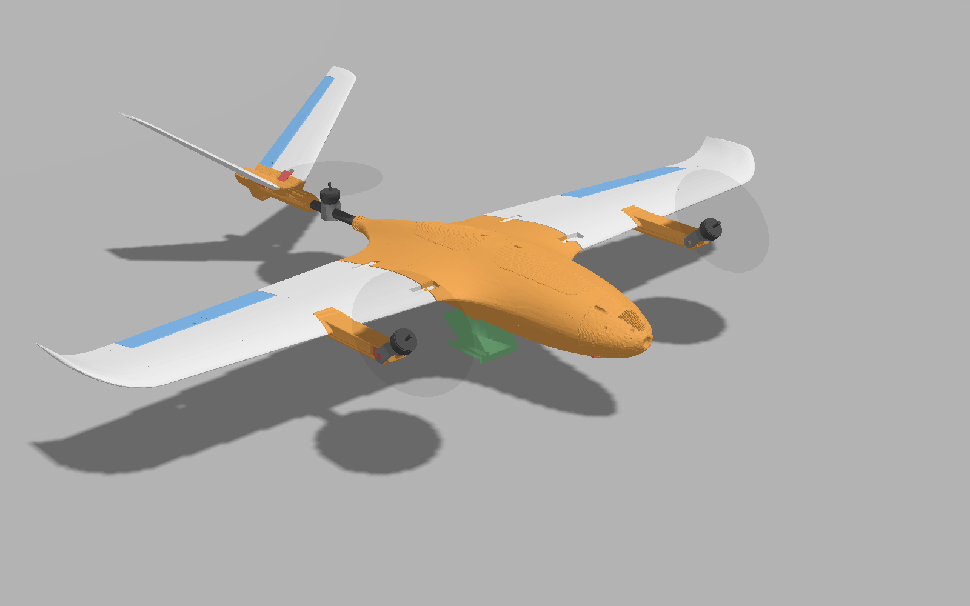
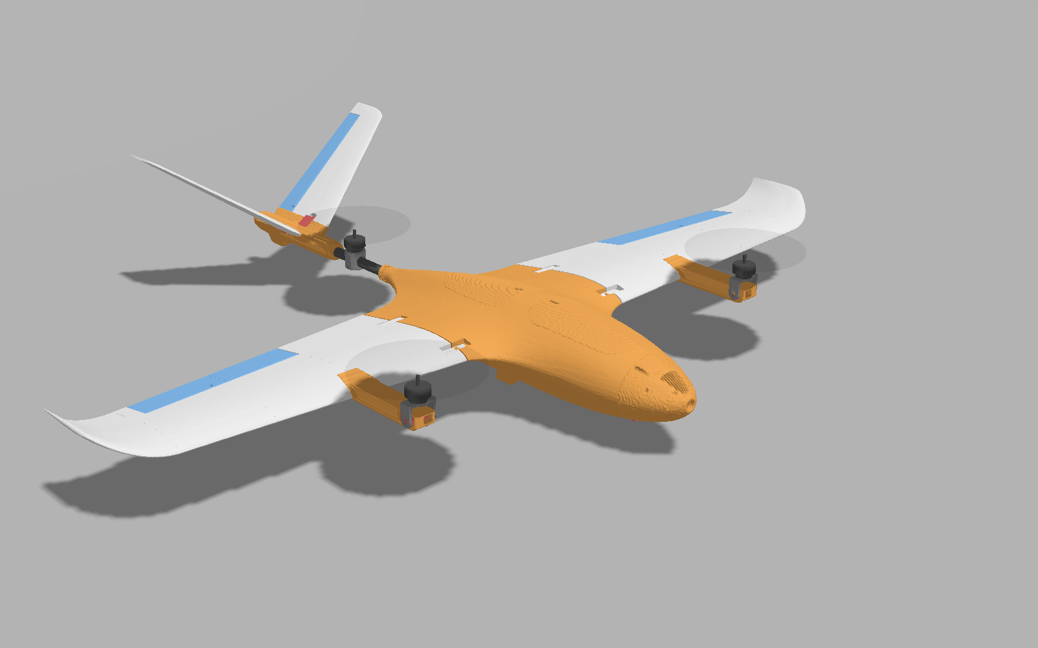
The two aircraft in Gazebo
The only difference is the box under the fuselage
With box
Without box
Gazebo + ArduPlane SITL · assumptions from the CFD study (0.8 mm walls) | 2

Slide 4
Results
One flight per version; cruise values are the second half of forward flight
 | With box | Without box
Forward flight and landing | pass | pass
Cruise airspeed (m/s) | 20.2 | 20.7
Cruise motor power (PWM, front motors) | 1807 | 1803
Hover motor power (PWM, average) | 1666 | 1661
Hover steadiness (tilt RMS, °) | 0.5 | 0.5
Rear motor share of hover thrust (CFD: 32.1%) | 30.8% | 31.3%
Climb rate (m/s) | 1.35 | 1.32
Time to reach 12 m/s (s) | 2.9 | 3.4
Gazebo + ArduPlane SITL · assumptions from the CFD study (0.8 mm walls) | 3

Slide 5
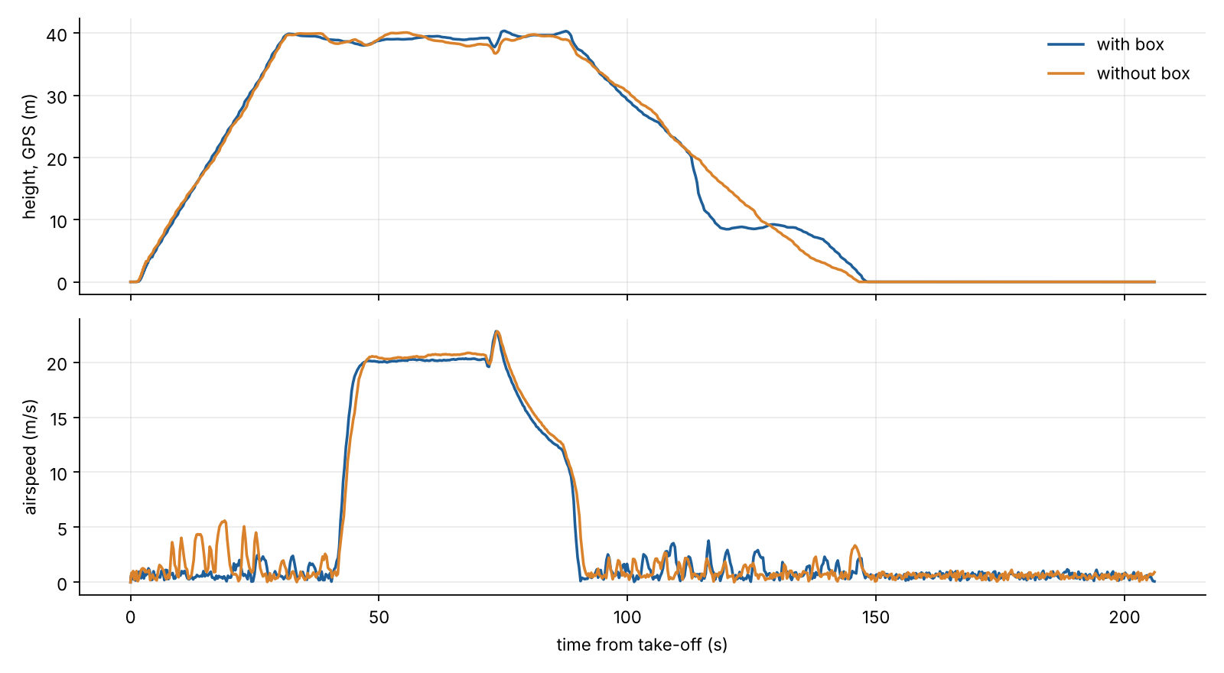
Height and airspeed through the flight
Climb, hover, forward flight (about 20 m/s), back to hover, landing
Gazebo + ArduPlane SITL · assumptions from the CFD study (0.8 mm walls) | 4

Slide 6
What it means
With the CFD weights, the box hardly changes how the aircraft flies. Hover, climb and handling are the same within the accuracy of one flight.
The box's drag shows in cruise: 20.2 m/s with the box against 20.7 m/s without, at the same motor power. This matches the CFD finding that the box's effect is drag, not weight.
Its 40 g needs only slightly more hover power (1666 against 1661 PWM).
The large differences in the earlier sim came from wrong weights (box 150 g instead of 40 g) and from a world that ran at half speed. Both are fixed.
Limits
One flight per version, so small differences (for example the time to reach 12 m/s) are within run-to-run noise.
Only the box's drag is in the flight sim. The CFD's change in pitch stability (static margin 7.0% with the box, 3.7% without) is not modelled.
Both versions swing about 18–20° while landing. That is a controller issue and has nothing to do with the box.
Gazebo + ArduPlane SITL · assumptions from the CFD study (0.8 mm walls) | 5

