Slide 1
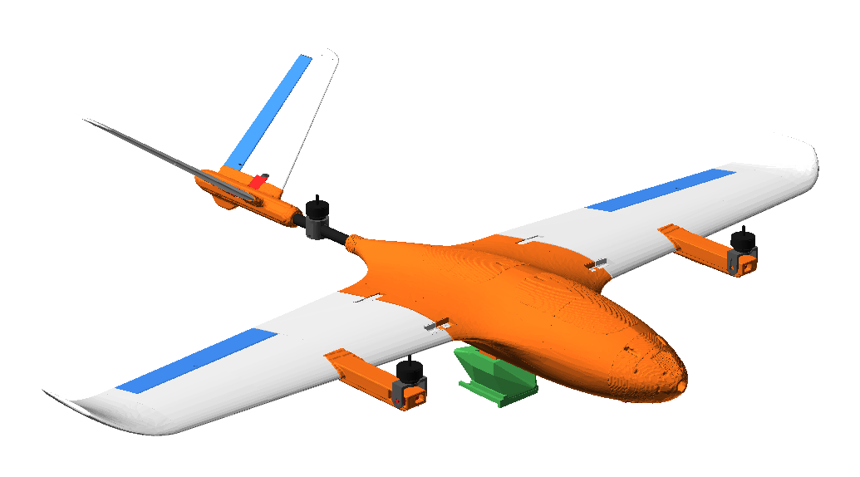
Stallion V2 VTOL: simulation results
Hover, transition to forward flight, and landing in Gazebo Harmonic with ArduPlane SITL

Slide 2
Hover and transition flights pass
PASS
PASS
20.8 m/s
7.9°
Hover
Transition
Max ground speed
Max tilt, forward flight
Max tilt 1.6° climb, 0.5° hold
Min alt 15.6 m in forward flight
Forward flight, FBWB
Settles within 2° after 17.5 s
Transition run: hover climb, transition, cruise, back-transition, and QLAND all completed; the aircraft reached the ground at the end
Hover run: QLAND was not finished inside the 15 s test window (see Convergence)

Slide 3
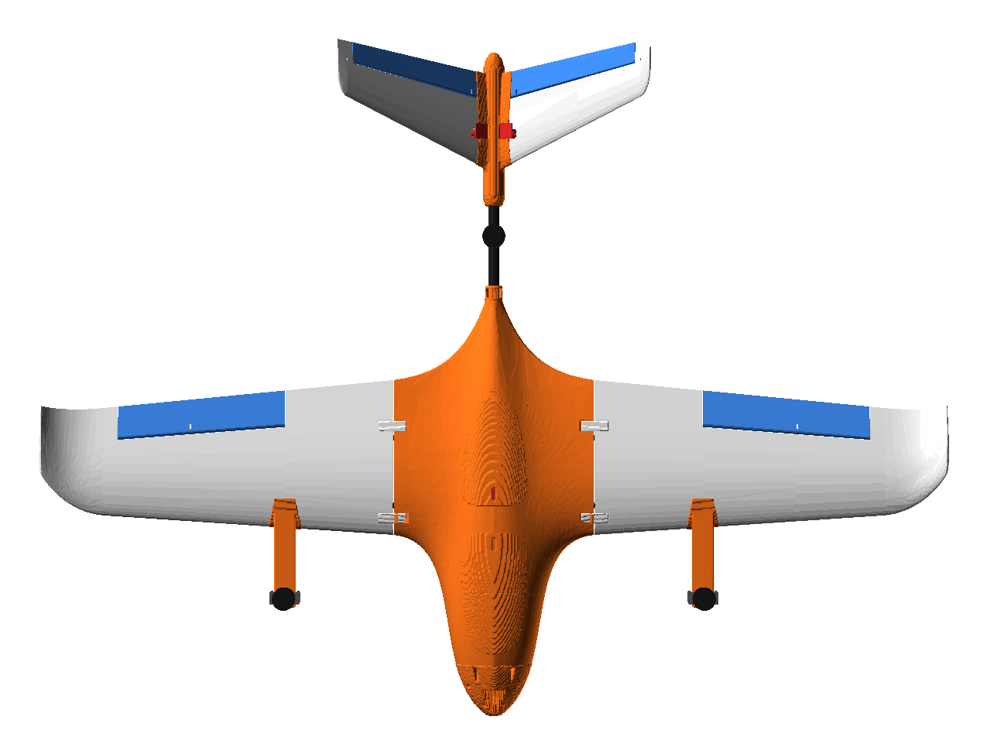
The model is built from the V2 CAD
Source: stallion_v2_equipped_with_pod.glb, 96 parts, converted to Gazebo axes (x forward, z up)
28 of 96 parts had mesh defects (holes, non-manifold edges, duplicate faces). All 96 pass after repair
Collision: one closed skin, 8,688 faces, shrink-wrapped from the CAD
Moving parts from CAD: 2 tilting motor mounts, 3 motors, 4 control surfaces, rear yaw mount
Centre of gravity placed at the manual's 60 mm aft of the wing-root leading edge

Slide 4
What changed in the simulation
Area | Change
Tilt limit | Q_TILT_MAX 90 → 45
V-tail servos | SERVO7/8 set to V-tail left/right (79/80), was elevator/rudder (19/21)
Control surfaces | Ailerons, V-tail ruddervators added as joints with lift surfaces
Propulsion | Prop model calibrated to a 17 N static thrust per motor; motor joint damping reduced
Drag | Parasite drag added from the 5.4 dm² frontal area
Hover throttle | Q_M_THST_HOVER 0.42 → 0.55

Slide 5
Hover: tilt stays under 2° until QLAND
Climb (0–9.5 s): max tilt 1.6°
Hold at 3.6–4.3 m (10–20 s): max tilt 0.5°
QLAND (20.6–35.2 s): tilt rises to 10.9°, ends at 4.6°. Not settled within the 15 s window

Slide 6
Transition: tilt settles after each phase
Hover 0–40 s · forward flight 40–70 s · back-transition 71–86 s · QLAND 86–206 s

Slide 7
Convergence by phase
Phase | Run | Max tilt | Final tilt | Within 2° after
Climb | Hover | 1.6° | 0.5° | Within 2° throughout
Hold | Hover | 0.5° | 0.1° | Within 2° throughout
QLAND | Hover | 10.9° | 4.6° | Not reached in 15 s
Forward flight | Transition | 7.9° | 2.6° | 17.5 s
Back-transition | Transition | 6.6° | 0.2° | 7.1 s
QLAND | Transition | 16.3° | 1.9° | 87.1 s
Within 2° after: the time from the phase start until |roll| and |pitch| both stay at or below 2° for 2 s. Tilt is the larger of |roll| and |pitch|.

Slide 8
Sim model: isometric and top

Slide 9
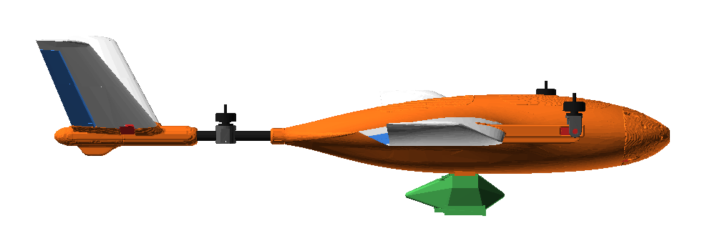
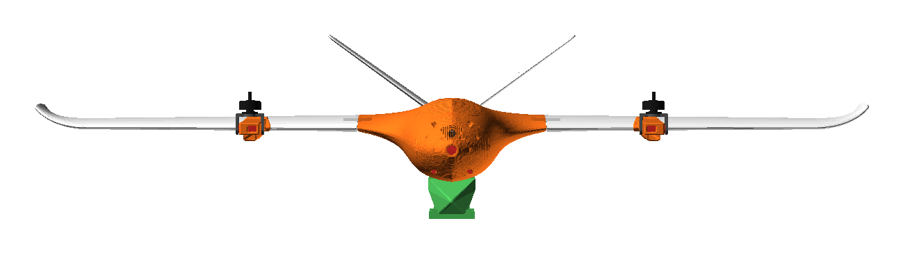
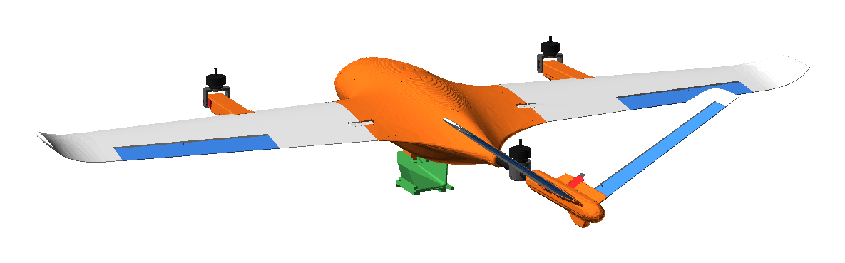
Sim model: side, front and rear

Slide 10
Open items
1
Hover landing
QLAND in the hover run reached 10.9° and did not settle within the 15 s window. Needs a longer landing check.
2
Hover gains
Tilt in QLAND reaches 16° after transition, so the low-speed gains need tuning.
3
Real aircraft params
stallion_matek_h743.parm still has Q_TILT_MAX 90 and SERVO7/8 = 19/21. Review before flying the real aircraft.

