Slide 1
Stallion V2 flight dynamics
With and without the vial pod
Gazebo Harmonic + ArduPlane SITL, automated hover and transition flights

Slide 2
Without the pod: 150 g lighter, and the flight changes
Both versions pass hover and forward flight and land after the transition
150 g
7.4 m
2.4 s
20°
Lighter without the pod: 2451 g → 2301 g
Hold altitude without pod, same throttle (with pod: 4.5 m)
Time to 12 m/s without pod (with pod: 11.3 s)
Largest roll or pitch during QLAND, either version: the descent does not settle
Hover: both versions hold altitude with similar attitude (roll and pitch RMS under 0.7°). The lighter airframe climbs higher at the same throttle.
Forward flight: both reach about 20 m/s steady ground speed. The without-pod airframe moves its altitude about 6 m (std) against 0.3 m with the pod.
Landing: both versions oscillate by about ±15–20° during QLAND. The landing controller is not tuned for these airframes.
Simulation: Gazebo Harmonic + ArduPlane SITL, 10 Hz logs | 2

Slide 3
What was tested, and what changed between the two versions
Same for both
Gazebo world, ArduPlane parameters, flight script and throttle profile
Hover test: climb 10 s at 1700, hold 10 s at 1500, QLAND
Transition test: climb 30 s at 1800, FBWB forward flight 30 s, QHOVER, QLAND
Chennai home position, 10 Hz flight logs
Changed without the pod
Mass 2451 g → 2301 g
Inertia and CG recomputed from the CAD
Pod visuals and pod collision removed
Not changed: drag, which is one fixed value for both (the pod is not modelled separately)
Simulation: Gazebo Harmonic + ArduPlane SITL, 10 Hz logs | 3

Slide 4
Mass and inertia: the pod is 150 g, CG barely moves
Estimate from the CAD. The printed airframe mass (1.0 kg) is assumed, not weighed.
Property | With pod | Without pod | Change
All-up mass (g) | 2451 | 2301 | −150
CG aft of wing-root LE | 60.0 mm | 59.7 mm | -0.3 mm
CG height (m) | 0.0605 | 0.0672 | +6.7 mm
CG lateral offset (y) | 6.3 mm | 6.7 mm | 0.4 mm
Roll inertia Ixx (kg·m²) | 0.1002 | 0.0984 | -0.0018
Pitch inertia Iyy (kg·m²) | 0.1188 | 0.1169 | -0.0020
Yaw inertia Izz (kg·m²) | 0.2101 | 0.2099 | -0.0003
Simulation: Gazebo Harmonic + ArduPlane SITL, 10 Hz logs | 4

Slide 5
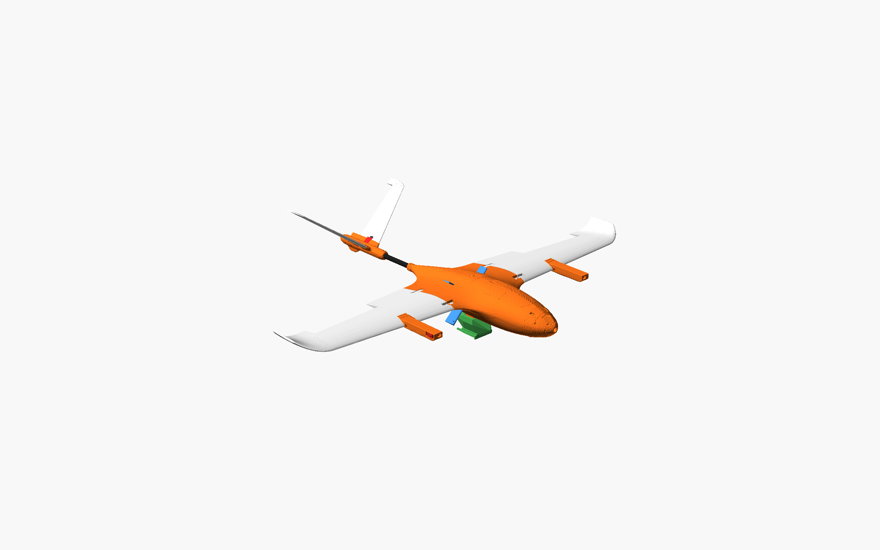
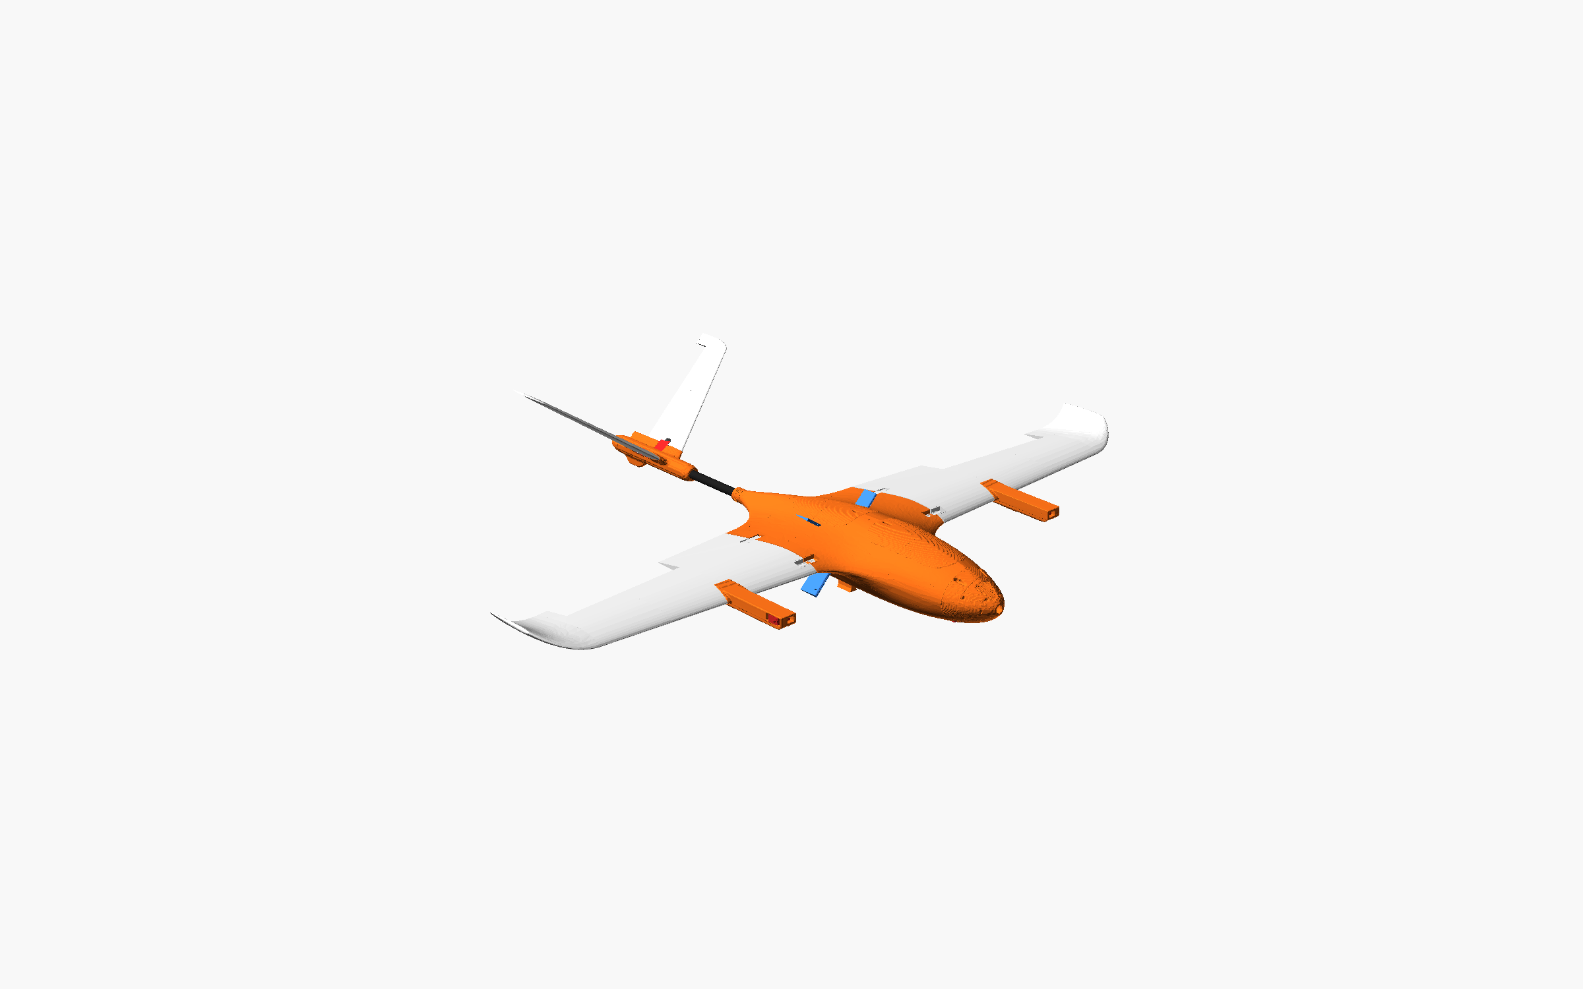
The model: the same airframe with and without the pod
With pod
Without pod
The pod (green) sits under the fuselage. Removing it takes out the pod's visual and collision mesh and 150 g of mass.
Simulation: Gazebo Harmonic + ArduPlane SITL, 10 Hz logs | 5

Slide 6
Hover: the lighter airframe climbs higher and holds with similar attitude
Hover test | With pod | Without pod
Altitude at end of climb (m) | 3.76 | 6.53
Peak climb rate (m/s) | 1.23 | 1.32
Hold altitude, mean (m) | 4.52 | 7.42
Hold altitude, std (m) | 0.19 | 0.17
Hold roll RMS (°) | 0.31 | 0.49
Hold pitch RMS (°) | 0.49 | 0.67
Hold max attitude, roll or pitch (°) | 1.09 | 1.50
Simulation: Gazebo Harmonic + ArduPlane SITL, 10 Hz logs | 6

Slide 7
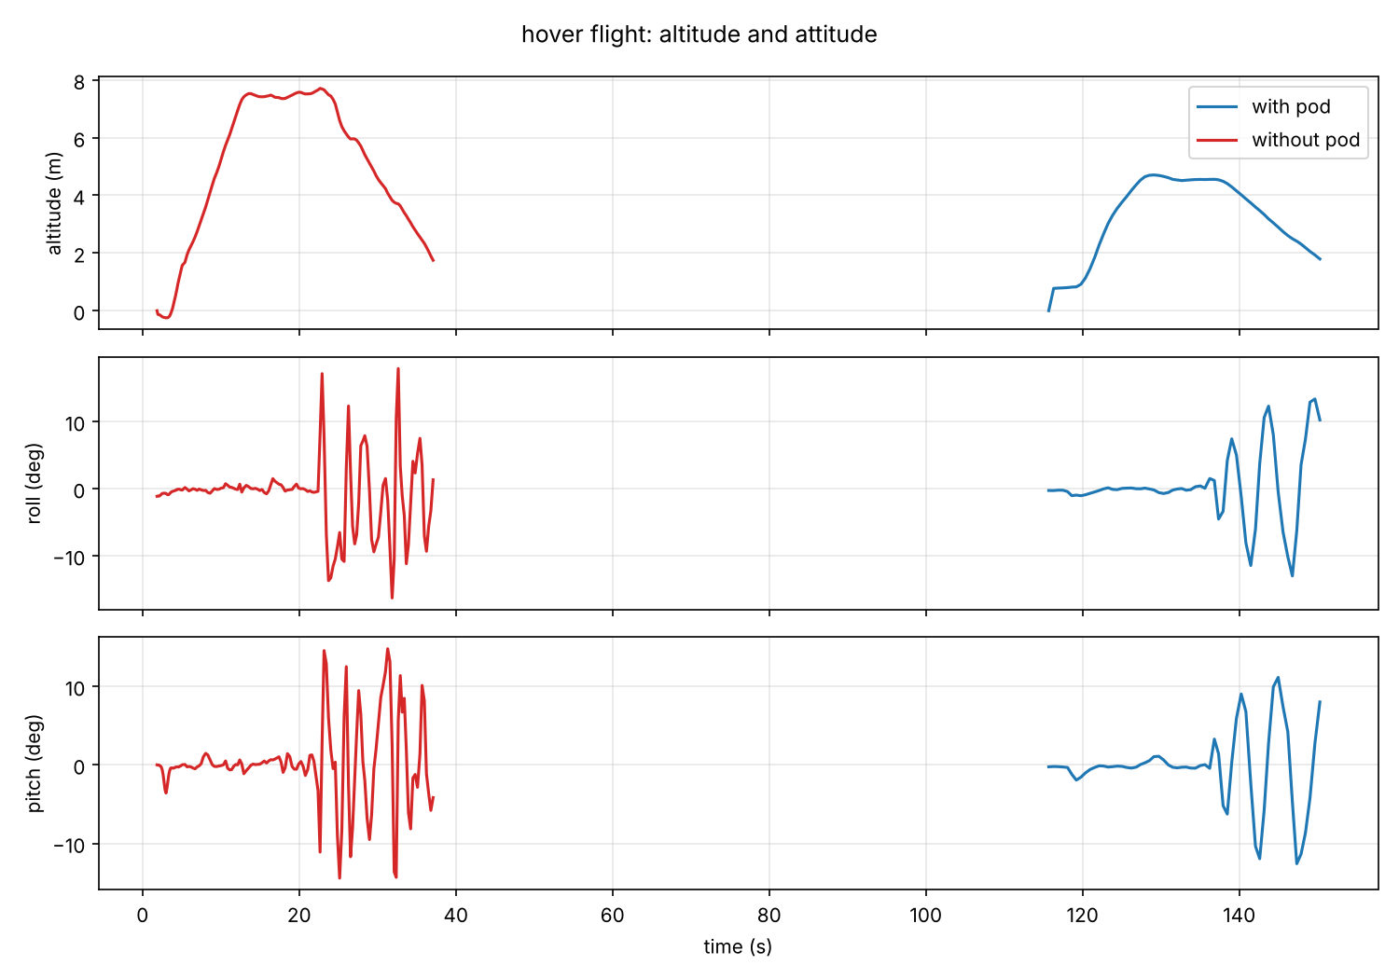
Hover flight: altitude and attitude over the full test
Simulation: Gazebo Harmonic + ArduPlane SITL, 10 Hz logs | 7

Slide 8
Forward flight: both reach about 20 m/s
FBWB, 30 s. Steady values use the second half of the phase. The lighter airframe reaches 12 m/s sooner.
Forward flight | With pod | Without pod
Time to 12 m/s (s) | 11.3 | 2.4
Ground speed, steady mean (m/s) | 20.5 | 19.8
Ground speed, max (m/s) | 20.8 | 21.8
Airspeed, steady mean (m/s) | 20.5 | 19.9
Altitude, steady mean (m) | 18.2 | 36.1
Altitude, steady std (m) | 0.29 | 5.87
Roll RMS, steady (°) | 0.50 | 0.17
Pitch RMS, steady (°) | 1.63 | 4.06
Max |pitch| over the phase (°) | 4.2 | 8.7
Simulation: Gazebo Harmonic + ArduPlane SITL, 10 Hz logs | 8

Slide 9
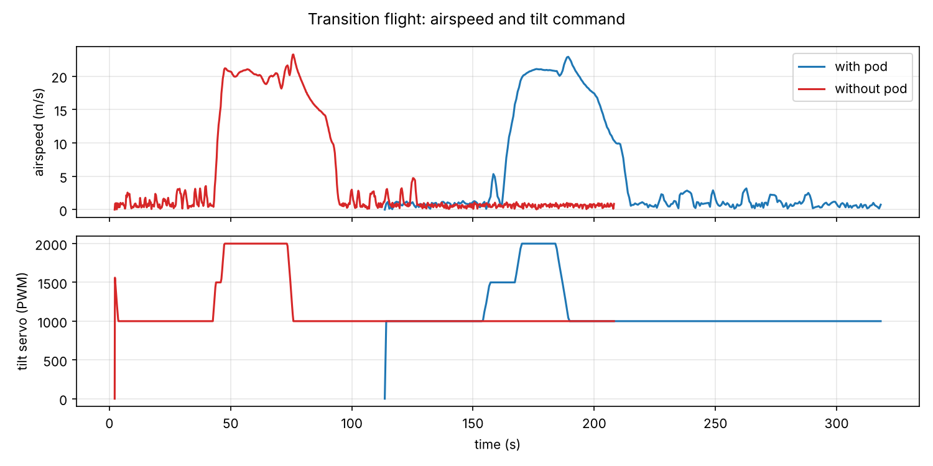
Transition: airspeed and tilt command
Simulation: Gazebo Harmonic + ArduPlane SITL, 10 Hz logs | 9

Slide 10
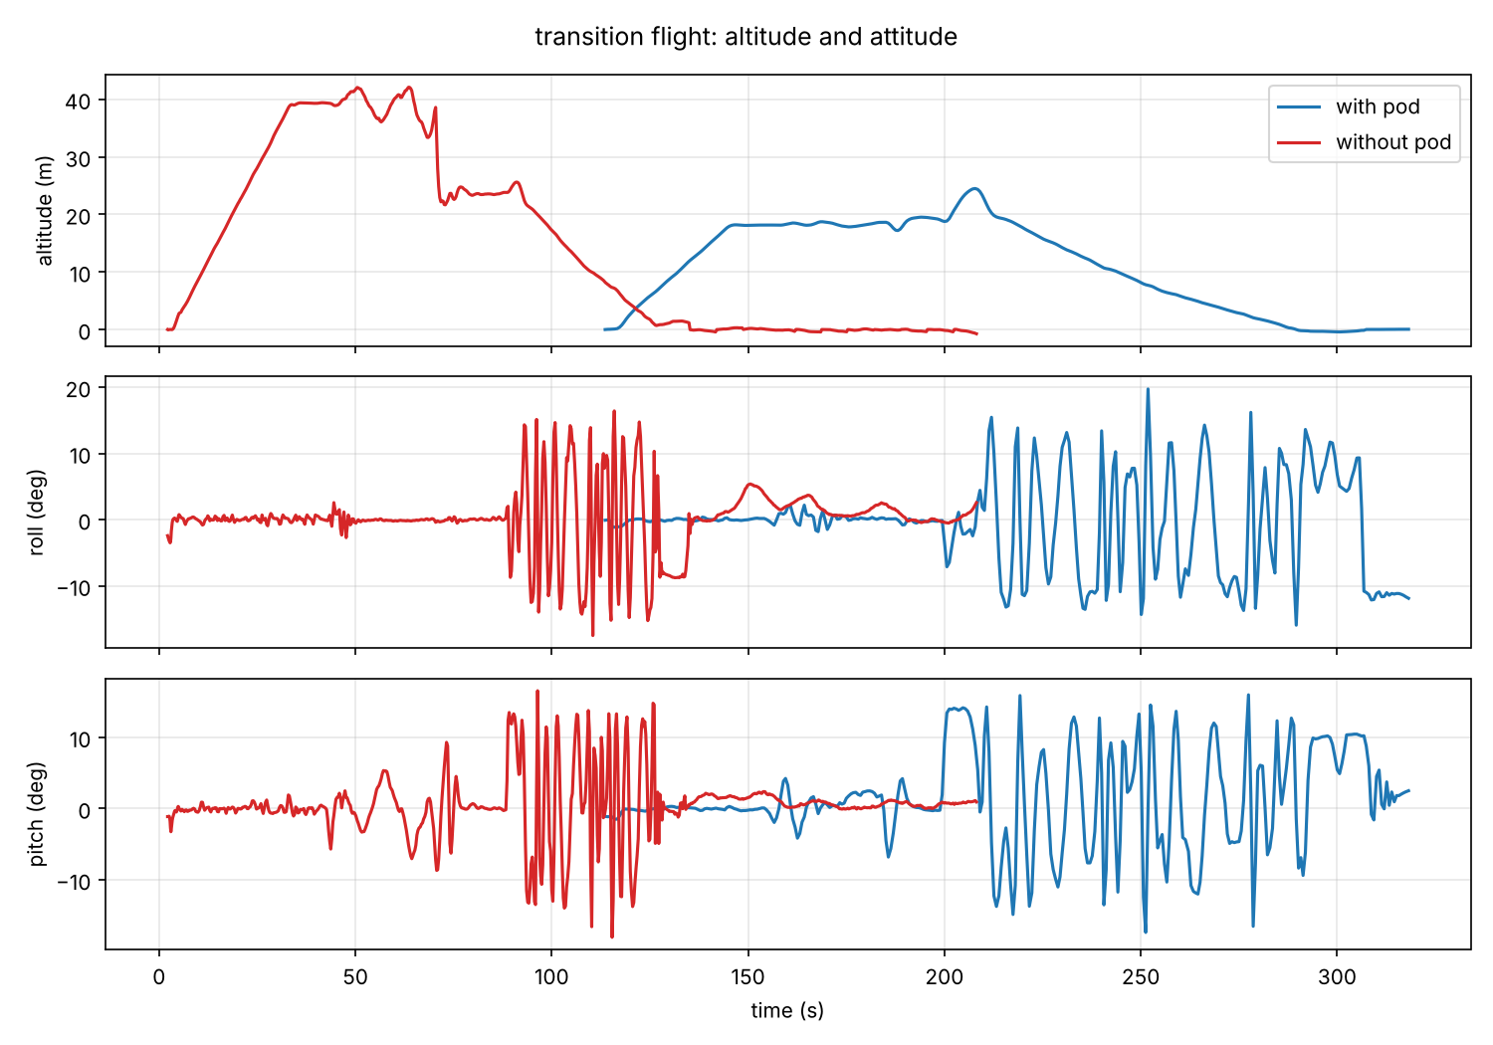
Transition flight: altitude and attitude over the full test
Simulation: Gazebo Harmonic + ArduPlane SITL, 10 Hz logs | 10

Slide 11
Back to hover and landing: both oscillate, and neither settles
Back transition and QLAND (transition test) | With pod | Without pod
Back transition: pitch RMS (°) | 2.54 | 2.35
Back transition: time to settle within 2° (s) | 6.5 | 3.2
QLAND: touchdown below 0.5 m (s after QLAND) | 88.2 | 46.9
QLAND: mean descent rate (m/s) | 0.21 | 0.50
QLAND: max descent rate (m/s) | 1.43 | 2.33
QLAND: max |roll| (°) | 19.7 | 17.5
QLAND: max |pitch| (°) | 17.4 | 18.1
Simulation: Gazebo Harmonic + ArduPlane SITL, 10 Hz logs | 11

Slide 12
Control effort in hover: motor and tilt commands
PWM values, hold phase; the spread (std) is how much the controller is working
Hold phase | With pod | Without pod
Motors mean, front-right / front-left / rear (PWM) | 1697 / 1719 / 1673 | 1685 / 1700 / 1666
Motors std, front-right / front-left / rear (PWM) | 15 / 16 / 15 | 14 / 14 / 24
Tilt servo mean (PWM, 1000 = hover) | 1000 | 1000
Aileron std (PWM) | 0.7 | 8.3
V-tail std (PWM) | 1.7 | 6.6
Simulation: Gazebo Harmonic + ArduPlane SITL, 10 Hz logs | 12

Slide 13
What the differences mean
The 150 g change is the main difference. Both get the same throttle, so the lighter airframe has more thrust-to-weight. That is why it climbs higher on the same throttle and reaches forward speed sooner.
The CG barely moves (under 1 mm), so the pod is not a balance problem. Without it the mass falls about 6% and pitch and roll inertia fall about 2%.
Hover attitude is similar in both. The without-pod airframe moves more in pitch in hover and forward flight, and its ailerons work much harder in hover (8.3 PWM std against 0.7).
The landing oscillation affects both versions in the same way. It is a tuning problem, not a pod problem.
Simulation: Gazebo Harmonic + ArduPlane SITL, 10 Hz logs | 13

Slide 14
Caveats and open items
Each variant was flown once per test. Repeat runs of the with-pod hover already varied by about 3° in peak tilt, so differences below that are not meaningful.
Printed airframe mass (1.0 kg) is assumed, not weighed. The 150 g pod mass (2 × 75 g) is also an estimate.
Drag is one fixed value for both versions. The model does not reduce drag when the pod is removed, so the real without-pod airframe is probably a little faster than shown.
Aerodynamic and propeller coefficients come from the manual and an estimate, not from wind-tunnel or flight data.
Next: re-tune the landing gains, repeat each test 3 times, and weigh the printed parts to firm up the mass.
Simulation: Gazebo Harmonic + ArduPlane SITL, 10 Hz logs | 14

