Slide 1
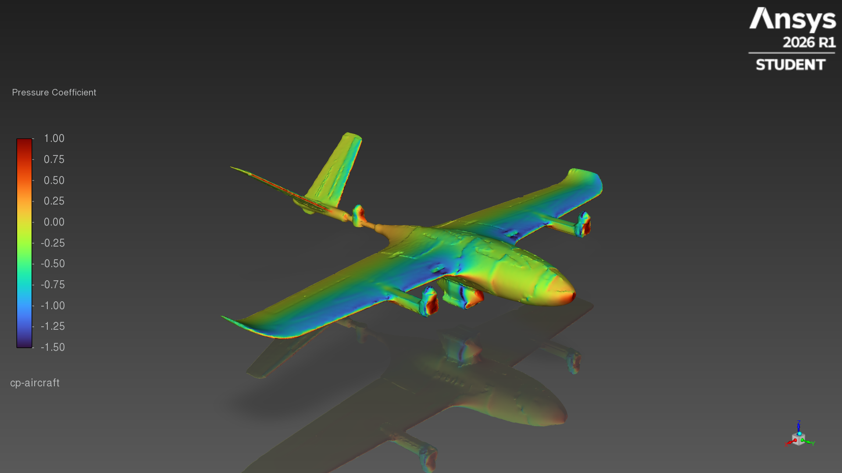
Stallion VTOL · payload pod
External aero CFD
20 m/s · angle of attack 0, 4, 8°
Ansys Fluent 2026 R1 Student · steady RANS, k-ω SST
Notes:
CFD of the Stallion VTOL equipped with the payload pod, built from stallion_v2_equipped_with_pod.glb.

Slide 2
Results
Whole aircraft at 20 m/s, sea-level air (ρ 1.225 kg/m³)
AoA | CL | CD | Cm | L/D | Lift (N) | Drag (N) | Iterations | Status
0° | 0.310 | 0.0665 | 0.010 | 4.66 | 16.8 | 3.59 | 150 | converged
4° | 0.697 | 0.0867 | -0.047 | 8.04 | 37.7 | 4.69 | 150 | converged
8° | 0.911 | 0.1424 | -0.135 | 6.40 | 49.3 | 7.70 | 600 | not converged (mean of last 200 it.)
8.0
37.7 N
4.69 N
best L/D (at 4°)
lift at 4°
drag at 4°
Reference area 0.22068 m², reference length 0.16409 m, moment centre [0.0, -0.27655, 0.07831] m (wing quarter chord). Cm positive nose-up.
Notes:
Forces integrated over the whole aircraft surface. 8° did not meet the convergence criterion within 600 iterations; its row is the mean of the last 200 iterations.

Slide 3
Coefficients vs angle of attack
Whole aircraft, 20 m/s
8° value is the mean of the last 200 iterations (not converged within 600).
Notes:
Lift, drag and lift-to-drag ratio against angle of attack.

Slide 4
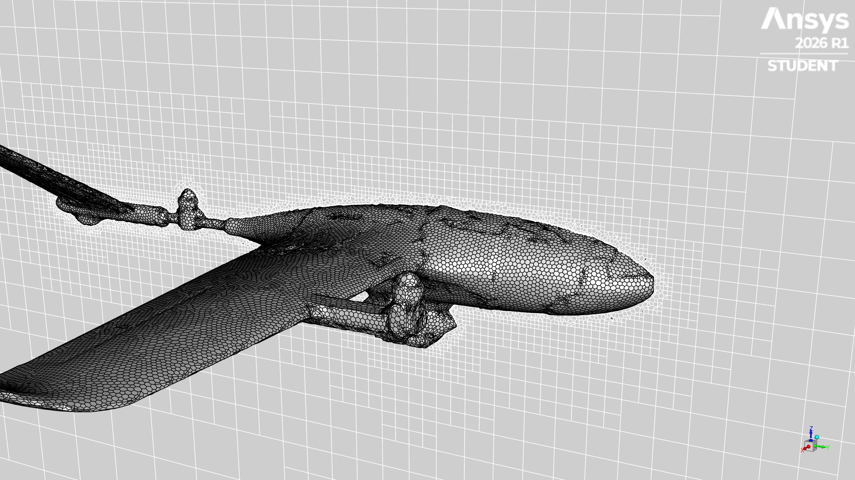
Geometry preparation
stallion_v2_equipped_with_pod.glb → watertight skin
 | Input GLB | Wrapped skin
CAD parts | 96 | 1 body
Separate bodies | 250 | 1
Non-manifold edges | 2,397 | 0
Facets | 691,670 | 298,872
Fuselage interior | hollow (open hatches) | solid
Max bounding-box change |  | 2.3 mm
Wrapped skin with the surface mesh, and the centre-plane volume mesh
Steps: merge the 96 parts and rotate to the solver frame (nose +Y, up +Z) → voxel shrink-wrap at 1.5 mm with openings up to 24 mm sealed → decimate → check: closed, manifold, and a ray test finds no air inside the fuselage.
Notes:
The GLB could not be meshed as delivered, so it was repaired and shrink-wrapped into one watertight outer skin before meshing.

Slide 5
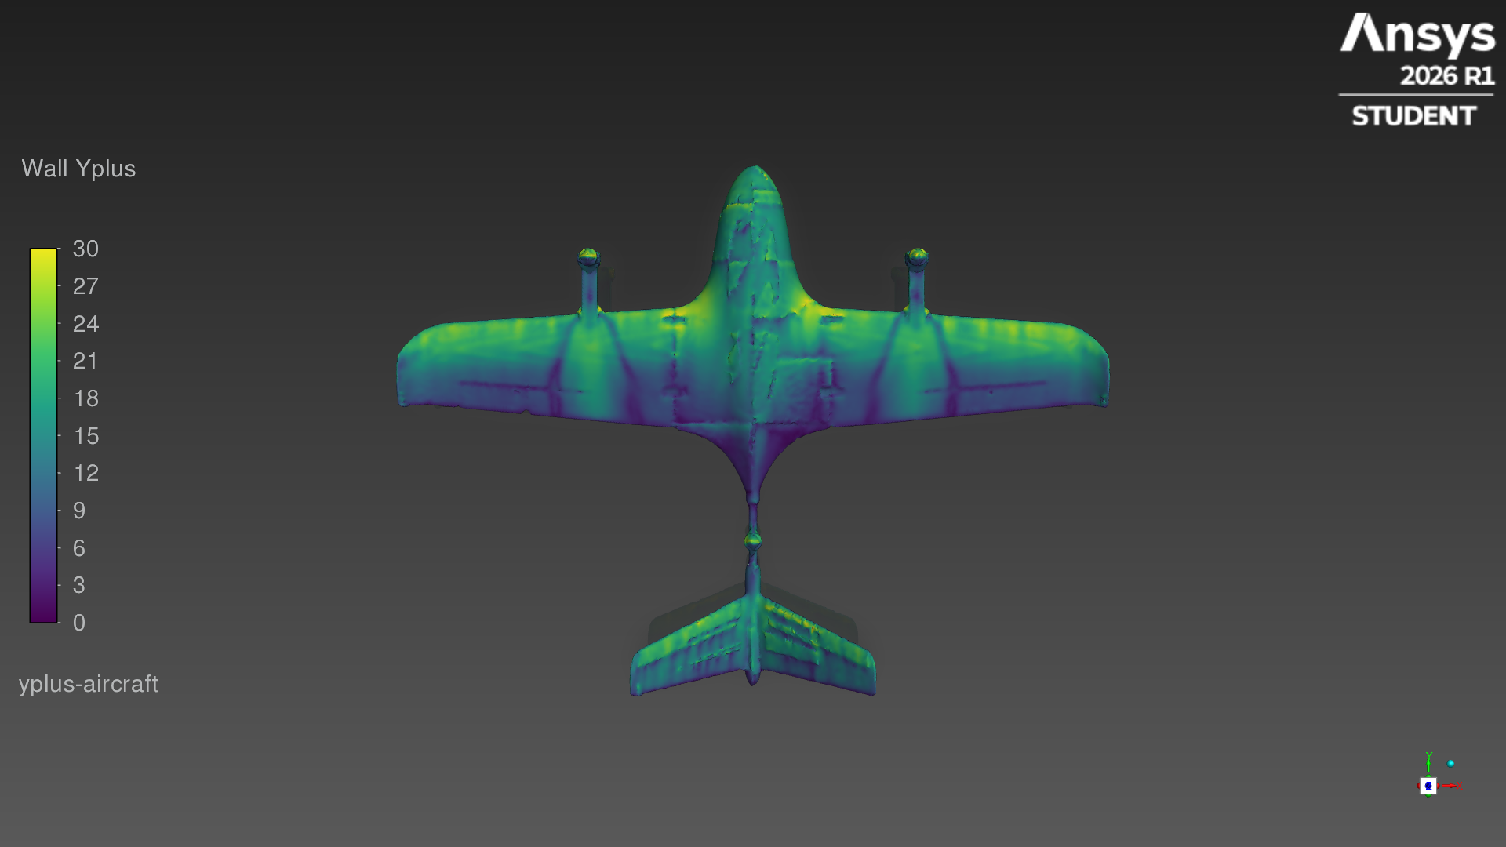
Mesh and solver setup
Mesh
poly-hexcore, 561,669 cells; 3 prism layers, first cell 0.5 mm; surface 5.5–26 mm
Domain
box 4 m upstream, 8 m downstream, 4 m sides, 4 m top/bottom
Boundaries
velocity inlet on 5 faces, pressure outlet behind; aircraft = no-slip wall
Flow
20 m/s, ρ 1.225 kg/m³, μ 1.7894e-05 Pa·s, turbulence intensity 1%
Model
steady, pressure-based coupled solver, k-ω SST
Wall y+ on the aircraft surface (4°)
Angles
0, 4, 8°, set by tilting the free-stream direction; same mesh for every angle
Notes:
Mesh and solver settings used for all three angles.

Slide 6
Convergence by angle
Criterion: CL and CD change < 0.2% per 50 iterations (150 min, 600 max)
AoA | Iterations | Status | CL spread, last 50 it. | CD spread, last 50 it. | Reported value
0° | 150 | converged | 0.05% | 0.10% | final iteration
4° | 150 | converged | 0.02% | 0.04% | final iteration
8° | 600 | not converged | 9.15% | 8.01% | mean of last 200 iterations
Spread = (max − min) / mean of the force coefficient over the last 50 iterations.
0° and 4° met the criterion at the minimum iteration count. At 8° CL and CD kept oscillating by several percent up to the 600-iteration limit; the reported 8° numbers are the average of the last 200 iterations.
Each angle was started from the previous angle's solution (0° → 4° → 8°).
Notes:
Convergence criterion: CL and CD each change by less than 0.2% over a 50-iteration block, with 150–600 iterations per angle.

Slide 7
Convergence histories
Notes:
Force-coefficient histories for every iteration of the run, and Fluent's scaled residuals.

Slide 8
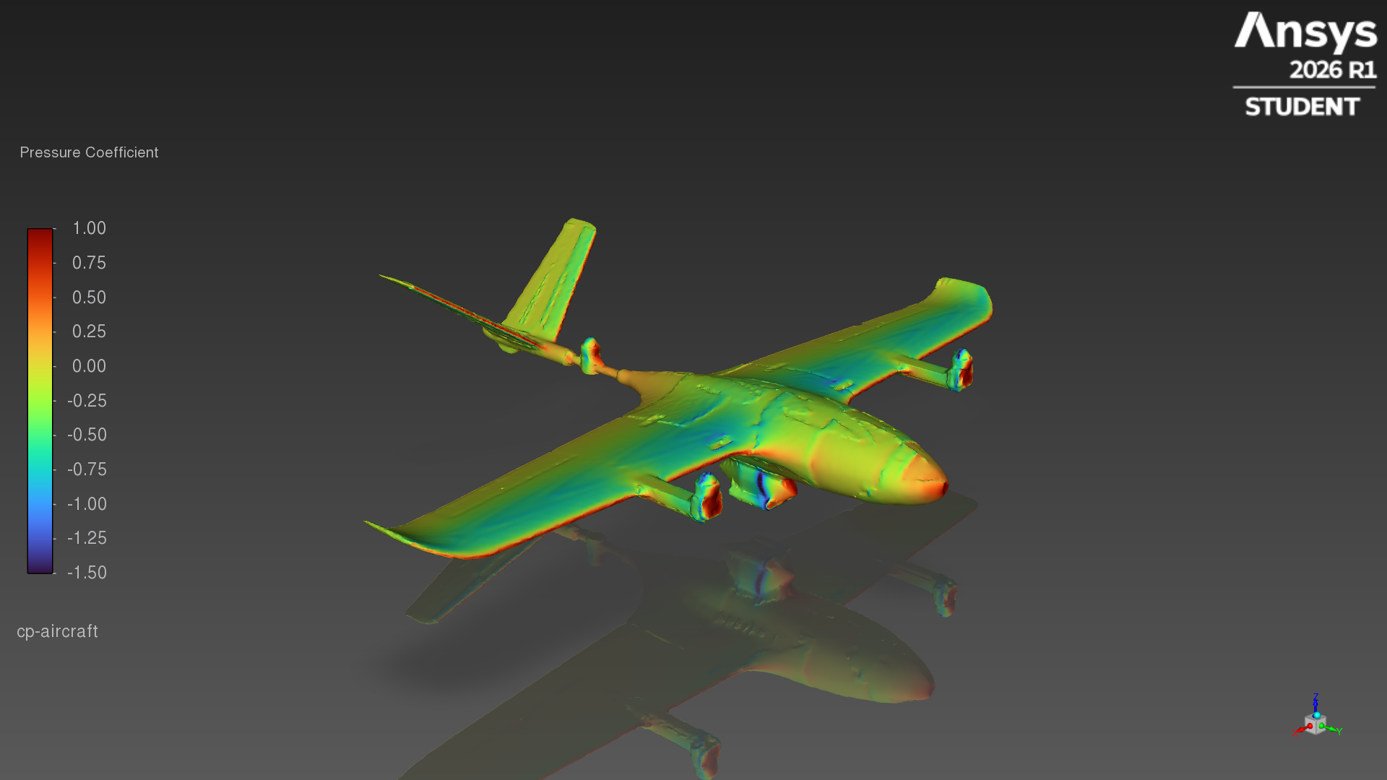
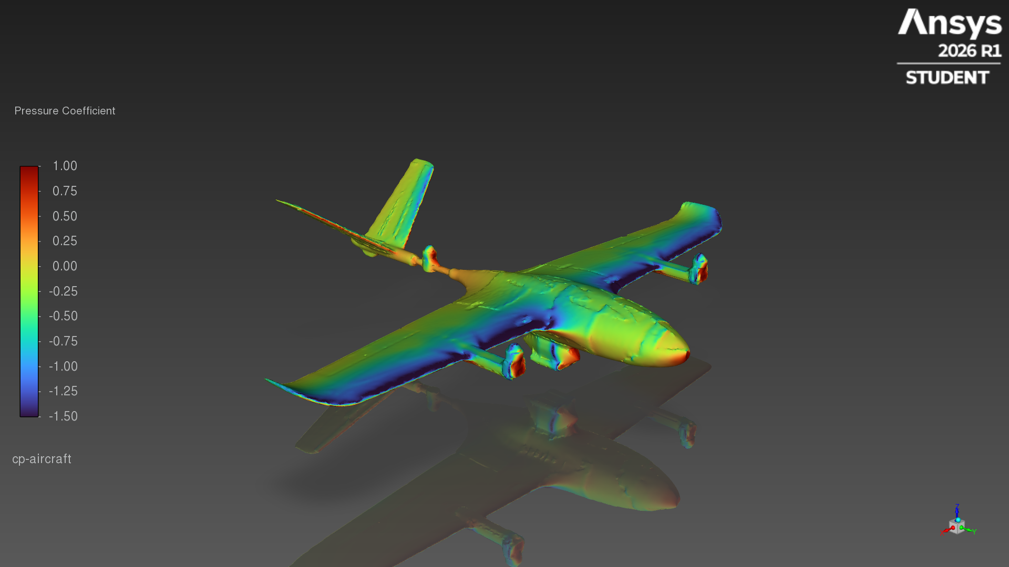
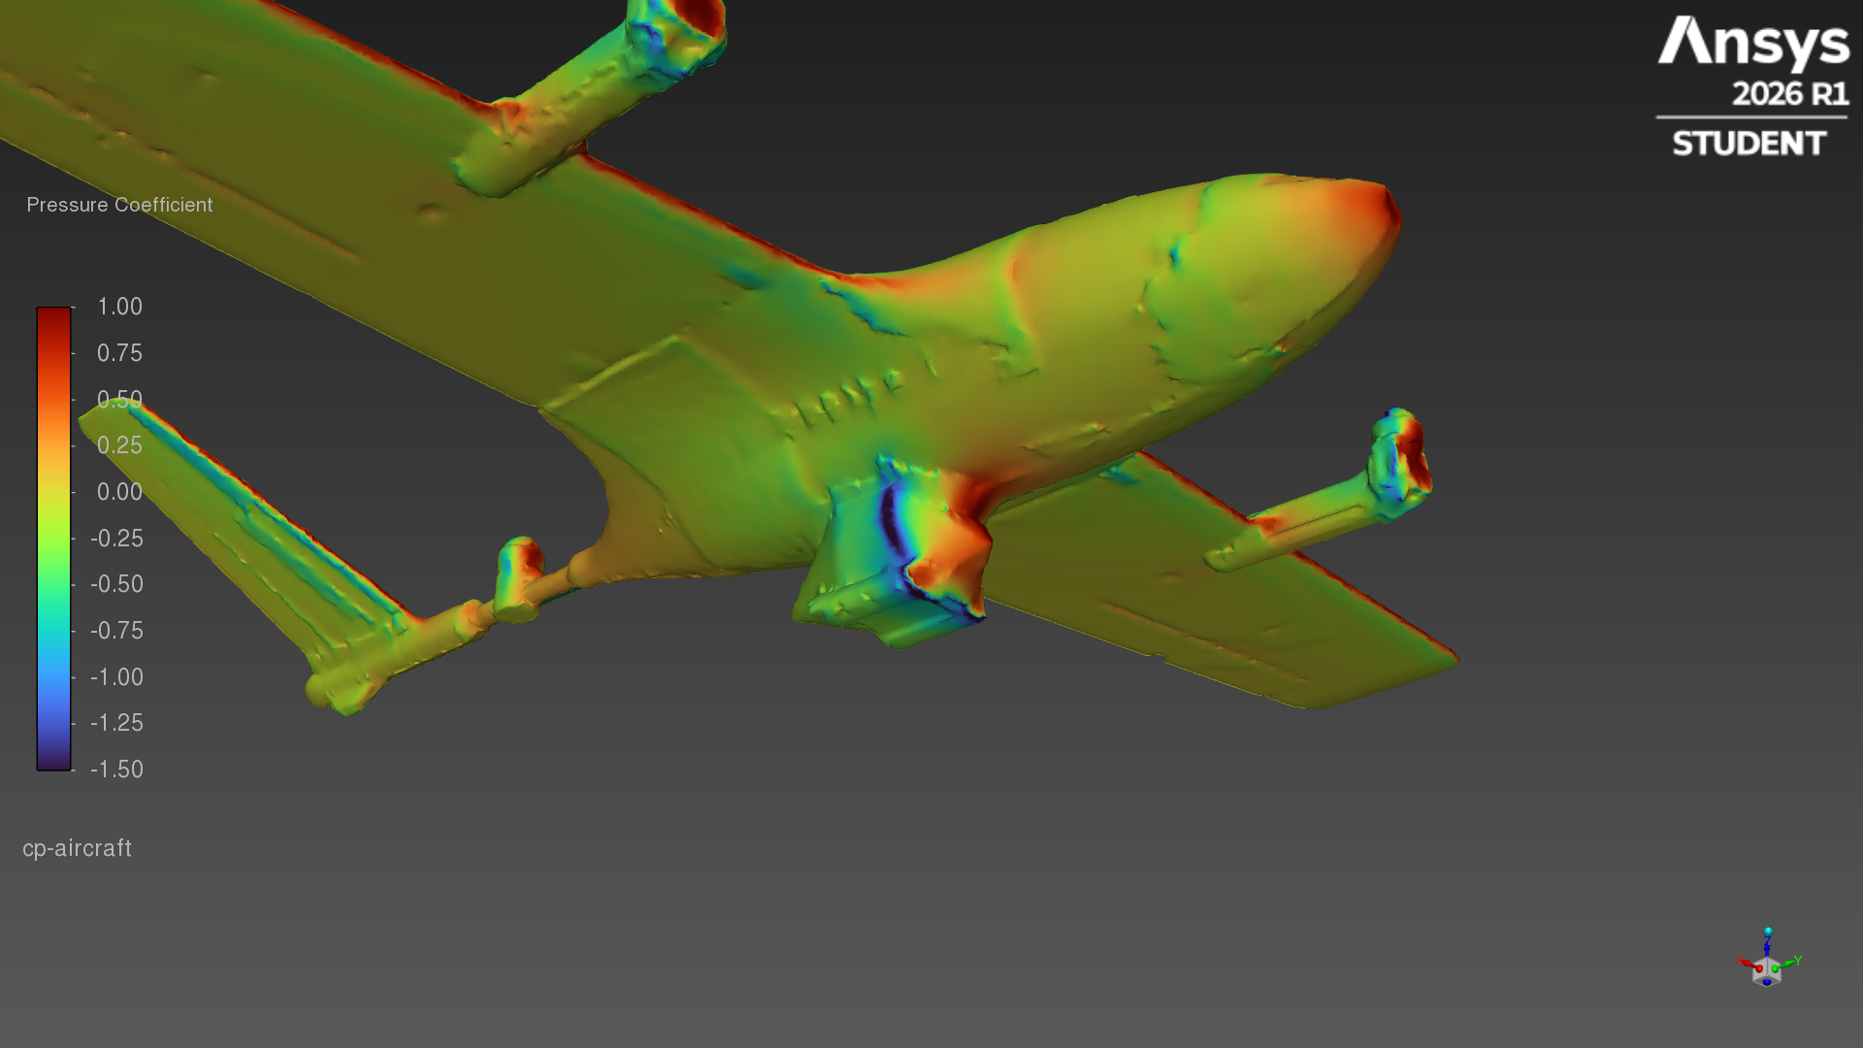
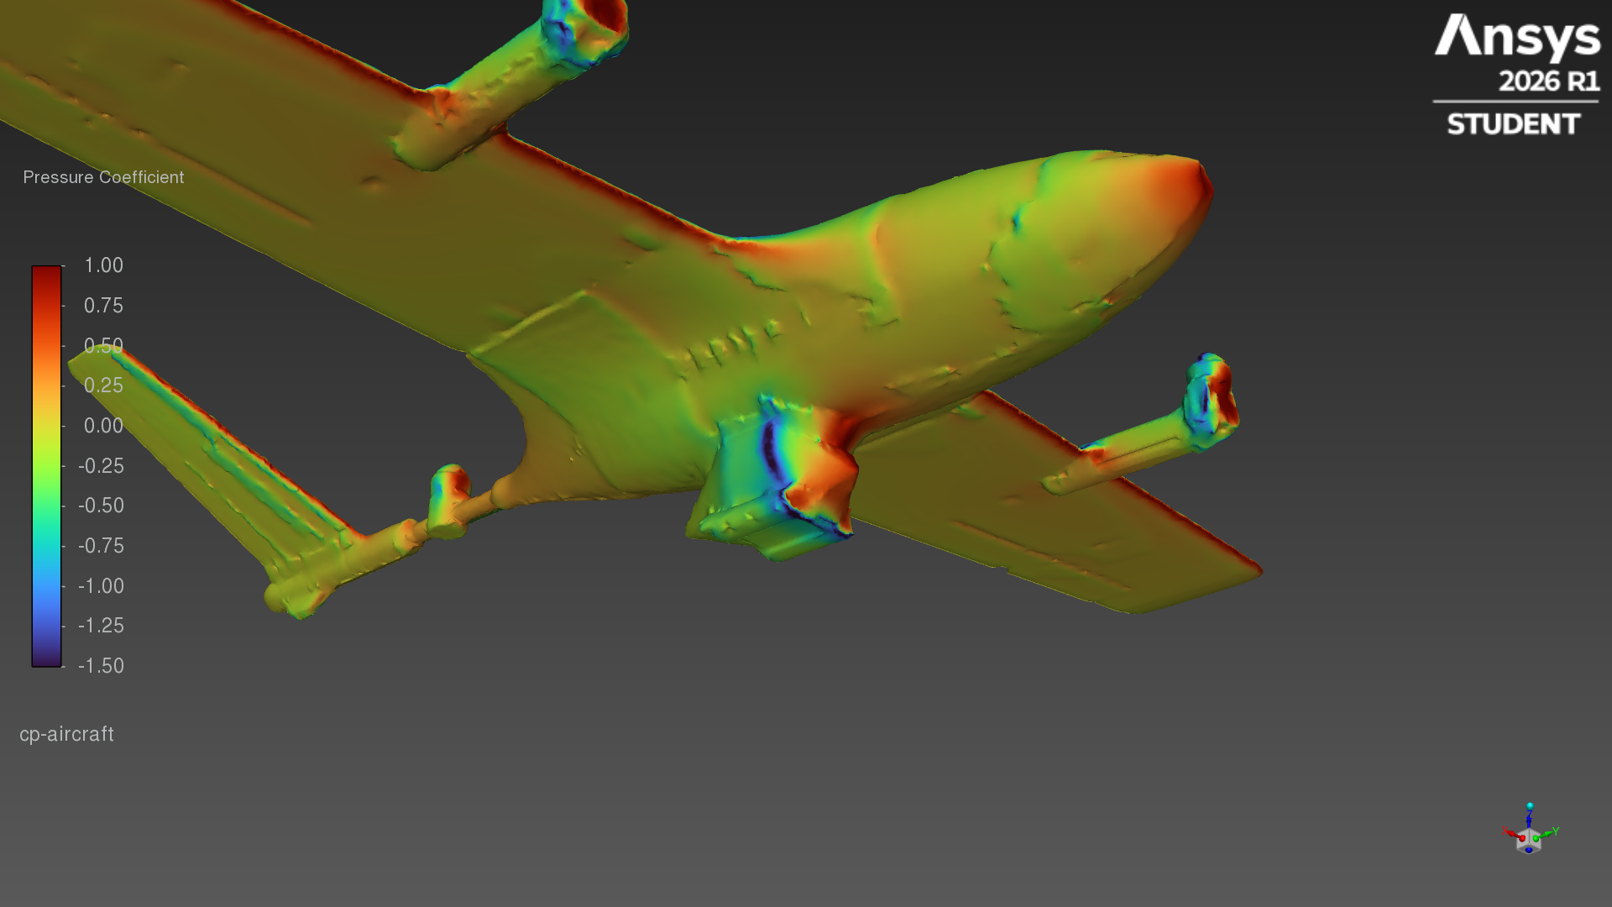
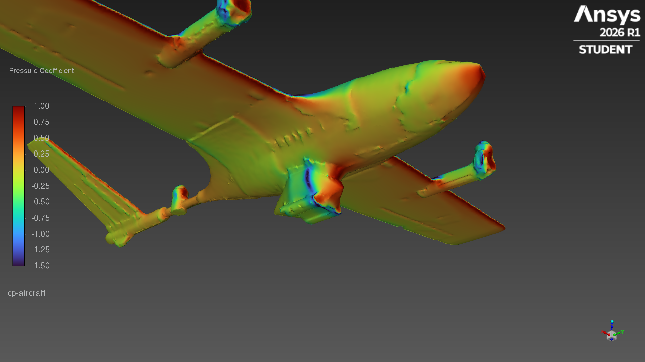
Surface pressure at each angle
Pressure coefficient, same colour scale (−1.5 to 1.0)
0° · top-side view
4° · top-side view
8° · top-side view
0° · pod, from below
4° · pod, from below
8° · pod, from below
Notes:
Pressure coefficient on the aircraft surface; same colour scale (−1.5 to 1.0) at every angle. Blue = below free-stream pressure, red = above.

Slide 9
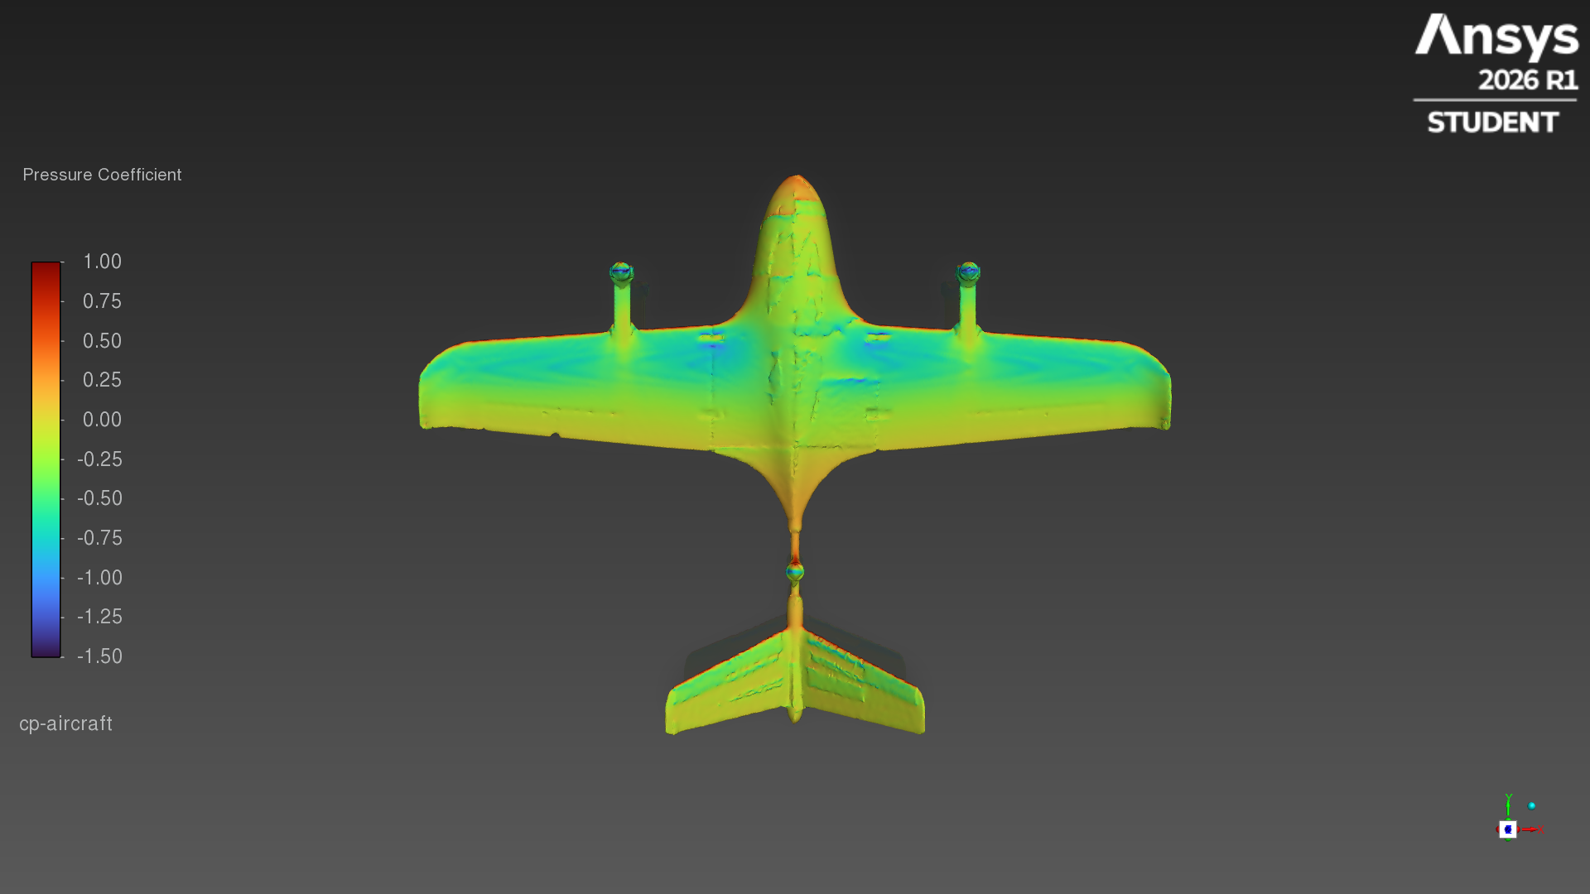
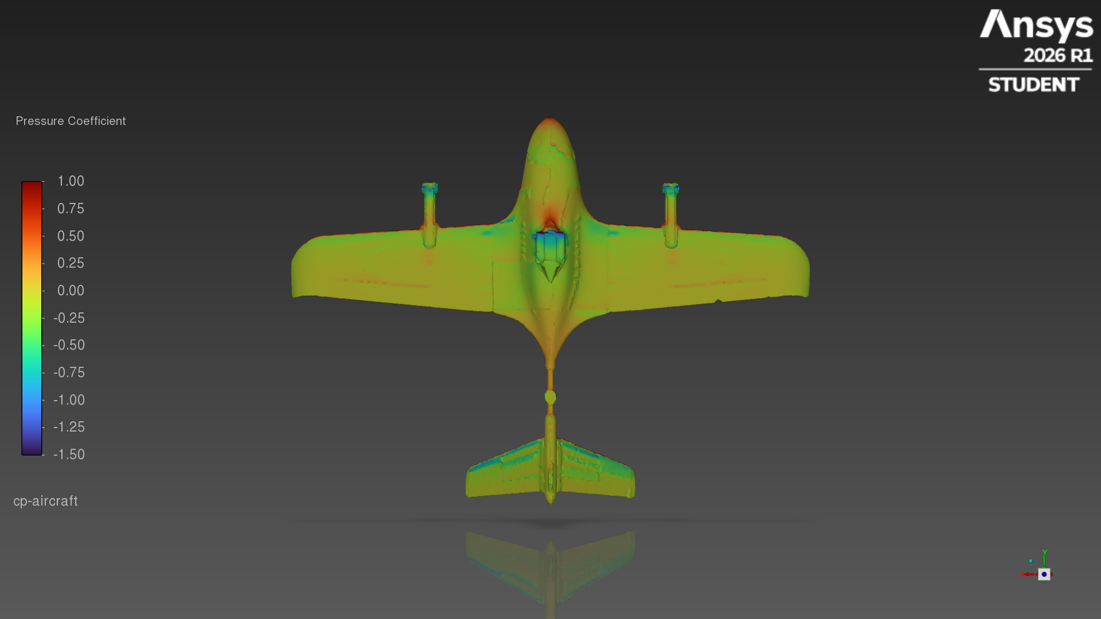
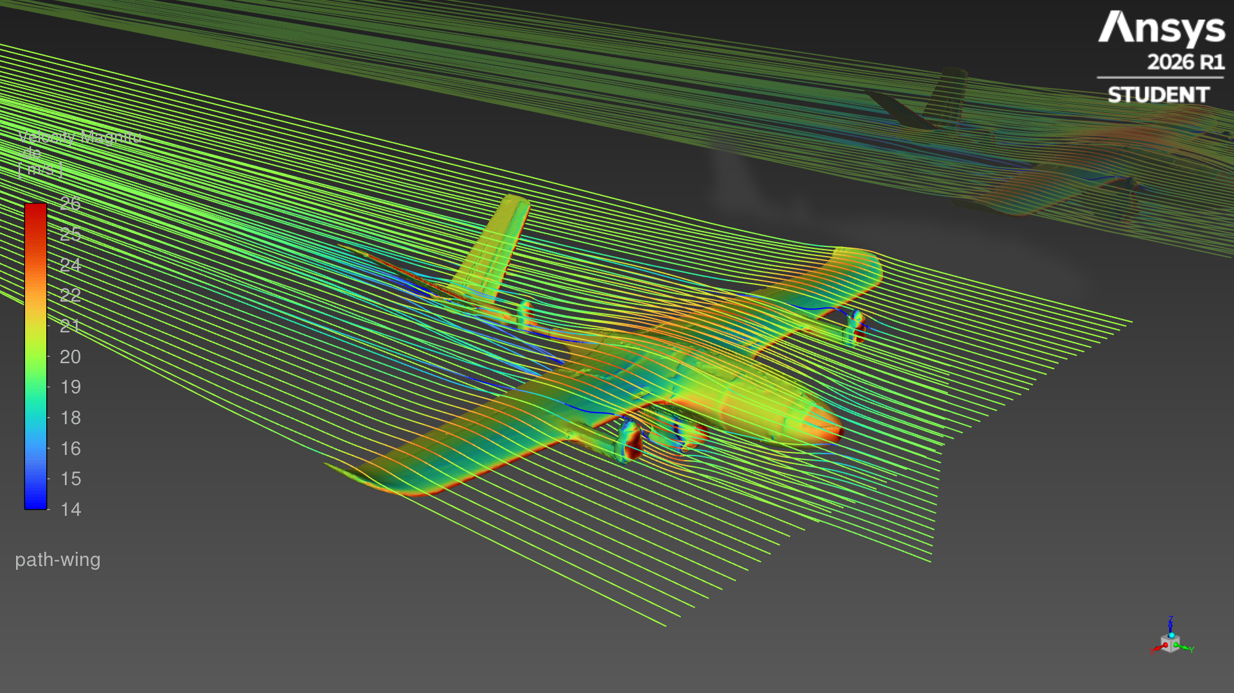
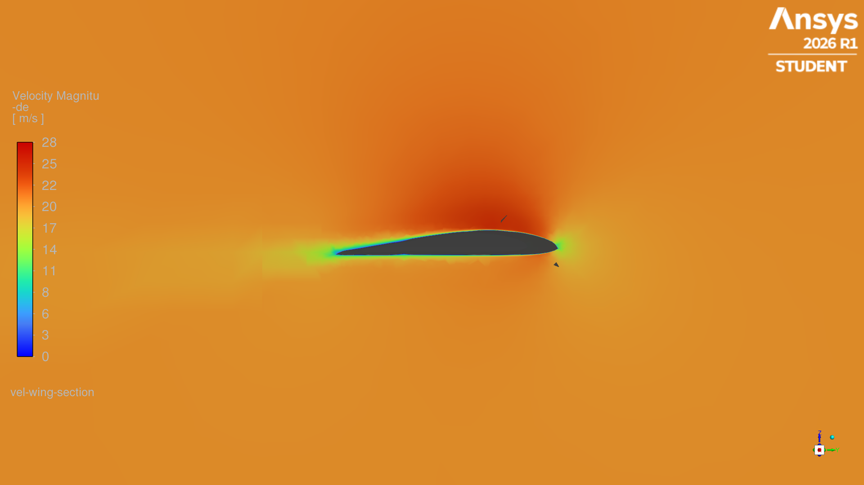
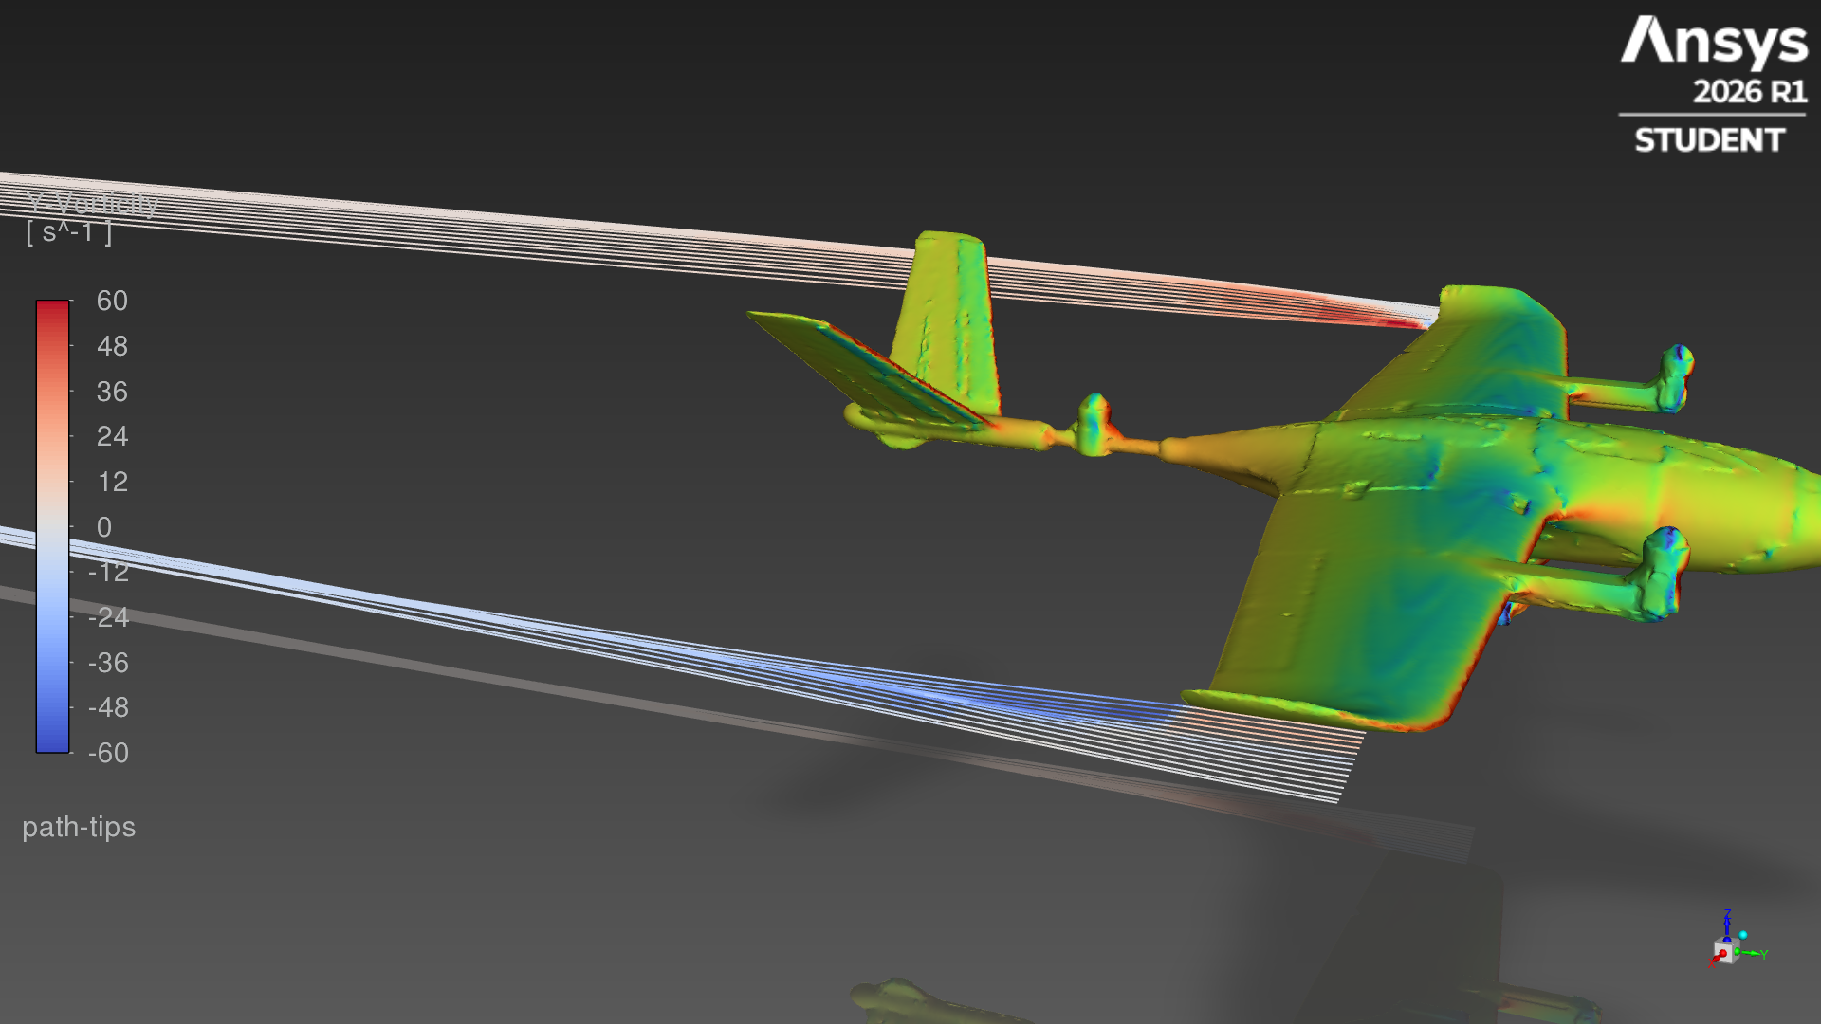
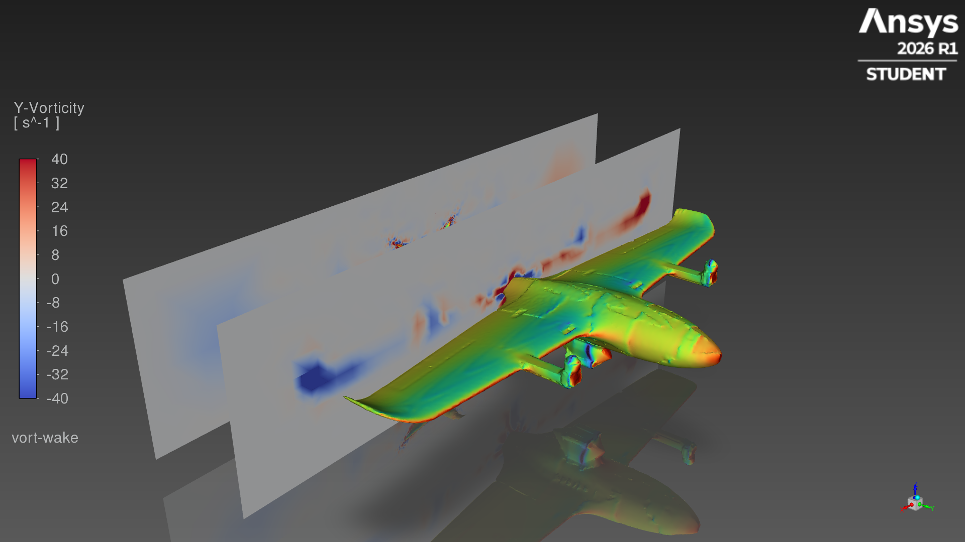
Angle of attack 0°
CL 0.310 · CD 0.0665 · L/D 4.66 · lift 16.8 N · drag 3.59 N · converged
Pressure coefficient, top
Pressure coefficient, underside
Streamlines, coloured by speed
Speed on a wing section at 0.55 m span
Tip streamlines, coloured by streamwise vorticity
Streamwise vorticity, 0.1 m and 0.4 m behind the wing
Notes:
All views at 0° angle of attack. CL 0.310, CD 0.0665, L/D 4.66 (converged).

Slide 10
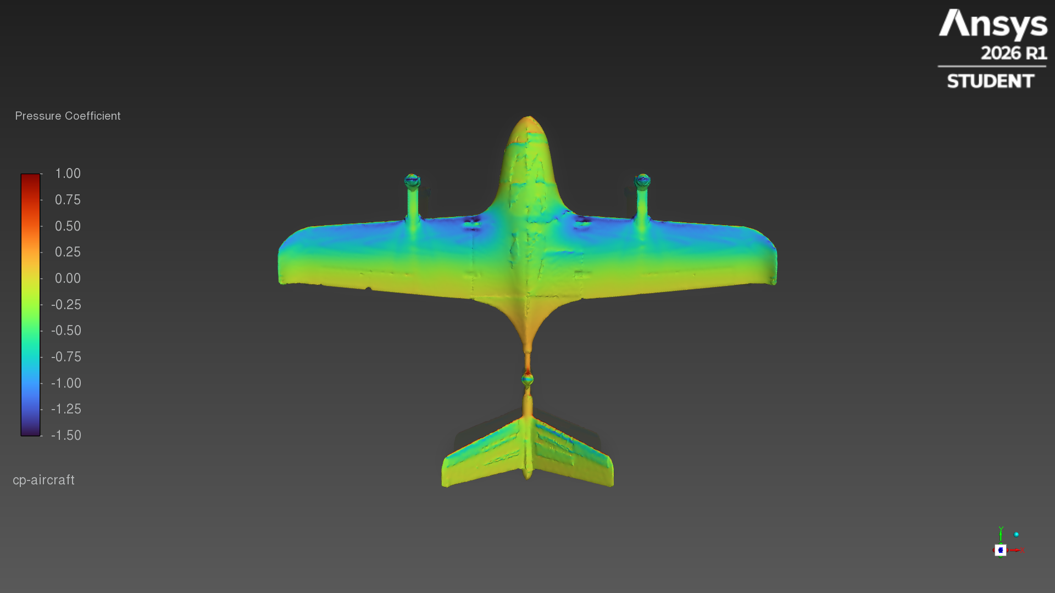
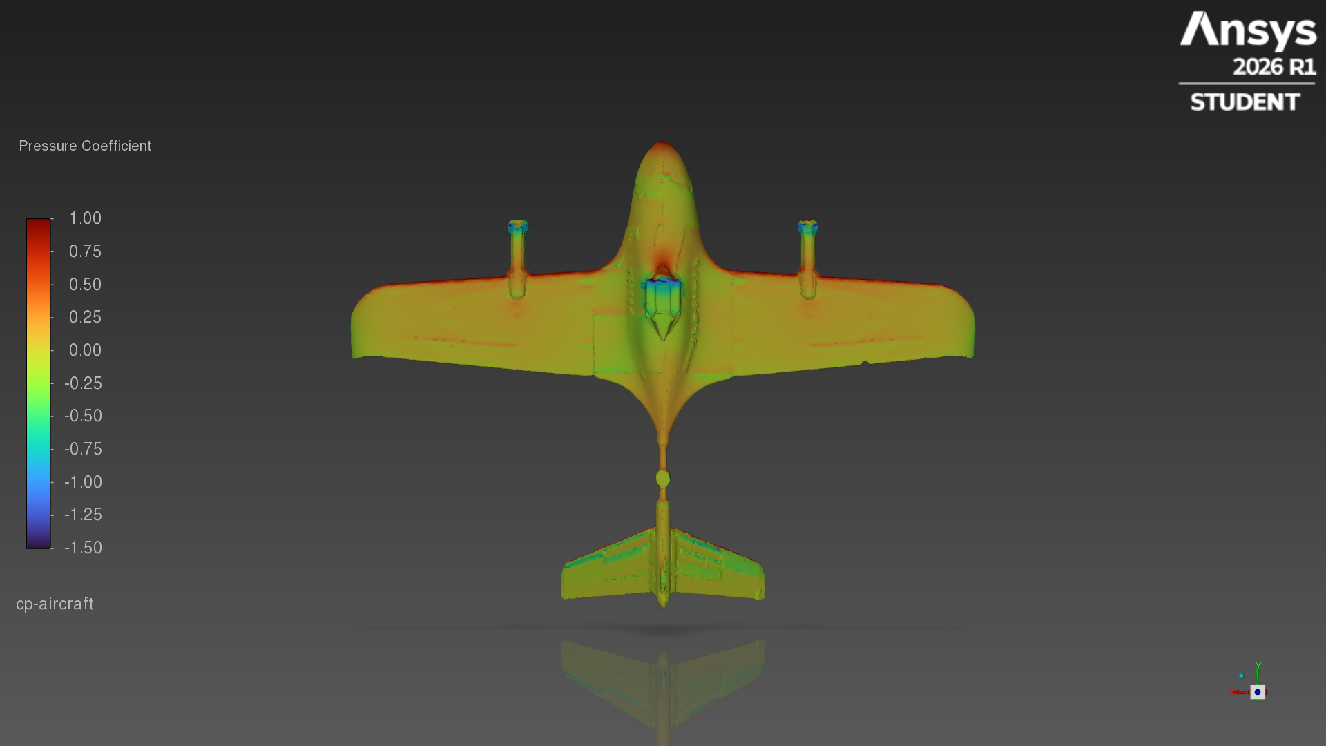
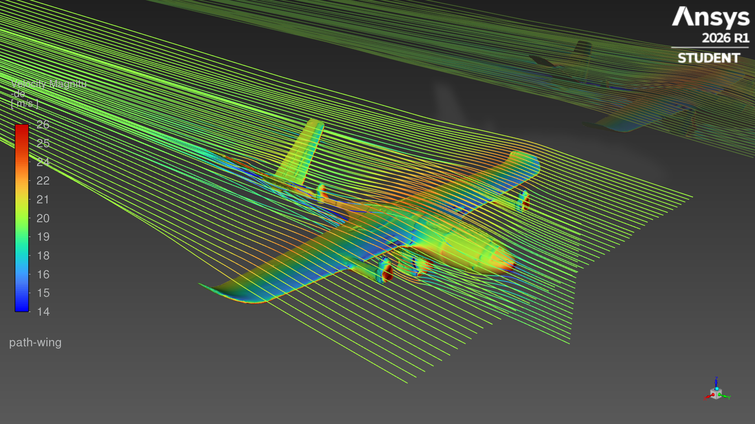
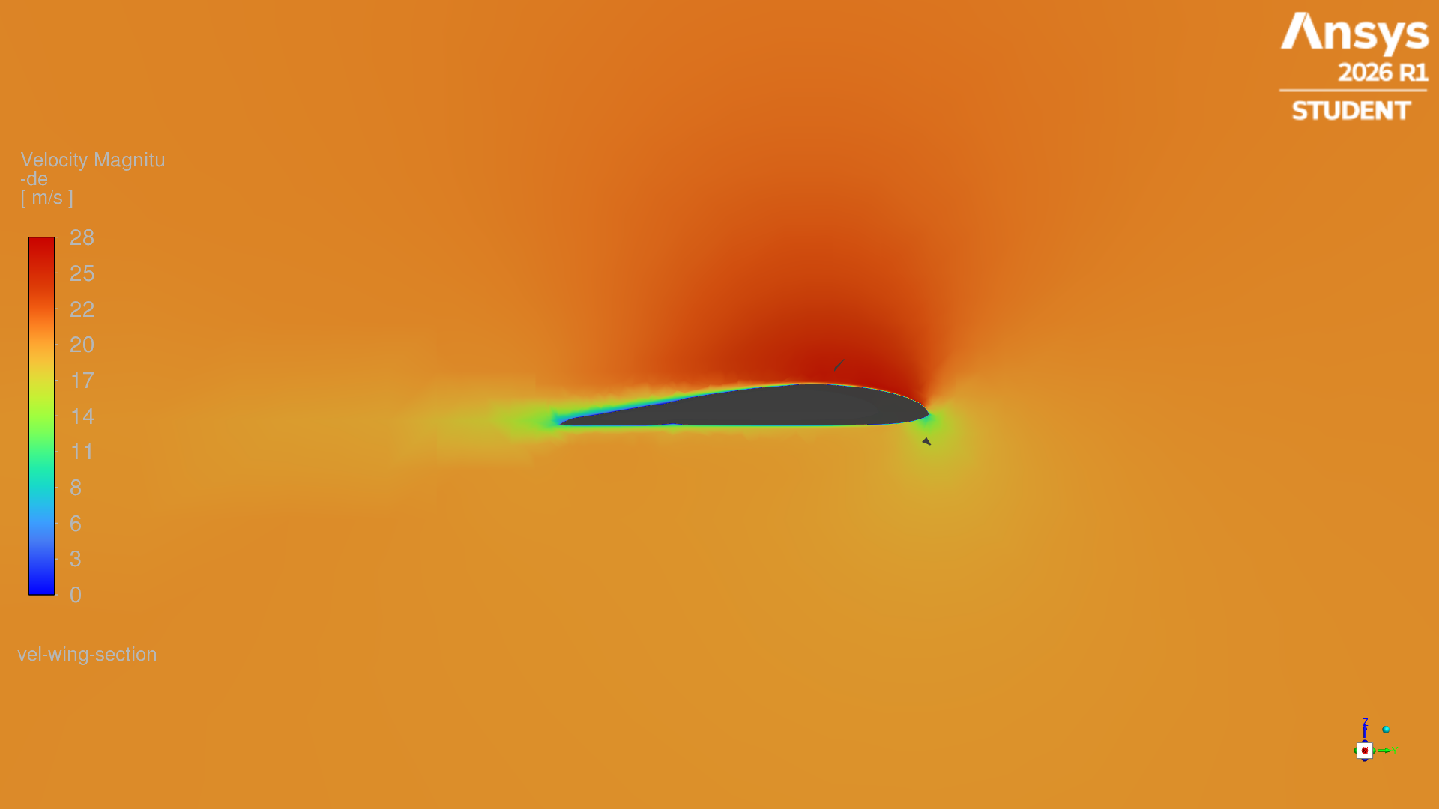
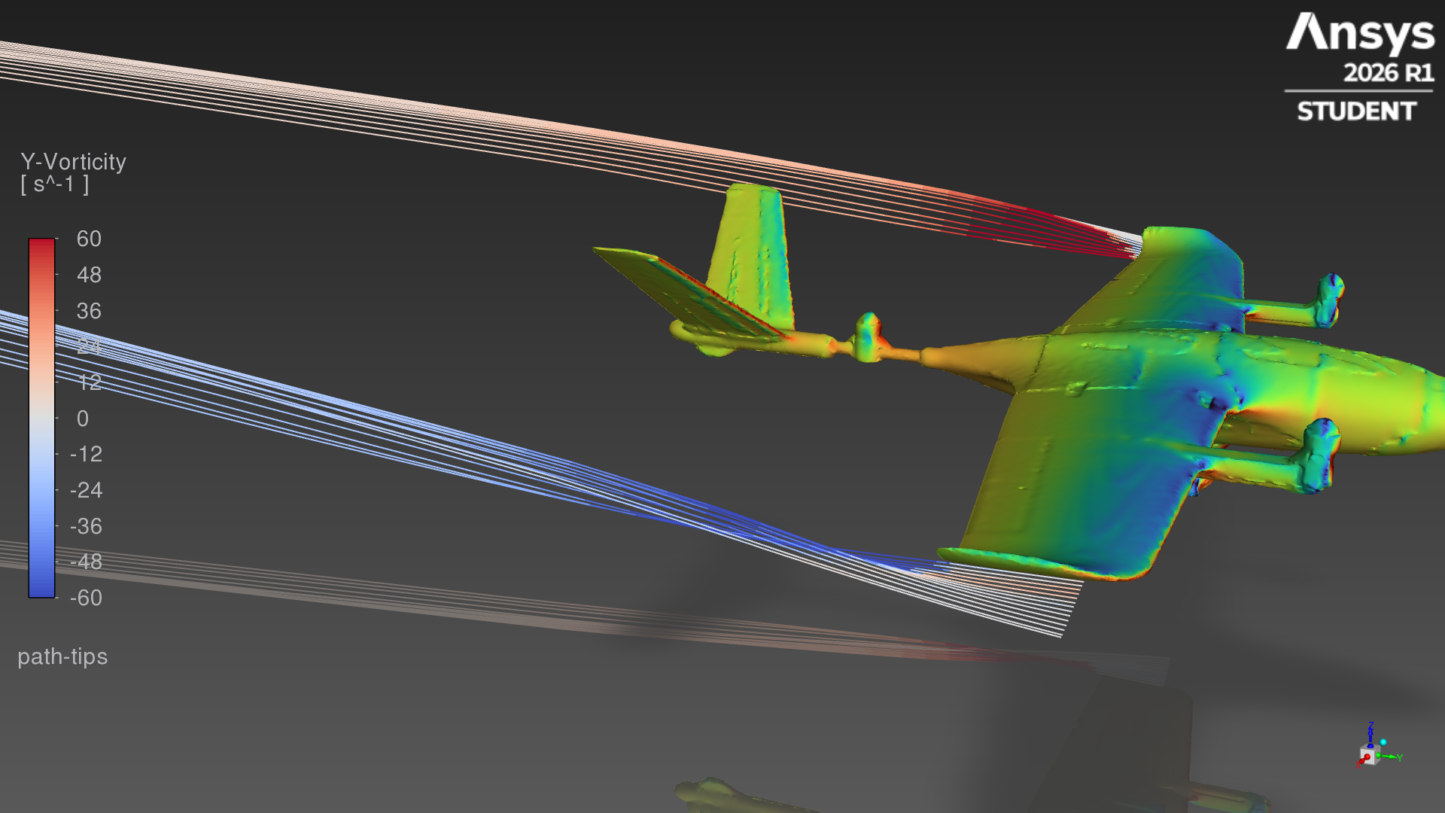
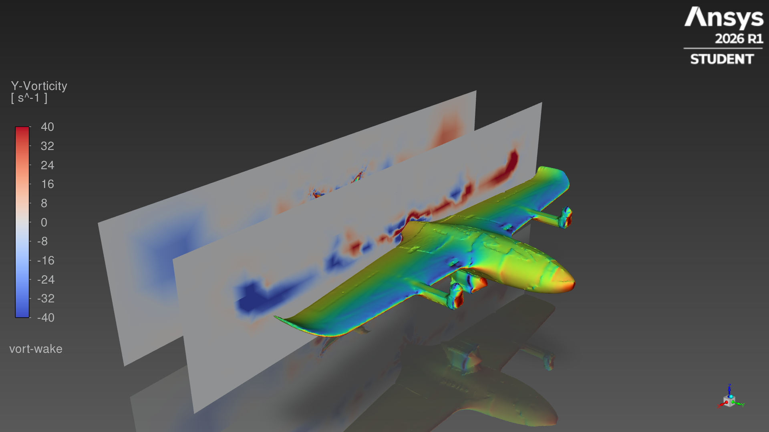
Angle of attack 4°
CL 0.697 · CD 0.0867 · L/D 8.04 · lift 37.7 N · drag 4.69 N · converged
Pressure coefficient, top
Pressure coefficient, underside
Streamlines, coloured by speed
Speed on a wing section at 0.55 m span
Tip streamlines, coloured by streamwise vorticity
Streamwise vorticity, 0.1 m and 0.4 m behind the wing
Notes:
All views at 4° angle of attack. CL 0.697, CD 0.0867, L/D 8.04 (converged).

Slide 11
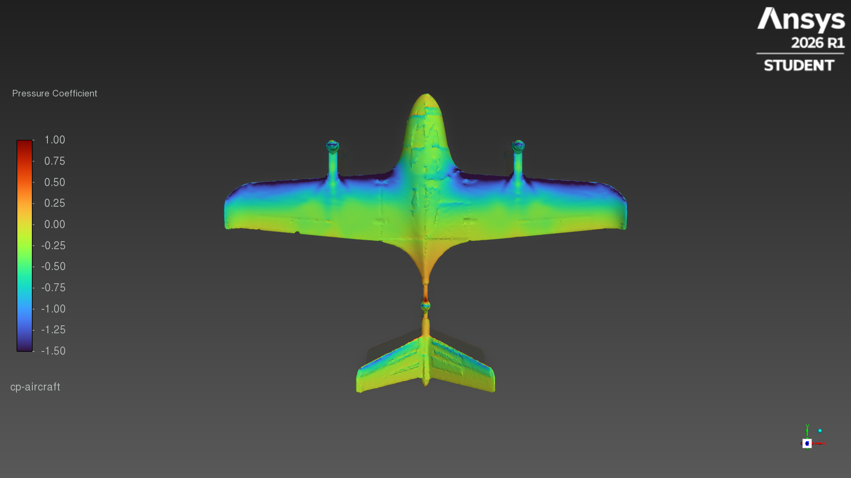
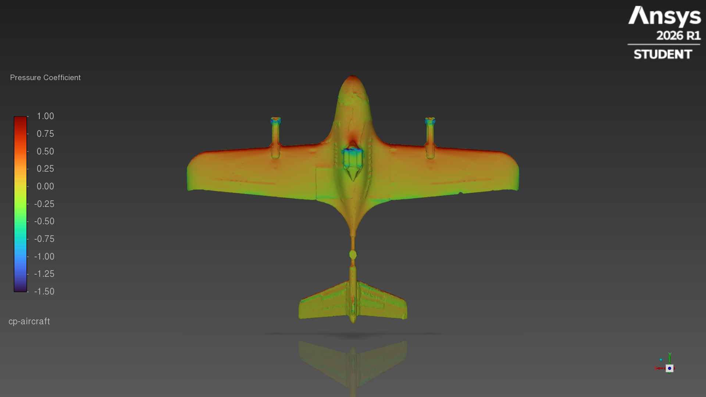
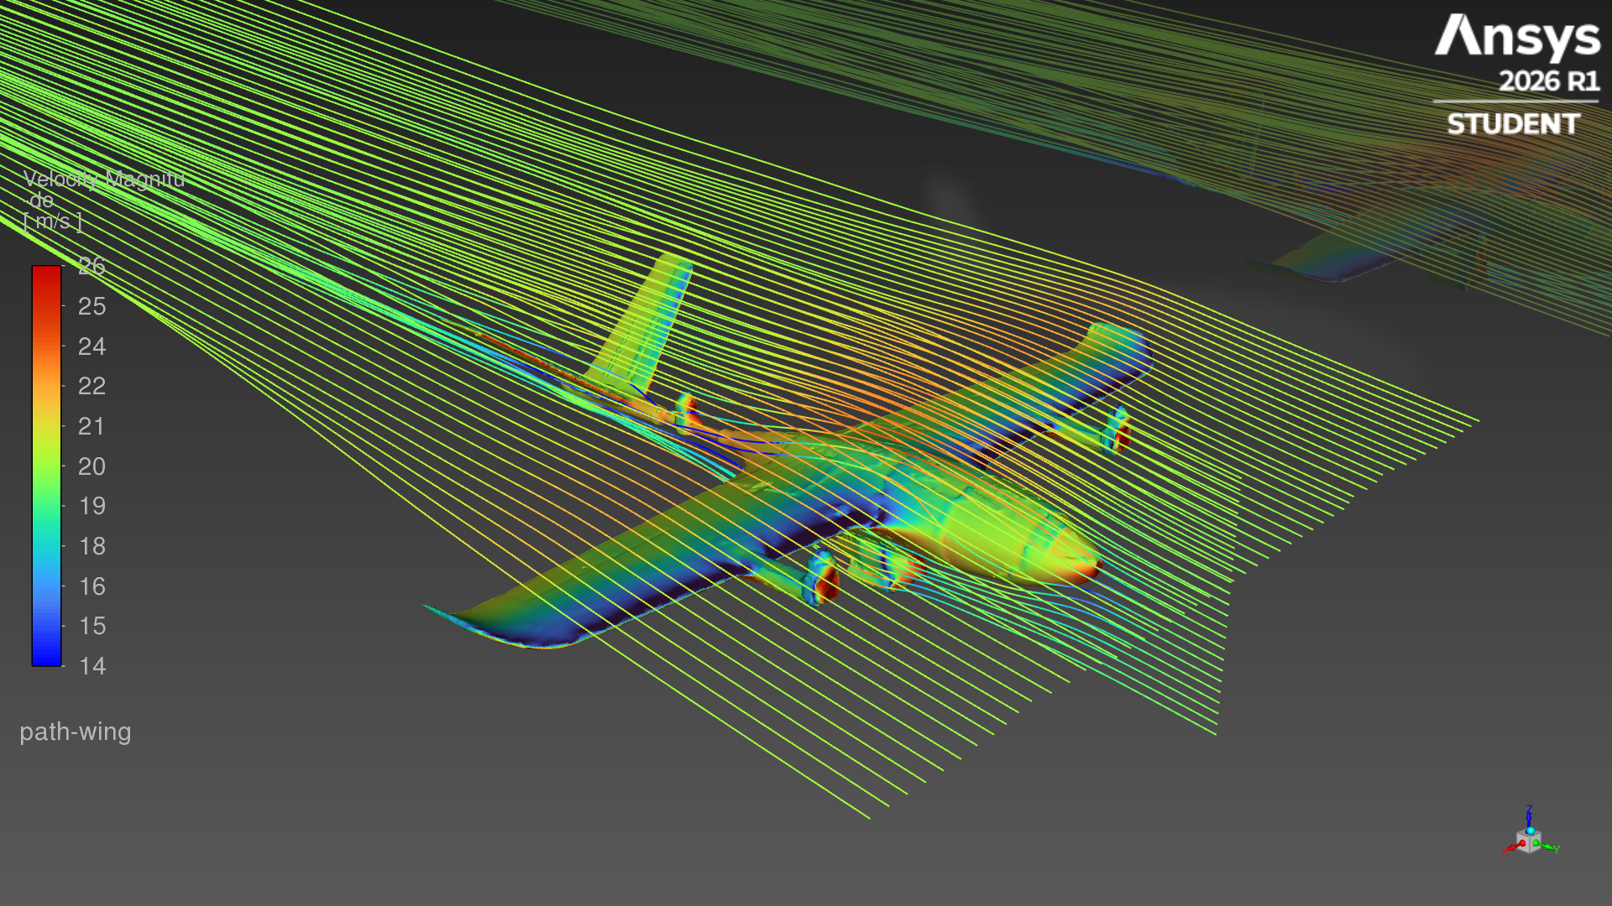
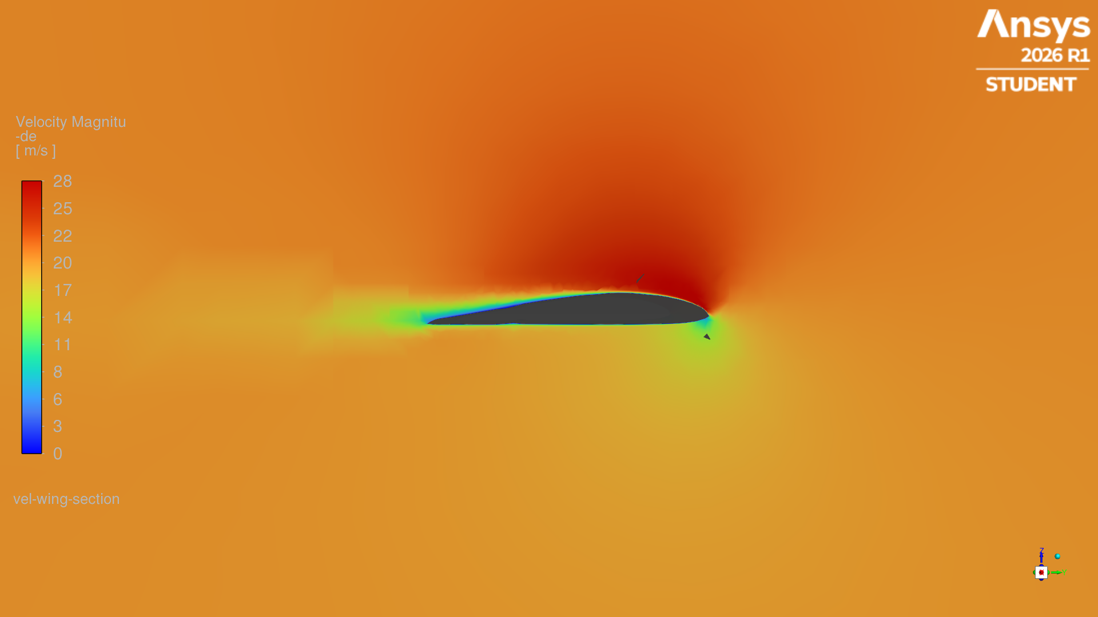
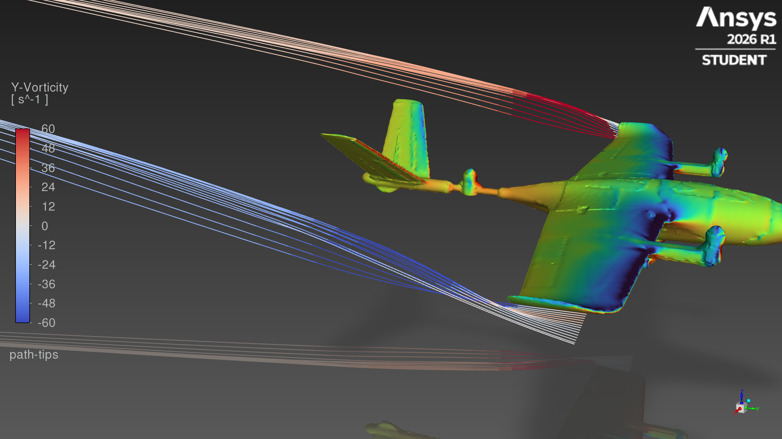
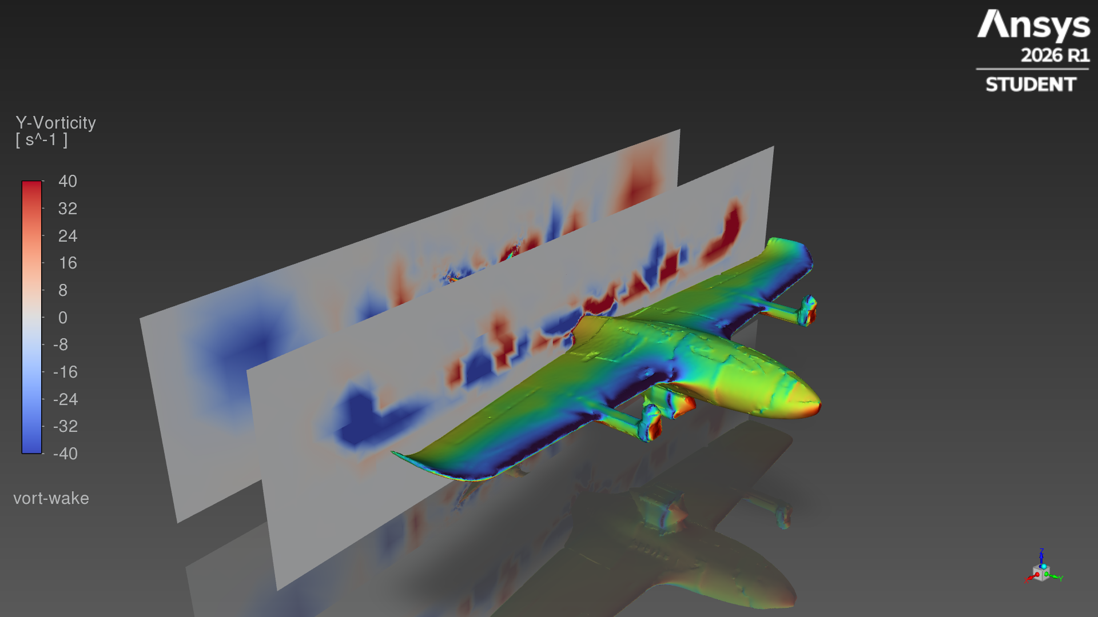
Angle of attack 8°
CL 0.911 · CD 0.1424 · L/D 6.40 · lift 49.3 N · drag 7.70 N · not converged, mean of last 200 iterations
Pressure coefficient, top
Pressure coefficient, underside
Streamlines, coloured by speed
Speed on a wing section at 0.55 m span
Tip streamlines, coloured by streamwise vorticity
Streamwise vorticity, 0.1 m and 0.4 m behind the wing
Notes:
All views at 8° angle of attack. CL 0.911, CD 0.1424, L/D 6.40 (not converged, mean of last 200 iterations).

Slide 12
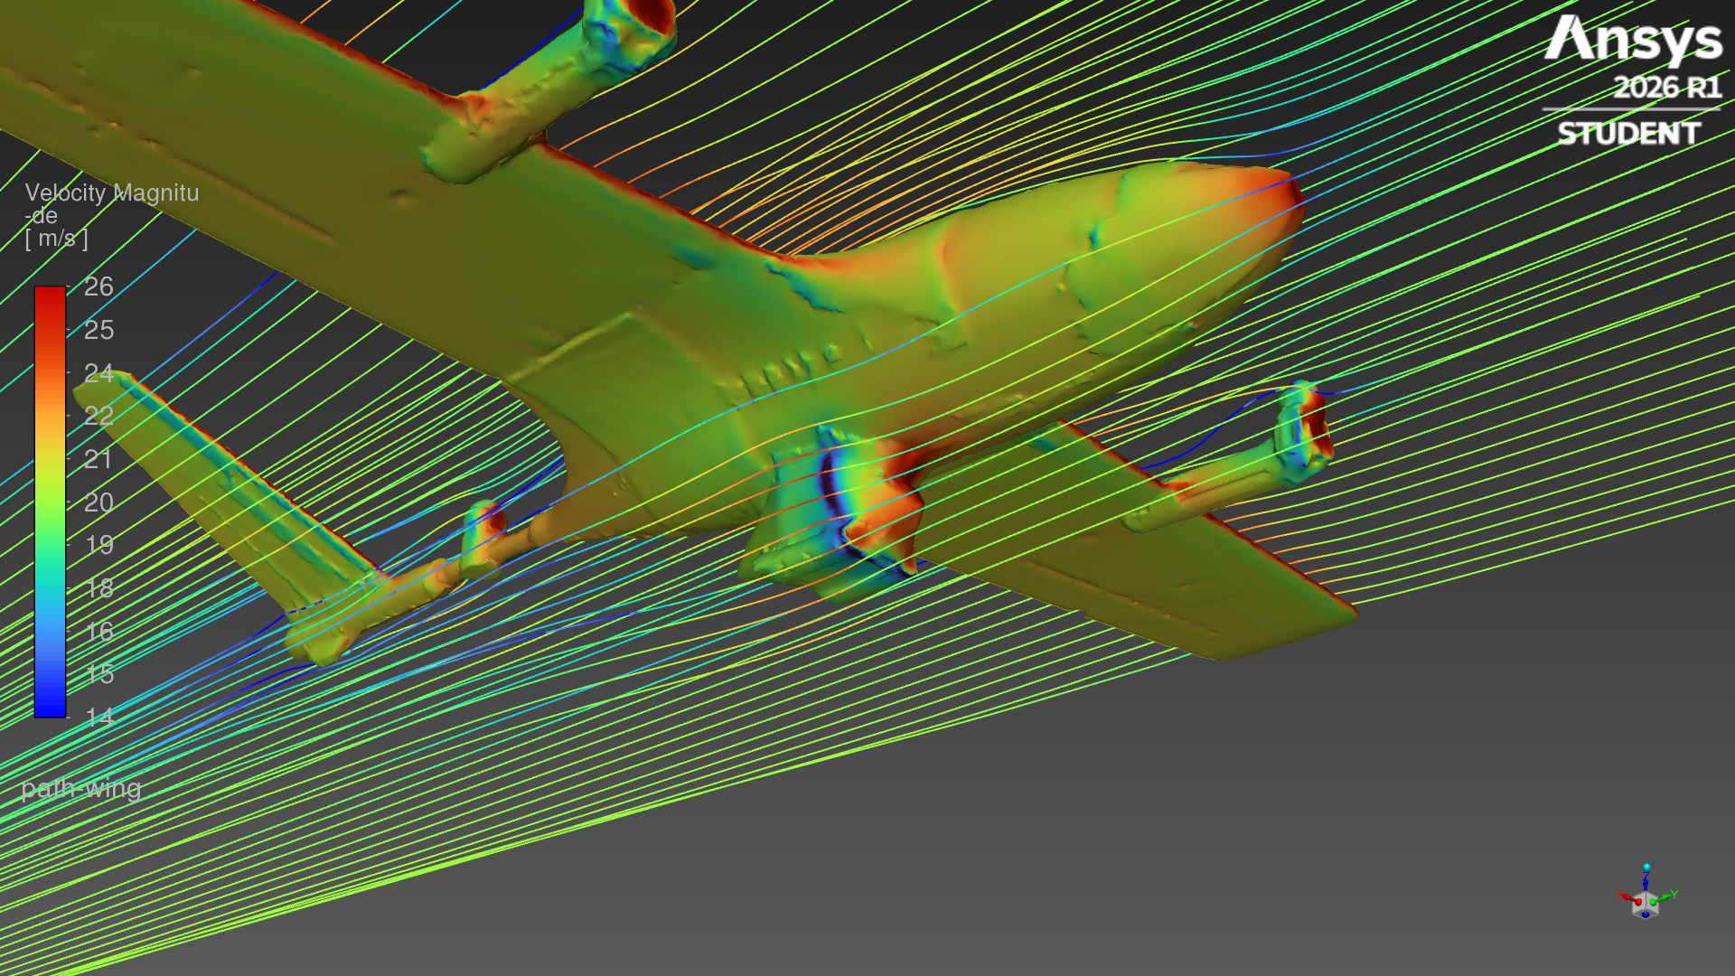
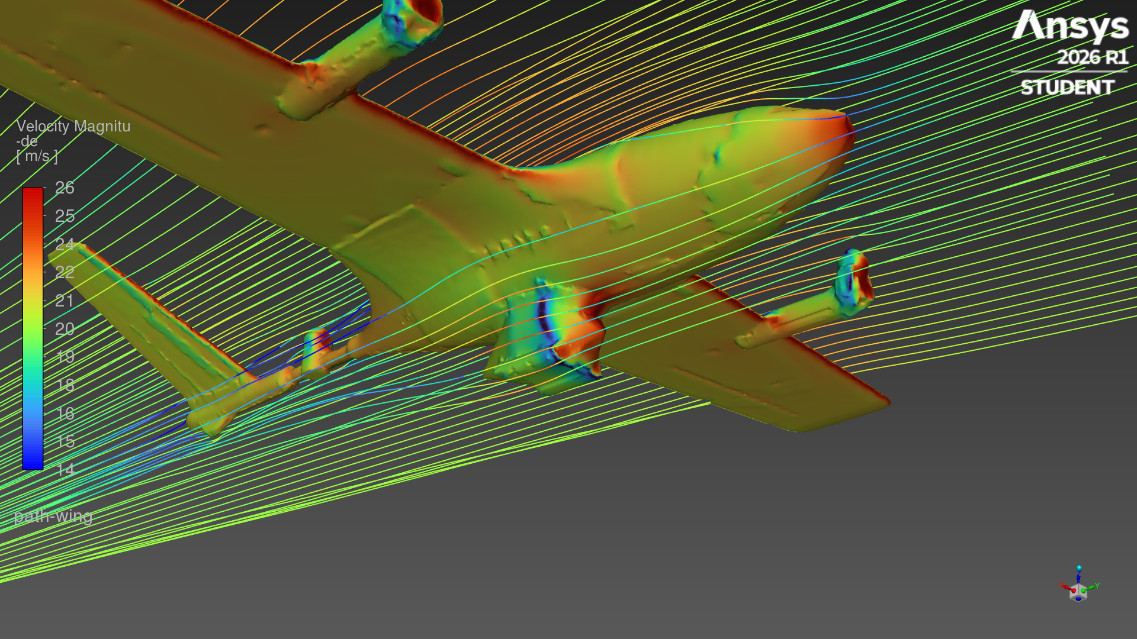
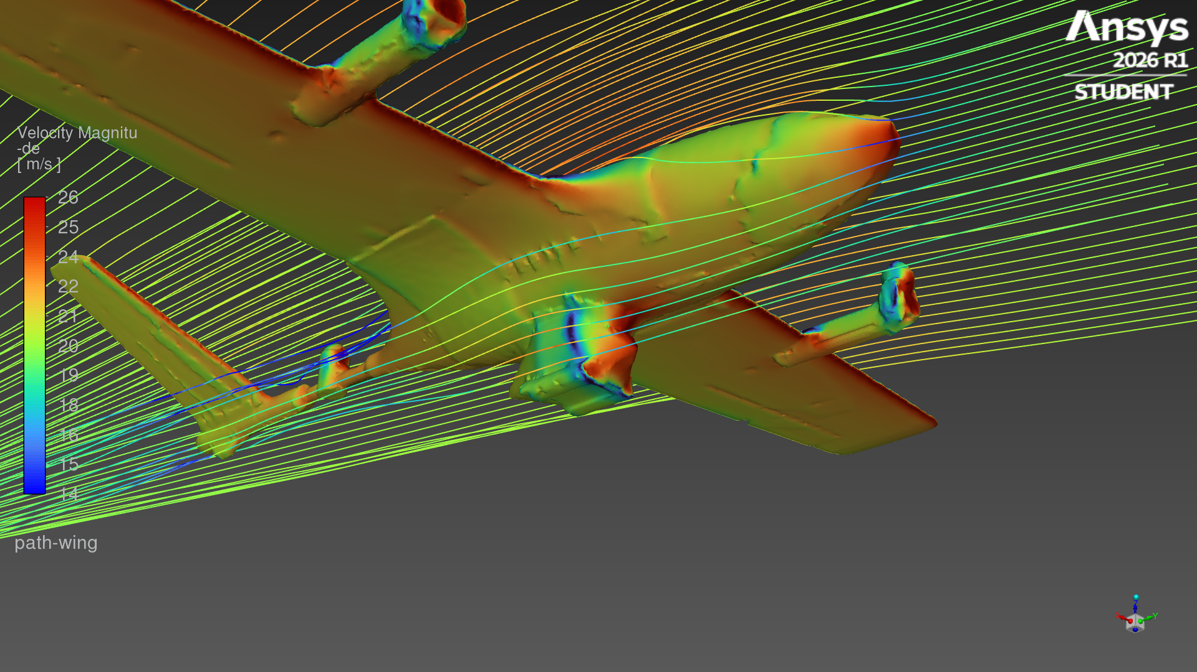
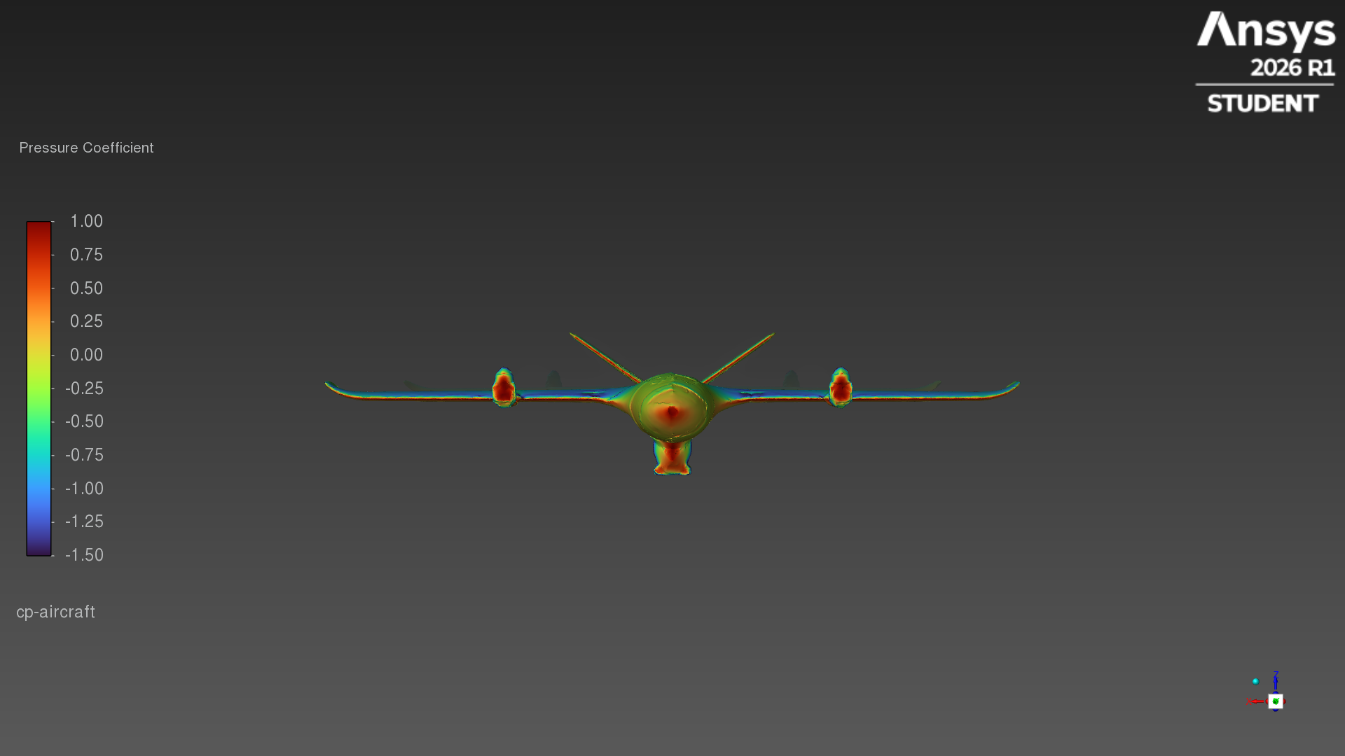
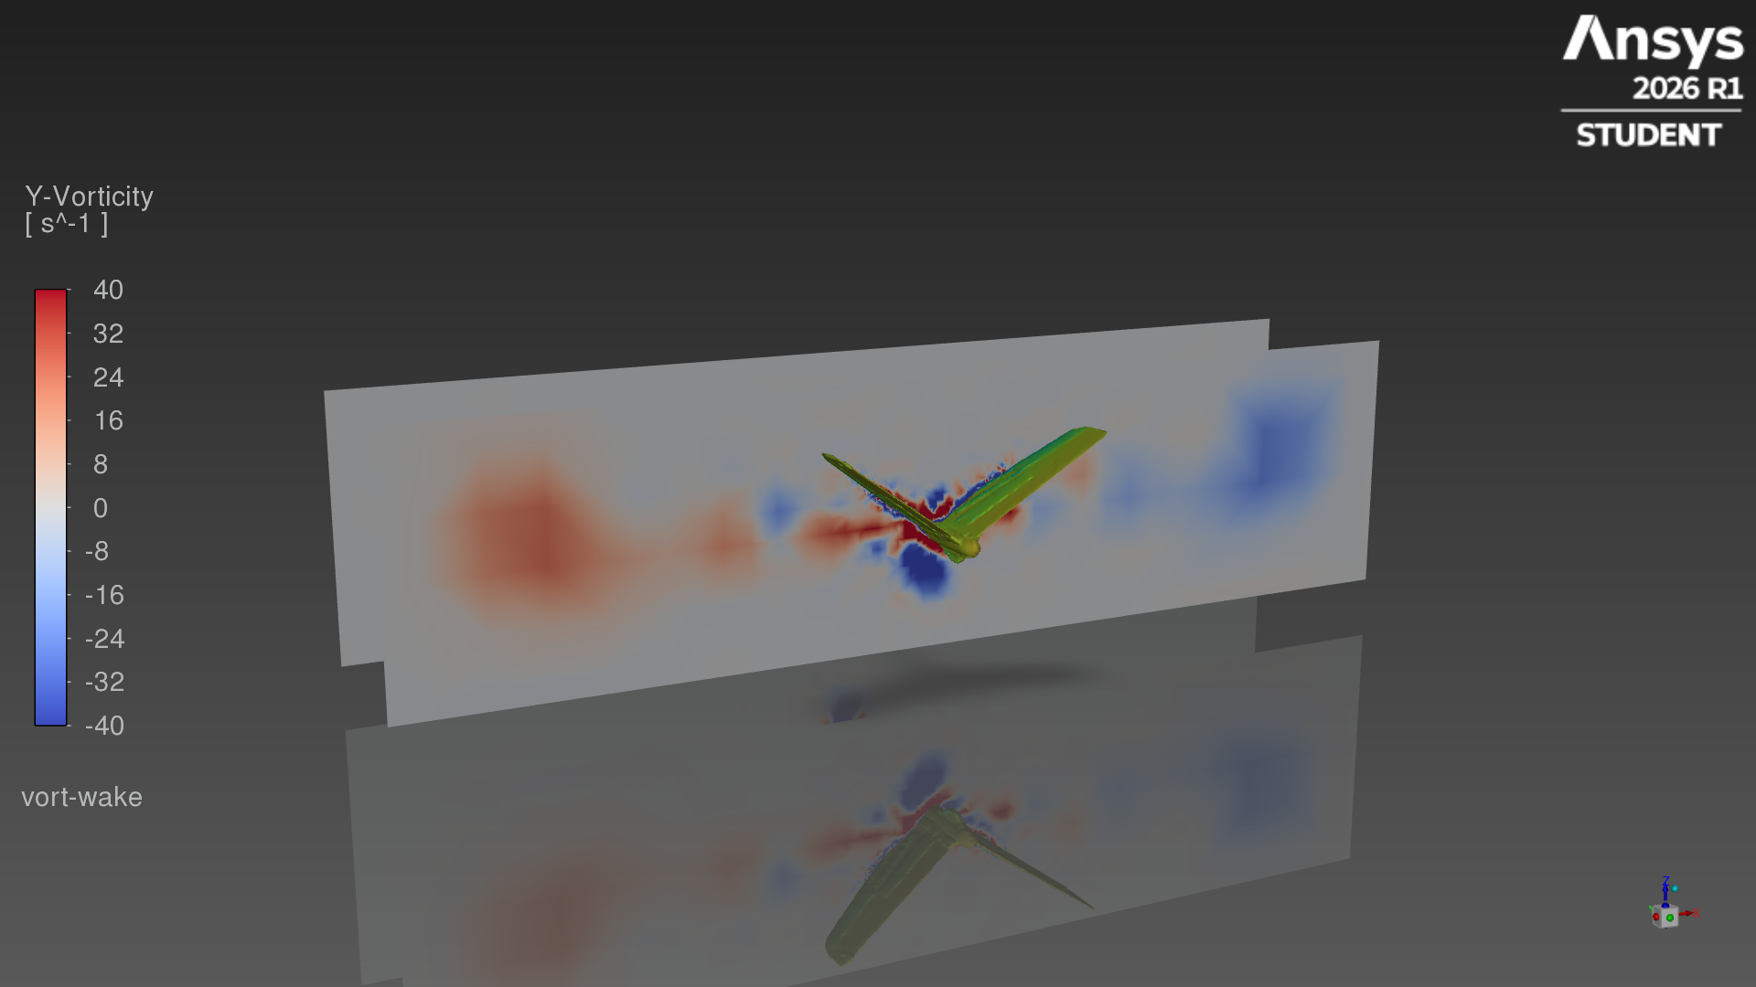
Flow past the pod
Streamlines coloured by speed (14–26 m/s), viewed from below
0°
4°
8°
Colour scales
Streamlines: 14–26 m/s
Pressure coefficient: −1.5 to 1.0
Streamwise vorticity: −40 to 40 1/s
Pressure coefficient, front view (4°)
Wake planes from behind (4°)
Notes:
Streamlines released ahead of the nose, viewed from below at the pod.

Slide 13
Modelling notes
Steady RANS (k-ω SST) on a 561,669-cell mesh; the Ansys Student licence limits the mesh to about 1M cells.
Airframe, motors and pod as in the GLB; propellers are not modelled.
Openings up to 24 mm (hatch gaps, slots) were sealed by the shrink-wrap; internal parts were removed.
Same mesh for all angles; angle of attack set by the free-stream direction.
8° did not converge within 600 iterations; its forces are the mean of the last 200 iterations.
Files: cfd_pod/results (cases, data, force histories, forces.csv) · cfd_pod/renders (all images) · demo.bat opens the case in Fluent
Notes:
What was and was not included in this simulation.

