Slide 1
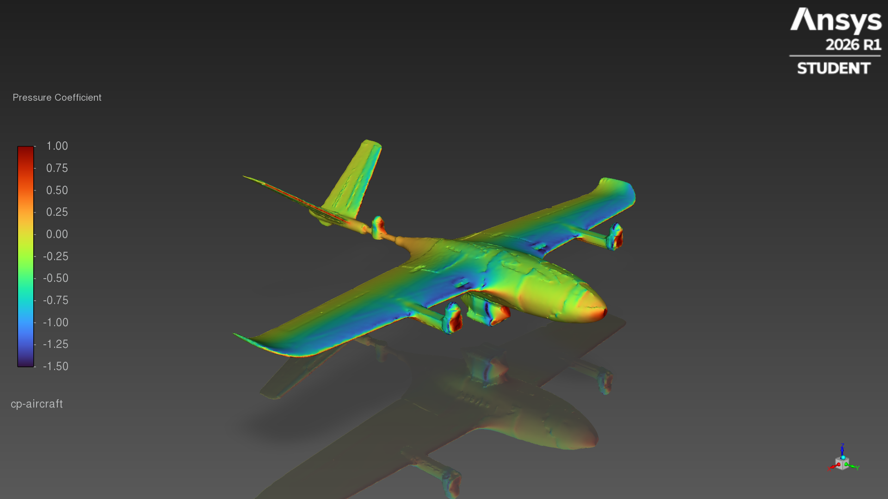
Stallion VTOL
Payload-pod CFD
External aerodynamics at 20 m/s, angle of attack 0, 4, 8°
Ansys Fluent 2026 R1 Student · k-ω SST · compared with the clean airframe
Notes:
Payload-pod variant of the Stallion VTOL, same CFD pipeline and settings as the clean airframe, so the differences are the pod and fitted motors.

Slide 2
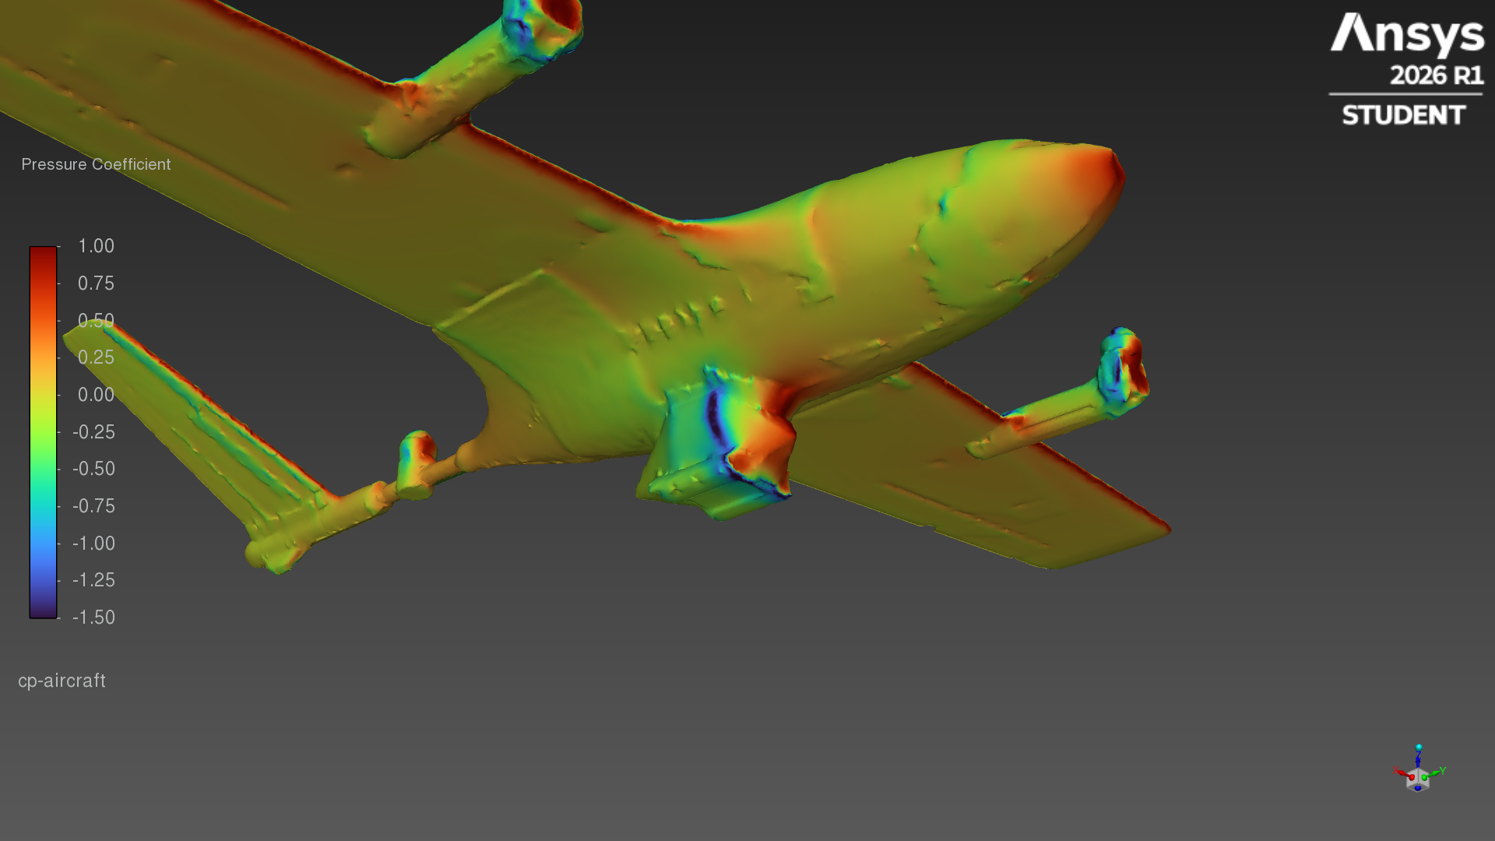
The pod costs drag, not lift
Cruise point: 4° angle of attack, 20 m/s
+28%
+1.02 N
-23%
-2%
drag coefficient
0.0678 → 0.0867
extra drag at 20 m/s
3.67 → 4.69 N
lift-to-drag ratio
10.5 → 8.0
lift coefficient
0.713 → 0.697
What the numbers say
The blunt pod (and the boom-front motors) add frontal area and wetted surface, so drag rises at every angle.
Lift is nearly unchanged: the wing does the lifting and the pod barely alters its loading.
Clean = original airframe STL · Pod = equipped GLB: payload pod plus tilt motors on the booms
Notes:
Headline numbers at the cruise angle (4°). Coefficients use the same reference area, chord and moment centre for both configurations.

Slide 3
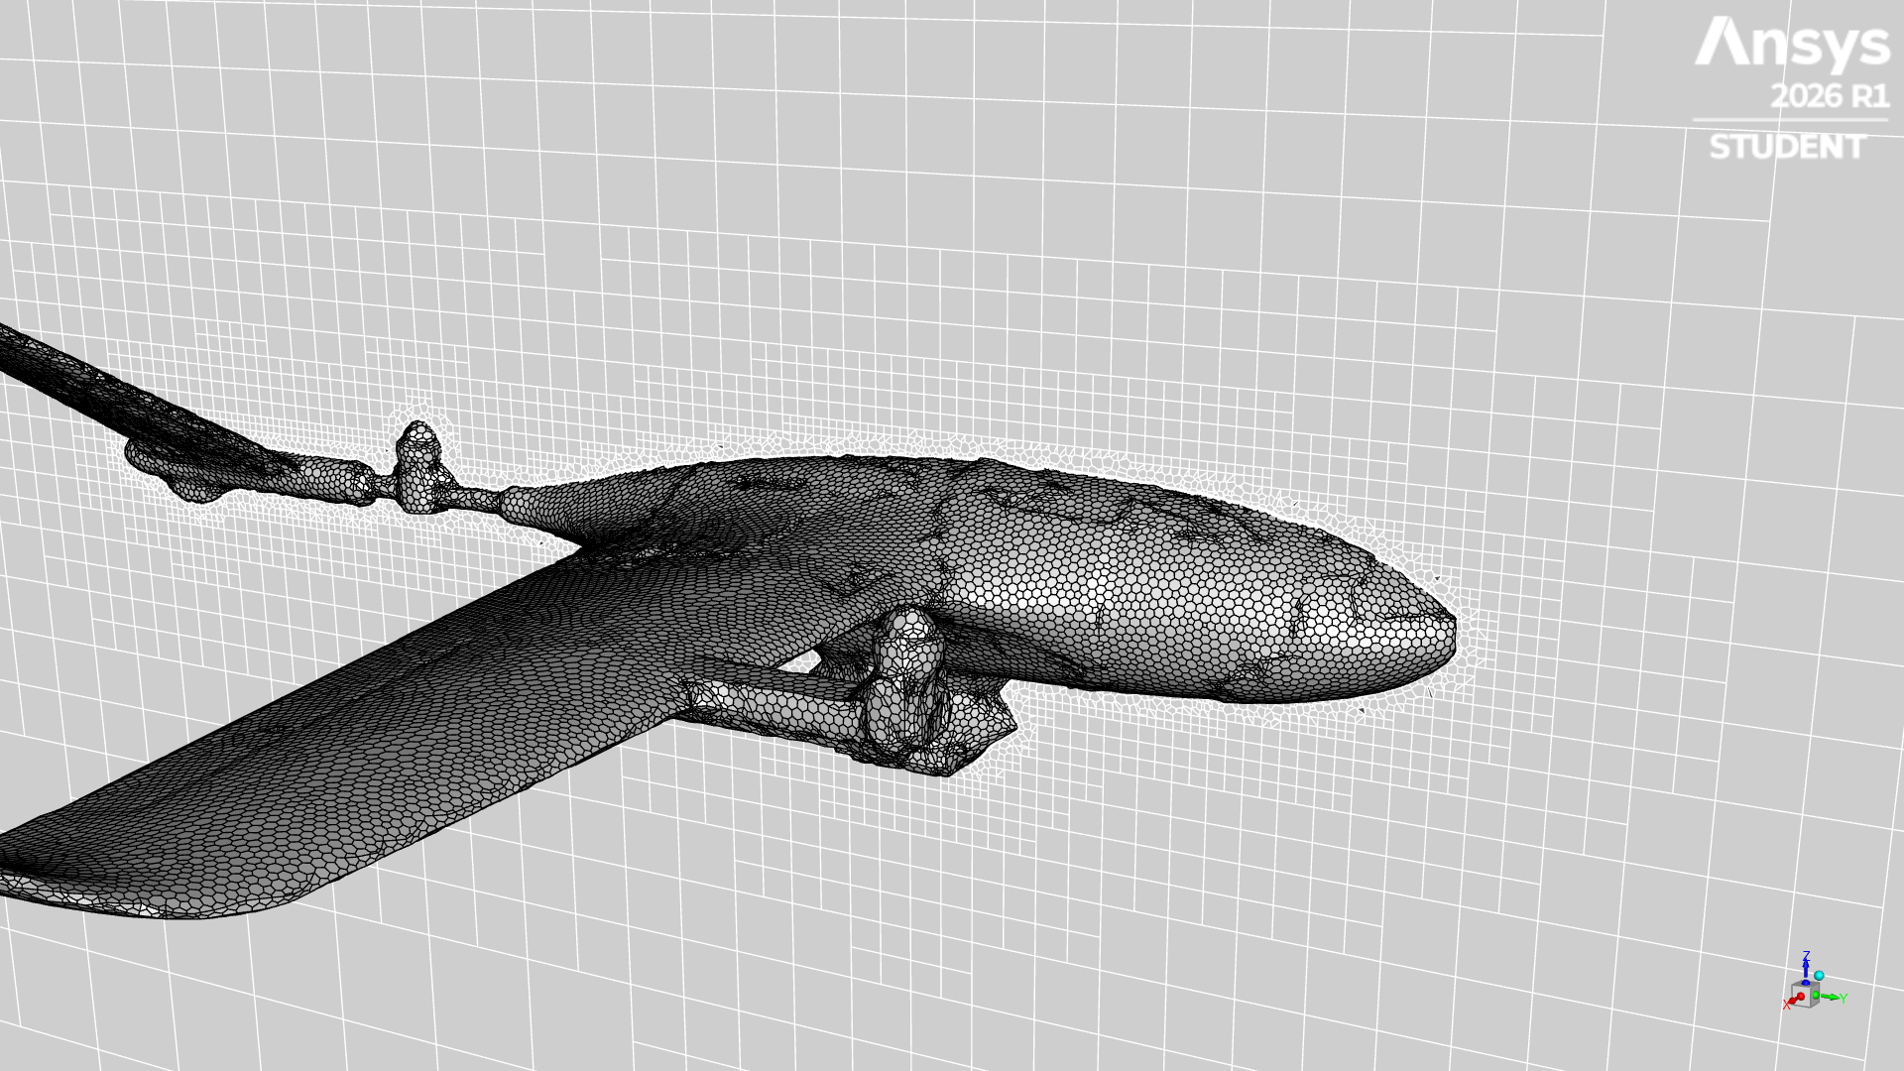
Geometry: 96-part CAD model → one watertight skin
Repair test on stallion_v2_equipped_with_pod.glb
 | Raw GLB | Wrapped skin
Separate parts / bodies | 96 / 251 | 1
Non-manifold edges | 2,397 | 0
Open edges | 76 (in GLB) | 0
Fuselage interior | hollow, open hatches | solid (gaps ≤ 24 mm sealed)
Facets | 691,670 | 298,872
Max shape change |  | 2.3 mm
Wrapped skin and the CFD surface mesh
Voxel shrink-wrap at 1.5 mm: air flood-filled from outside, signed-distance skin from the real facets, then decimated to the Student-licence size. A ray test confirms no air pockets inside the body.
Notes:
The GLB is a CAD assembly: 96 parts including internal electronics and spars, many touching or overlapping. It cannot be meshed directly, so it was shrink-wrapped into one solid skin.

Slide 4
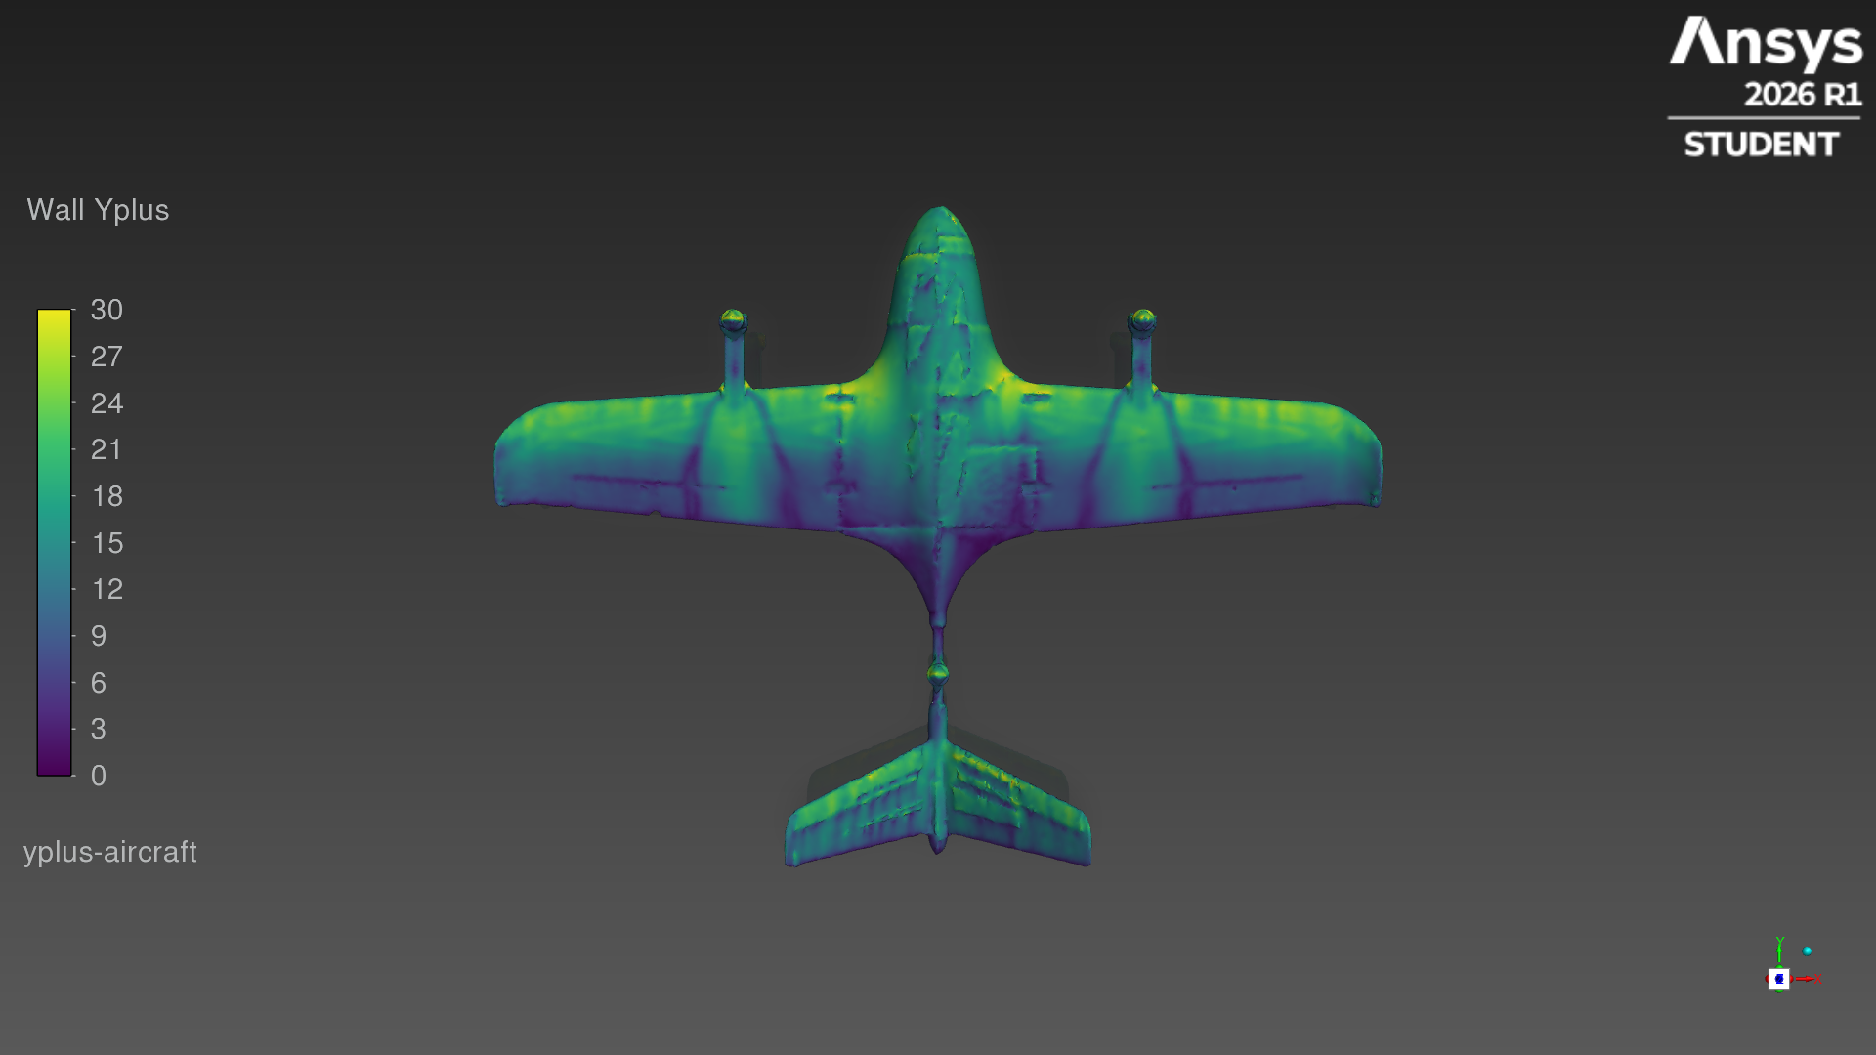
Mesh and solver setup
Same settings for both configurations; only the geometry changes
Mesh
poly-hexcore, 561,669 cells (clean 513,695), 3 prism layers (first cell 0.5 mm), surface 5.5–26 mm
Domain
box 4 m upstream, 8 m downstream, 4 m to the sides and top/bottom
Flow
20 m/s, sea-level air (ρ 1.225 kg/m³), steady, incompressible
Model
pressure-based coupled solver, k-ω SST turbulence
Angles
0, 4, 8° by tilting the free stream; one mesh for all
Wall y+ ≈ 5–25: SST with wall treatment
Convergence
stop when CL and CD change < 0.2% per 50 iterations (150–600)
Notes:
Identical mesh sizing and solver settings for both configurations.

Slide 5
Aerodynamic coefficients: clean vs pod
Whole aircraft, 20 m/s
Unconverged angles (8°) report the mean of the last 200 iterations: the flow there is unsteady, likely early separation.
Notes:
Lift is almost identical; drag is higher at every angle, so L/D drops.

Slide 6
Force results
Reference area 0.2207 m², chord 0.1641 m, moment centre at the wing quarter chord
AoA | Config | CL | CD | Cm | L/D | Lift N | Drag N | Status
0° | Clean | 0.313 | 0.0461 | 0.000 | 6.8 | 16.9 | 2.49 | converged
0° | Pod | 0.310 | 0.0665 | 0.010 | 4.7 | 16.8 | 3.59 | converged
4° | Clean | 0.713 | 0.0678 | -0.043 | 10.5 | 38.6 | 3.67 | converged
4° | Pod | 0.697 | 0.0867 | -0.047 | 8.0 | 37.7 | 4.69 | converged
8° | Clean | 0.951 | 0.1223 | -0.128 | 7.8 | 51.4 | 6.61 | unsteady (mean)
8° | Pod | 0.911 | 0.1424 | -0.135 | 6.4 | 49.3 | 7.70 | unsteady (mean)
Notes:
Full table. Forces in newtons at 20 m/s for this aircraft size.

Slide 7
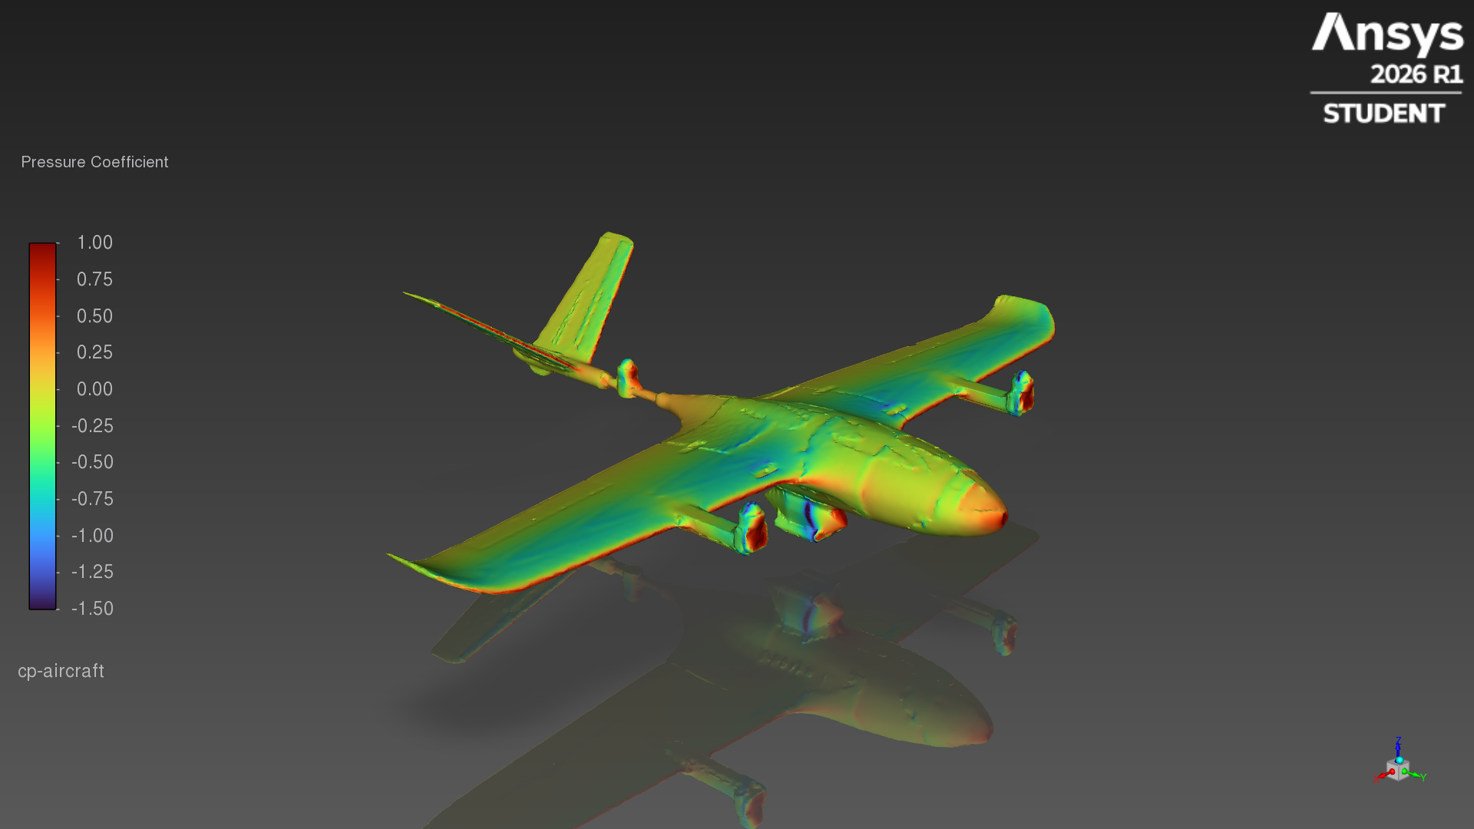
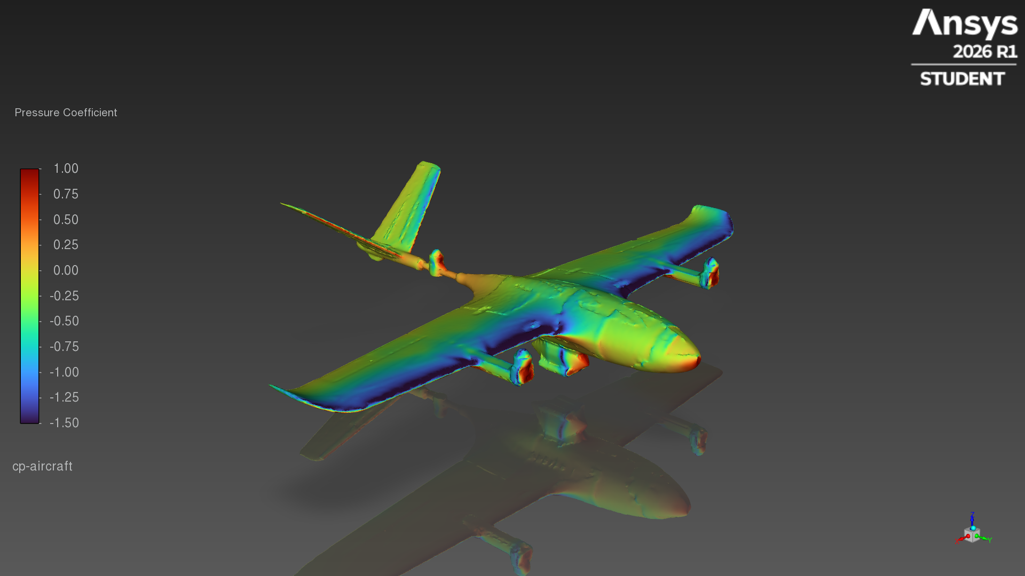
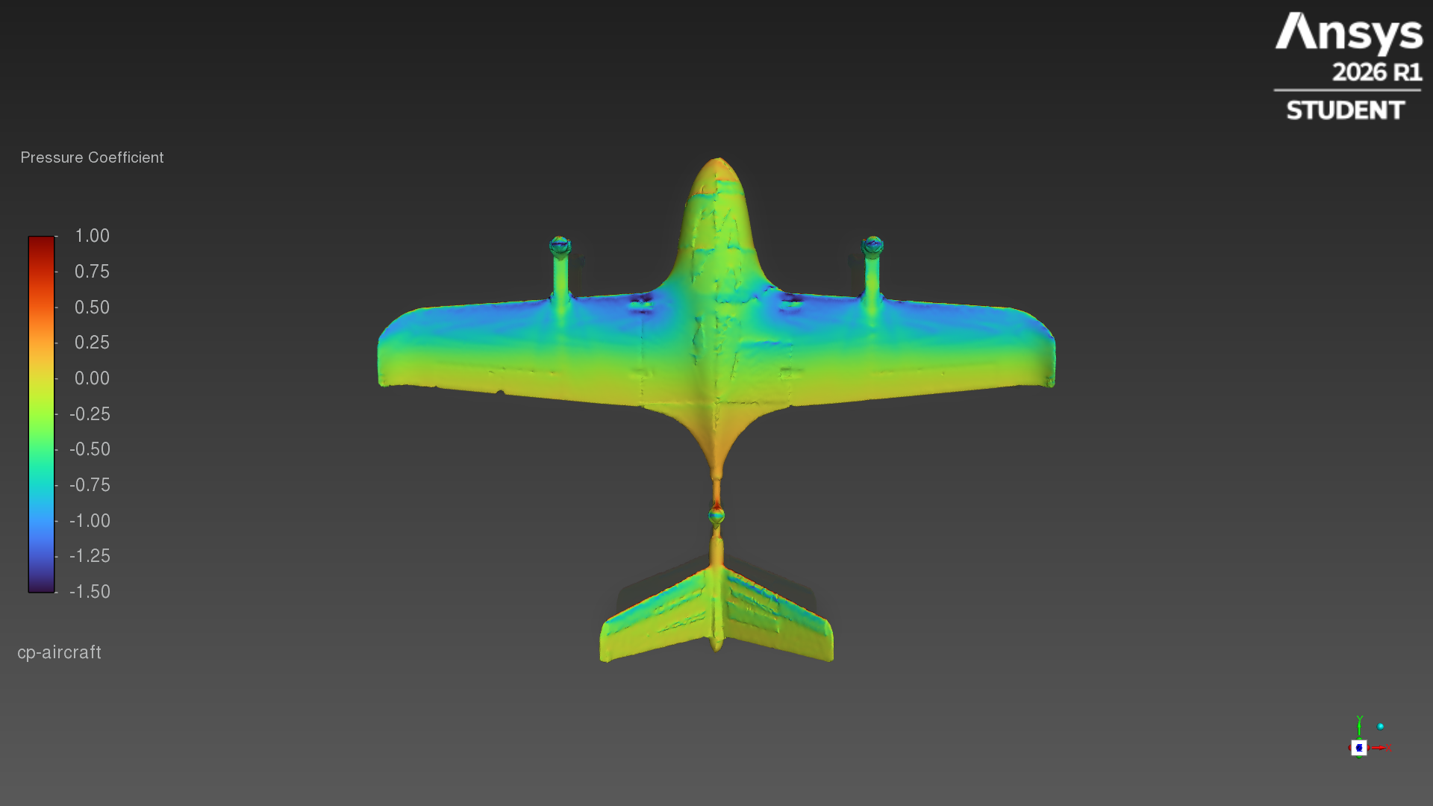
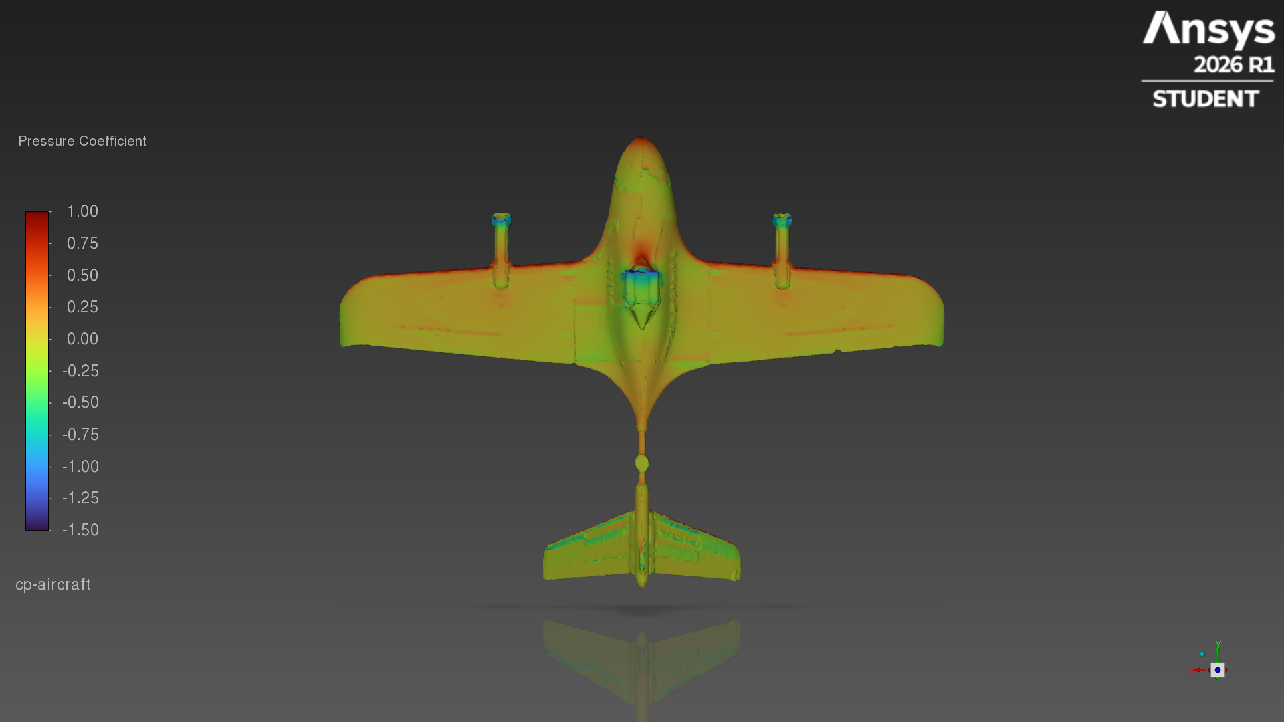
Surface pressure grows with angle of attack
Pressure coefficient on the pod configuration
0° · CL 0.31
4° · CL 0.70
8° · CL 0.91
4°: top and underside
Suction covers most of the upper wing; the underside sits near free-stream pressure, apart from the pod nose.
Notes:
Blue = suction (low pressure) on the wing's upper surface, the source of lift; it grows with angle. Red = stagnation at the nose, pod front and leading edges.

Slide 8
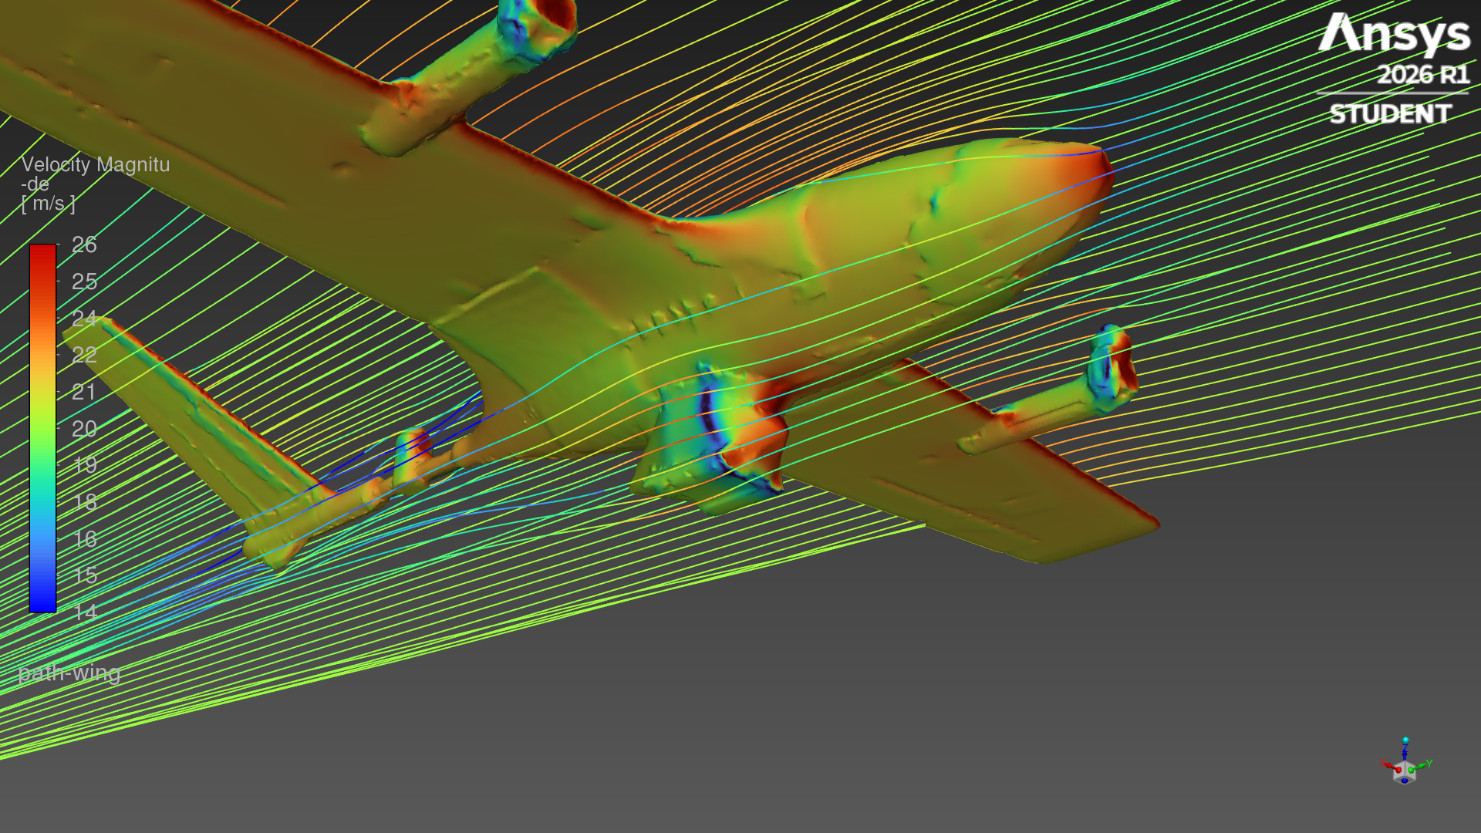
Flow around the pod
Underside close-up at 4°
Pressure coefficient
Streamlines released ahead of the nose
Design hint: a rounder nose and a tapered tail on the pod would cut its pressure drag; mounting it closer to the fuselage reduces the exposed area.
Notes:
The pod's blunt front stagnates the flow (red); its chamfered sides accelerate it (blue), and the flat rear leaves a small low-pressure wake. That is where the extra drag comes from.

Slide 9
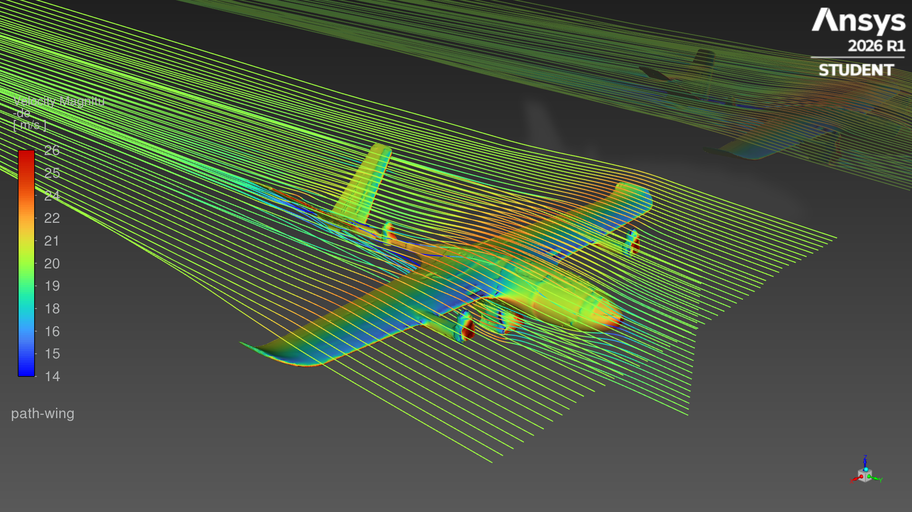
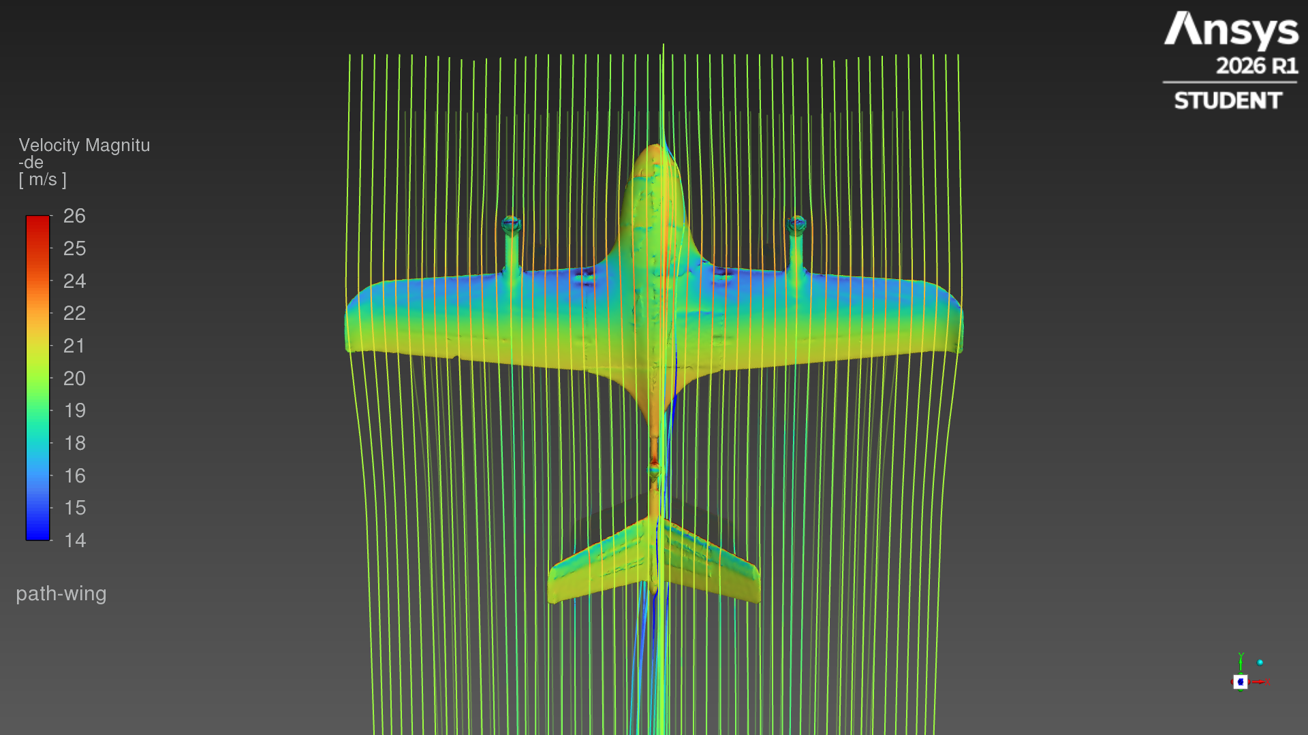
Streamlines over the aircraft
Colour = local speed, 4°
Top view
Flow speeds up over the wing (orange) and slows near the nose and pod (blue).
The tail boom and V-tail sit in the wing's downwash.
Notes:
Streamlines bend upward ahead of the wing (upwash) and downward behind it (downwash). Turning the air downward is what produces lift.

Slide 10
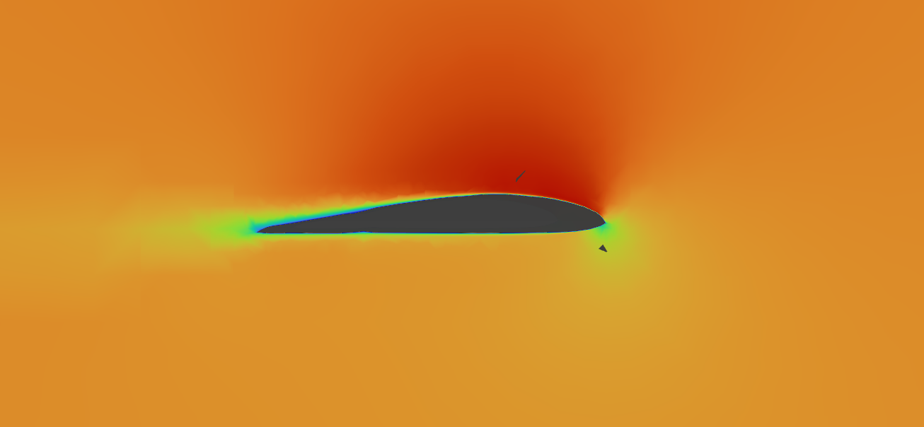
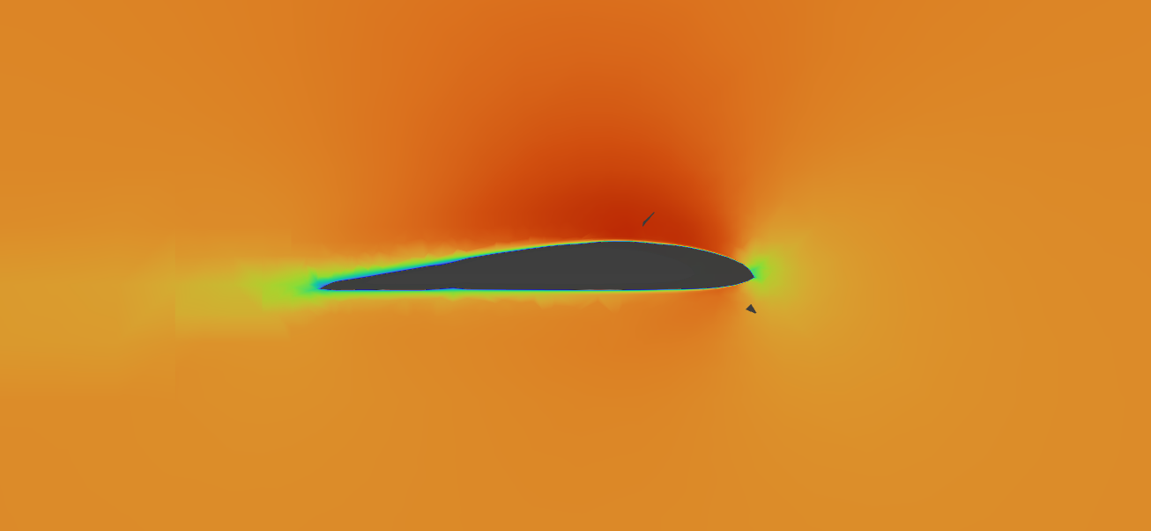
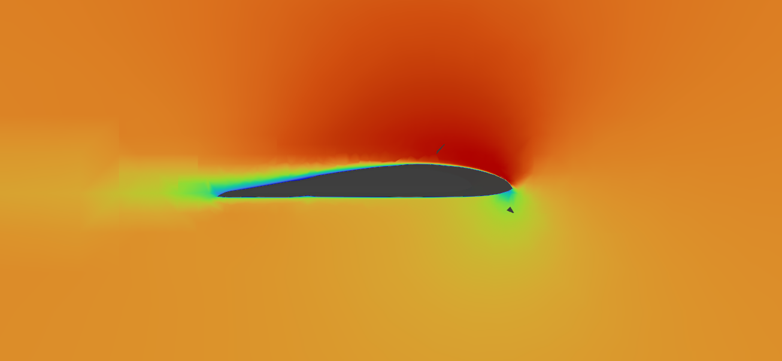
Wing section: flow speed
Cut at 0.55 m span, outboard of the motor boom
0°
4° · colour = speed, 0 (blue) to 28 m/s (red), free stream 20 m/s
8°
Fast flow over the upper surface (red) is the suction that lifts the wing; the thin trailing wake is profile drag. At 8° the upper boundary layer thickens toward the trailing edge, matching the unsteady forces.
Notes:
Airfoil section at 0.55 m span. The suction peak strengthens and moves forward as the angle rises.

Slide 11
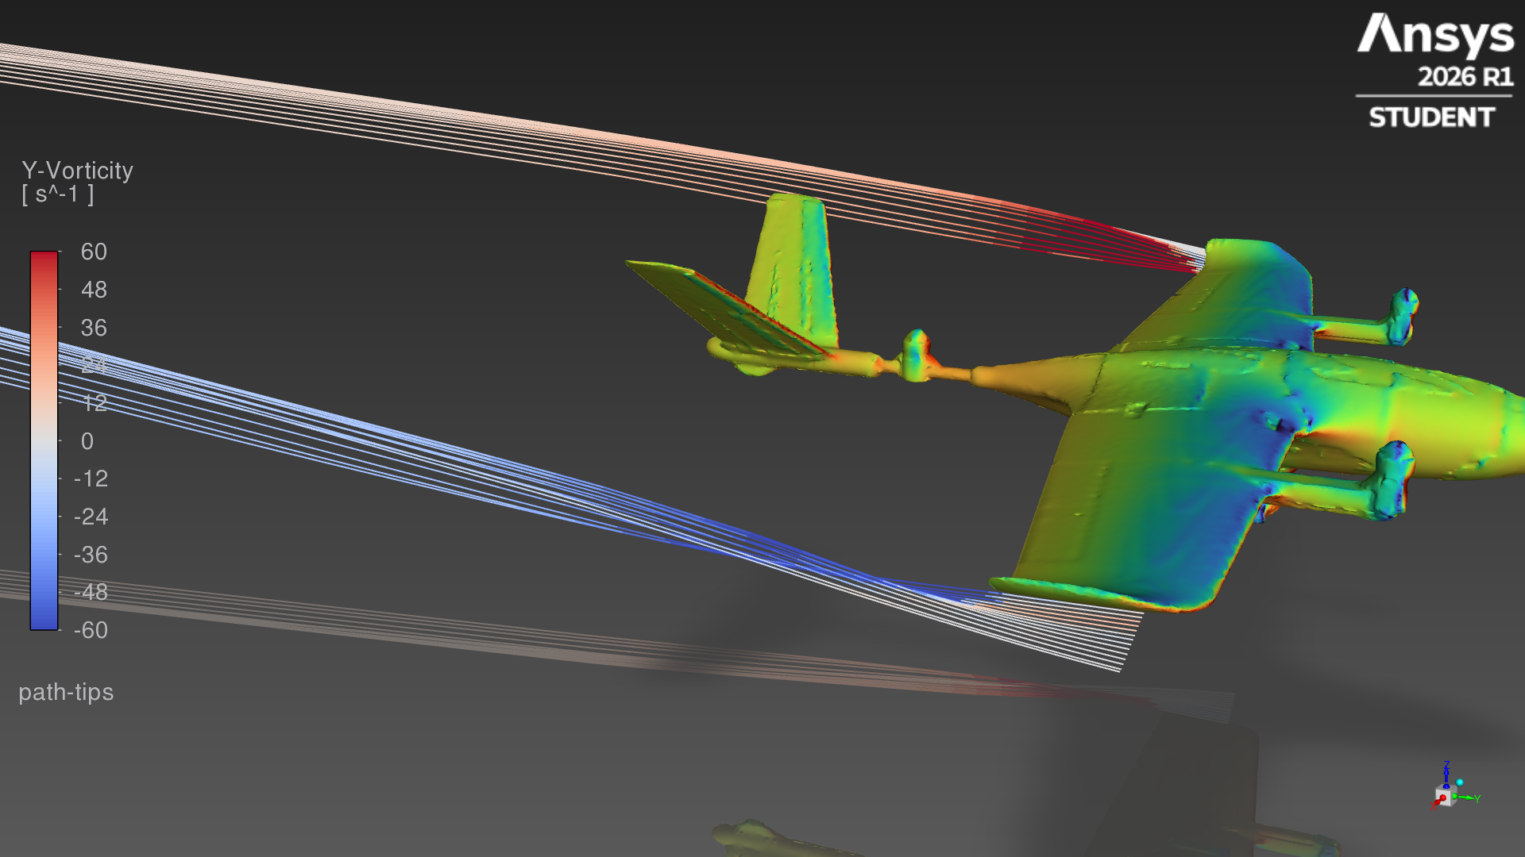
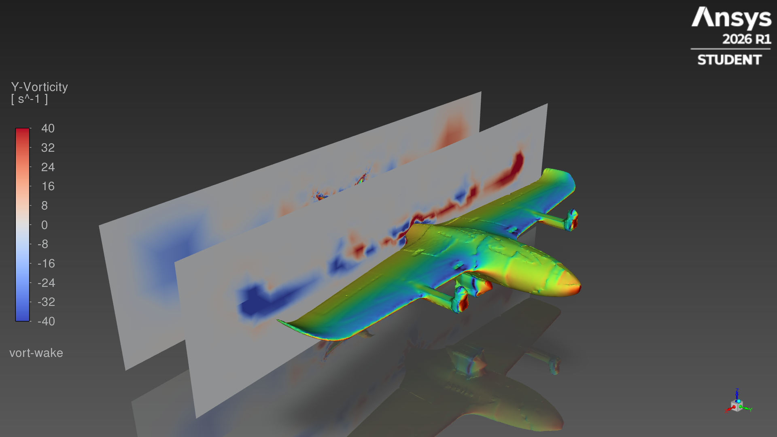
Wing-tip vortices and wake
4°, pod configuration
Tip streamlines, coloured by streamwise vorticity
Streamwise vorticity 0.1 m and 0.4 m behind the wing
Red and blue mark opposite rotation. The pair weakens downstream; part of that is the coarse far-field mesh (student cell limit), so the far wake is under-resolved.
Notes:
Higher pressure under the wing spills around the tips and rolls up into two counter-rotating vortices: the source of induced drag.

Slide 12
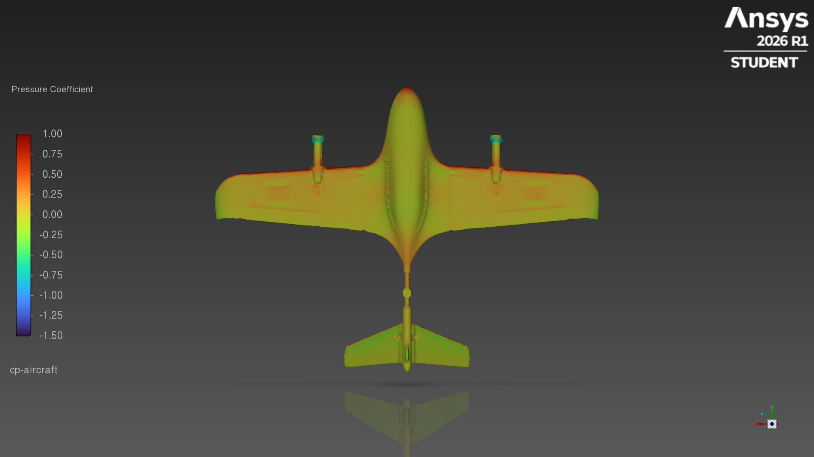
Clean vs pod at 4°
Underside pressure coefficient, same colour scale
Clean · CD 0.0678 · L/D 10.5
Pod · CD 0.0867 · L/D 8.0
Everything else looks the same: the wing loading barely changes (CL 0.713 vs 0.697), while the pod's stagnation front and suction edges plus the boom-front motors add 1.02 N of drag at 20 m/s.
Notes:
Same angle, same colour scale. The pod is the only obvious change in the surface pressure.

Slide 13
Confidence and next steps
Good for
Comparing configurations: both use identical mesh settings, solver and reference values.
Trends with angle of attack, pressure distribution, where drag comes from.
Ballpark L/D and lift at cruise.
Limits
~0.56M cells (student limit): absolute drag is approximate; the far wake is coarse.
Propellers not modelled (motors as static shapes).
Small gaps (hatch seams, under 24 mm slots) sealed by the wrap.
8°: unsteady, reported as a time average.
Next: refine near the pod, add a 10–12° point for stall, and try a faired pod shape.
Notes:
Close with what the results can and cannot support.

