Slide 1

Note: The data and information in this document is reflective of a hypothetical situation and client. This document is to be used for KPMG Virtual Internship purposes only.
Sprocket Central Pty Ltd
Data analytics approach
[Division Name] - [Engagement Manager], [Senior Consultant], [Junior Consultant]

Slide 2
Note: The data and information in this document is reflective of a hypothetical situation and client. This document is to be used for KPMG Virtual Internship purposes only.
Agenda
Introduction
Data Exploration
Model Development
Interpretation

Slide 3
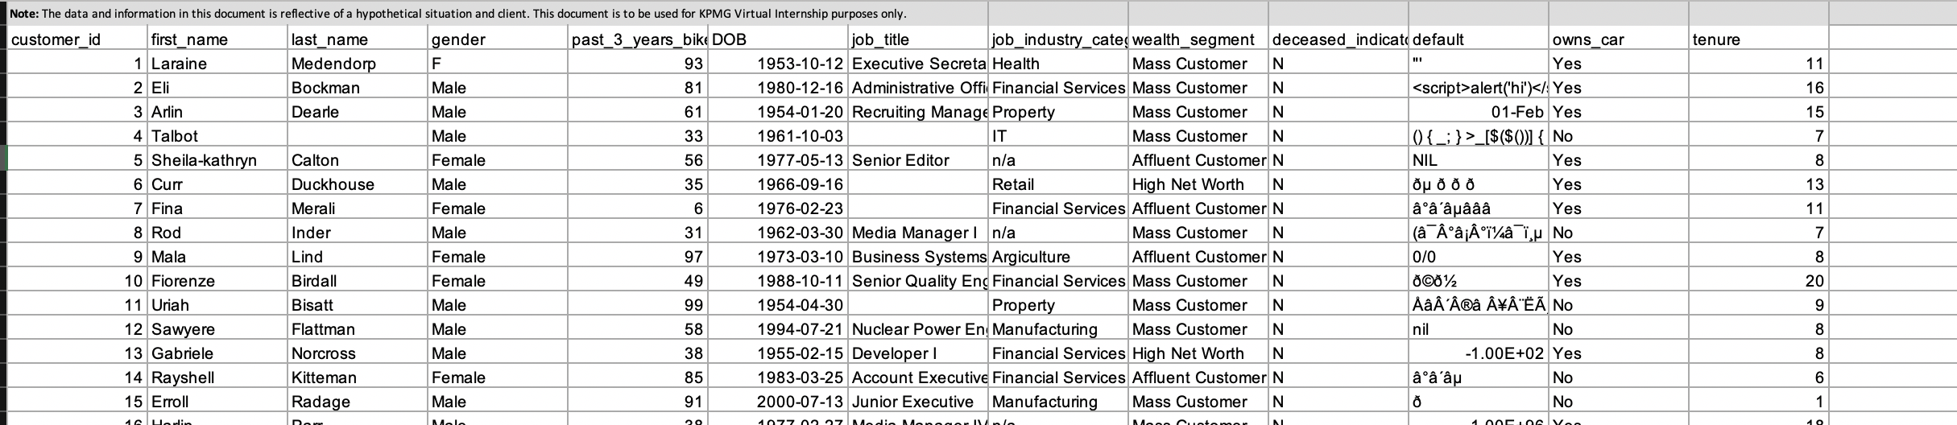
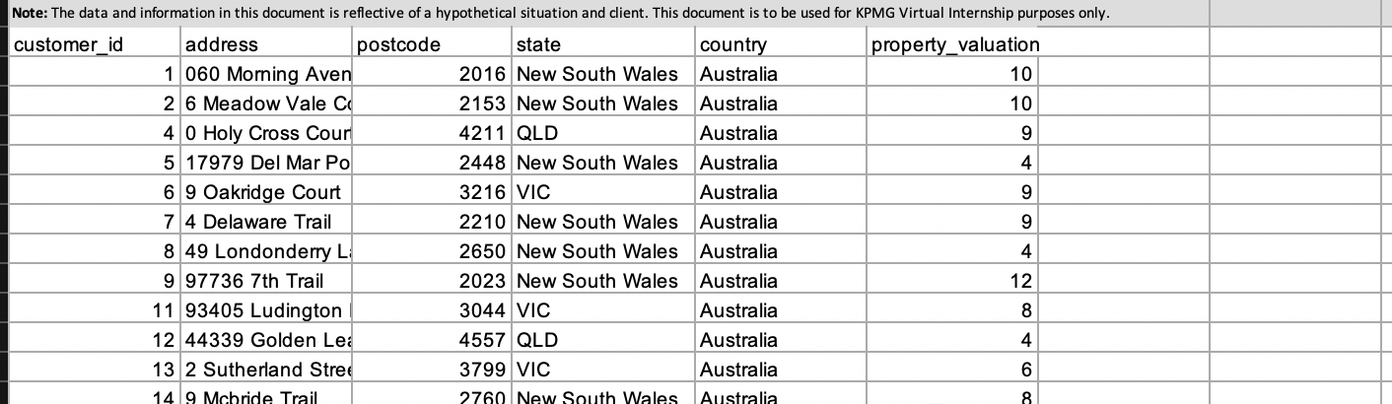
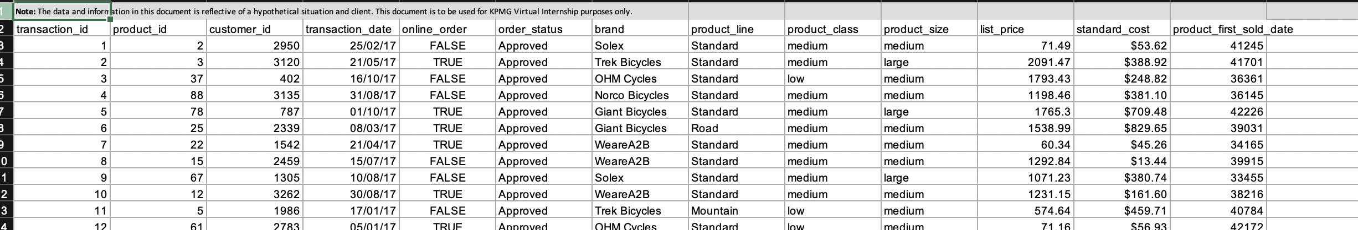
Note: The data and information in this document is reflective of a hypothetical situation and client. This document is to be used for KPMG Virtual Internship purposes only.
Introduction
Datasets used for this presentation
We have used three datasets for the data exploration, model development and Interpretation :-
1.) Customer Address
2.) Customer Demographic
3.) Transaction

Slide 4
Note: The data and information in this document is reflective of a hypothetical situation and client. This document is to be used for KPMG Virtual Internship purposes only.
Data Exploration
Data Exploration is the first phase of the 3 Week Scope. This phase will mainly consists of two parts :- Data Briefing and Data Quality Assessment
Approach Taken :-
Our team had analyzed every dataset using Microsoft Excel and other tools like Tableau Plus. We wanted to check if there are any data quality issues which might hinder the analyzation of the data.
In Microsoft Excel, we had used several features like “Filter”, ”Remove duplicates” etc. in order to check data recurrences and to analyze the data accordingly.

Slide 5
Note: The data and information in this document is reflective of a hypothetical situation and client. This document is to be used for KPMG Virtual Internship purposes only.
Data Exploration
Data Briefing
We will now discuss briefly the datasets provided by Sprocket Central Pty Ltd.
1.) Customer Address :- Consists of customer id, address, postcode, state, country and property valuation.
2.) Customer demographic :- Consists of information of mainly name, customer id, gender, DOB, tenure, information about jobs and wealth segment
3.)Transaction :- Consists of information of mainly the brand name, product class, transaction id, date, online order status and prices related to the product

Slide 6
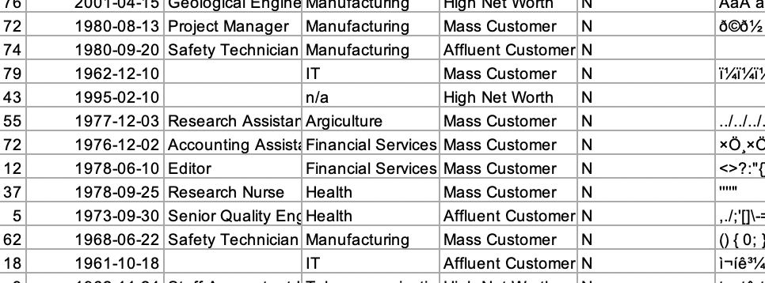
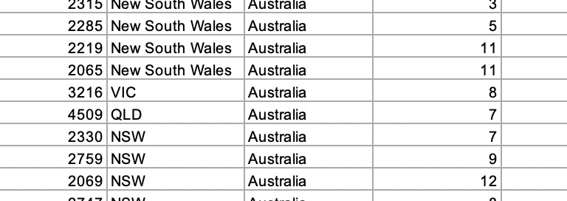
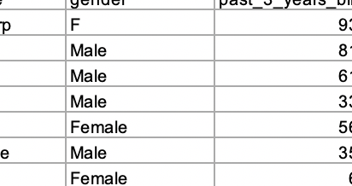
Note: The data and information in this document is reflective of a hypothetical situation and client. This document is to be used for KPMG Virtual Internship purposes only.
Data Exploration
Data Quality Assessment :-
While observing the three datasets, there were few data quality issues identified. These are :-
1.) The datasets are not synced with each other .
2.) Empty value fields have been observed
3.) The values provided for an attribute is inconsistent.
4.) Inconsistent data type used for the same attribute.
Place any supporting images, graphs, data or extra text here.

Slide 7
Note: The data and information in this document is reflective of a hypothetical situation and client. This document is to be used for KPMG Virtual Internship purposes only.
Model Development
Model Development is the second phase of the 3 Week Scope.
In this phase, we will use images, charts and images to represent our observed data for all the three datasets. This will help us to create a model for every dataset. This model will help us in the final phase :- Interpretation.

Slide 8
Note: The data and information in this document is reflective of a hypothetical situation and client. This document is to be used for KPMG Virtual Internship purposes only.
Model Development
Approach Taken
In this phase, we wanted to compare the data of several components like brands, amount of online orders done etc. For this, we had compared it using pie-charts and compared the results and made important observations.

Slide 9
Note: The data and information in this document is reflective of a hypothetical situation and client. This document is to be used for KPMG Virtual Internship purposes only.
Model Development
Customer Address
What we can observe from the pie chart, maximum number of the customers are present in NSW(New South Wales) while the least number of customers are present in QLD.

Slide 10
Note: The data and information in this document is reflective of a hypothetical situation and client. This document is to be used for KPMG Virtual Internship purposes only.
Model Development
Customer Demographic
What we observe from this chart is that most of the customers are those people who have the job type “Manufacturing” and “Financial Service” while the least number of customers are those who have the job type “Telecommunications”

Slide 11
Note: The data and information in this document is reflective of a hypothetical situation and client. This document is to be used for KPMG Virtual Internship purposes only.
Model Development
Customer Demographic
What we observe in the chart, most of the customers who buy bicycles are females.

Slide 12
Note: The data and information in this document is reflective of a hypothetical situation and client. This document is to be used for KPMG Virtual Internship purposes only.
Model Development
Customer Demographic
What we observe from the pie chart is that most of the customers are those who own a car

Slide 13
Note: The data and information in this document is reflective of a hypothetical situation and client. This document is to be used for KPMG Virtual Internship purposes only.
Model Development
Transactions
What we observe from this chart is that most of the customers buy the cycles of brand “Solex” while least of the customers buy the cycles of brand “Norco Bicycles”

Slide 14
Note: The data and information in this document is reflective of a hypothetical situation and client. This document is to be used for KPMG Virtual Internship purposes only.
Model Development
Transactions
What we can observe in this chart is that almost equal percentage of customers prefer and don’t prefer online ordering.

Slide 15
Note: The data and information in this document is reflective of a hypothetical situation and client. This document is to be used for KPMG Virtual Internship purposes only.
Model Development
Summary
We have now modeled the observed data for all the three datasets. We need to interpret the results of the charts and plan the strategies on how to target the 1000 new customers to increase the profits accordingly.

Slide 16
Note: The data and information in this document is reflective of a hypothetical situation and client. This document is to be used for KPMG Virtual Internship purposes only.
Interpretation
Interpretation is the third phase of the 3 Week scope
Approach Taken :-
We had carefully looked at the observations which were made in stage two. After careful analysis, we had interpreted the strategies to be used to target the new customers.
Following the model development, we have planned the strategies accordingly. These are :-
1.) We need to target those customers who are mainly from NSW because most of the people at NSW buy the bicycles from the company. Also, the statistics of the motor vehicle census at ABS website show that NSW is one of the states to have less motor vehicles registered than that of QLD and VIC.

Slide 17
Note: The data and information in this document is reflective of a hypothetical situation and client. This document is to be used for KPMG Virtual Internship purposes only.
Interpretation
Interpretation(cont.)
2.) Also, those customers are vey valuable and who have the job-type “Financial Service “ and “Manufacturing” because they are most likely to boost the business.
3.) In terms of Gender, Females have been found to be more targetable customers than men
4.) In order to increase the sales, it is recommended to sell “Solex” brand cycles the most because it is the most loved brand.
Our team hopes that you all are satisfied by the points made in the last phase.

Slide 18
Note: The data and information in this document is reflective of a hypothetical situation and client. This document is to be used for KPMG Virtual Internship purposes only.
Appendix

Slide 19
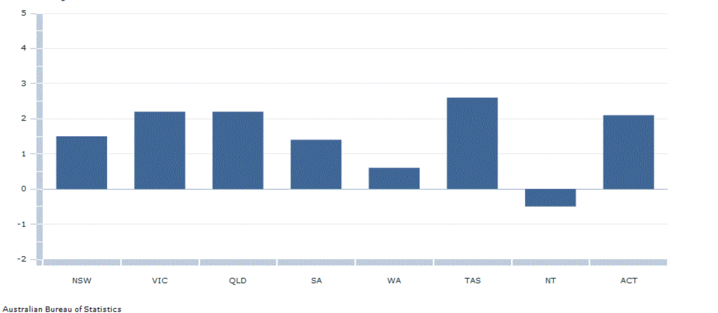
Note: The data and information in this document is reflective of a hypothetical situation and client. This document is to be used for KPMG Virtual Internship purposes only.
Appendix
This is an optional slide where you may place any supporting items.
This chart has been taken from the websitehttps://www.abs.gov.au/browse?opendocument&ref=topBar. This chart is a a part of the motor census taken in 2019.

