Slide 1
Offshore Health Assessment
for NZ Quota Refugee Cases
Keiko Foster
IOM Australia
NRRF 24 May 2017

Slide 2
About IOM
Established in
1951
UN
Migration Agency
166
Member states
150+
Countries with IOM offices
DIGNIFIED, ORDERLY AND SAFE MIGRATION FOR THE BENEFIT OF ALL
9,000+
Employees
480+
field offices

Slide 3
IOM Migration Health
HEALTHY MIGRANTS IN HEALTHY COMMUNITIES
Promoting and delivering quality health care
for migrants and host communities
Migration Health Assessments and Travel Health Assistance
Health Promotion and Assistance for Migrants
Migration Health Assistance for Crisis-Affected Populations

Slide 4
Migration Health Assessments and Travel Health Assistance
Components under Migration Health Assessment Programme (HAP):
Review of medical and immunization history
Physical examination
Mental health evaluation
Clinical or laboratory investigations
Radiological screening (CXR)
Serological tests and chemical analysis (blood/urine)
Referral for consultation with specialists
Health education and pre– and post‐test counselling
Public health surveillance and outbreak management in camps, transit centres and other temporary settlements
Arranging for the administration of vaccinations
Provision of or referral for directly‐observed treatment for certain conditions (e.g. TB, malaria, sexually-transmitted infections, parasitic infections, anti‐retroviral administration and prevention of mother-to-child vertical transmission)
Ensuring fitness to travel Detailed documentation of findings, preparation of required immigration health forms and documents
Quality control/quality assurance of services
Confidential transfer of relevant information or documentation to appropriate immigration or public health authorities
Provision of medical escorts/special services or arrangements for travel and relocation

Slide 5
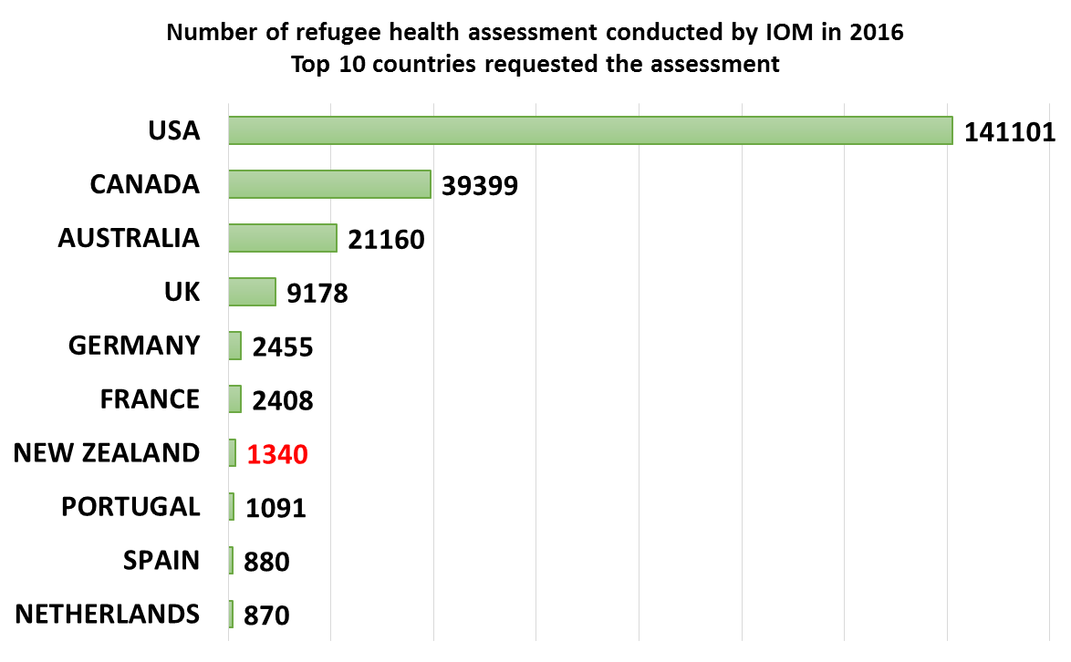
Migration Health Assessments and Travel Health Assistance
Facts and Figures:
66 IOM clinics around the world
173 IOM Panel Physicians working on the Health Assessment Programmes for NZ
Over 224,000 health assessments were conducted globally in 2016
Over 1,300 health assessments were conducted for NZ cases in 2016

Slide 6



Health Assessment
Locate applicants
Check identification
Arrange appointments
Create health record
Health Assessment request
Email/Manifest
LME
CXR
HIV
Health Assessment
Assessment by health assessors
No
Additional test required?
Yes
Additional test request
Additional test(s)
Specialist referrals

Slide 7
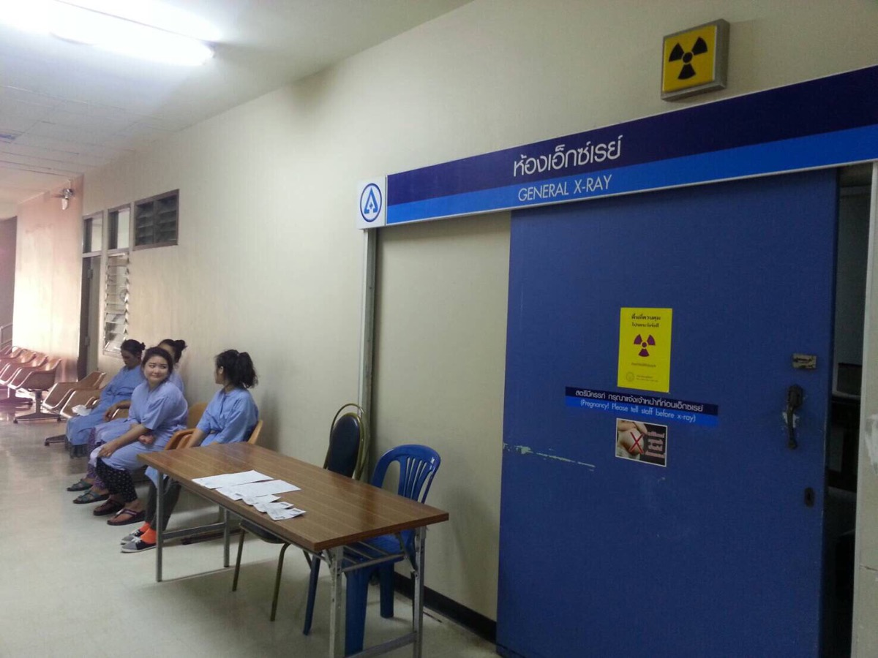
TB screening and treatment
TB screening:
Physical exam by panel physicians for the pregnant applicants and applicants under 11 years old
Chest X Ray (CXR) for all others
Validity of CXR certificate:
6 months

Slide 8
TB screening and treatment
CXR request
CXR / review
IOM Teleradiology Centre
Result
Assessment by health assessors
Grade A
Grade B
Additional test required?
eMedical
Yes
Additional test request
Confirmatory examinations (8-10 weeks)
Positive?
Yes
Final clearance
TB Treatment (approx. 6 months)

Slide 9
Departure Health Check
Travel request
Check validity of CXR
If it is expired, repeat CXR is arranged.
If the confirmatory test is required, travel date may need to be changed
Check vaccination requirement and status
Check travel fitness
Brief clinical review
Medical history
Viral signs and general appearance
Any concern?
Yes
Final clearance
Further consultation by IOM doctor
Fit for air travel?
Any special arrangement required during travel? (e.g. medical escort)?
Any new settlement needs since the initial health assessment?

Slide 10
Contact Details
IOM Australia
Country Office with Coordinating Functions for the Pacific
Phone: +61 2 6267 6600
Website: http://australia.iom.int/
Email: cbrresettlement@iom.int

