Slide 1
New Zealand Refugee Resettlement Strategy:
Update on 2016 outcome measures and indicators
Andrew Lockhart, National Manager Refugee and Protection, INZ

Slide 2
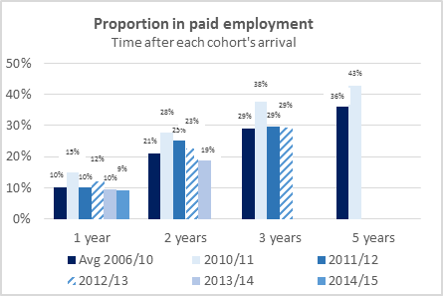
Self-sufficiency
Success Indicator
Increased proportion in paid employment

Slide 3
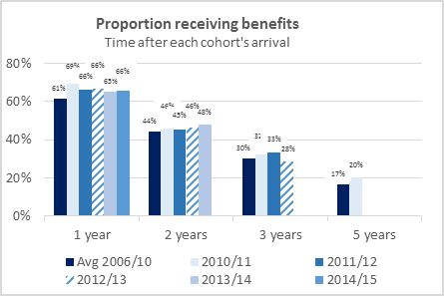
Self-sufficiency
Success Indicator
Reduced proportion receiving unemployment-related benefits

Slide 4
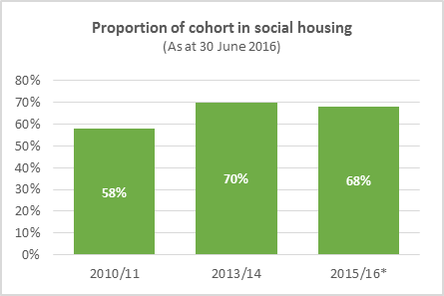
Housing
Success Indicator
Reduction in the proportion of refugees receiving housing assistance after two years and five years in New Zealand

Slide 5
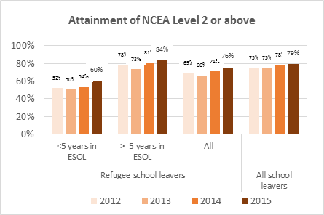
Education
Success Indicator
Proportion of refugee school leavers attaining NCEA Level 2 after 5 years or more in the New Zealand education system

Slide 6
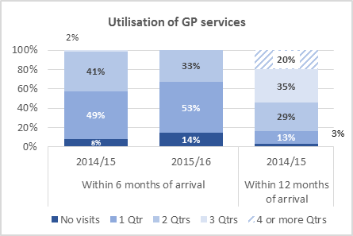
Health and Wellbeing
Success Indicator
Utilisation of GP services

Slide 7
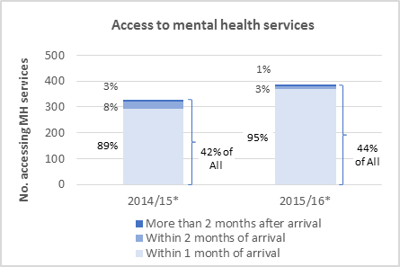
Health and Wellbeing
Success Indicator
Access to mental health services (at least one face-face visit)

Slide 8
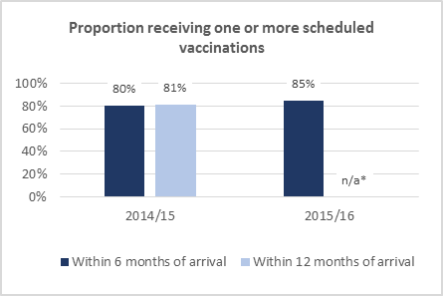
Health and Wellbeing
Success Indicator
Proportion of quota refugee children receiving age-appropriate immunisations (within 6 and 12 months of arrival)

