Slide 1

Phil Wysocki
Disability Support Services
Ministry of Health

Slide 2
Who is funded through DSS?
The Ministry’s DSS client group consists of people who:
· present for assessment for DSS before the age of 65
AND
· have a physical, intellectual, or sensory disability or a combination of these, which is likely to:
remain even after provision of equipment, treatment and rehabilitation
continue for at least six months, and
result in a need for on-going support.
Notes:
This is the current access criteria
Can be difficult to define eg ASD – recently included
Does not include long term chronic conditions such as diabetes and asthma, but does include parkinsons etc

Slide 3
What we know about our clients
Approx 32,000 receive regular, ongoing support
Another 70,000 per year receive one off support (equipment)
More males (56%) than females (44%)
16% Maori, 6% Pacific, 5% Asian, 69% Other
38% of clients are under the age of 19, and 8% are over the age of 65
47% of clients live in their own or the family home
Principal disabilities include intellectual (46%), physical (27%), ASD (16%), sensory (4%), neurological (2%)
Notes:
The remainder of residences include housing nz, rest home, boarder, unknown

Slide 4
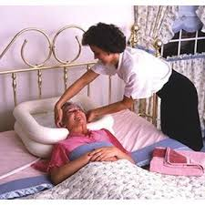
Community Supports
Disability Information and Advisory Services
Personal Cares – eg showering, dressing
Household Management – eg meal preparation, cleaning, laundry
Funded Family Care – for resident family of adults with a disability
Carer Support/Respite – for full time carers to take a break from their caring responsibilities
Supported living – managing a
budget, shopping, transport around
the community
Notes:
Paid in hours of support per week following an assessment by the NASC
Based on unmet need – after the family and the community provide support, we meet the balance of the clients needs
Household management ave 4 hours per week (8,000 clients), personal care 11 hours per week (7,000 clients), supported living 11 hours per week (2,500 clients) Carer support (14,000 clients)
Funded family care was introduced in Oct 2013 – high and very high needs, adult children, max 40 hours per week, disabled person the employer

Slide 5
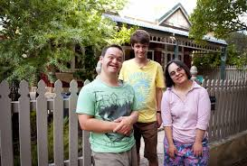
Residential Care
Includes
Community residential (group homes, usually of 4 clients, often ID)
Rest homes (for physically disabled people needing clinical (nursing) supports)
Hospitals (for high needs
clients)
Notes:
In past years (20 years ago) babies and young children were placed into institutional care such as Kimberley
Since deinstitutionalisation which started in the 1970’s and ended in 200’s, we have moved to smaller, group homes
Choice in Community Living and Supported Living contracts are a new way of supporting people to be independent
Idea of citizenship – if you don’t own or rent property or have a bank account, where are you recognised in law?
People want to choose where they live and who they live with – imagine if you had no say about this in your lives.
One example of the clients in a home who have stayed together in the same house but now they rent it from the provider. They choose their support staff and when and how often the support staff will attend.
Ave annual cost $68k per client per annum, 7,000 clients, 1,500 homes

Slide 6

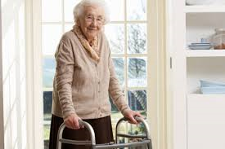
Environmental Support
Includes:
All people with a long term disability
who need equipment (including over
65’s)
Housing and vehicle modifications
Cochlear implants
Hearing aids
Spectacle and contact lens subsidy
Notes:
Explain about over and under 65 issue
Managed through two providers – access able in Auckland/Northland and Enable in the rest of the country.
Provide core and specialised equipment to people with a disability related need such as wheelchairs, walking frames, shower stools, bed and chair raisers etc to approx 40,000 people per year.
Do some housing mods but only one in a lifetime – what does this mean for someone leaving home?
14,000 hearing aid claims per year $511 contribution
Support children through a spectacle subsidy for under 16’s who require prescription lenses (CSC holders only), approx 30,000 claims per year

Slide 7
Specialist Services
Behaviour Support
Child Development Services
Rehabilitation Services

Slide 8
Needs Assessment Service Coordination (NASC) agencies
Taikura NASC visits the Mangere Centre
Provides general information regarding NASC process and disability services in NZ
Provides full NASC services to those refugees settling in the Auckland region
Provides support for referrals to other NASC regions through the Red Cross social workers or GP practice at Mangere

Slide 9
Needs Assessment Service Coordination (NASC) agencies
15 NASCs across the country by region
Refugees will be linked to NASC services as required through the resettlement network – Red Cross social worker or GP
This can occur within the first 6 weeks at Mangere Centre or once the person has moved to their resettlement region
Notes:
So how do people access these services – referral to a NASC
Not to be confused with older persons NASCs or Mental health NASCs!

Slide 10
Accessing Equipment
NASC or your GP can help access to a specialist assessment through your local DHB
A specialist assessor (OT, PT) will assess eligibility and what equipment can support disability related needs
Equipment solutions are delivered through two national contracted providers (Enable and accessable)
Solutions can range from simple walkers right through to housing access and modifications
There are eligibility and access criteria for high cost solutions

