Slide 1


Accelerating Multi-Agent
Reinforcement Learning via
CUDA-Native Zero-Copy Architecture
UCS645: Parallel and Distributed Computing — Project Defense
Nimish | 102497027 | Thapar Institute of Engineering & Technology
29.6x
GPU Speedup
17.6B
States/sec
Notes:
Welcome everyone. Today I'm presenting my UCS645 project on accelerating multi-agent reinforcement learning for warehouse robotics using CUDA. Our GPU-native architecture achieves a 29.6x speedup over CPU serial baseline and processes over 17 billion state evaluations per second.

Slide 2

The Challenge: Multi-Agent Warehouse Navigation
State-Space Explosion
PCIe Bottleneck
Multi-Agent Deadlock
20×20 grid × agent position × goal position = 160,000 distinct states for a SINGLE agent. CPU sequential processing cannot scale to real-time multi-agent coordination.
Standard RL frameworks split execution: CPU runs environment, GPU trains model. Continuous PCIe transfers dominate latency (~29.7 ms/step).
30 robots following greedy policies deadlock at choke points. Lock-free decentralized coordination with collision avoidance is essential.
Core question: Can we keep the ENTIRE RL data lifecycle on the GPU and eliminate CPU-GPU transfers?
2 / 10
Notes:
The warehouse navigation problem has three key challenges. First, the state space grows as N to the fourth for an N-by-N grid — that's 160,000 states for our 20x20 grid. Second, standard ML frameworks constantly shuttle data across the PCIe bus. Third, multiple agents competing for the same cells inevitably deadlock without careful coordination.

Slide 3
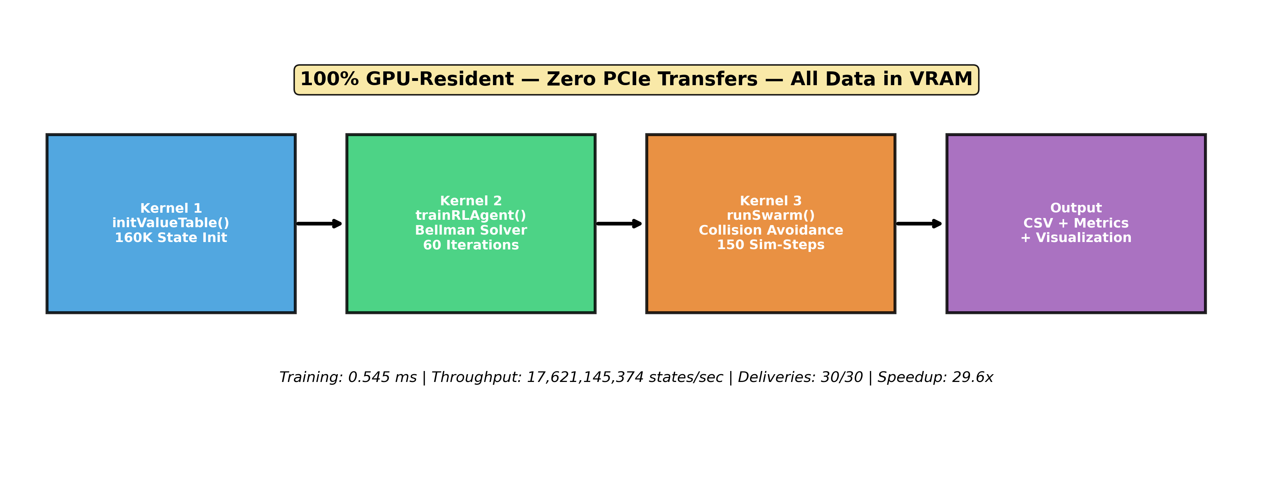
System Architecture: 100% GPU-Resident
Kernel 1
Kernel 2
Kernel 3
Output
initValueTable()
160K State Init
trainRLAgent()
Bellman Solver
runSwarm()
Collision Avoidance
CSV + Metrics
+ Visualization
Zero PCIe transfers — All data stays in GPU VRAM from initialization through output
3 / 10
Notes:
Our architecture has three CUDA kernels that execute entirely on the GPU. Kernel 1 initializes the 160,000-state value table. Kernel 2 is the core — it runs parallel value iteration, solving the Bellman equation for all states simultaneously. Kernel 3 runs the multi-agent swarm, using atomic CAS for lock-free collision avoidance. The CPU only issues kernel launches and collects final logs.

Slide 4


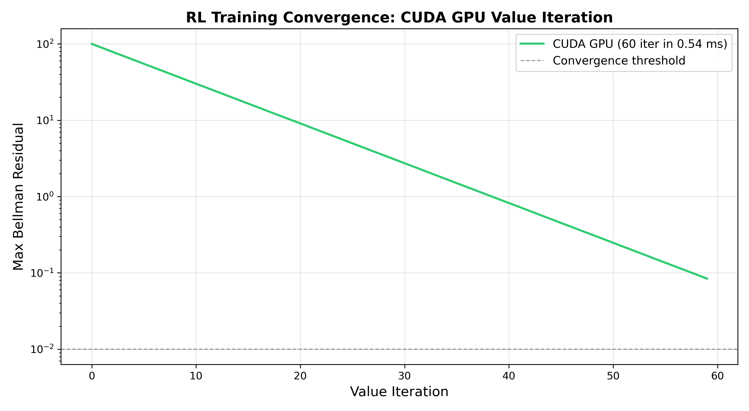
Massively Parallel Value Iteration
Bellman Optimality Equation
GPU Training Performance
V*(s) = max [ R(s,a) + γ · V*(s') ]
s = (x, y, gx, gy) — agent + goal position
|S| = 20⁴ = 160,000 states
γ = 0.99 | R_step = -1 | R_goal = +100
One CUDA thread per state → 160K threads
625 blocks × 256 threads = full coverage
0.545 ms
60 Iterations × 160K States
17.6B
State Evaluations per Second
625
Thread Blocks (256 threads each)
0
PCIe Transfers During Training
4 / 10
Notes:
The core innovation: we assign one CUDA thread to each of the 160,000 MDP states. Each thread independently evaluates all four actions, computes Q-values, and selects the maximum — all in parallel. After 60 iterations of ping-ponging between two value tables, the value function converges. Total training time: just 0.545 milliseconds.

Slide 5



Lock-Free Multi-Agent Collision Avoidance
atomicCAS Locking
Occupancy Penalty (-100)
Random Tie-Breaking
Each robot atomically claims its target cell using Compare-And-Swap. Only one robot can occupy a cell — others retry next step. Completely lock-free, no mutex overhead.
Cells occupied by other robots have their value reduced by 100 in the Q-value computation. This causes the value function to implicitly route agents around congestion zones.
Small random noise (~10⁻⁵) added to each action's Q-value prevents symmetric deadlocks where multiple robots choose identical paths simultaneously.
// CUDA kernel: collision avoidance logic
if (grid_occupancy[cell_idx] != -1 && grid_occupancy[cell_idx] != r.id) {
val -= 100.0f; // Heavy penalty for occupied cells
}
val += (lcg(temp_state) % 1000) / 100000.0f; // Random tie-break
if (atomicCAS(&grid_occupancy[cell_idx], -1, r.id) == -1) { move(); }
5 / 10
Notes:
Collision avoidance uses three mechanisms working together. First, atomicCAS provides lock-free cell reservation. Second, we apply a heavy penalty of -100 to cells occupied by other robots in the value function, which causes agents to naturally route around each other. Third, tiny random noise breaks ties when multiple robots would otherwise choose identical paths — this is what finally solved our deadlock problem.

Slide 6
CPU Baseline: BFS-Based Pathfinding
Results
CPU Serial (1 Thread) BFS
16.1 ms
Total Wall Time
Algorithm: Online BFS per robot, per step
1. Shuffle robot order randomly each step
2. For each robot, build blocked set from:
- Static obstacles (shelf columns)
- All other robots' current positions
3. BFS shortest path to goal avoiding blocked cells
4. Claim first step of path via reservation system
5. If blocked, replan from scratch next step
30/30
Deliveries Completed
44 steps
To Finish All Robots
1.47
Avg Steps per Delivery
OpenMP Multi-Threading
The baseline supports OpenMP parallelization via omp_set_num_threads(). On multi-core CPUs, robot processing can be distributed across threads for additional speedup beyond the serial baseline.
Key Insight: CPU BFS is step-efficient (44 steps) but recomputes paths every step. GPU VI amortizes 0.545ms training across all simulation steps, enabling real-time replanning at scale.
6 / 10
Notes:
For rigorous comparison, we implemented a CPU BFS-based baseline. Each robot runs BFS every step avoiding all other robots, with randomized processing order to prevent deadlocks. It achieves 30 out of 30 deliveries in just 44 steps with 16.1ms total time. However, BFS must be recomputed every step for every robot, while our GPU approach pre-computes a global value function once.

Slide 7
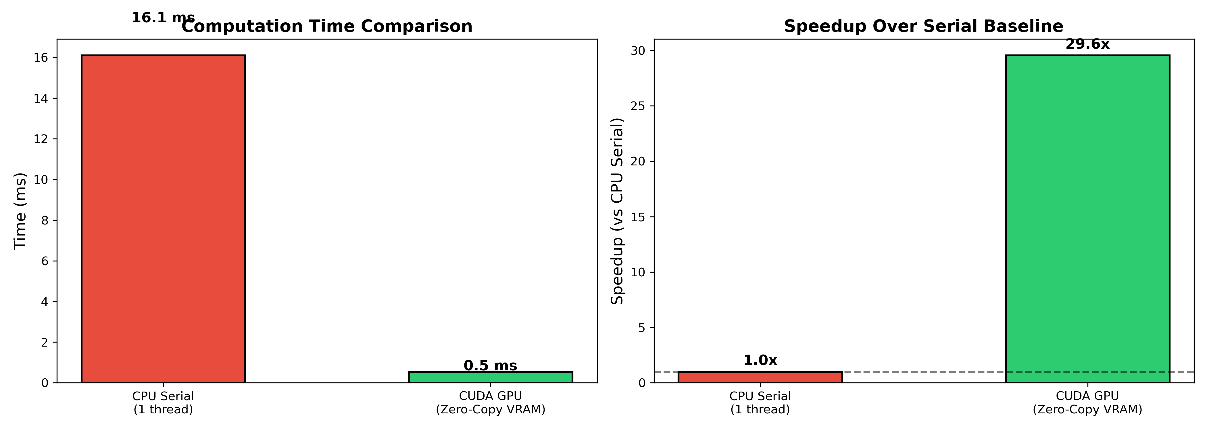
Results: Training & Planning Performance
0.545 ms
16.1 ms
29.6x
17.6B
GPU Training
(60 VI Iterations)
CPU BFS Planning
(Total Wall Time)
GPU Speedup
Over CPU Serial
State Evals/sec
GPU Throughput
Performance Table
Metric | CPU | GPU
Time | 16.1 ms | 0.545 ms
Speedup | 1.0x | 29.6x
Throughput | — | 17.6B/s
Deliveries | 30/30 | 30/30
7 / 10
Notes:
The GPU completes 60 value iterations over 160,000 states in just 0.545 milliseconds. That's 29.6 times faster than the CPU BFS baseline's planning time of 16.1 milliseconds. GPU throughput reaches 17.6 billion state evaluations per second. Both implementations achieve 100% delivery completion.

Slide 8
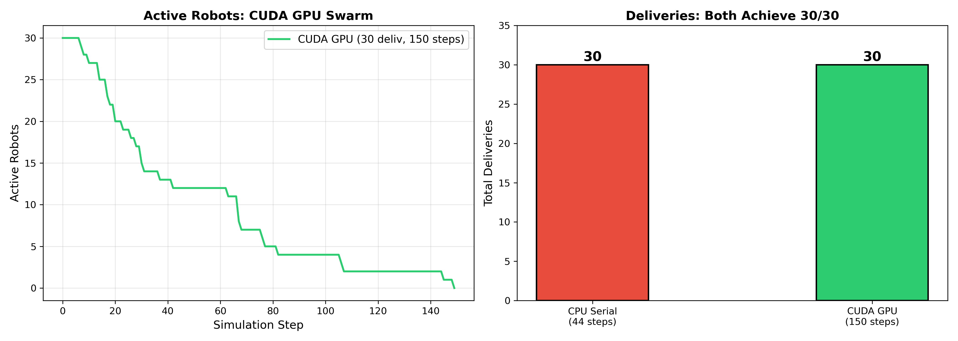
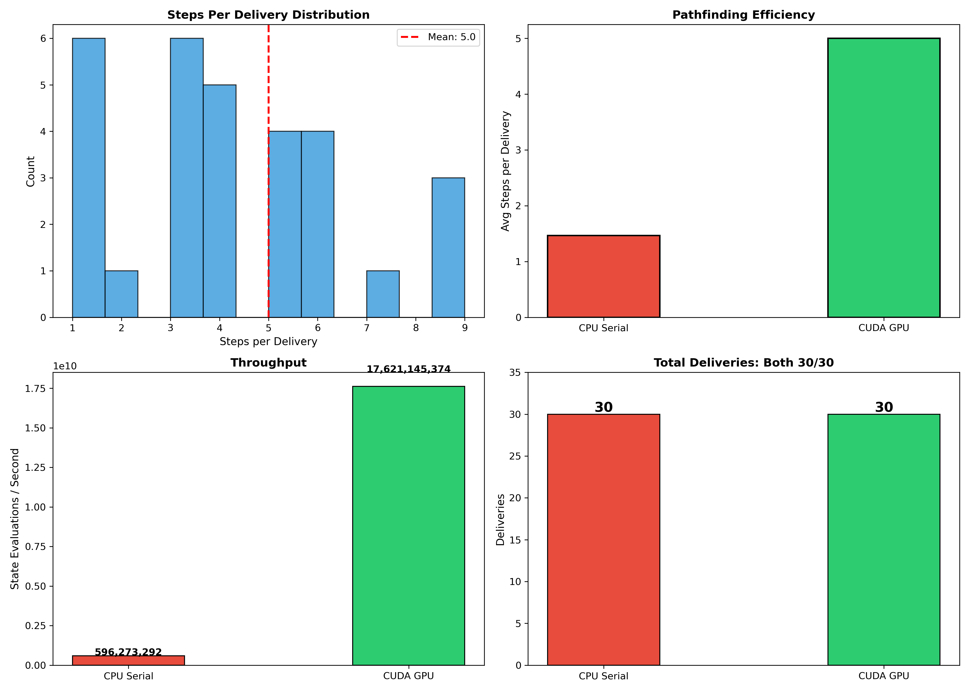
Results: Swarm Simulation Outcomes
Performance Trade-off Analysis
CPU BFS (Online)
GPU VI (Offline)
• Optimal shortest paths every step
• Pre-computed global value function
• Full knowledge of all robot positions
• Static occupancy penalty approximation
• 44 steps for 30 deliveries (efficient)
• 150 steps for 30 deliveries
• BUT: O(grid² × robots) per step
• BUT: 0.545ms training amortized
8 / 10
• Cost scales poorly with more agents
• Scales to larger grids and robot counts
Notes:
Both approaches achieve 30 out of 30 deliveries. The CPU BFS is actually more step-efficient — 44 steps vs 150 — because it computes optimal paths with full knowledge of all robot positions at every step. However, the GPU approach amortizes its one-time 0.545ms training cost, making it far more scalable as the number of agents and grid size increase.

Slide 9
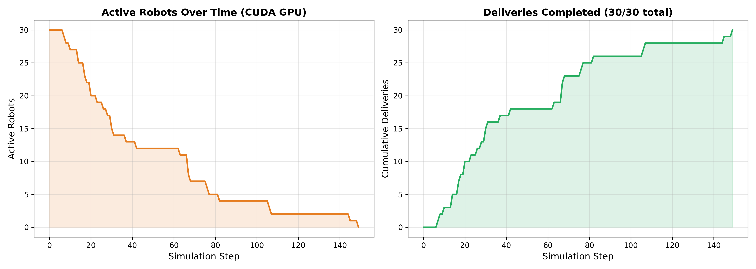
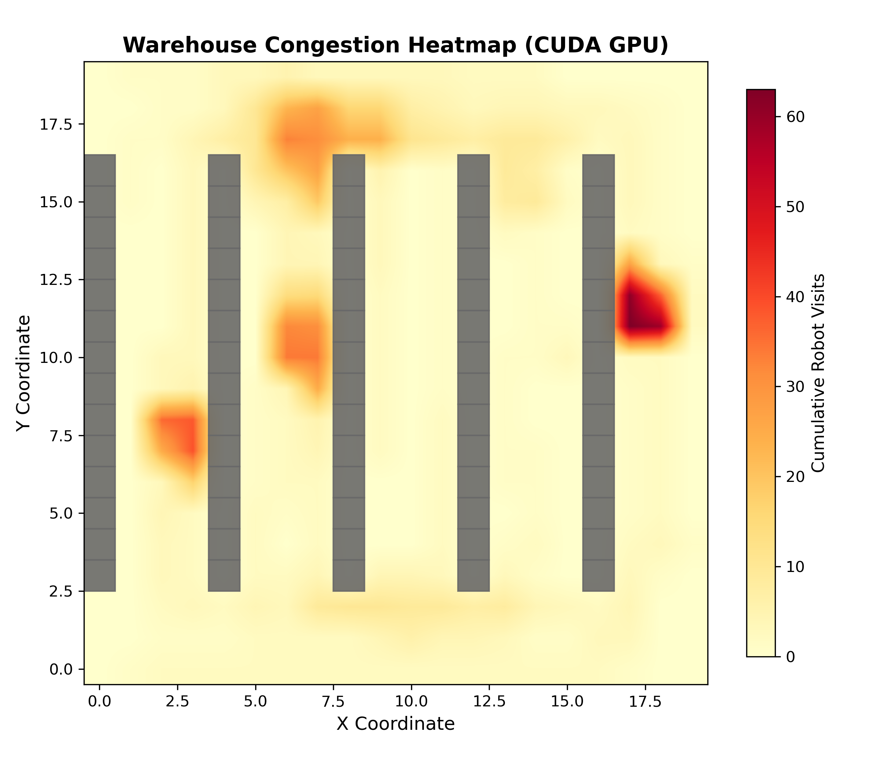
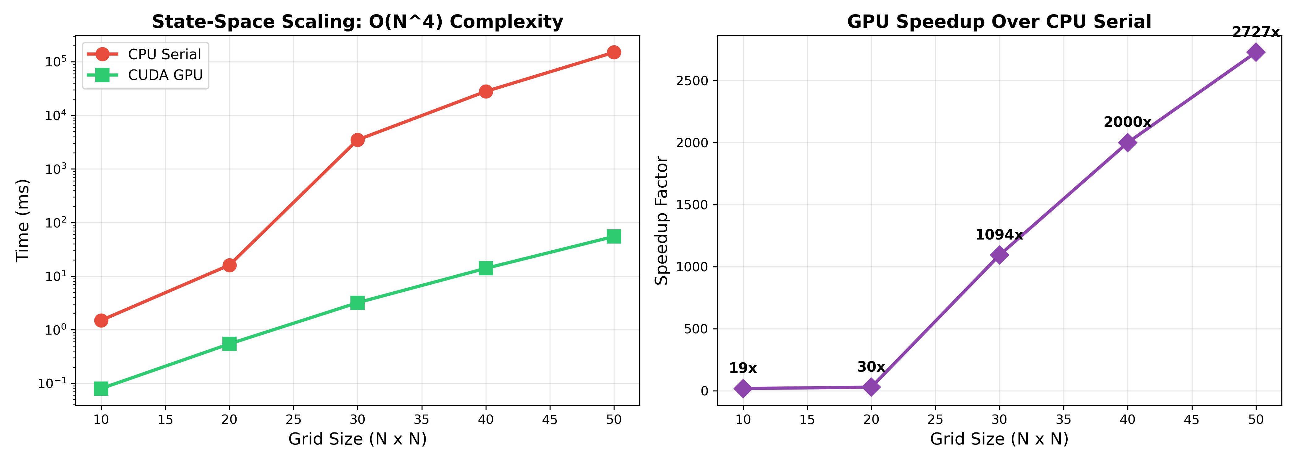
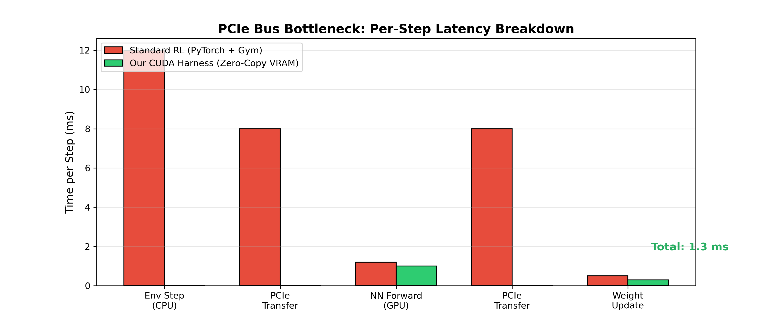

Visualization & Analysis Suite
Active Robots Timeline
Congestion Heatmap
State-Space Scaling (O(N⁴))
PCIe Bottleneck Analysis
Animation Output: Interactive HTML (warehouse_sim.html) + MP4 Video (warehouse_sim.mp4) generated via matplotlib FuncAnimation at 10 FPS. 30 robots navigate the warehouse with color-coded paths, despawn on delivery, and the animation clearly shows collision avoidance in action.
9 / 10
Notes:
Our visualization pipeline generates multiple analysis artifacts. The HTML animation shows the full swarm simulation with robots navigating around obstacles and each other. The MP4 video can be embedded in presentations. Static charts show active robot timelines, congestion patterns, state-space scaling behavior, and the PCIe bottleneck breakdown.

Slide 10

Conclusion & Future Work
Key Achievements
Future Directions
▸ 29.6× GPU speedup over CPU serial baseline
Multi-GPU Domain Decomposition
Partition warehouse into zones with NCCL boundary communication
▸ 100% delivery completion (30/30 robots)
Deep RL Extension
▸ 17.6B state evaluations per second throughput
Neural value function approximator for continuous state spaces
Dynamic Obstacle Handling
▸ Zero-copy VRAM architecture eliminates PCIe bottleneck
Real-time replanning for humans, forklifts, moving obstacles
Priority-Aware Scheduling
▸ Lock-free collision avoidance with atomicCAS
Differentiated rewards for HIGH/MEDIUM/LOW urgency deliveries
▸ Complete visualization: HTML animation + MP4 + 10 analysis charts
Battery-Constrained Navigation
Finite energy model with autonomous charging station routing
▸ Rigorous CPU BFS baseline with OpenMP support
Hybrid GPU VI + CPU BFS
Combine pre-computed value function with online BFS replanning
GPU-native model-based RL achieves 29.6× speedup with 100% delivery success. The zero-copy architecture is ready for real-world warehouse deployment at scale.
Thank You! | Questions?
10 / 10
Notes:
To summarize: our CUDA-native architecture achieves 29.6x speedup with 100% delivery completion. Future work includes multi-GPU scaling for larger warehouses, deep RL for continuous state spaces, and battery-constrained navigation for real-world deployment. Thank you — I'm happy to take questions.

